Slide 1
Chapter 19: Drifting Toward Disunion,
1854-1861

Slide 2
JUMBO QUESTIONS 19
Periodization
  The authors analyze the drift toward disunion from 1854 to 1861. Yet, many other historians have argued that this “drift” began prior to 1854. If you were to select a date other than 1854 to begin a chapter about the origins of the Civil War, what would it be? Provide evidence from this chapter and previous ones to support your choice
Causation
  What were the long- and short-term causes of the Civil War?
Interpretation
  After you read the chapter and “Varying Viewpoints: The Civil War: Repressible or Irrepressible?” which of the schools of thought about the coming of the Civil War do you find most persuasive? Find specific examples from this and previous chapters to support your choice.

Slide 3
Harriet Beecher Stowe
  Harriet Beecher Stowe published Uncle Tom's Cabin in 1852. It stirred the North's sense of morality against slavery and was a substantial catalyst toward war. When Lincoln met Stowe, he said, "So you're the little woman who wrote the book that made this great war."
    In one line, the novel was about the splitting up of a slave family and the mistreatment of likable Uncle Tom by a cruel slave master.
    The book was wildly popular, eventually selling millions of copies and becoming a stage play.
    Perceptions on the book differed: the North considered it as shedding light on the slaves' situations; the South said it was unfair and purely fiction since Stowe had never been down South and therefore had no idea of Southern reality.
    As important as helping start the war, Uncle Tom's Cabin helped prevent Britain from joining the war on the South's side. This had been the Southern plan all along, but British workers sympathized with Uncle Tom's plight and held back their government from helping keep Uncle Tom and friends down.

Slide 4
Hinton Helper
  The Impending Crisis of the South by Hinton Helper was written at the same time and also criticized slavery.
    Its criticism was not on a moral basis, however, but in more of an economic sense.
    Helper disliked blacks and aristocratic whites. He argued that slavery hurt non-slave owning whites in the South.
    No Southern publisher would print the book. A Northern publisher did and slave-owning white down South were worried. The book was banned down South but became something of a hit among abolitionist up North.

Slide 5
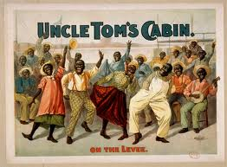
Impact of Literature
  Together, these books drove the North—South wedge deeper into the nation.

Slide 6
The North-South Contest for Kansas
Since it was opened to popular sovereignty and was perched to grow, Kansas became the new slavery battleground.
  The unspoken understanding during the Kansas-Nebraska Act was that Kansas would go slave and Nebraska free.
    But, Northerners were sending loads of settlers to Kansas. Organizations like the "New England Emigrant Aid Company" helped suit up the settlers, many carrying "Beecher's Bibles" (rifles) named after Rev. Henry Ward Beecher (Harriet's brother) who helped purchase them.
    To the South, it appeared the North was trying to "steal" the agreement through the popular sovereignty election.

Slide 7
The Election of 1855 to Legislature
  When the election rolled around, pro-Southern "border ruffians" jumped over from Missouri to Kansas to "vote early and vote often."
  The South "won" the election for Kansas to become a slave state and set up a government at Shawnee Mission.
    Free-soilers cried foul and set up their own government in Topeka.
    Thus, after the election, there were two governments: one slave and based on a bogus election, and one free and illegitimate.
  Things worsened when a roving gang of pro-slavery hoodlums, led by the outlaw William Clark Quantrill, shot up and burnt down free-soil Lawrence, Kansas.
  The slavery issue was certainly not solved.

Slide 8
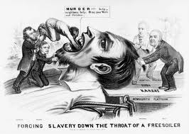
Kansas in Convulsion
  The violence continued when John Brown and men set out for revenge for Lawrence. At Pottawatomie Creek he killed and chopped up 5 slavery supporters.
    With the chaos and violence, Kansas was being called "Bleeding Kansas."

Slide 9
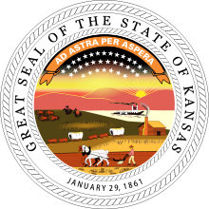
Kansas as a State?
  Kansas had a large enough population by 1856 to apply for statehood. The pro-slavery government wrote up the Lecompton Constitution which could be approved "with" or "without slavery." But, even if "without slavery" were chosen, slave-owners already present would still be protected.

Slide 10
Kansas Would Have Slaves
  Thus, Kansas would have slaves either way.
    Abolitionist felt this vote was bogus, boycotted the election, and thus the Lecompton Constitution passed "with" slavery. It was sent to Washington D.C. for approval.
    Pres. James Buchanan gave his approval, but the Senate had to approve the Constitution.
    Ironically, it was Stephen Douglas, the author of Kansas/Nebraska popular sovereignty, who led the opposition. Douglas felt the election wasn't true popular sovereignty due to the irregularities of the voting. His leadership got the Constitution shot dead in the water.

Slide 11
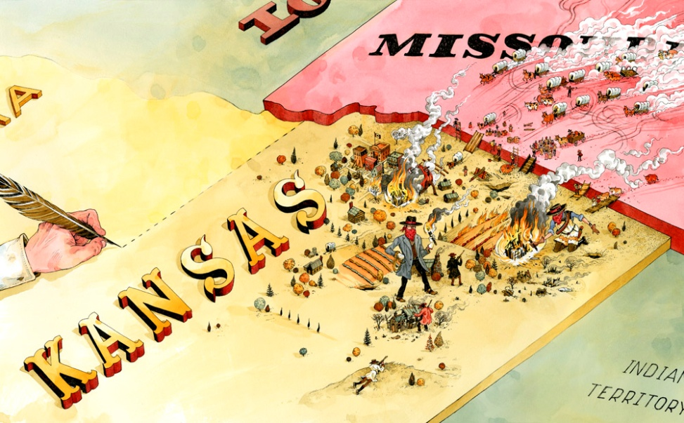
Result
  (a) the Democratic party was terribly divided
  (b) Kansas was now left in limbo—somewhere in between a territory and a state
  (c) the slavery question was still not answered.

Slide 12
“Bully” Brooks and His Bludgeon
  Tension and passion from Bleeding Kansas worked into Congress. Sen. Charles Sumner (northern abolitionist) graphically criticized a South Carolina congressman.
  Preston Brooks, a fellow Congressman and relative the criticized, took offense to Sumner's comments.
  Brooks reasoned that he should challenge Sumner to a duel, but duels were only for gentlemen and Sumner's comments revealed that he was no gentleman.
  A beating was what Sumner deserved, at least as Brooks figured.

Slide 13
What Happened Next…
  So, "Bully" Preston Brooks whacked Charles Sumner over the head on the floor of Congress with a walking cane. Sumner was severely injured, and Brooks was expelled from Congress only to get re-elected in the next election.
  The results of this poor behavior were:
  (a) Sumner's "Crime Against Kansas" speech became a rallying point for the North
  (b) Brooks became something of a Southern cult hero
  (c) it became clear that compromise was now over (and replaced by Bleeding Kansas, name-calling, and cane-thwacking).

Slide 14
“Old Buck” vs. “The Pathfinder”
  The election of 1856 had three main candidates…
    The Democrats chose James Buchanan. He had considerable experience but was not affiliated with the growingly unpopular Kansas-Nebraska Act.
    The Republicans chose John C. Fremont, the "Pathfinder" and hero of the Mexican War.
    The American Party was a newcomer and nominated Millard Fillmore. They were better known by their nickname, the Know-Nothing Party. It was an anti-immigrant party that got its nickname by their supposed response of, "I know nothing," when asked if they were in the party.

Slide 15
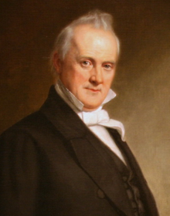
The Election was UGLY!!!
  The election was ugly, complete with mudslinging and charges of conspiracy and scandal. Fremont was accused of being Catholic which hurt his votes.
  James Buchanan won the election.
  Perhaps it was all for the better since Fremont's judgment and ability had come into question and since his loss opened the door for a much more capable Abe Lincoln four years later.

Slide 16
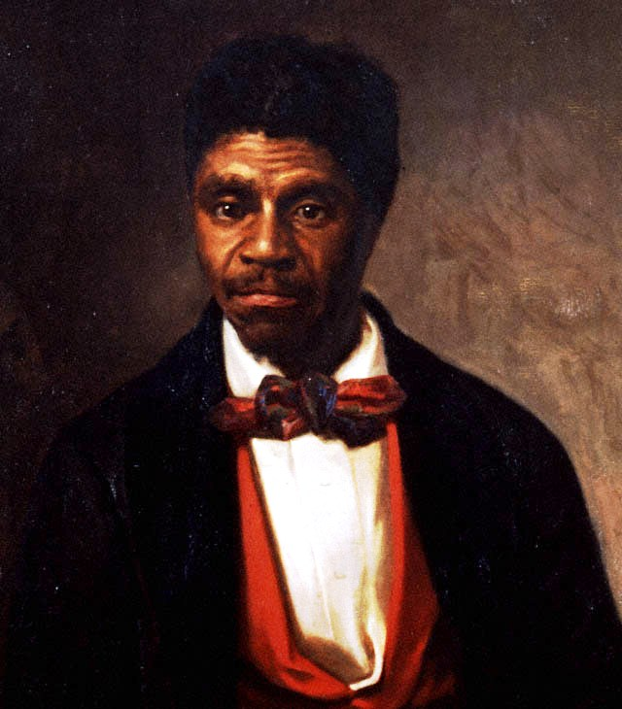
The Dred Scott Case
  In March of 1857, the Supreme Court, led by Chief Justice Roger Taney, handed down the Dred Scott decision.
  Dred Scott was a Missouri slave whose owner moved (with Scott) to Illinois and Wisconsin, then back to Missouri. Dred Scott sued for his freedom arguing that since he'd lived in free states, he was free.

Slide 17
The Dred Scott Decision Said…
    Dred Scott (and all slaves) was not a citizen and therefore not entitled to sue. In other words, he lost.
    The Court went further and said that a legislature/Congress cannot outlaw slavery. This was the bombshell statement.
    The Court then concluded the Missouri Compromise had been unconstitutional all along (because it’d banned slavery north of the 36° 30’ line and doing so was against the point #2 listed above).

Slide 18
Impact of the Court Case
  This was a huge victory for the South and it infuriated the North. The North-South wedge was driven deeper.
  The North—South scoreboard now favored the South, undeniably.
  The South had
  (1) the Supreme Court
  (2) the president
  (3) the Constitution on its side. The North only had Congress (which was now banned from outlawing slavery).

Slide 19
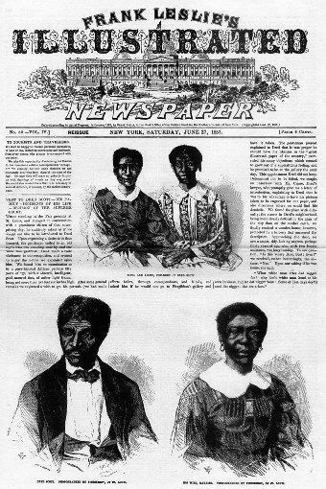
Evidence the Constitution Supported the South
    It's the Supreme Court that officially interprets the Constitution and they'd just said it favored the South in the Dred Scott decision.
    The 5th Amendment said Congress could not take away property, in this case, slaves.

Slide 20
A Catch-22
      It could be argued that slavery was in the Constitution by way of the Three-Fifths Compromise.
      It could be argued slavery was not in the Constitution since the word “slavery” indeed never was present, but using this argument, the 10th Amendment said anything not in the Constitution is left up to the states, and the Southern states would vote for slavery.
      Either way, if slavery was in or out, the North lost.

Slide 21
The Financial Crash of 1857
  Adding to the chaos of the times was the Panic of 1857—yet another in the string of financial crunches that took place every 20 years in the 1800's.
  The economics of the situation weren't particularly bad, but the psychological fallout for a troubled time was very strong.
    Causes for this panic were:
    (a) inflation caused by California gold
    (b) over-production of grain
    (c) over-speculation (the perennial cause), this time in land and railroads.
    The North was hit hardest. The South was largely unaffected, supposedly proving that cotton was indeed king.

Slide 22
The Homestead Act
  At the same time, a Homestead Act was passed by Congress but vetoed by Pres. Buchanan.
  It's goal was to provide 160 western acres for a nominal price.
    The fear was that it would drain Northern workers to the cheap land and Southerners feared the west would fill up with free-soilers.
  The tariff rate also went up due to the panic.
  The prior rates had recently been reduced to only 20%, due to Southern complaints, but the new law sent them right back up.

Slide 23
Here Comes Lincoln (BTW- he is killed, there…I did it before Winter Break)
  The Illinois Senate race of 1858 took the national spotlight.
  The Democrats put up Sen. Stephen Douglas and the Republicans put up Abraham Lincoln.
  Douglas was likely the "biggest name" Senator of the day and expected to easily be re-elected over backwoodsy Lincoln.
  Douglas was also considered the best debater of the time. Lincoln, however, had a homespun, down-home wit and logic about himself and was also a fine debater.

Slide 24
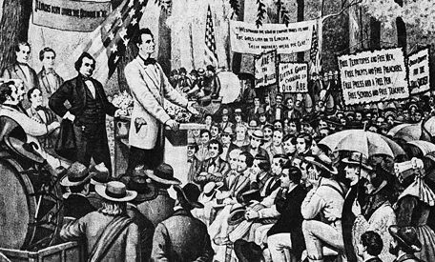
The Lincoln-Douglas Debates
  Lincoln challenged Douglas to a series of debates and Douglas accepted. The "Lincoln-Douglas debates" were a series of seven debates spread across Illinois.
    Lincoln was the underdog in but proved that he could stand and argue toe-to-toe with Douglas.

Slide 25
The Freeport IL Debate
    In Freeport, Lincoln essentially asked, “Mr. Douglas, if the people of a territory voted slavery down, despite the Supreme Court saying that they could not do so (point #2 of the Dred Scott decision), which side would you support, the people or the Supreme Court?”
    This put Douglas in a lose-lose situation—either way he decided, someone would be upset.
    Douglas (“Mr. Popular Sovereignty”) replied with his “Freeport Doctrine.”
    It said that, since ultimate power was held by the people, slavery should be banned if the people indeed voted it down, regardless of how the Supreme Court ruled.

Slide 26
The Freeport Doctrine
  Douglas won the Illinois Senate race over Lincoln.
    But, the South turned against Douglas.
      Initially, the South had loved Douglas because he'd opened up so much land to popular sovereignty.
      Then, Douglas shot down Kansas' bid for statehood as a slave state—upsetting the South.
      Finally, the Freeport Doctrine infuriated the South when he turned his back on the Supreme Court’s pro-South, Dred Scott decision.

Slide 27
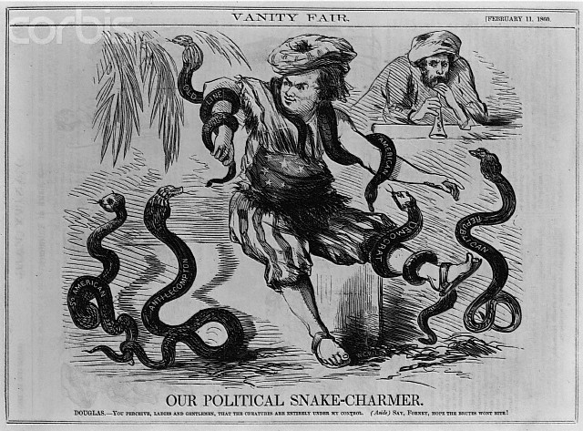
Impact of the Freeport Doctrine
    The Freeport Doctrine ruined Douglas hopes to win the 1860 election for presidency, which had been his goal all along.
    Douglas had "won the battle but lost the war"—in winning the 1858 Illinois Senate election, it cost him the 1860 presidential election.

Slide 28
John Brown- Murderer or Martyr?
  John Brown re-emerged in Harper's Ferry, Virginia with a wild plan to abolish slavery.
    His plan: to take over the federal arsenal in Harper's Ferry, pass out weapons to local slaves, initiate a huge revolt, and thus free the slaves.
    What happened: he and his men took over a building but were quickly holed up by Marines led by Lt. Col. Robert E. Lee. He was quickly captured, tried, convicted, sentenced to death, and hanged.

Slide 29
Impact of His Death
    To the South, justice had been served to a man guilty of murder and treason. Southerners also felt his actions were typical of the radical North.
    Northern reactions varied from viewing Brown as having good intentions but terribly wrong actions, to seeing Brown as a martyr. Brown himself realized he could do more for abolition as a martyr than alive.
    Brown's martyr image was perpetuated by journalists, artists, and song-writers. They portrayed Brown as a man who died fighting against the injustice of slavery. True or not, the martyr image gave strength to the moral cause of abolition.

Slide 30
The Disruption of the Democrats
  In the 1860 election, Democrats tried, and failed, to nominate a candidate at their convention in Charleston, SC. The party was squarely split over the slavery issue.
    Northern Democrats had a convention in Baltimore and nominated Stephen Douglas with a popular sovereignty position.
    Southern Democrats had their own Baltimore convention and nominated John C. Breckinridge with a pro-slavery position.
  The Know-Nothings nominated John Bell of Tennessee. They called themselves the Constitutional Union Party, and tried to mend fences by offering as their platform, simply, the Constitution.

Slide 31
A Rail-Splitter Splits the Union
  The Republicans nominated Abraham Lincoln, passing up on William "Higher Law" Seward who had too many enemies.
    The Republican strategy was to win the election without getting a single Southern vote—a bold plan.
    They were successful in bringing together a broad group including free-soilers (stopping slavery's expansion), manufacturers (a higher tariff), immigrants (rights), westerners (a Northwestern railroad), and farmers (cheap homesteading land).

Slide 32
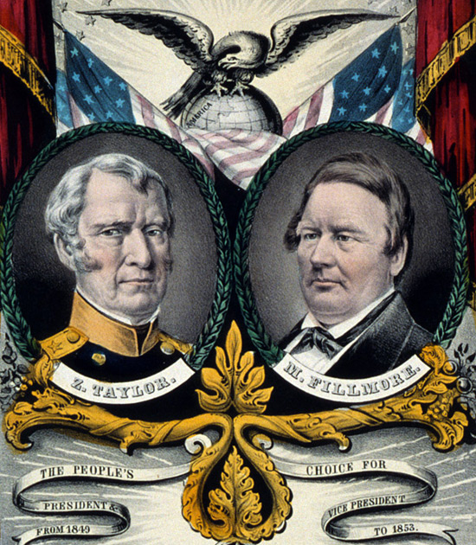
Keep in Mind…..
  It's noteworthy that at this time, Lincoln was not an abolitionist, just a free-soiler. That is to say he wanted to stop the spread of slavery, but allow it where it currently existed.

Slide 33
The Electoral Upheaval of 1860
  Lincoln got only 40% of the popular vote, yet he won the presidency.
  It was a very sectional race: the North went to Lincoln, the South to Breckinridge, the “middle-ground” to the middle-of-the-road candidate in Bell, and Missouri, neighbor of popular sovereignty Kansas, went to Douglas.

Slide 34
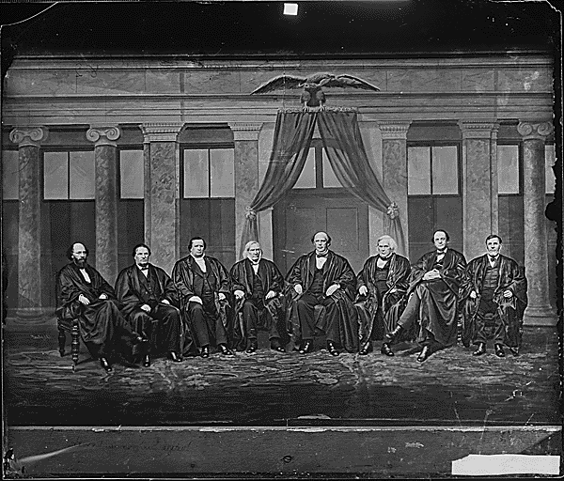
South Still Strong
  Despite the presidency, the South was still standing strong.
    The South had a 5-to-4 majority in the Supreme Court.
    The Republicans didn't control either the House or Senate.

Slide 35
The Secessionist Exodus
  During the campaign, South Carolina had pledged to secede from the union if Lincoln won.
  After Lincoln's victory, the question was whether S.C. would follow through or it they'd been just bluffing.
  They followed through and seceded in December of 1860.
    The "Deep South" (Alabama, Mississippi, Florida, Georgia, Louisiana, and Texas) followed over the next six weeks prior to Lincoln's inauguration.
    Four other Southern states would leave the U.S. later.
    These states met in Montgomery, AL in February, 1861, and formed the "Confederate States of America".
    Jefferson Davis was elected as the president of the C.S.A.

Slide 36
The Collapse of Compromise
  A final attempt at compromise was made by James Henry Crittendon of Kentucky.
  His Crittendon Compromise proposed to extend the old Missouri Compromise line of 36°30’; north of the line would be free, south of it would be slave.
  "Honest" Abe Lincoln, however, had run on a free-soil pledge and was not going to back down on his pledge.
  The compromise fizzled without Lincoln's support.
  It certainly appeared by this time that compromise was dead and bloodshed was imminent.

Slide 37
Farewell to the Union
  The Southern states seceded because they felt their slave-based way-of-life was being threatened by the North's dominant numbers.
  Southerners also wrongly thought that the North would not take any action to stop the South from leaving.
  Southerners felt starting a new nation would enable them to mature economically—to grow their own industry, banking, shipping, etc.
  The South likened their situation to the American colonies of 1776 who'd broken away from England.

