Slide 1
Chapter 17: Manifest destiny and its legacy

Slide 2
….and Tyler Too!
  William Henry Harrison, the Whig president elected in 1840, suddenly died after only one month in office.
  Harrison's campaign slogan had been "Tippecanoe and Tyler Too." Now, with Tippecanoe dead, it was Tyler's turn to be president.
    John Tyler was not part of the Whig plan. Whig leaders Henry Clay and Daniel Webster had intended to control President Harrison. But, Tyler had a strong independent streak.
    Tyler did not share Whig beliefs. He'd been chosen as V.P. to "balance the ticket" by attracting elite Southerners.

Slide 3
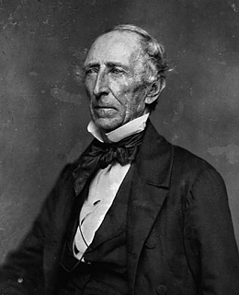
Who is This Guy?!?
  John Tyler was a bit of an enigma, very difficult to figure out.
    He was a Southern gentlemen of the old school, with high principles.
    He leaned toward Jefferson/Jackson ideals, but disliked Jackson's my-way-or-highway style.
    So he went to the Whigs.
    The Whigs considered him a Democrat in Whig clothing.
    In truth, his ideas did align much more with the Democrats than with the Whigs.

Slide 4
A President Without a Party
  The Whigs went ahead with their strong nationalistic plans. Up first was the banking issue.
    Whigs, led by Henry Clay, wanted to end the independent treasury (where government money was kept in independent banks).
    A law was passed to end it, and Tyler went along and signed it.
    Clay then sought to make a new Bank of the United States. This time, Tyler vetoed it. He then vetoed another similar bill.
    Democrats were very happy, the Whigs were furious. The Whigs kicked Tyler out of the Whig party.
    Thus he became a president without a party.

Slide 5
A War of Words with England
  American-English hatred still ran deep and a few events deepened the wounds.
    British lenders were angry when American debtors couldn't or wouldn't pay up after the Panic of 1837.
  Other incidents were more violent.
    The U.S. ship Caroline was attacked above Niagara Falls by Canadians. America was not pleased.
    Another situation arose in the Bahamas when the American ship Creole was overtaken by 130 slaves.
    The British gave the slaves asylum (safe haven).
    Southern Americans were not happy.

Slide 6
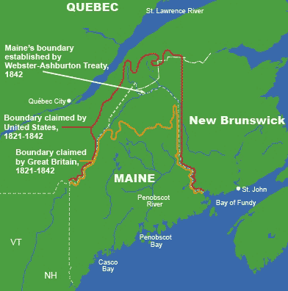
Manipulating the Maine Maps
  A dispute arose over between the U.S. and Britain over the Maine-Canada border.
    Britain wanted a road built from the Atlantic port of Halifax through to Quebec.
    The U.S. wanted the land.
  The dispute became violent in the Aroostoook War, largely by lumberjacks fighting on each side over who'd get to chop down the lumber.

Slide 7
Solution
  The dispute was settled peacefully with the Webster-Ashburton Treaty
  The treaty drew a line generally at the Aroostook River and roughly split the difference of land.
    The U.S. also got the Mesabi range in Minnesota.
    Unknown then, the Mesabi iron ore range became an extremely valuable piece of land and helped supply the American industrial revolution's need for iron ore to make steel.

Slide 8
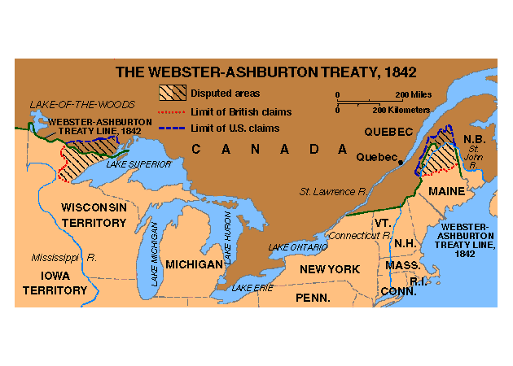
Webster-Ashburton Treaty

Slide 9
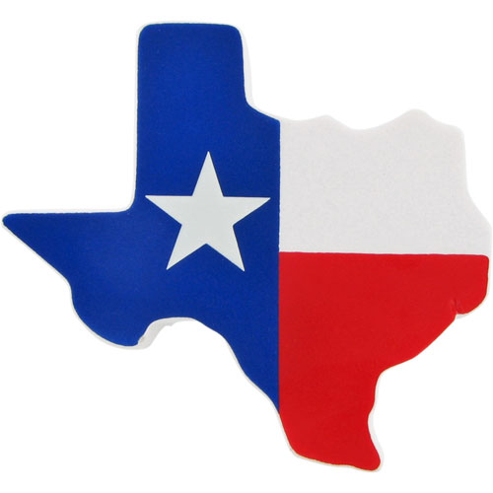
The Lone Star State
  Since 1836, Texas was standing alone as its own country. It was eager to join the U.S., but the North was reluctant to accept another slave state.
  Meanwhile, Texas was making international friends in Britain, France, Belgium, and Holland. This concerned the U.S.

Slide 10
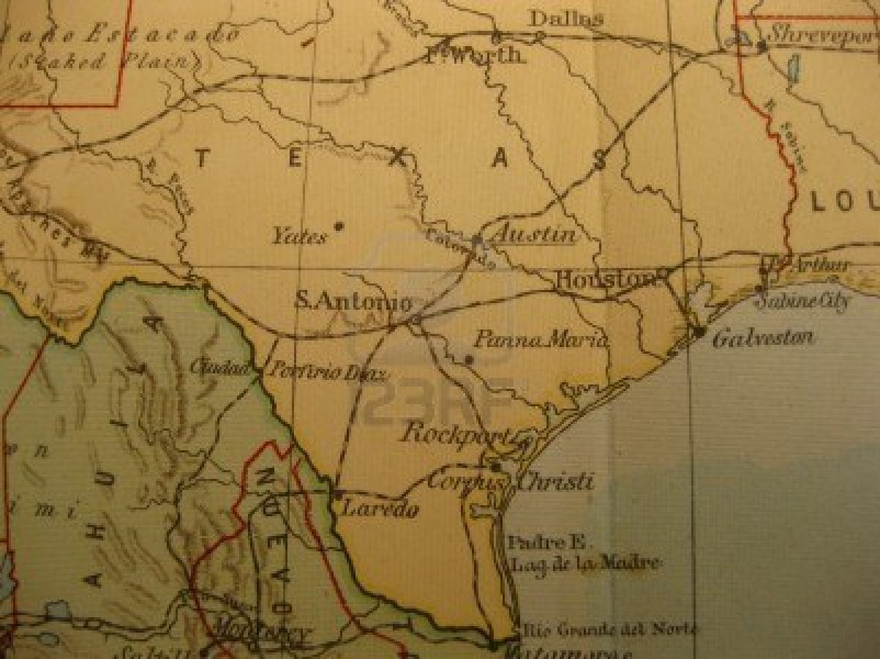
Americans Want Texas
  The American thinking then wondered that, if Texas "buddied-up" with England, the results would be…
    American cotton would decline in value since Texas would supply England.
    The Monroe Doctrine would be undercut because England would have a toehold in the Americas.

Slide 11
Push for Statehood
  The urge to annex Texas grew. The issues still were…
    The North decried the Southern "slavocracy" (a perceived Southern "slave-conspiracy" to always gain more slave land).
    If the U.S. just outright annexed Texas, the result just might be a war with Mexico.
    Britain was eager to have an ally in Texas to help undercut the growing American power.
The obvious benefits, however, of annexing Texas would be tons of land and economic possibilities

Slide 12
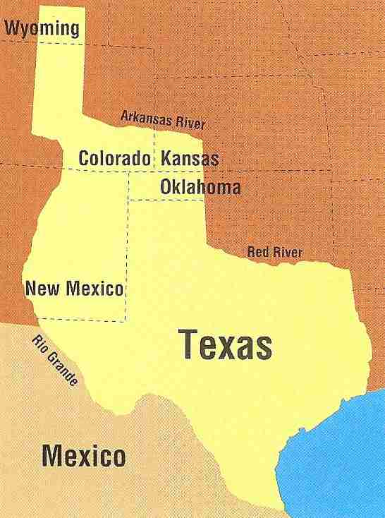
Polk Makes it Happen
  The indecision came to an end with James K. Polk. In 1844, Polk ran for president on a very clear pro-expansion platform.
  His victory was seen as a "mandate" for manifest destiny (the people essentially voted for expansion).
  Early in 1845 Texas was invited to join the U.S. and did so.
  Unsurprisingly, Mexico was not happy and charged that the U.S. had underhandedly stolen Texas away.

Slide 13
Oregon Fever!
  Oregon was claimed by four nations: Spain, Russia, England, and the U.S.
  The first two dropped their claims leaving England and America.
    England had the earliest claim and a strong one based on occupation north of the Columbia River.
    The U.S. also had a strong claim based on the exploration of Capt. Robert Gray along the coast and Columbia River and Lewis and Clark's expedition into the heart of the Oregon territory.

Slide 14
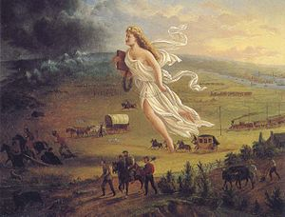
A Mandate (?) for Manifest Destiny
  In the election of 1844, James K. Polk defeated Henry Clay for president.
  Polk was known as "Young Hickory" (after Andrew Jackson) due to his similar beliefs and his birth in Pineville, NC only some 20 miles from Jackson's birthplace.
  Polk ran on a very clear "Manifest Destiny" platform. To vote for Polk was to vote for expansion.

Slide 15
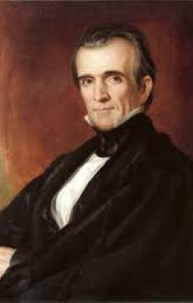
Polk the Purposeful
  James K. Polk laid out a 4-point mission for himself and the nation (then achieved all 4 points in 4 years). His goals were to…
    Lower the tariff.
    Restore the independent treasury (put U.S. money into non-government banks).
    Clear up the Oregon border issue.
    Get California.

Slide 16
Economic Reforms
  Polk and his Sec. of Treasury Robert J. Walker lowered the tariff from 32% to 25% with the help of Southerners in Congress. Northern industrialists cried foul and warned of economic despair (it never happened).
  The independent treasury was restored despite complaints of Whigs.

Slide 17
Border Issues Settled
  The Oregon border issue was settled. England and the U.S. asked, "Which latitude is the border of Oregon, as far north as 54°40' or as far south as 42°?"
    England first answered "42° latitude," then said the "Columbia River."
    The U.S. first answered "54°40' latitude," ("54-40 or fight!" was the battle cry), then said "49° latitude."
    The agreement was to roughly split the land at the 49th parallel (excluding Vancouver). Polk agreed and the Senate agreed and it was final.
    Some Americans wondered why the U.S. would agree to half of Oregon but push for all of the Mexican lands. The answer was coldly that England was strong and Mexico was weak.

Slide 18
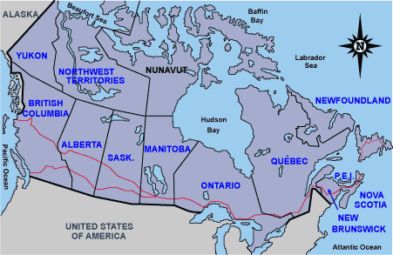
49th Parallel

Slide 19
Misunderstandings with Mexico
  The final goal, getting California, posed a problem—it belonged to Mexico.
  The American tradition in acquiring land was forming
    (a) the U.S. tries to buy the land, if that doesn't work
    (b) the U.S. would use force.
    These are the actions Polk took.
  Polk sent John Slidell as an envoy to Mexico City to make an offer to purchase California for $25 million.
  Mexico was still upset at the U.S. over Texas and Slidell was coldly turned away.
  The attempt to purchase had failed; it was time for more aggressive actions.

Slide 20
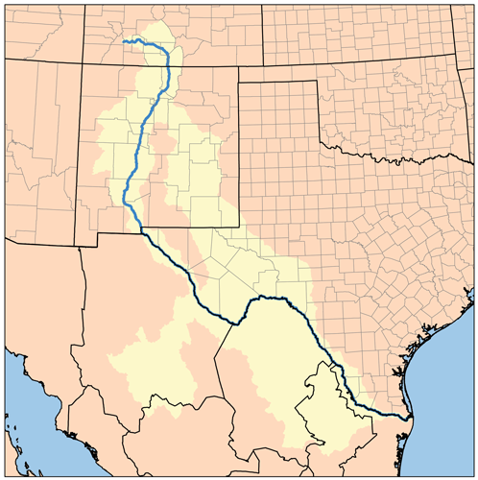
American Blood on American (?) Soil
  President Polk wanted action.
  He ordered 4,000 troops to the Rio Grande border.
  Mexico disputed the move saying the Texas-Mexico border was the Nueces River, not the Rio Grande.
  With "the ball was in their court," Mexico crossed the Rio Grande and a skirmish followed with the U.S. troops. Polk could now point to Mexico as the aggressor.

Slide 21
Declaration of War
    Polk quickly asked Congress to declare war and Congress quickly did so.
    A newcomer on the scene was Abraham Lincoln.
    Abe questioned the "spot" on which the skirmish took place in his "spot resolution".
    He was reluctant to vote for war since he wanted to know which nation owned the disputed land.
    He was largely booed down.
    Arguments flew as to whether Polk had bullied the U.S. into a war, but never-the-less, America was at war.

Slide 22
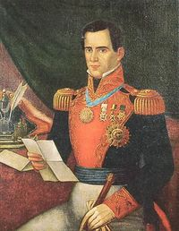
Mastering of Mexico
  Santa Anna "pulled a fast one" on Polk, however.
  Santa Anna was exiled in Cuba but hinted that if he was allowed to return to Mexico he'd double-cross his country.
  Polk let him go but he did just the opposite—he rallied the troops.

Slide 23
Three Phases of War
  The American victory over Mexico was dominating. The war itself could be divided into 3 main phases…
    Phase 1 - The initial goal was to get California, so that was the first order of business.
    Phase 2 - Fighting in Texas saw Gen. Zachary Taylor score victories, notably at Buena Vista where Santa Anna was defeated again.
    Phase 3 - Conquest of Mexico City. Gen. Winfield Scott ("Old Rough and Ready") was sent to Mexico City to deliver the coup d'grace. He retraced Hernando Cortez's same path from Vera Cruz to Mexico City and likewise conquered the capital city.

Slide 24
Fighting Mexico for Peace
  Polk sent a diplomat, Nicholas Trist, along with Gen. Winfield Scott's army.
  Trist was to secure a peace deal as soon as Polk's demands were met.
    Trist was erratic, recalled by Polk, refused to return to America, and worked a deal anyway.
  Trist's deal, the Treaty of Guadalupe Hidalgo had a huge scope…
    It ended the war.
    America got land, the Mexican Cession, entailing California, but also the future states of NV, AZ, NM, CO, and UT.
    The U.S. would pay $15 million for the land, and assume $3.5 million in debts owed from Mexico to the U.S.
    In essence, the U.S. had forced Mexico to "sell" the Mexican Cession lands.

Slide 25
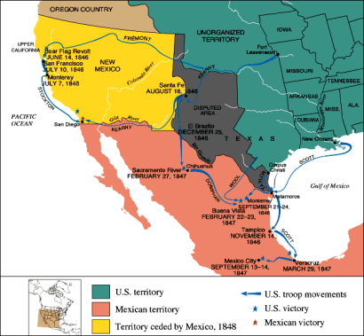
Effect of the War in Mexico
  America had only 13,000 deaths, mostly by disease.
  The Mexican War was good practice for future generals Robert E. Lee and Ulysses S. Grant who'd one day clash in the Civil War.
  The war started a turning point in American-Latin relations, a turning point for the bad.

Slide 26
Slavery?
  The most looming issue after the war was the question, "What will be done about slavery in these new lands?"
    David Wilmot proposed the Wilmot Proviso suggesting the Mexican Cession lands be closed to slavery. The House passed it, twice, but the South would have nothing to do with the Proviso. Since the Senate was balanced, the Wilmot Proviso failed in the Senate.
      Although it failed, the importance of the Wilmot Proviso lay in the fact that it opened old wounds—those of slavery.
      It's this question of slavery in the new lands that would start the Civil War in 1861, only 13 years later.
  Mexico was understandably bitter. Half their lands had been wrested from them in only a couple of decades.

