Slide 1
The APUSH DBQ
It’s the Long Essay, with documents
and higher expectations.

Slide 2
DBQ Essay
15 minutes reading & planning
45 minutes writing
Scoring: Moving from 9pt scale (from WHAP) to a 7pt scale in APUSH
Designed around Historical Thinking Skills, the 7 Themes and Concept Outline
This essay may have larger time periods than the long essay
Periods 1 and 9 will ALWAYS be paired with another time period.
DBQ will have approximately 6-7 documents
More objective than subjective grading.
Notes:
Check for understanding on the Concept Outline, 7 Course Themes and Historical Thinking Skills
Strategies for teaching the redesigned AP US History Course
Covering Content: Explain to the teachers your ideas for covering the redesigned content on a A/B Block (show examples).
Introduce the use of Interactive Notebooks Checks and how they help to drive your AP US History course.
Strategies to prepare students for the redesigned 2015 AP Exam
Describe in detail how best to approach the Short-Answer questions (10 line questions).
Introduce how best to attack the Long Essay using the revised Rubric
Introduce how best to attack the Document Based Question including the 7 bullets that must be present in their DBQ.
--State a relevant thesis that directly addresses all parts of the question.
--Support the thesis or a relevant argument with evidence from all, or all but one, of the documents.
--Incorporate analysis of all, or all but one, of the documents into your argument.
--Focus your analysis of each document on at least one of the following: intended audience, purpose, historical context, and/or point of view.
--Support your argument with analysis of historical examples outside the documents.
--Connect historical phenomena relevant to your argument to broader events or processes.
--Synthesize the elements above into a persuasive essay.
Multiple Choice: Explain how the new multiple choice questions are stem driven and that students must practice these multiple choice questions. Express your concern about the difficulty of the reading level contained in the stems, but explain one solution to this problem is to use 5mins a day reading through a primary source document to expose see reading difficulty (ask student to write down words they don’t know on a sheet of paper or share out) and what is the theme of the document.
The teachers will get into groups of three or four and will be assigned a time period from the Concept Outline. Each group will begin to create multiple choice questions using the Eyewitness and Others blue and red books along with the Avalon project website primary sources. Each group will create 10-20 Multiple Choice Questions for there assigned time period. These will be shared with me and I will post them along with the Reading selection to my website. By the end of the summer I should have a good bank of questions to share with all of my participants with in each time period.

Slide 3
DBQ Rubric
A. Thesis 0 – 1 Point
Skills assessed: Argumentation + targeted skill
States a thesis that directly addresses all parts of the question. The thesis must do more than restate the question.
This is the same as in the Long Essay

Slide 4
DBQ Rubric
B. Analysis of historical evidence AND support of argument: 0 – 4 points
Skills assessed: Use of Evidence, Argumentation, + targeted skill (e.g., Comparison)
You NEED to do both: provide the evidence AND use it to support the argument
The point rubrics follow:

Slide 5
DBQ Rubric
B. Analysis of historical evidence and support of argument: FOR 1 point
Offers plausible (logical) analysis of the content of a majority of the documents, explicitly to support the stated thesis or a relevant argument.

Slide 6
DBQ Rubric (45mins)
B. Analysis of historical evidence and support of argument: FOR 2 points
Offers plausible analysis or BOTH the content of a majority of the documents, explicitly using this analysis to support the stated thesis or a relevant argument; AND
At least one of the following for the majority of the documents:
Historical context,
Intended audience,
Purpose, and/or
The author’s Point of view
Use ANY of the concepts above, but use what is
MOST RELEVANT TO THE ARGUMENT BEING MADE!

Slide 7
DBQ Rubric
B. Analysis of historical evidence and support of argument: FOR 3 points
Offers plausible analysis or BOTH the content of all or all but one of the documents, explicitly using this analysis to support the stated thesis or a relevant argument; AND
At least one of the following for all of the documents:
Historical context,
Intended audience,
Purpose, and/or
The author’s Point of view

Slide 8
DBQ Rubric
B. Analysis of historical evidence and support of argument: AND FOR 4 POINTS
Analysis of outside examples to support thesis/argument (0 – 1 point)
Earns all 3 points (from previous slide) AND
Offers plausible analysis of historical examples beyond/outside the documents to support the stated thesis or a relevant argument
-YOU have brought a lot of quality outside information

Slide 9
DBQ Rubric
C. Contextualization: 0 - 1
Accurately and explicitly connects historical phenomena relevant to the argument to broader historical events and/or processes.
**This is the contextualization for the topic of the essay. It is bigger than the contextualization for each document that you might do.
This is very easy to place in the intro paragraph or the conclusion (based on the essay topic)

Slide 10
DBQ Rubric
D. Synthesis: 0 – 1 points
Skills assessed: Synthesis
Response synthesizes the argument, analysis of documents, and context into a coherent and persuasive essay by accomplishing one or more of the following as relevant to the question:

Slide 11
DBQ Rubric
D. Synthesis: 0 – 1 points
Skills assessed: Synthesis
*Similar to the Long Essay
Appropriately extends or modifies the stated thesis or argument
1 point or
Recognizes and effectively accounts for disparate, sometimes contradictory evidence from primary sources and/or secondary works in crafting a coherent argument
1 point or
Appropriately connects the topic of the question to other historical periods, geographical areas, contexts, or circumstances
1 point

Slide 12
AP US History Grading Scale for DBQs
Essays are part of the ‘test’ category and are weighted 60% of the overall grade (with multiple choice, short answer, and long essays)
7 – 100%
6 – 94%
5 – 86%
4 – 78%
3 – 70%
2 – 62%
1 – 54%
Notes:
Switch to your FRQ – DBQ Power Point presentation

Slide 13
DBQ – 7 Simple Rules
State a relevant thesis that directly addresses all parts of the question.
Support the thesis or a relevant argument with evidence from all, or all but one, of the documents.
Incorporate analysis of all, or all but one, of the documents into your argument.
Focus your analysis of each document on at least one of the following: intended audience, purpose historical context, and/or point of view.
Support your argument with analysis of historical examples outside the documents.
Connect historical phenomena relevant to your argument to broader events or processes.
Synthesize the elements above into a persuasive essay that extends your argument, connects it to a different historical context, or accounts for contradictory evidence on the topic.
7 RULES = 7 POINTS!
Notes:
Switch to your FRQ – DBQ Power Point presentation

Slide 14
The DBQ Approach
Do not immediately turn to the documents. Try to plan your response as if you do not have any documents to assist you– like the Long Essay.
Brainstorm a list of all the possible outside (non-document-based) information you might use in answering the question. Do this in a graphic organizer that helps to facilitate your thinking with what the prompt is asking.
Try to formulate a tentative thesis statement before you read the documents.

Slide 15
Document Use In the Essay
When you have used the document, you may write (1) or (Doc 1) at the end of the reference to the document. Never begin a sentence with “Document 1 says . . .” or “In document 1 . . .”
Remember that your score on the DBQ will be based on how well you used the document to support the argument, integrate outside information, and the use of HIPPO info that accompanies the document/argument.
You may use your own interpretive commentary to analyze both outside information and the documents, clearly showing how and why they support your ideas.

Slide 16
Using the Documents
DON’T QUOTE THE DOCUMENTS (THE READER ALREADY KNOWS WHAT THEY SAY…)
SAY WHAT YOU NEED TO SAY, THEN (Doc 1)
DON’T SAY “ACCORDING TO DOCUMENT 1…”
NEVER USE DOCUMENTS IN THE THESIS STATEMENT
DON’T “BUNCH UP” THE DOCUMENTS, USE DOCUMENTS THROUGHOUT THE ESSAY TO SUPPORT THE DIFFERENT ASPECTS OF THE ARGUMENT

Slide 17
An example of how to use a document: paraphrase & analyze
In Winthrop’s sermon, City Upon A Hill, he highlights the purpose of Puritan settlement as God’s people doing God’s work. They viewed themselves as the second wave of the Israelites and were to be an example to the world. (Doc 1) Thus, the Puritans’ actions were guided by their beliefs system which was reflected in both their political and social structures.

Slide 18
How NOT to use a document: Don’t Quote
In Document 1, John Winthrop states, “wee shall see much more of his wisdome power goodnes and truthe then formerly wee have beene acquainted with, wee shall finde that the God of Israell is among us”. This shows that the Puritans were Gods people and were going to succeed as a colony.

Slide 19
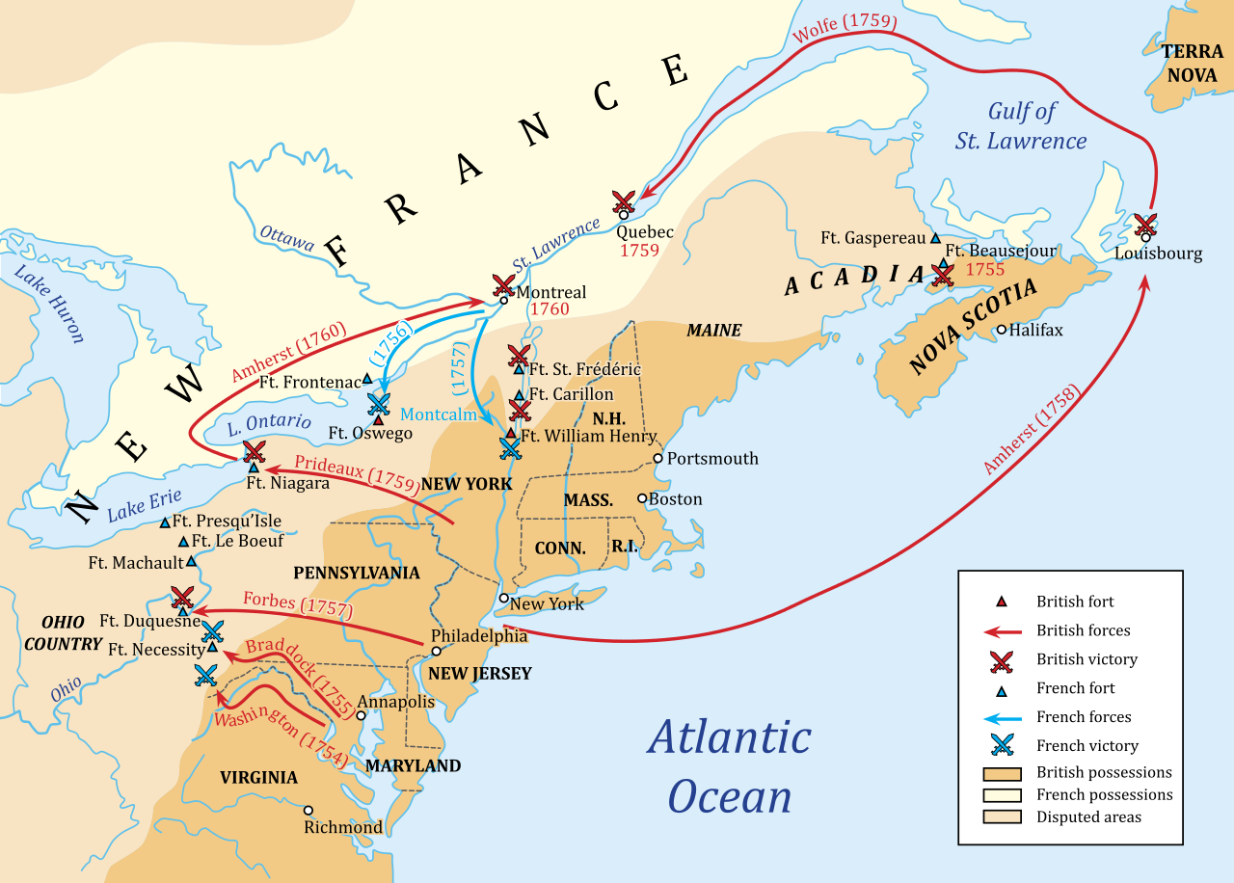
Your turn: An example from the Seven Years War
Document 1

Slide 20
What information is known?
H
I
P
P
O
What information can taken away from this document?

Slide 21
Document 1 Outside Information
Key British victories along the St. Lawrence River
Most battles were fought in territory that was disputed (both the French and British claimed the land)
The British were able to advance and gain land and military momentum
So, how could that be used in an essay?

