Slide 1
Chapter 13: The Rise of Mass Democracy, 1824-1840

Slide 2
JUMBO QUESTIONS
Comparison
  How do the ideas expressed by some southerners during the Nullification Crisis compare to those expressed by some northerners during the Hartford Convention? Do both of these movements complement the theory of constitutional interpretation articulated by Jefferson and Madison in the Virginia and Kentucky Resolutions? How many relevant parallels are there between the two?
Interpretation
  Which interpretation of Jacksonian Democracy described in “Varying Viewpoints: What was Jacksonian Democracy?” would the text authors most likely endorse? How many examples of relevant historical evidence can you find in this chapter to support your choice?
Patterns of Continuity and Change over Time
  The authors state that during the Jacksonian era “the old suspicion of political parties as illegitimate disruptors of society’s natural harmony gave way to acceptance, even a celebration, of the sometimes wild contentiousness of political life.” What changed and what did not change over time during this time?

Slide 3
The “Corrupt Bargain” of 1824
  The election of 1824 was the last of the old-style politics.
  The big winner of this transformation was the common man.
  The political game would soon be changed.
  Specifically, the common white man as universal white manhood suffrage (all white men could vote) became the norm.

Slide 4
Unique Election of 1824
    There were four candidates, not two: Andrew Jackson of Tennessee, Henry Clay of Kentucky, William H. Crawford of Georgia, and John Q. Adams of Massachusetts.
      They all called themselves "Republicans."
    Since the votes were spread out, no candidate got a majority of the electoral vote and won. Jackson got the most votes, but not a majority. Adams came in second, then Crawford, then Clay.
    The election went to the House who'd pick the president from the top three finishers

Slide 5
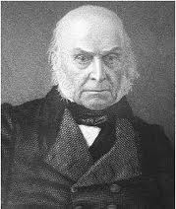
Outcome
  Henry Clay, as House Speaker, was in a unique position to influence the vote.
  Jackson was Clay's main rival (they both were westerners)
  So Clay threw his support to Adams.
  Adams won.

Slide 6
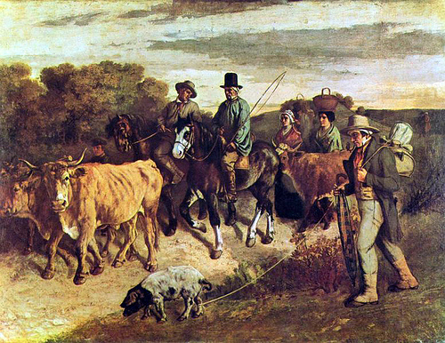
Turning Point…
The election energized the common man to get out and vote like he'd never done before.

Slide 7
Adams as President
A Yankee Misfit in the White House
  John Quincy Adams, like his father John Adams, was an puritanical Yankee. He was intelligent, respected, honorable, stern, tactless. As president, he was very able but somewhat wooden and lacked the “people’s touch” (which Jackson notably had).
  Adams stubbornly refused to remove public officials to make room for new ones. He removed only 12 people during his presidency.
    This frustrated party workers who'd expected a job. Why work to keep him in office? they wondered.
  John Q. Adams pushed nationalist programs to build (a) roads and canals, (b) a national university, and (c) a national observatory.
    The public was not excited. The South was already turning against internal improvements (roads, canals) and a national university or observatory would mean keeping the tariff going. These things were seen as an elitist waste of money. Most Americans were simple farmers, not scholars.
  Pres. Adams tried to slow down the western land speculation. Although this was likely a wise move financially speaking, the West hated this. They'd grown accustomed to getting easy credit to easily buy land.
    Down South, land was also an issue. Georgia wanted to kick out the Cherokee Indians. Pres. Adams wanted to deal justly with the Indians but the Georgia governor succeeded in keeping the federal government out.
    Adams now had two sections lined against him: the South and the West.

Slide 8
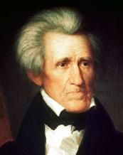
Election of 1828
Going “Whole Hog” for Jackson in 1828”
  Almost immediately after the corrupt bargain election of 1824, Andrew Jackson started campaigning for 1828. His theme was simple: the people had been swindled by the politicians, and he was the people's choice for 1828.

Slide 9
Different Approaches
    Jacksonians swayed people against John Q. Adams by painting him as dishonest huckster (in reality, he was an honest and honorable man).
    They also claimed Adams had procured the services of a servant girl for a Russian tsar's lust.
    Adams' supporters got ugly too. They said Jackson was crude, rude, prone to whiskey.
    They charged that Rachel Jackson was an adulteress. She'd been married prior to Jackson, then it was discovered that her divorce hadn't been finalized.
    The Jackson's quickly fixed the situation, but the words stung.

Slide 10
“Old Hickory” as President
  Old Hickory personified the rising "New Democracy."
    He was a westerner, tough, battle-scarred, rough-around-the-edges, half-educated and half-self taught, tall and lean.
    He was America's first rags-to-riches story. He'd been born in a cabin in the Carolinas (we’re not even sure if it was North or South Carolina, and both states still claim to be his home). His family moved to Tennessee and through hard work and strength of character, Jackson rose to own a plantation, and became a judge, congressman, general and a war hero.
    Jackson was adored by his soldiers who gave him the nickname "Old Hickory" because of his toughness and loyalty.
    He was the first president who'd been nominated by a convention.
  Jackson was passionate in everything. He was prone to choke up while speaking in Congress, he had a temper and was in several duels (he had a bullet lodged in his chest for life from dueling), and always "went all out" in whatever he did.
  At his inauguration gala he flung open the White House doors (the People's House) for all to come in and party. The party quickly got rowdy until the punch was moved outside and the crowd followed. To the wealthy, this was the mobocracy for real.

Slide 11
The Spoils System
  President Jackson quickly started what was called the "Spoils System." The spoils system rewarded political party workers with government jobs. This meant government workers already in office had to be fired to make room for the new.
    Many said this wasn't right and criticized the spoils system. They also claimed that the people he put into office had no qualifications.
    Jackson shot back saying, "To the victor belong the spoils." This meant that whoever wins the presidency can do as he pleases.
    Jackson also argued that federal jobs weren't offered on a for-life basis and that a little change is a good thing in a government.
  Being the old military man, loyalty was everything. Jackson was loyal to the people who helped get him elected, and he wanted people underneath him that were loyal to him.
  Despite the criticism, only one fifth of the federal employees were replaced. Later on, presidents would make clean sweeps of the executive branch.
  Corruption also slid into the government.
    Some of the men were less-than-honorable yet were given jobs due to their help in the election.
    One Samuel Swartwout was put in charge of the customs duties at the port of New York. Nine years later he "Swartwouted out" and ran off to England; his accounts were $1 million short.

Slide 12
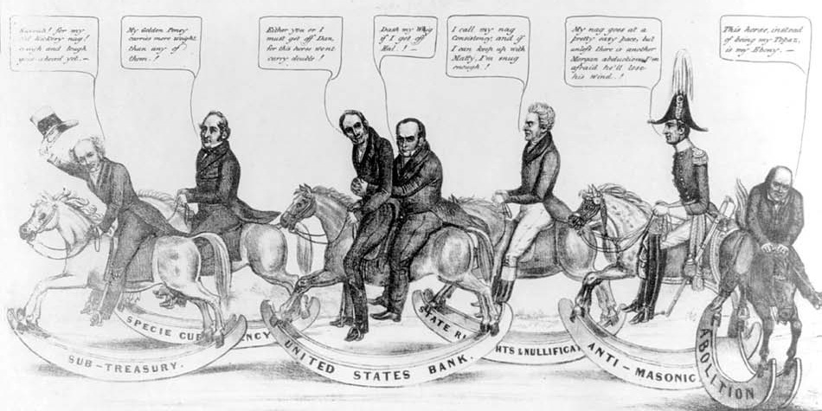
The Tricky “Tariff of Abominations”
The tariff (tax on imports) became the hot issue in the 1820s and 30s.
It nearly brought America to civil war before being worked out by compromise.
  Congress had raised the tariff significantly in 1824, but wool manufacturers called for an even higher tariff.

Slide 13
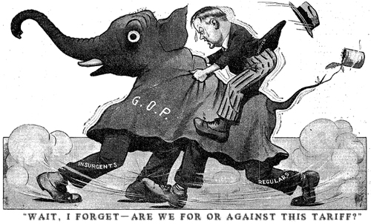
Jackson’s Opinion
  Jackson and his followers hated the tariff.
  They felt it was a tool of the rich to get richer by jacking up prices that the poor would have to pay.
  Jacksonians planned to hike the tariff to the sky-high rate of 45%, thinking it would never pass.

Slide 14
The Plan Backfired- Sectional Warfare Began
    New England liked the high tariff since it protected manufacturers. Daniel Webster (Mass.) became the North's main spokesperson.
    Southerners, and Westerners, hated it because it drove up the cost of things that they purchased. John C. Calhoun (SC) became the South's main spokesperson.

Slide 15
About the Same Time…
The South also struggled with slave rebellions.
    Denmark Vesey was a free black who led a slave rebellion in Charleston, SC in 1822.
    It was unsuccessful, but scared the southern whites to what might happen, especially in areas with an almost 1:1 white-to-black ratio like South Carolina.
    Also, Britain was moving toward abolition of slaves.
    The South felt the pressure and began considering secession and using the tariff as the issue.

Slide 16
South Carolina Exposition
  Took the Virginia and Kentucky Resolutions to the next level.
  The Exposition said that the states, such as South Carolina, could nullify (or declare null and void) the tariff.
  This was a direct challenge to the federal government.
  Would the federal government allow states to pick-and-choose the laws they followed? Or would all federal laws be binding?

Slide 17
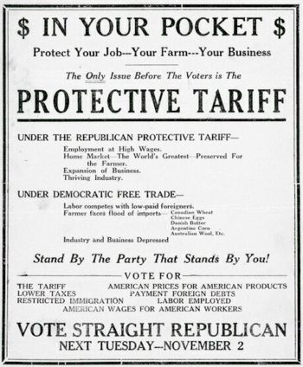
The “Nullies” in South Carolina
  A showdown had developed between the federal government and the states.
  Congress eased tensions with the Tariff of 1832 that removed the worst parts of the Tariff of 1828 (AKA Tariff of Abominations).
  Still, the principle of nullification was under question.
  South Carolina again led the nullification charge…

Slide 18
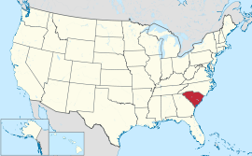
Threats of Secession…
    "Nullies" sought the 2/3 majority needed in the SC legislature to nullify the tariff. They got the votes and SC officially voted to nullify the federal tariff.
    SC even threatened secession if Washington tried to impose the tariff over the nullification vote.

Slide 19
Jackson’s Reaction
  Andrew Jackson was not a president with whom to bluff or pick a fight. Jackson was the old fighter, dueler, and warrior.
    Privately, Jackson threatened to go to SC and start hanging the leaders.
    With any other president this would just be tough-talk; Jackson, however, just might actually do it.
    Publicly, he got the military ready. Civil war hung as a real possibility.

Slide 20
Clay’s Compromise
  Henry Clay proposed a compromise which settled the situation.
    Clay's personal motives were to prevent his foe Andrew Jackson from scoring a victory.
    Clay's compromise said that the tariff rate would be reduced by about 10% over 8 years.
    Despite debate, the compromise passed and violence was thwarted.
    Congress also passed the Force Bill (AKA "Bloody Bill" in the Carolinas) authorizing the president to use force if necessary to collect the tariff.

Slide 21
Effect of Compromise
  Like a true compromise, the "winner" of the nullification crisis was unclear.
    South Carolina and the states did not join behind the nullification cause like SC expected.
    But, South Carolina won in that, all by itself, it succeeded in driving the tariff down.
    The federal government won in the sense that it got SC to abide by the tariff (Ie. SC repealed its nullification law).

Slide 22
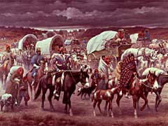
The Trail of Tears
  Westward expansion meant whites and Indians continued to bump into one another. Problems followed.
  Since the 1790s, the U.S. policy was to gain Indian land only through treaty. These treaties were
    sometimes questionably made
    often overlooked or broken.

Slide 23
Indian-White Relationships Varied
    There were attempts to assimilate Indians into white society, notably the Society for Progating the Gospel Among the Indians (est. 1787).
    Some tribes readily adopted white ways they felt beneficial. The Cherokee of Georgia settled down to become farmers; largely accepted Christianity
    Sequoyah devised a Cherokee alphabet so they could write
    The tribe soon set up a government with a legislative, executive, and judicial branch.

Slide 24
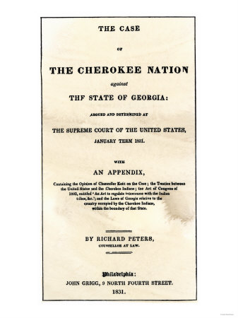
Georgia’s Point of View
      Georgia challenged and revoked the Cherokee's right to rule themselves. The Cherokee appealed to the Supreme Court which supported the Indians, 3 times.

Slide 25
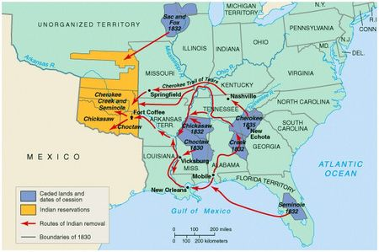
Jackson’s Plan
  Pres. Jackson's policy on Indians was clear and simple–Indians and whites couldn't live together peacefully so the Indians were to be removed to the West.
  This was the general consensus of white America at the time.

Slide 26
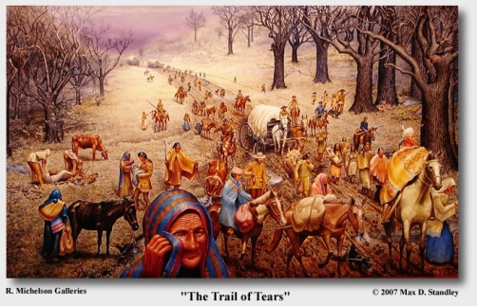
Indian Territory
    Oklahoma was the appointed "Indian Territory."
    Indian Removal Act was passed by Congress making the relocation law and the Bureau of Indian Affairs was started to oversee matters.

Slide 27
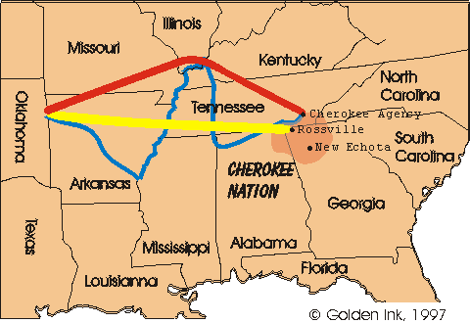
Trail of Tears
      The military rounded up eastern tribes and drove them westward.
      Most infamous was the Trail of Tears where the Cherokee were forced to walk from their Georgia home to Oklahoma.
      The walk was miserable and fatal (4,000 out of the 15,000 died).

Slide 28
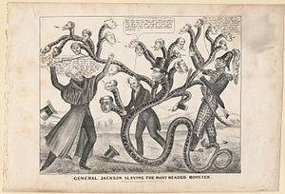
The Bank War
  Andrew Jackson held the common western view of a distrust in banks.
  Mainly, he distrusted the B.U.S., the Bank of the United States.

Slide 29
Jackson's Problems with B.U.S.
    Jackson's view was that the B.U.S. was a tool of the rich to get richer at the poor's expense.
    Jacksonians felt that the rich used "hard money" to keep the common man down.
    The B.U.S. minted "hard money" (actual metal money) which the wealthy preferred since it gave the economy stability.
    The farmers preferred "soft money" (paper money) that would lead to inflation, devalue the dollar, and make loans easier to pay off.

Slide 30
B.U.S.
  B.U.S. president Nicholas Biddle carried out bank policies of
    coining hard money
    cracking down on western "wildcat banks" by calling in loans.
    He, and the B.U.S., was compared to a serpent that could grow multiple heads when one was cut off.

Slide 31
The BUS was a Political Tool
    Although the B.U.S. charter didn't expire until 1836, Henry Clay and Daniel Webster started a re-charter bill in 1832.
    The goal was to have Andrew Jackson veto it (as expected) and therefore give himself a political black eye.
    The thought was that Jackson would be in a lose-lose situation…
      If he vetoed it…the North would be angry and would not vote for his re-election.
      If he signed it…the South and West would be angry because he'd gone to Washington and "sold them out" to big business. Either way, he'd be in trouble come election time in 1836.
    Congress passed it and Jackson vetoed the B.U.S. re-charter bill saying, "The Bank…is trying to kill me, but I will kill it."

Slide 32
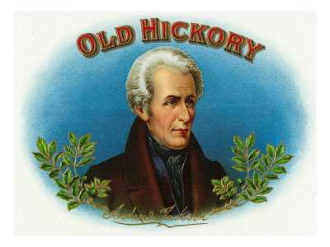
“Old Hickory” Wins Again- 1832
  In the 1832 election, it was Andrew Jackson for reelection being challenged by Henry Clay.
    Jackson again appealed to the common man and urged them to "Go the whole hog."
    Clay's slogan was "Freedom and Clay" but was criticized for his gambling, dueling, cockfighting, etc.

Slide 33
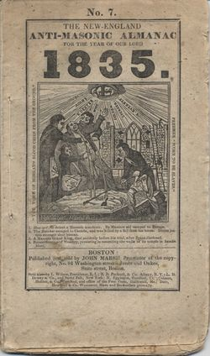
A Third Party Emerges
    The emergence of a third party, the Anti-Masonic Party.
      The Masons or Freemasons were (and still are) a secret society.
      Due to its secret nature, questions, mystery, and a skeptical air swirled around them.
      The Anti-Masonic Party was made up of a mix of various groups that were joined by
      dislike of the Masons and/or
      dislike of Jackson (who was a Mason).

Slide 34
National Conventions
    This meant that the people of each party nominated their candidate, not the "big whigs" in a backroom choosing a candidate for the people.
    The use of a printed party platform.
    This was done by the Anti-Masonic Party when they printed their positions on the issues. This would become the norm for all parties.

Slide 35
Burying Biddle’s Bank
  Jackson could've waited until 1836 and the B.U.S. charter would've expired, but he was in a fighting mood and wanted to kill it right then. So…
    Jackson started withdrawing money from the B.U.S. and depositing it into local, "pet banks" or "wildcat banks."
    Nicholas Biddle fought back by calling in loans from the wildcat banks to the B.U.S.

Slide 36
The Result
  Bank chaos, and often, bank foreclosure.
  Ironically, the common man, whom Jackson set out to defend, often lost his farm in the bank confusion.
  Even though Jackson was largely at fault for the turmoil, from the common man's perspective, the B.U.S. and eastern big-whigs were to blame.

Slide 37
Birth of the Whigs
  Jacksonians, officially the "Democratic-Republicans," began calling themselves simply the "Democrats."
  This is the Democratic party we think of today.
  A second party also formed, the Whig Party.
  The Whigs were a very diverse group, but they generally…
    Disliked Jackson (this was the main tie that bound them).
    Liked Henry Clay's American System, especially its internal improvements (building roads, canals, etc.).
  By this time, the "Era of Good Feelings" was over (with its one political party) and America had a two-party system of politics.

Slide 38
The Election of 1836
  "King Andrew" was still very popular and he, in effect, chose his successor and the next president–Martin Van Buren as the Democratic candidate.
  The Whig Party was disorganized (due to its infancy and hodge-podge make-up).
  They nominated a favorite son candidate from each section in hopes of splitting the electoral vote, preventing anyone from getting a majority and winning, and thus throwing the election into the House of Representatives (like in 1824).
  Their plan failed as Van Buren, the "Little Magician" won 170 to 124 (all Whig votes combined).

Slide 39
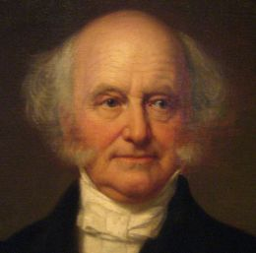
Big Woes for the “Little Magician”
  Van Buren followed Jackson's coattails right into the White House, but Van Buren was no Jackson.
  Jackson was the people's president, a common guy himself. Van Buren was very smart, crafty, experienced, and effective, but he lacked the "people's touch" and personality of a Jackson.

Slide 40
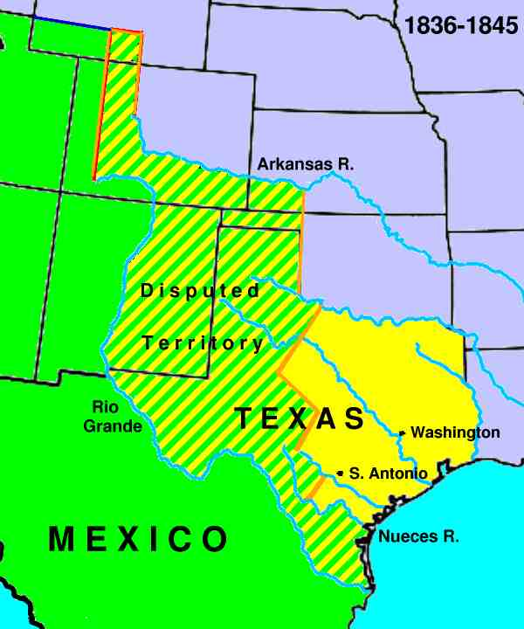
Problems were Brewing…
    In 1837, in Canada, a rebellion caused turmoil along the border. Van Buren played the neutral game between Canada and Britain which gained no friends.
    Anti-slavery folks in the North were upset because the idea of annexing Texas, a slave land, was being tossed around.
    And worse yet for Van Buren, the economic situation was beginning to crumble.

Slide 41
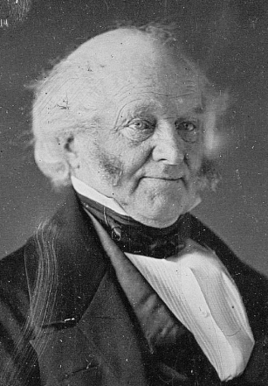
Depression Doldrums
  There's an irony with Martin Van Buren: he benefited from his close tie with Jackson by being elected president, but he was hurt by Jackson as well as he
  Inherited Jackson's enemies
  Was brought down by the economic chaos Jackson had begun.

Slide 42
Panic of 1837
  Its causes were:
    Over-speculation, especially in land, but also in other get-rich-quick schemes like canals, roads, railroads, and slaves.
    Andrew Jackson's bank policies and resultant chaos also aided the Panic of 1837.
    Jackson's "specie circular" hurt as well. This was a decree by Jackson that all debts were to be paid only in specie (gold or silver) but not worthless bank notes (paper money).
    The failure of crops helped the Panic.

Slide 43
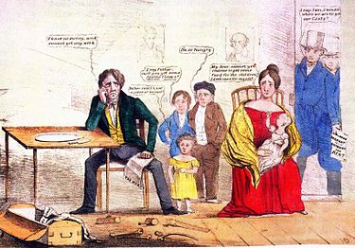
The First Domino Falls…
    The failure of two major banks in England and the reverberations across the ocean.
    Many banks went under. Many farmers lost their farms.

Slide 44
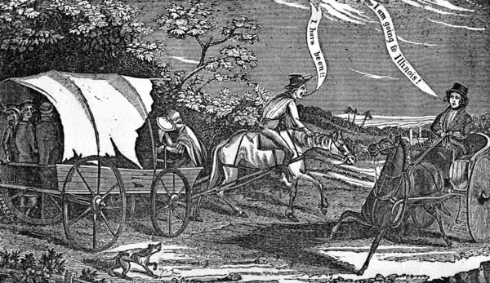
The Whigs Formed a Plan
    They proposed expanding bank credit, higher tariffs, and money for internal improvements.
    President Van Buren disliked wasteful government spending and halted such plans.

Slide 45
“Divorce Bill”
  The government should "divorce" itself from banking altogether.
    This bill set up an "independent treasury" where extra government money would be kept in vaults (not in the banks.
    This would give the government stability independent of the whims of the banking world.
    The Divorce Bill went on a roller-coaster ride: it was controversial, passed, was repealed by the Whigs, then reenacted 6 years later.
    It did serve as a first step toward the modern Federal Reserve System.

Slide 46

Gone to Texas
  Americans, especially southerners hungry for more cotton land, were eyeing Texas. But, Texas was foreign land and therefore had to be approached with caution.
  Americans asked Spain if they could enter Texas and were told they could not. Then, Mexico had a revolution, broke from Spain, and said that the Americans could enter Texas.

Slide 47
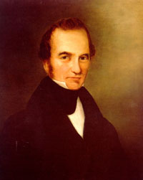
“Old 300”
  In 1823, Stephen Austin led the "Old 300" families into Texas with the conditions that
  (1) they must become Mexican citizens
  (2) they must become Catholic
  (3) no slavery was allowed.

Slide 48
Problems with Mexico
    The first two conditions were ignored without concern, the third condition was outright broken since their main reason for going to Texas was to grow cotton.
    In 1830, Mexico freed its slaves.
    To the Texans, those were fighting words.
    Conflict emerged and Texans were jailed while protesting (including Stephen Austin in Mexico City).
    Mexican president Santa Anna had had enough by 1835 and got together an army to teach the Texans a lesson.

Slide 49
The Lone Star Rebellion
  Texas declared independence early in 1836 and called itself the "Lone Star Republic".
  Santa Anna wouldn't take the declaration without a fight, however.
  Santa Anna led 6,000 soldiers to the Battle of the Alamo.
  There he destroyed about 200 stubborn Texans, including William Travis, Davy Crockett, and Jim Bowie.
  The battle cry "Remember the Alamo!" was heard across Texas.

Slide 50
Texas Wins
  Santa Anna scored a similar win at Goliad. This also fueled Texans' passions.
  Texas president Sam Houston led his troops to the Battle of San Jacinto. This was the turning point…
    Santa Anna was caught (a) in a bend in the river, (b) without lookouts, and (c) taking a siesta.
    He was beaten in 20 minutes.
    Santa Anna was forced to sign a document saying Texas was independent, then he was released.
    He promptly said the document was null and void. Still, Texas was independent.

Slide 51
Texas as its Own Nation?
  Then president Andrew Jackson formally recognized Texas as a nation.
  Texas wanted to join America so the question then was: would Texas become the next U.S. state?
    Slavery would delay Texas' statehood. The northern states would not allow another slave state.
    They accused the south of trying to establish a "slavocracy" where the whole Texas situation was a supposed conspiracy to gain a slave state.
    Texas would have to wait.

Slide 52
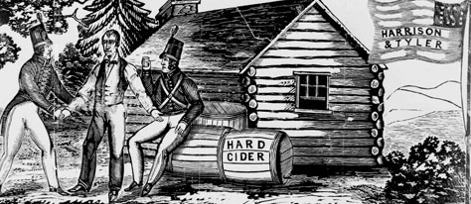
Log Cabins and Hard Cider of 1840
  In the 1840 election, the Democrats nominated Martin Van Buren for reelection. The Whigs nominated Indian-fighting hero William Henry Harrison.
  From the beginning, Van Buren was in trouble due to the economic fallout of the Panic of 1837.

Slide 53
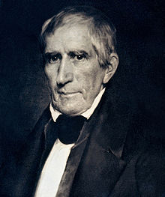
Not A Lot of Substance
  The election dealt more with personalities and hoopla than with issues.
    Van Buren, who came from humble beginnings, was painted as a rich snob out-of-touch with the people.
    Harrison, who came from wealthy beginnings, was painted as the born-in-a-log-cabin type. He adopted a log cabin as the symbol of the campaign.

Slide 54
First Modern Election
      Voter turnout was a whopping 75% (as opposed to roughly only 25% for the 1824 "corrupt bargain" election or 50% in 1828).
      Hard cider was given out, campaign slogans were created ("Tippecanoe and Tyler Too"), songs were sung, issues or problems were hidden behind slogans and cheers–essentially, everything superficial about modern campaigns was born.
  Harrison won easily, 234 to 60 in the electoral vote.
  The vote was a protest against the poor economy.

Slide 55
Politics for the People
  During the Federalist era, an elite record with impeccable experience was respected.
  By the 1830's, being born in a log cabin and rising up from poverty was more respected.
  A politician born rich was a politician doomed.

Slide 56
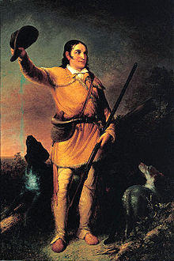
The West is the Best
  Any politician from the west was especially liked: such as Andrew Jackson, Davy Crockett, and William Henry Harrison.
  These men made their names by their shooting skills and/or Indian fighting out west.

Slide 57
The “New Democracy”
  This change became known as the "New Democracy" where the "common man" voted for a common sense politician who was more like the "average Joe" than the college grad.
    The top characteristic of the New Democracy was "universal white manhood suffrage" (all white men could vote).
    These new politicians were known as "coonskin congressman".

Slide 58
The Two-Party System
The Democrats
The Whigs
    The Democrats were the common man's party.
      True to founder Thomas Jefferson's beliefs, they championed liberty of the individual.
      Loved states' rights (and therefore disliked the federal government doing too much).
      It was made up of the lower classes, mostly of farmers.
      It was made up mostly of people in the South, West, and in the rural or small-town areas.
    The Whigs were the upper class's party.
      The were like the Federalists of older days.
      Favored a stronger federal government that could take action for the nation's benefit.
      Favored issues such as internal improvements, tariffs, a strong national bank, public schools.
      It was made up mostly of the educated and wealthier classes.
      It was made up largely from the cities and the East.

