Slide 1
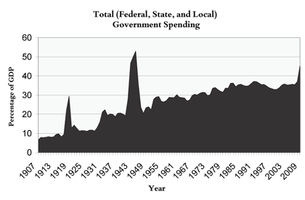
The Progressive Era & the End of Laissez-Faire America

Slide 2
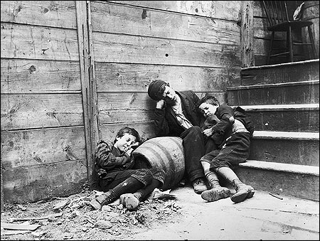
I. Muckrakers Expose the Evils of Industrial Capitalism
A. Jacob Riis and New York’s Poor

Slide 3
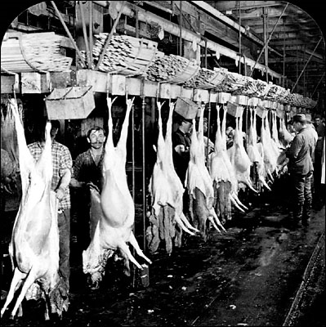
B. Upton Sinclair and America’s Meat

Slide 4
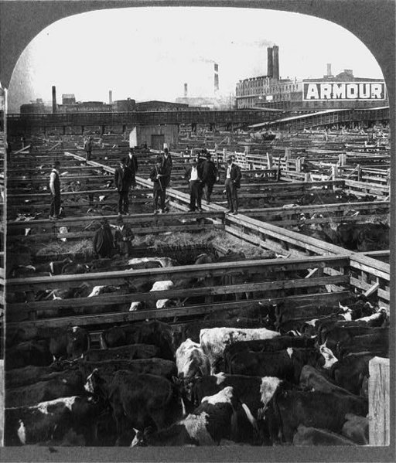

Slide 5
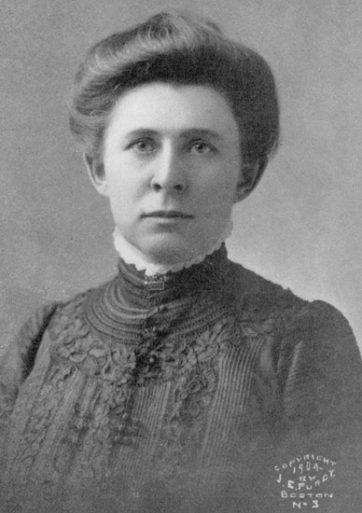
C. Ida Tarbell and Standard Oil

Slide 6
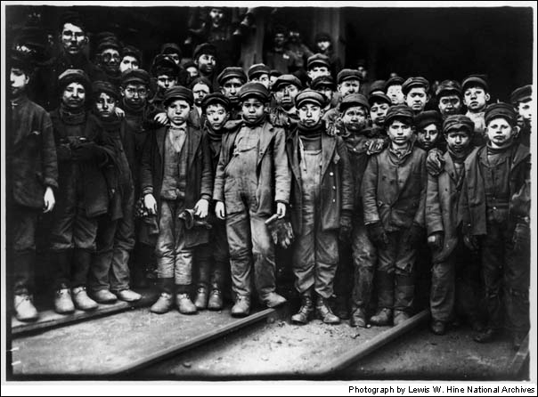
II. Solution #1: Keep Capitalism, But Protect the People
A. Protecting Children and Women Workers: Child Labor Laws & Muller v. Oregon

Slide 7
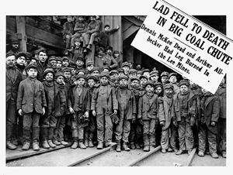

Slide 8
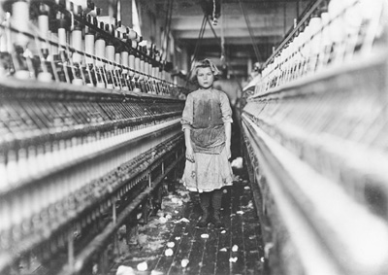

Slide 9
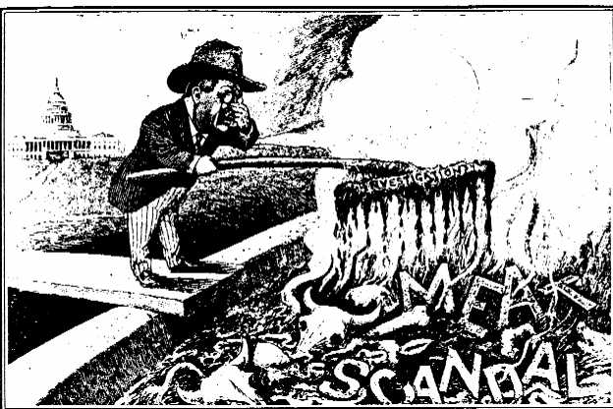
B. Protecting Consumers: Meat Inspection Act and Pure Food & Drug Act

Slide 11
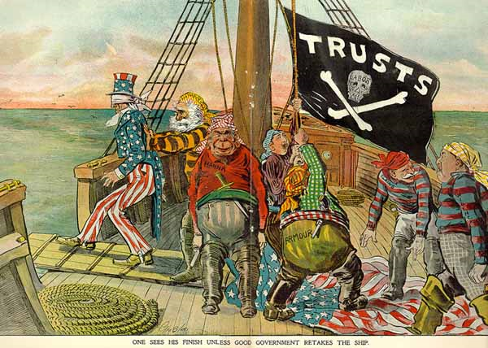
C. Protecting Small Businesses: The Elkins, Hepburn and Clayton Anti-Trust Acts

Slide 12
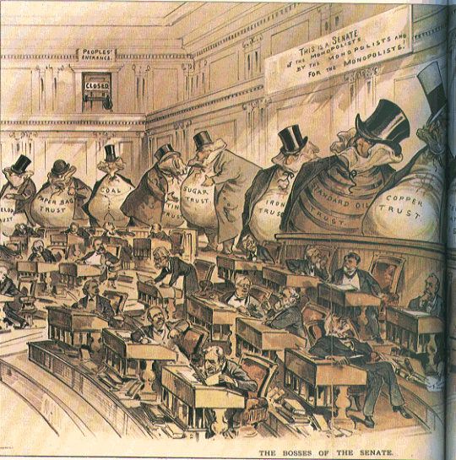
III. Solution #2: More Democracy, More Power to the People

Slide 13
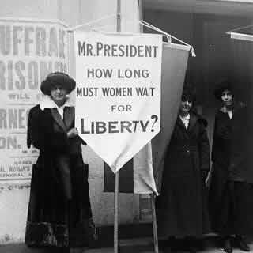
A. Women Win the Right to Vote: The 19th Amendment

Slide 14
B. Direct Election of Senators: 17th Amendment
Original Constitution (1787): The Senate of the United States shall be composed of two Senators from each State, chosen by the Legislature thereof, for six Years; and each Senator shall have one Vote.
17th Amendment: The Senate of the United States shall be composed of two Senators from each State, elected by the people thereof, for six years….

Slide 15
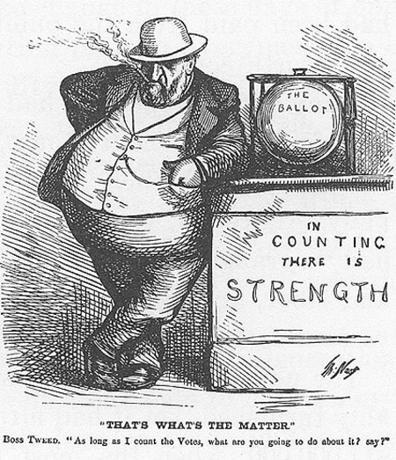
C. Voting Privately: The Australian Ballot

Slide 16
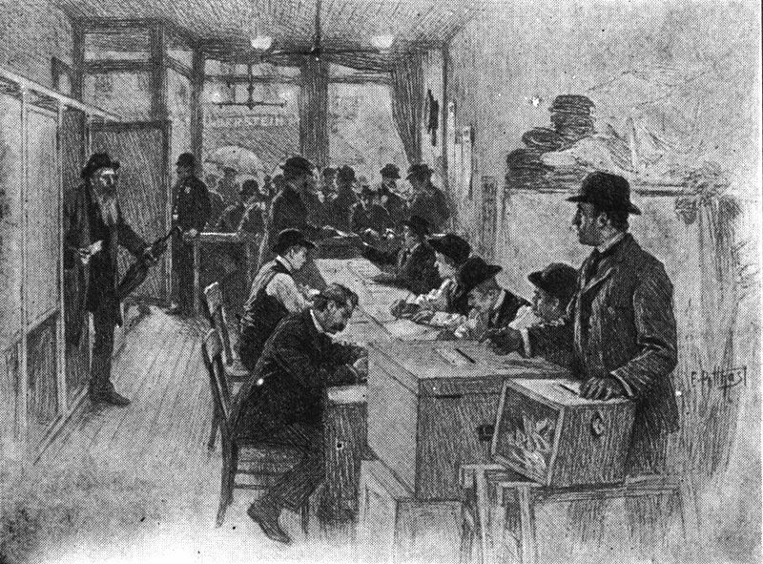
New York (1900)

Slide 17
D. Recalls, Referenda, and Initiatives

Slide 18
IV. The Results
A. Political: Little Long Term Impact

Slide 19
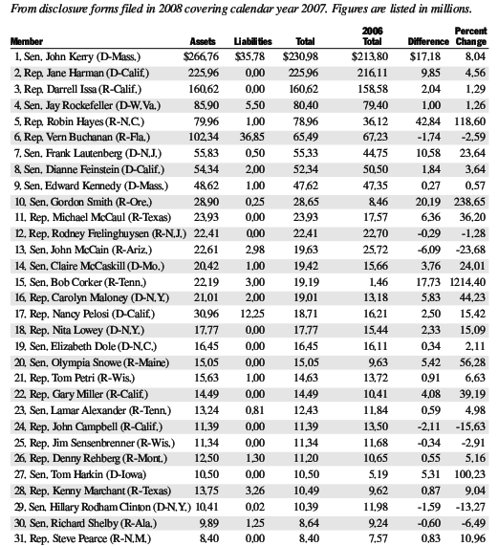

Slide 20
B. Economic: The End of Laissez-Faire America

