Slide 1
Chapter 19:
Drifting Towards Disunion

Slide 2
More Issues in the 1850’s
Bleeding Kansas
Incendiary Literature (Uncle Tom’s Cabin)
Brooks-Sumner Incident
Dred Scott Decision of 1857
Panic of 1857
John Brown- Martyr or Murderer
Election of President Lincoln

Slide 3
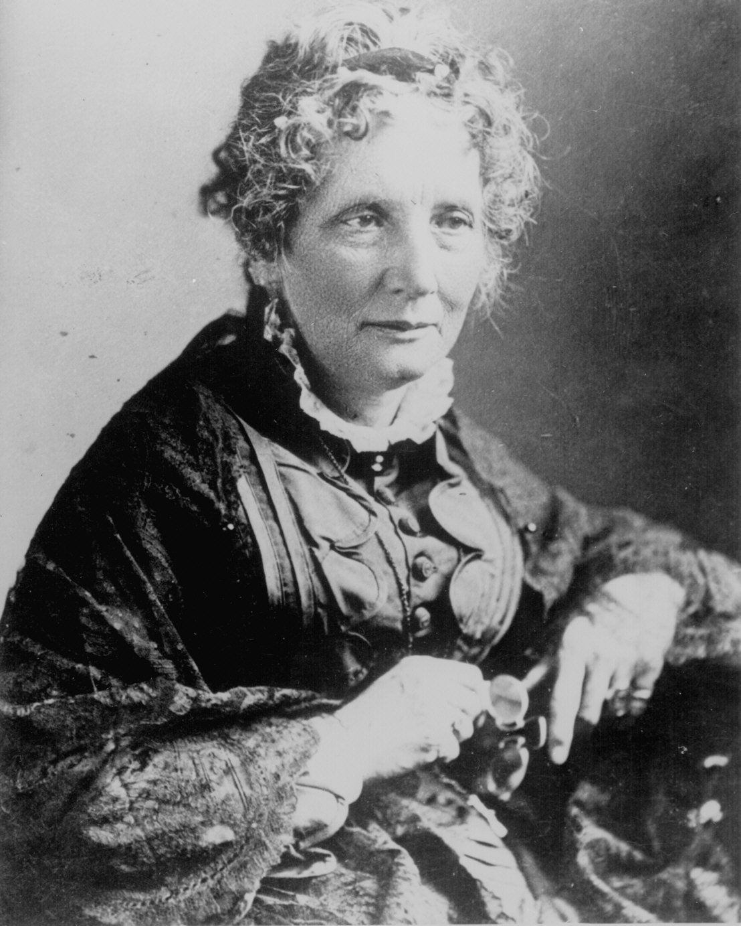
Harriet
Beecher
Stowe
(1811 – 1896)
So this is the lady who started the Civil War.
-- Abraham Lincoln

Slide 4
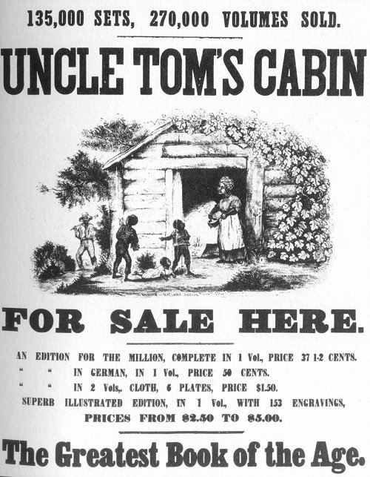
Uncle Tom’s Cabin
1852
Sold 300,000 copies in
the first year.
2 million in a decade!

Slide 5
Uncle Tom’s Cabin
Beecher was a mother of 6 children
After passage of Fugitive Slave Law, she was determined to awaken the North to the horrors of slavery and its inhumane practice of separating families
She claimed that “God wrote it.”
One of the most important novels in American history. For many readers, it describe the evil that was slavery and turned many Northerners in abolitionists.

Slide 6
Uncle Tom’s Cabin
South denounced the book because Beecher never actually witnessed at first hand slavery in the Deep South
Many in the North condemned the Fugitive Slave Law
Novel also popular in France and Britain. Both governments considered joining the Civil War on the South’s behalf, but the public outcry would have been too intense, and much of it was due to Uncle Tom’s Cabin

Slide 7
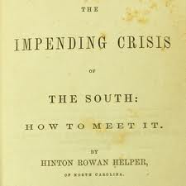
Hinton R. Helper
Helper was a non- aristocratic white from North Carolina
In 1857, he published The Impending Crisis of the South
Argued that non-slave owning whites were the ones who were hindered the most by slaver
Southern plantation owners worried the book would convince Southern whites to rise up against them. So they burned Helper’s books at book burning parties
Not hugely popular in the North, but gained some notoriety.

Slide 8
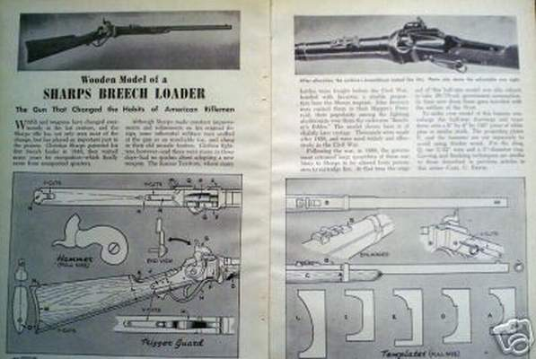
Contest for Kansas
In many ways, reflected the worst of popular sovereignty as groups from the North and South both attempted to infiltrate Kansas in hope of influencing its status as either a free state or slave state.
New England Emigrant Company:
  An anti-slavery organization who sent 2,000 settlers to Kansas to support abolition
  Many carried “Beecher Bibles,” named after Henry Ward Beecher. They were the new deadly breech loading Sharps rifles.

Slide 9
Contest for Kansas
Many southerners armed small group of slaveowners in response to the Northerners.
But census of 1860 made it clear that slavery was not attractive in Kansas. Only 2 slaves were found among the 107,000 inhabitants (only 15 in Nebraska).
In 1855, when it came time to vote, proslavery ruffians poured in to vote and vote often
Slavery supporters won the territorial election and set up a government at Shawnee Mission. The free-soilers, upset at the fraudulent election, set up their own government in Topeka.

Slide 10
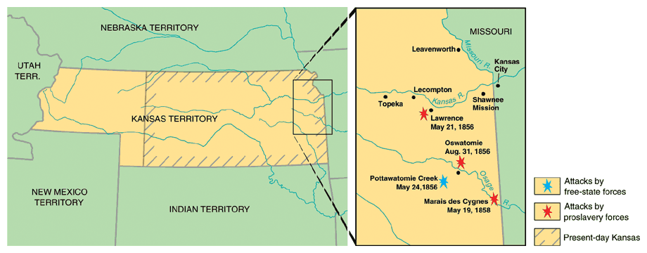
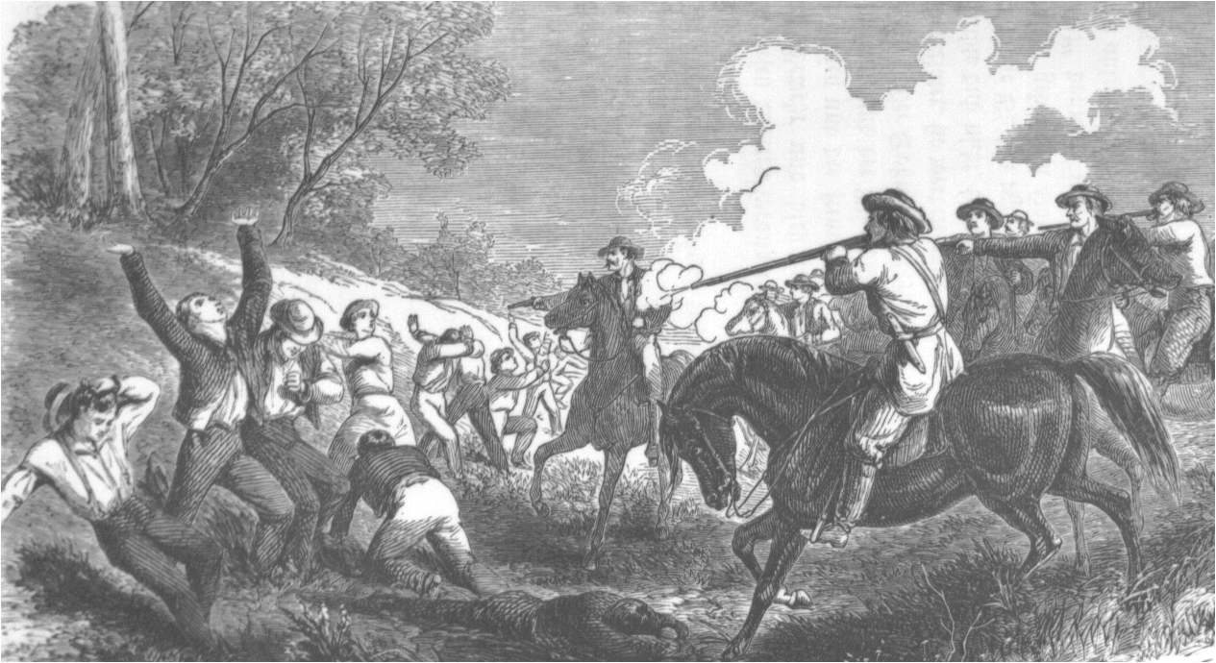
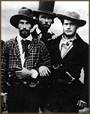
“Bleeding Kansas”
Border “Ruffians”
(pro-slavery Missourians)

Slide 11
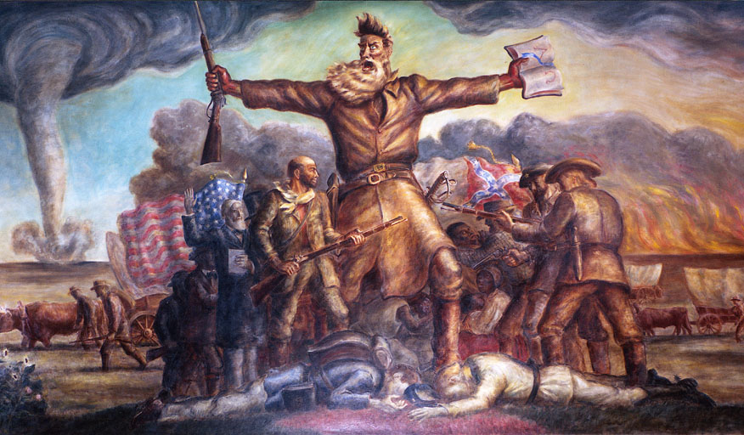
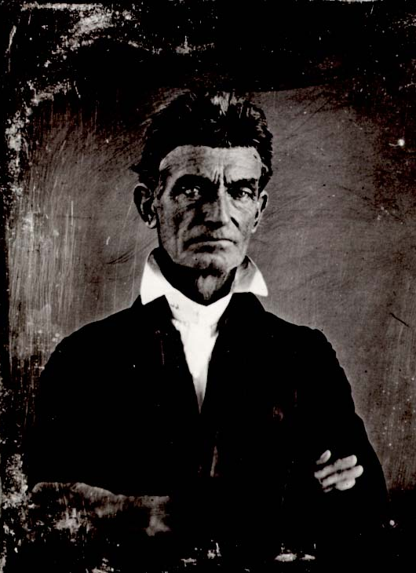
John Brown: Madman, Hero or Martyr?
Mural in the Kansas Capitol building
by John Steuart Curry (20^{c})

Slide 12
Pottawatomie Creek
John Brown
  Obsessively dedicated to the abolitionist cause
  In 1856, he was in Kansas
  Angry over the attack at Lawrence, he led a band of his followers to Pottawatomie Creek in May 1856
  Brown and his band grotesquely hacked 5 supposedly proslavery followers to pieces.
  This bloody attack hurt the free soil cause and resulted in retaliations from proslavery followers
  Kansas would erupt in civil war in 1856 and would merge with the larger war from 1861-1865.

Slide 13
Lecompton Constitution
President Buchanan supported the constitution.
However, Stephen Douglas did not and called it a sham.
Douglas convinces to have the constitution voted basically on popular vote and the free-soilers vote it down. Kansas enters the union in 1861 as a free state
The dispute between Buchanan and Douglas helps split the Democratic party, the last national party. Fear of two sectional parties grows.

Slide 14
Lecompton Constitution
The Lecompton Constitution (1857, enough people, mostly free-soilers, to apply for statehood.
Proslavery territorial government devised a sneaky plan
The people could vote for EITHER
  The new Kansas state constitution with slavery or
  The new Kansas state constitution with out slavery.
  But even if they did this the slave owners property would stil lbe protected by law
  THUS—slavery was protected either way
  .The anti-slavery forces refuse to vote and Kansas votes in slavery.
  Douglas convinces Congress, that it is a sham election and the Lecompton Const is thrown out.
  Kansas won’t become a state until 1861--FREE

Slide 15
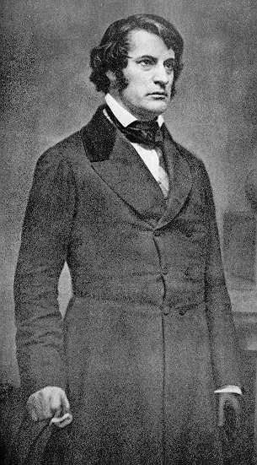
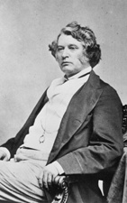
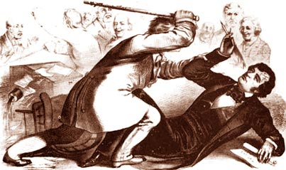
“The Crime Against Kansas”
Sen. Charles Sumner
(R-MA)
Congr. Preston Brooks
(D-SC)

Slide 16
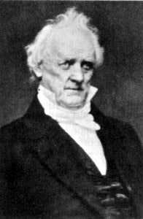
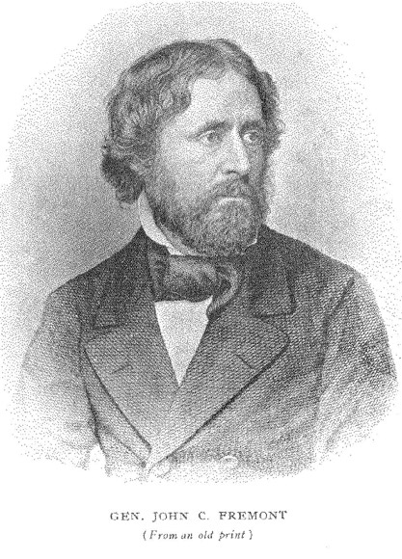
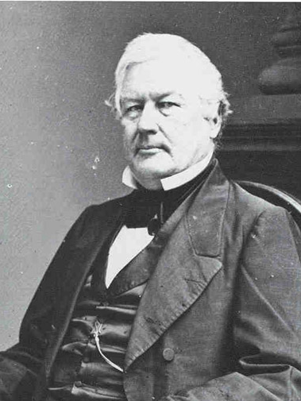
1856 Presidential Election
√ James Buchanan John C. Frémont Millard Fillmore
Democrat Republican Whig

Slide 17
James Buchanan
Nominated in Cincinnati to represent the Democratic Party in the 1856 presidential election
He was muscular, white-haired, tall (6 feet), with a short neck and protruding chin. He also, due to an eye defect, carried his head to one side.
A wealthy Pennsylvania lawyer, he was in London during the Kansas incident. So he was considered “Kansas-less” and also relatively enemyless. So, to put it succinctly, he was electable.
Nicknamed “Old Buck.”
Democrats campaigned on the idea of popular sovereignty in the territories.

Slide 18
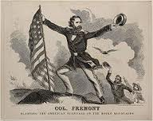
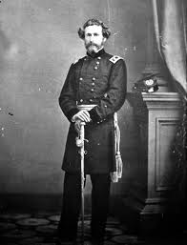
John C. Fremont
Nominated for president by the burgeoning Republican party in Philadelphia.
Seward was probably the more logical choice due to his popularity, but he did not openly campaign for the nomination.
Fremont chosen mostly because he was not tainted by the Kansas issue either.
Nicknamed the Pathfinder. Was suppose to find a path to the White House.
Republicans campaigned on the idea of no slavery in the territories.

Slide 19
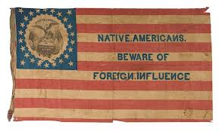
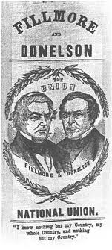
Millard Fillmore
Candidate for the American Party, better known as the Know-Nothing Party.
Anti-foreign and anti-catholic due to the influx of Germans and Irish.
Slogans was “Americans Must Rule America”

Slide 20
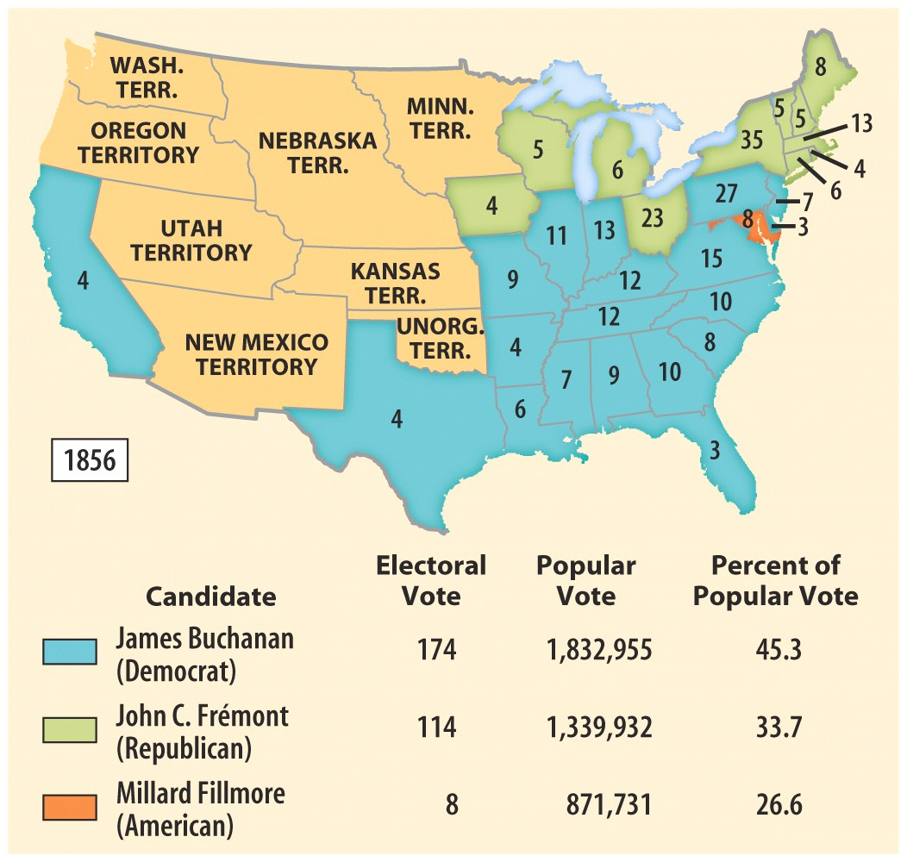
1856 Election Results
Fremont’s character
Was part of the
Reason he lost. Also,
Threats from Southern
Fire-eaters that they would
Secede if a ‘Black
Republican” was elected.
Consequently, many
Northerners voted
Buchanan to save the Union
And business interests in the
South.
Better anyways, Fremont was not the leader the U.S
needed during a Civil War. He was no Lincoln. And the
North was not ready to let
The South depart in 1856.
More events from 1856-1860
Will change the mood on the
North

Slide 21
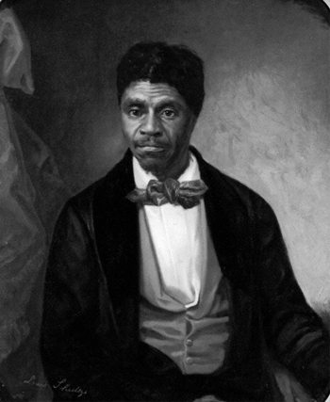
Dred Scott v. Sanford, March 6, 1857
Dred Scott argued that since he had
lived for 5 years with his master in
Illinois and the Wisconsin Territory, he
should be free due to the fact he lived
on free soil for so long.
Supreme Court, under chief justice
Taney who was from Maryland,
ruled that Dred Scott was a black
slave, so he was not a citizen.
Non-Citizens could not sue in federal
courts.
Important to remember that the South
had a majority in the Supreme Court.

Slide 22
Dred Scott Case
Overreach of Taney’s Court
  On technical grounds alone, the Dred Scott case could have been thrown out of the courts.
  However, Taney and the pro-Southern majority decided to go further.
  They Ruled:
    Slaves were private property and could be taken to any territory and legally hold them there in slavery
    5th Amendment forbade Congress from depriving people of their property without due process of the law
    The Court also ruled that the Missouri Compromise of 1820 was unconstitutional, because Congress could not ban slavery in any territory, regardless of what the territorial legislatures decided themselves they wanted.

Slide 23
Reactions to Dred Scott
Southerners, obviously were happy with this decision.
Followers of popular sovereignty were angry and upset at the Court’s ruling, especially Stephen Douglas. This drive a wedge between Northern Democrats and Southern Democrats
Republicans were infuriated by the decision of the Supreme Court. Claimed that the court made a decision and not a ruling and was not binding. Republicans also were angry that the Court ventured into the realm of politics and did not arbitrate on the facts and law of the case.

Slide 24
What caused the
Panic of 1857??
What were its
effects on the nation?

Slide 25
Causes of Panic of 1857
Not as bad economically as the Panic of 1837, but psychologically, it was devastating.
Causes
  Influx of California gold inflated the currency
  Crimean War caused over stimulated the growing of grain, and land speculation occurred and also over speculation on railroads.
Results
  North hit hardest and 5,000 businesses closed within a year
  Unemployment was rampant and many were short of basic necessities such as food
  South was barely hit due to stability of cotton. This caused the South to be overconfident in the strength of their economy vis a vis the North

Slide 26
People’s Response to Panic
Many in the North started to demand for free farms of 160 acres from the government.
Many argued that the government should not sell land for revenue, but gift it to pioneers who risked their life and health to settle it.
However, some were against this:
  Eastern Industrialists feared their workers would move West for the free land
  South against it because free soilers and antislavery groups would populate these territories and tip the political blance clearly in favor of the abolitionists.
Homestead Act passed in 1860:
  Made public lands available at 25 cents an acre.
  However, Buchanan vetoed the bill.
Panic of 1857 also convinced some that a new tariff was needed.
  Passed before the Panic, it reduced tariffs to 20% on dutiable goods. Lowest since the War of 1812.
  Northerners blamed their misfortunes on the Tariff.
Panic of 1857 gave Republicans two issues for the 1860 election: protection of the unprotected and also farms for the farmless.

Slide 27
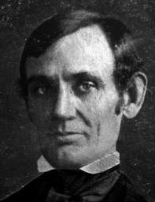
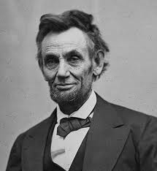
Abraham Lincoln
Nominated in 1858 to challenge Stephen Douglas for his Senate seat
Lincoln was 6’4 and very lanky. He was a lawyer from Springfield Illinois.
No silver-spoon child of an elitist family. Born in 1809 in Kentucky in a a log cabin to poor parents. Mostly a self-taught man who was an avid reader.
On the frontier, he showed his strength through wrestling and weight lifting. He also worked for some time as a splitter of logs.
He married Mary Todd, who was from an influential family in Kentucky.
Referred to as Honest Abe because he would not take a case that asked him to go against his conscience.

Slide 28
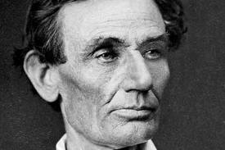
Lincoln's Political Life
Served one term in Congress from 1847-1849. He was a Whig candidate at the time and his term was nothing of note.
Passage of Kansas-Nebraska act lit a fire under him and this helped jumpstart his political career. He emerged as one of the foremost politicians and orators of the North west in the republican Party
In the Republican National Convention in 1856, Lincoln received 110 vice-presidential nominee votes.

Slide 29
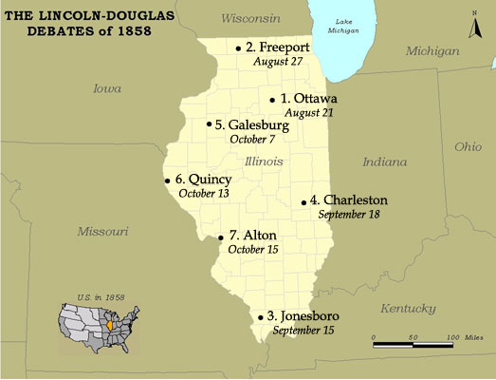
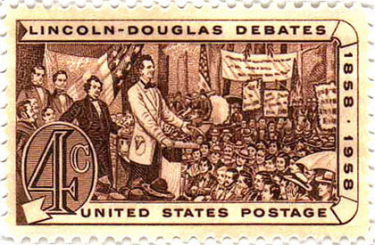
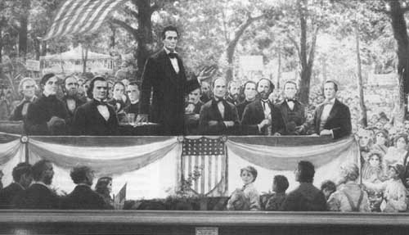
The Lincoln-Douglas (Illinois Senate)
(7) Debates, 1858
A House divided against itself, cannot stand.

Slide 30
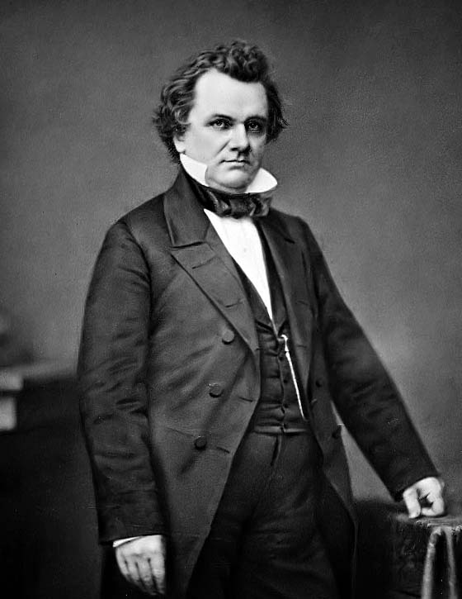
Stephen Douglas
& the
Freeport Doctrine
Popular
Sovereignty Would win in the territories, regardless of the Suprme Court’s ruling in Dred Scott

Slide 31
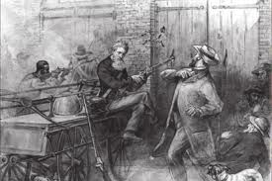
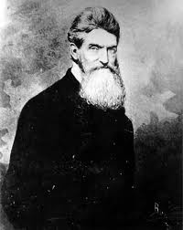
John Brown: Murderer or Martyr
Scheme for the South
  Attack the South with a group of men, call upon the slaves to rise up against the slaveowners, furnish them with arms, and establish a black free state.
  Harper’s Ferry- a federal arsenal
    Brown secured weapons from Northern abolitionists and recruited a group of about 20 men.
    In October 1859, while trying to secure more arms at Harper's Ferry, Brown and his men killed seven people and wounded 10 others.

Slide 32
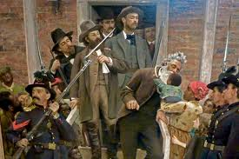
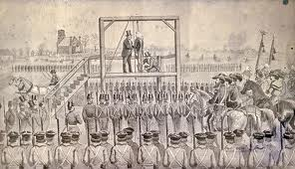
John Brown: Murderer or Martyr
Brown was unable to convince many slaves to rise up and revolt, so he and his band of soldiers were captured by U.S. Marines, led by Colonel Robert E. Lee
John Brown was sentenced to execution, rather than imprisonment. As a result, his fame grew as he became a martyr for the abolitionist cause.
Brown wrote to his brother: “I am quite cheerful in view of my approaching end, being fully persuaded that I am worth inconceivably more to hang than for any other purpose…..I count it all joy. I have fought the good fight, and have, as I trust, finished my course.”

Slide 33
John Brown: Murderer or Martyr
Brown realized he was much more valuable to the abolitionist cause dead than alive. As a result, he made himself a martyr.
His last words became famous as he courageously walked up the scaffold steps. Basically, he carried himself so well and his devotion to the cause was so resolute that he became an exalted character.
South viewed Brown as a murderer and as someone who committed treason. They reasoned how could they stay apart of the Union if murderous gangs of men were financed by abolitionists.
On the other hand, in the North, abolitionists were furious with Brown’s execution. On the day of his execution, in many Northern cities they tolled bells, fired guns, lowered flags, and held rallies.
So, murderer or martyr depended on whose side you were on.

Slide 34
Election of 1860
Democrats:
  Deeply divided between the Northern Democrats and the Southern Democrats.
  Met in Charleston to determine the presidential nominee. Douglas was a leading candidate of the northern wing of the party, but the South considered him to be a traitor.
  As a result, many of the delegates from the South walked out of the convention.
  The remaining delegates could not get the votes necessary to nominate Douglas, so the whole convention was dissolved.
  They met again in Baltimore, and Douglas was nominated for the presidency. However, South walked out again and decided to nominate their own candidate. They selected john C. Breckenridge.
So the Democratic Party was officially divided, on sectional lines.

Slide 35
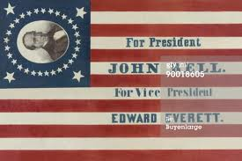
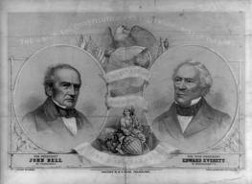
Election of 1860
Constitutional Union Party
  Worried about the future of the Union, they joined together old Whigs and also members from the Know Nothing Party
  Commonly referred to as “Do Nothing” Party or “Old Gentlemen’s” Party
  They nominated John Bell, believed to be a compromiser.

Slide 36
Election of 1860
Republicans
  Seward was by far the most popular, but he hurt his chances by making too many enemies.
  Lincoln was nominated on the 3rd Ballot.
  Republican Platform was attractive to many people:
    Free-soilers- non-extension of slavery
    Northern Manufacturers- a protective tariff
    Immigrants- no abridgement of rights
    Northwest- pacific railroad
    West-Internal improvements
    Farmers-Free Homesteads
Southern secessionists made it clear, if Lincoln is elected, they would split from the Union.

Slide 37
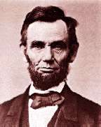
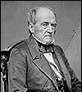
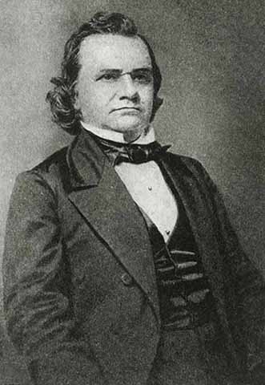
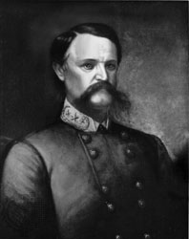
1860
Presidential
Election
√ Abraham Lincoln
Republican
John Bell
Constitutional Union
Stephen A. Douglas
Northern Democrat
John C. Breckinridge
Southern Democrat

Slide 38
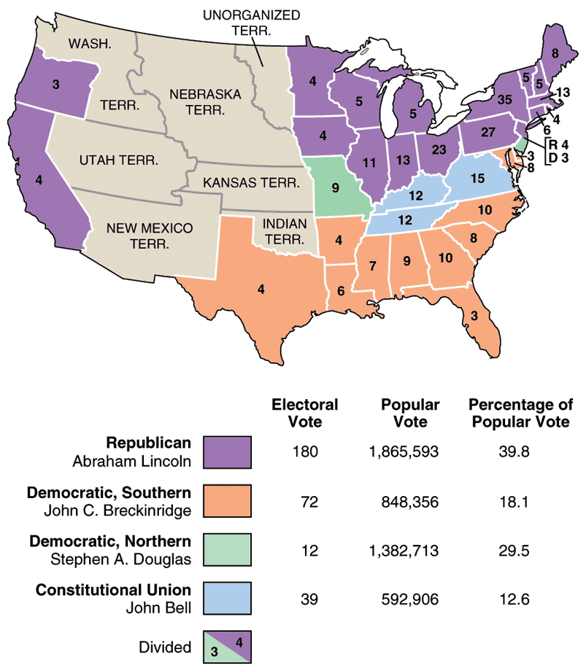
1860
Election
Results
Lincoln was a minority
President because he only
Received 39.8% of the vote.
Douglas, only with 12
Electoral votes, did quite
Well in the popular vote. In
Fact, the Democrats had
More votes than Lincoln.
But Lincoln would have won
Even with a Unified
Democratic Party.

Slide 39
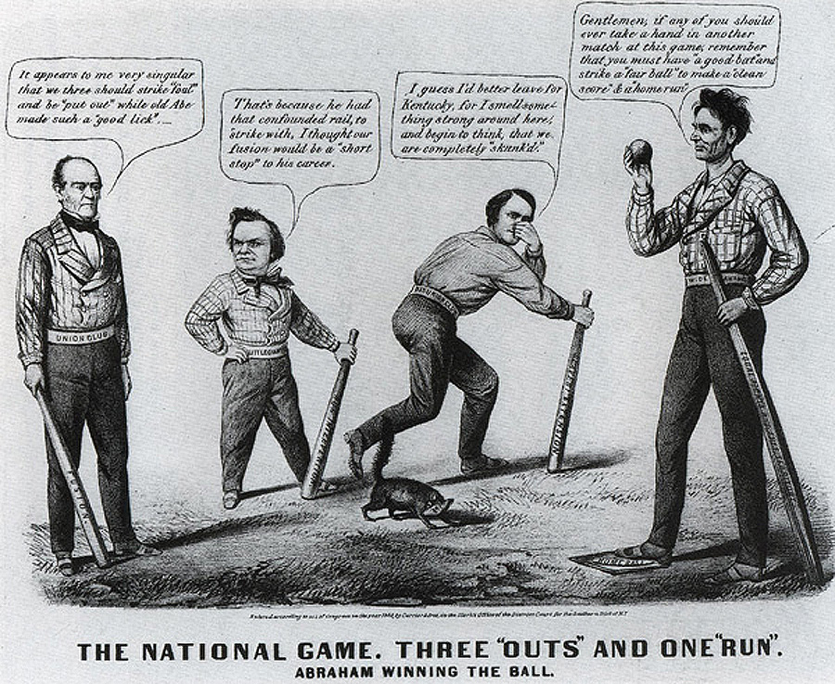
1860 Election: 3 “Outs” & 1 ”Run!”
Lincoln is beardless. Why? This is right after the election but when he arrived in
D.C., he had a beard.

Slide 40
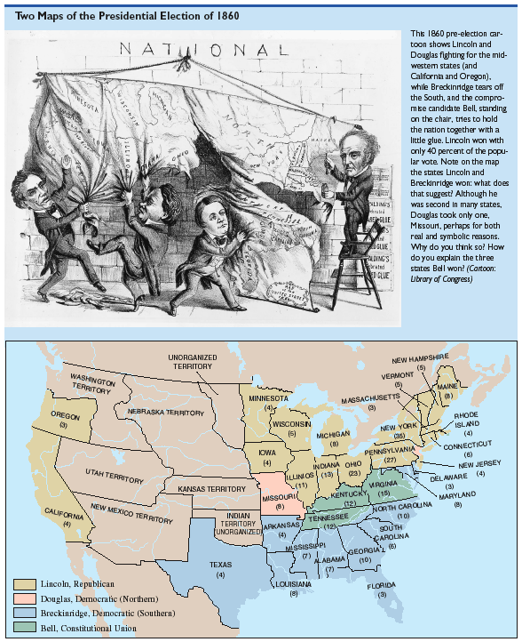
1860 Election: A Nation Coming Apart?!

Slide 41
Election of 1860
Election results did not suggest the nation was ready for secession
  Breckenridge did not even carry his home state of Kentucky and B\Douglas and Bell had more votes combined in the South than he did.
  Also, even though Lincoln was elected, his party did not control the Senate, the House, nor did the North have the majority on the Supreme Court.
  Thus, slavery could not be touched or changed in the South. This could only be done by constitutional amendment, and that needed a 3/4th vote which was impossible to obtain.
  So, the South in many ways miscalculated by seceding. Politically, it was impossible to eradicate slavery.

Slide 42
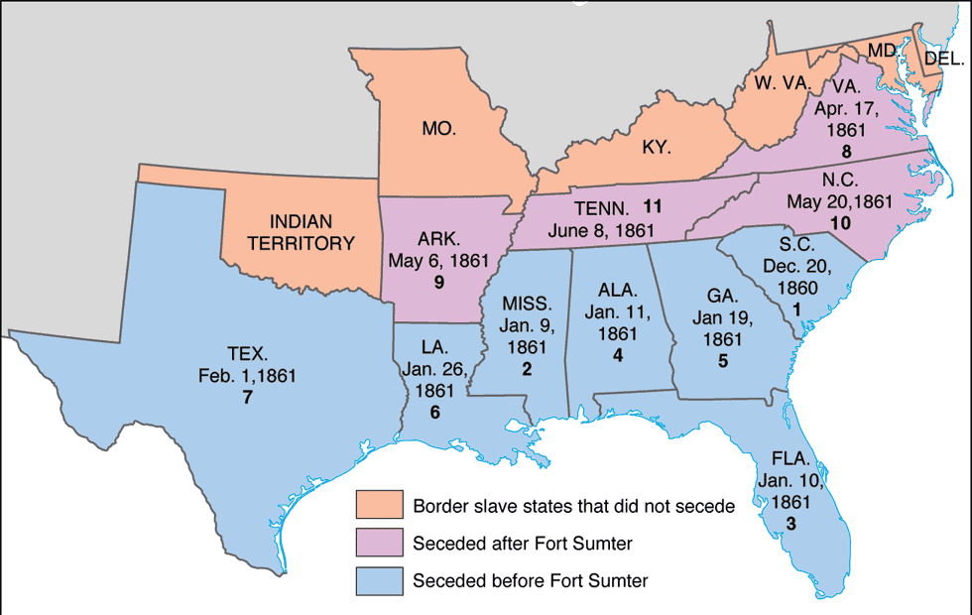
Secession!: SC→ Dec. 20, 1860

Slide 43
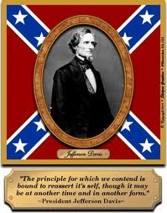
Confederate States of America
Formed in February of 1861.
Jefferson Davis was chosen as President of the new Confederate States of America:
  A dignified and austere Senator from Mississippi.
  Also a West Point graduate and former cabinet member
  Had a wide range of military and administrative experience.

Slide 44
Lame Duck Session
Lincoln does not take office until March 6, 1861. By that time, 7 states will have already seceded. So he his handed a tough situation.
Buchanan did basically nothing. He was normally conservative and did not find any legal language forbidding the South from seceding.
Many called for an Andrew Jackson like measure, military force. But Buchanan understood that the situation was much more vile than the Nullification Crisis. Also, Buchanan did not have a large army to actually use.
As the book states, the weakness was not in Buchanan’s hands, but in the Constitution and the Union itself. It is silly to blame one man for the failures of the whole nation.

Slide 45
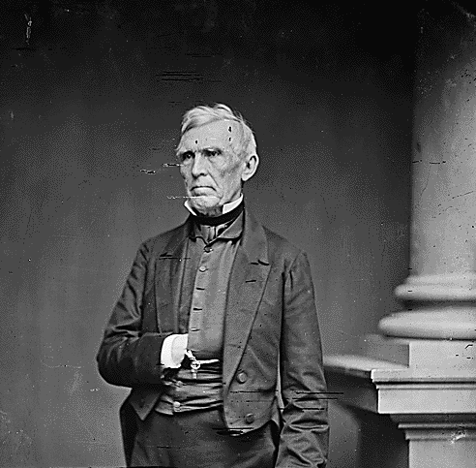
Crittenden Compromise:
A Last Ditch Appeal to Sanity
Senator John J. Crittenden
(Know-Nothing-KY)
Amendment stated that slavery would
be forbidden above the 36’30 line,
and anything South would be allowed
to exist under federal protection.
Lincoln rejected Crittenden’s
Proposal.

Slide 46
Why did South Secede?
Tipping of the political balance
Triumph of the new Republican party
Free-Soil criticism
Abolitionists
Underground Railroad
John Brown
Davis: “All we ask is to be left alone”

