Slide 1
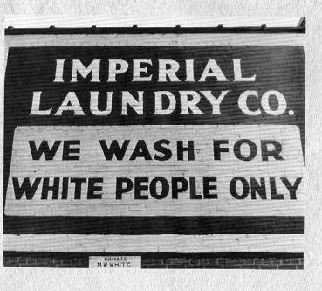
Jim crow laws photo essay
by: lina mawari

Slide 2
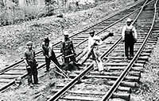
Economic: African Americans were rejected jobs, therefore resulted in poverty.

Slide 3
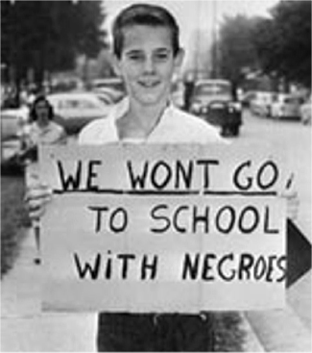
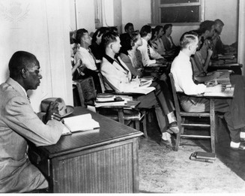
Educational: African Americans weren’t allowed to attend white schools. If they did they were criticized.

Slide 4
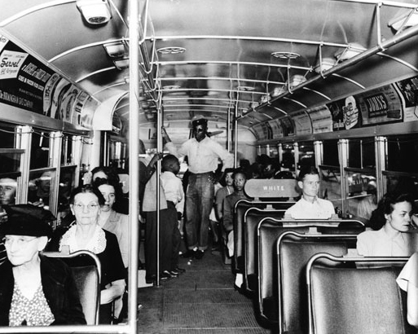
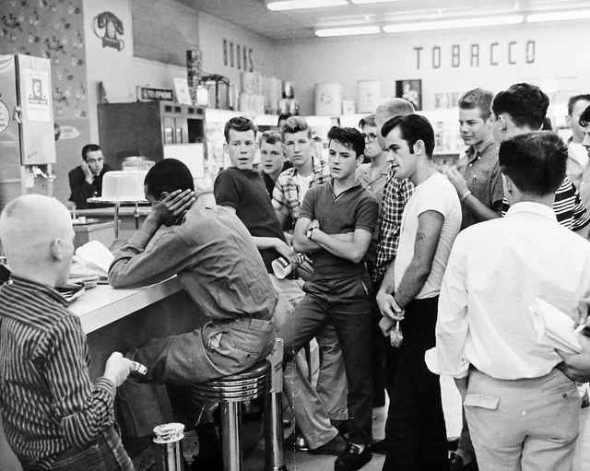
Social: basically whites didn’t want African Americans involved In anything they did.

