Slide 1
Jim Crow Laws Photo Essay
By: Jack Blanzy

Slide 2
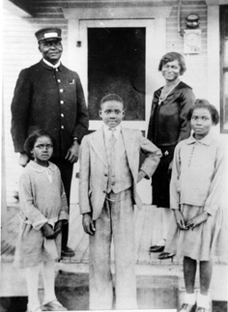
Start of the Jim Crow Reign
After the civil war most southern states denied blacks the same rights as whites had starting in the 1870’s.
This is a picture of a black family post civil war.

Slide 3
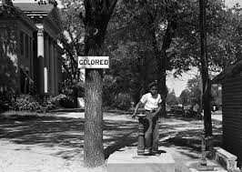
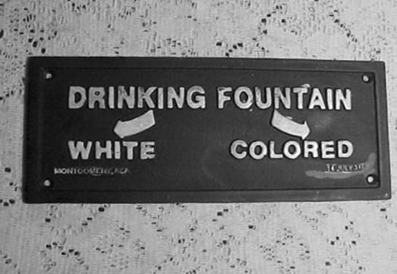
Second Class Citizens
Under the Jim Crow Laws, blacks were made Second Class Citizens.
Blacks had segregated transportation, restaurants, schools, Public Places, Etc.
This is a segregated drinking fountain, whites would not allow blacks to use the same one as they do.
This is a bus stop strictly for black citizen’s because whites would not allow blacks the same space as them.

Slide 4
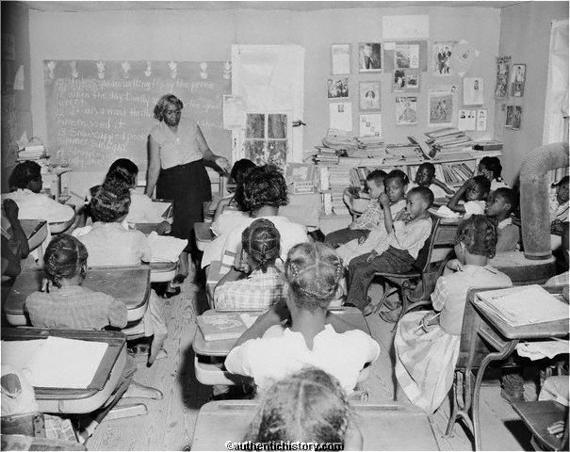
Standard of Living
The Jim Crow Laws also made it difficult for blacks to hold high paying jobs.
Blacks under the Jim Crow Laws usually had the worst jobs and the worst education because they did not have the same opportunities as whites did.
This is a picture of an all black classroom because at the time white’s would not allow blacks to attend the same schools as they did.

Slide 5
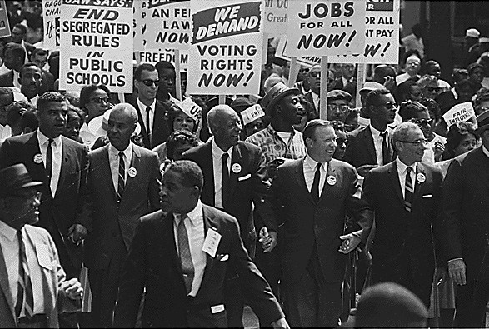
Changes in Segregation
This picture depicts blacks protesting the Jim crow laws.

Slide 6
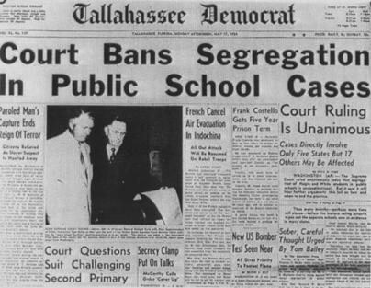
Brown V. Board of Education
The Supreme Court Case of Oliver Brown v. Board of Education was a landmark case that ended segregation in schools.
Segregation was declared unconstitutional in 1954.
This is a picture of a newspaper recalling the events that took place in the Brown V. Board of Education.

Slide 7
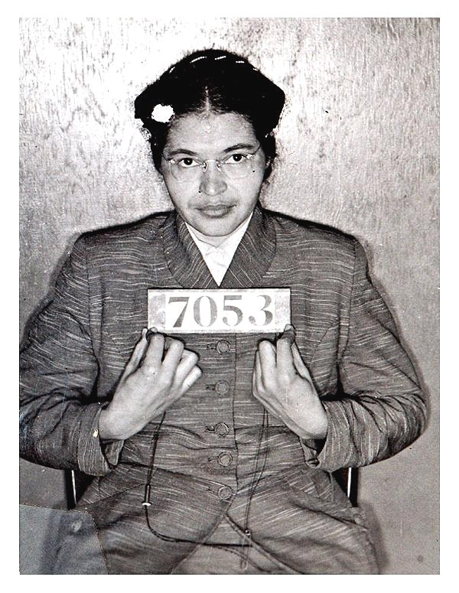
Rosa Parks
Rosa Parks refused to give up her seat for a white person on a public transportation bus in Montgomery, Alabama in 1955.
This act of defiance was a benchmark for the civil rights movement for ending segregation.
This is a picture of Rosa Parks after she was arrested.

Slide 8
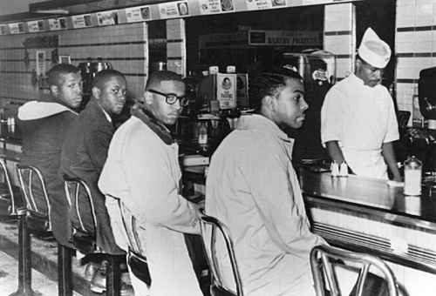
Greensboro Sit-ins
Jim Crow Laws also did not let blacks and whites eat together at the same restaurant.
The Greensboro sit-ins were influential in breaking down these barriers and further ending segregation.
This picture was taken while the Greensboro sit-in’s were taking place.

Slide 9
Conclusion
With much hard work and determination blacks had the jim crow laws done away with.

