Slide 1
Jim Crow Laws Photo Essay

Slide 2
Introduction
The Jim Crow Laws was a list of laws that took away blacks rights. Some of them were as follows: blacks couldn’t go to the same schools as whited, and they couldn’t use the same bathrooms.

Slide 3
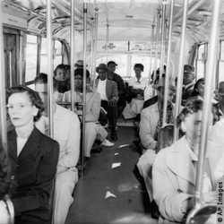
Busses
In this picture, black people are being forced to sit in the back of the bus because white people wanted their seats. This impacted blacks because they had to give up open seats if a white man wanted it.

Slide 4
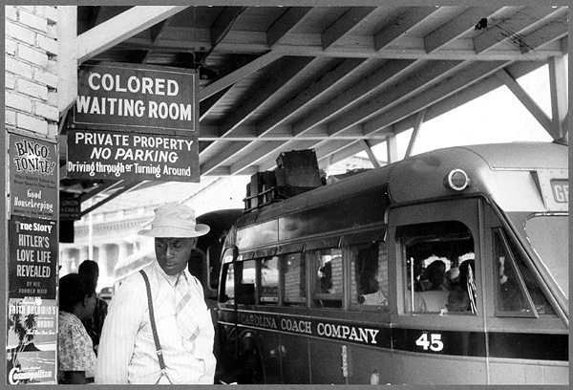
Busses
Also, in this day the bus stations waiting are was divided by color of your skin. They had separate waiting areas and ticket booths for black white people.
In this picture, it shows a waiting room for the busses for African Americans.

Slide 5
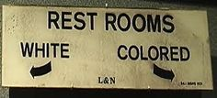
Restrooms & water fountains
In any place that had a bathroom, African Americans had to use the colored bathrooms. If they would be punished. Also they were not as sanitary as the white restrooms.
This picture is showing what bathroom the African Americans could use.

Slide 6
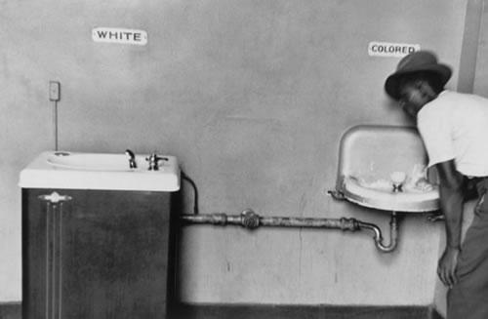
Restrooms & water fountains
Similar to the bathrooms black people could not use the same drinking fountains as whites. The colored drinking fountains tended to be smaller and not as good quality.
This shows a black man using the colored drinkimg fountain in a restaurant.

Slide 7
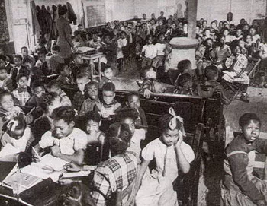
Schooling
The law stated that school would be segregated and whites and blacks would attend separate schools. In the schools for African Americans the teaching was not as good and they did not have as many resources.
In this picture it shows an African American school, and the students are crowded and don’t have a suitable environment.

Slide 8
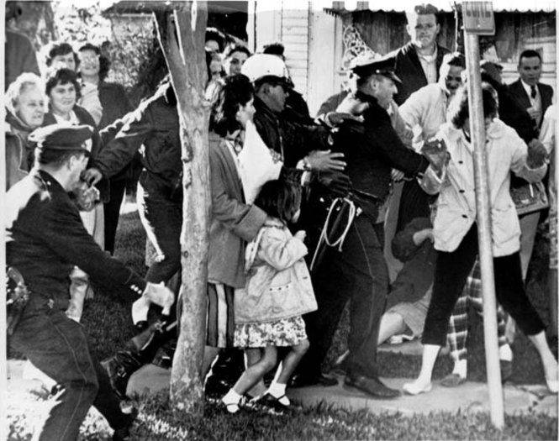
Schooling
In Novemebr of 1960, Ruby Bridges, a young black girl, was the first afruican amerucan to attend a white school. All the people threatened her and they needed army troops to escort her in.
This picture shows Ruby being escorted into school by police officers.

Slide 9
Conclusion
Overall, African Americans fought and won their rights, and disbanded the Jim Crow Laws.

