Slide 1
Jim Crow Laws Photo Essay
By: Abdullah Bushamie

Slide 2
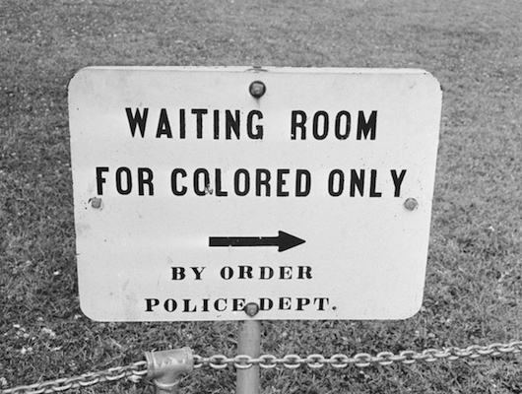
Introduction
Jim Crow Law- A practice or policy of segregating or discriminating against blacks, as in public places, public vehicles, or employment.

Slide 3
Effects
This caused several African Americans to revolt and demand for racial equality. These laws led to the civil rights movement led by Martin Luther King Jr.

Slide 4
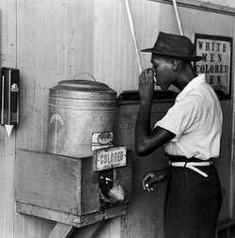
Water Fountains
Black and white people were not allowed to drink out of the same water due to the belief that blacks would contaminate water fountains.

Slide 5
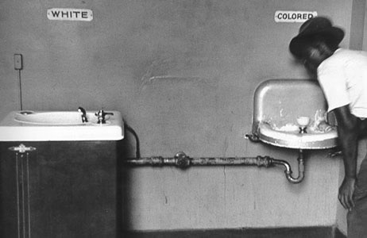
Water Fountain
This picture shows the words colored over the water fountain for black people and white over the fountain for white folk. It is shown that the colored water fountain is also not as high tech as the white one

Slide 6
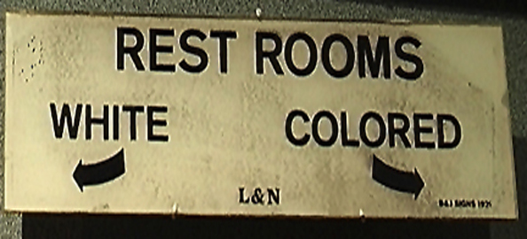
Rest Rooms
Black people also had to go in different rest rooms than white people due to these Jim Crow Laws. The black bathrooms were in much worse condition.

Slide 7
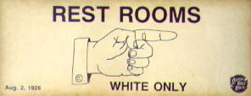
Restrooms
This picture shows again how whites can only go in the certain bathroom that this sign was pointing to.

Slide 8
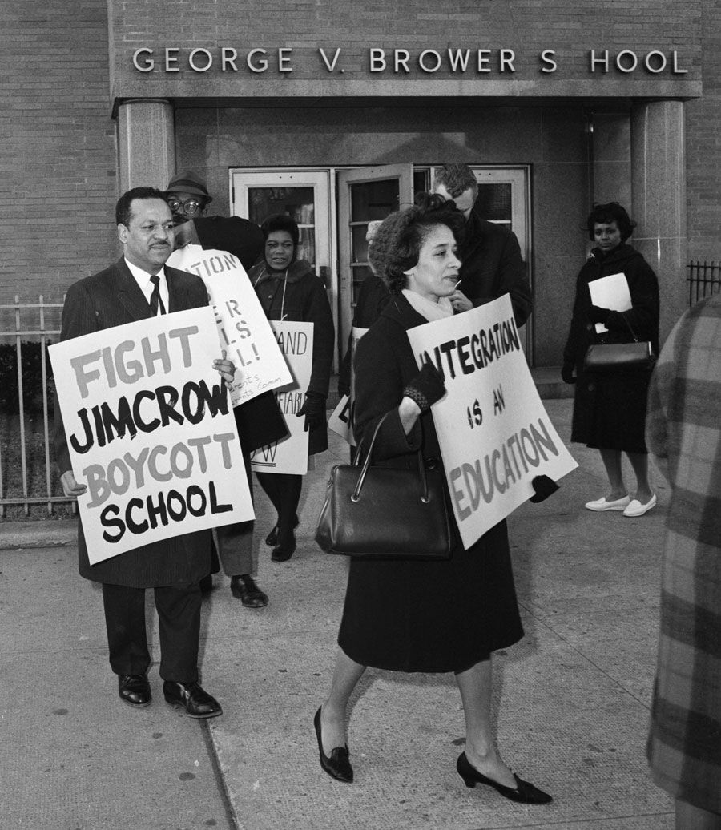
Schools
Blacks and whites were also not supposed to go to the same schools. White people also did not want to go to school with blacks either. People did fight for their equality though, shown in this picture. The black schools were under worse conditions.

Slide 9
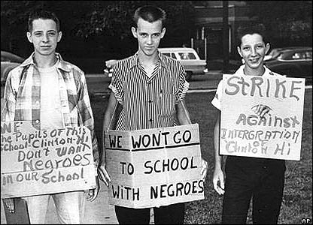
Schools
Whites did not want to go into schools with black people. As shown in this picture, white kids protested about going to school with black children.

Slide 10
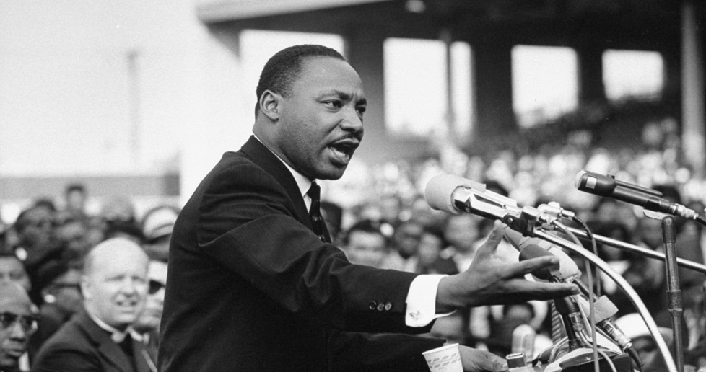
Conclusion
These Jim Crow laws affected several other ways in public places, but even not being allowed to drink out of the same water fountain, or going to the same school shows how segregated people were back than. The things that blacks had rights to using were in much worse condition than white peoples. These laws do not exist anymore due to Martin Luther King Jr. and the civil rights movement.

