Slide 1
Jim Crow Laws Photo Essay
By Jacob Schweiger

Slide 2
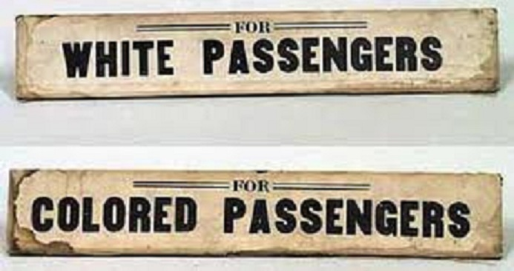
Introduction
The Jim Crow laws prevented from blacks and whites being together and doing certain things in public.
The picture represents
public transportation
that is segregated

Slide 3
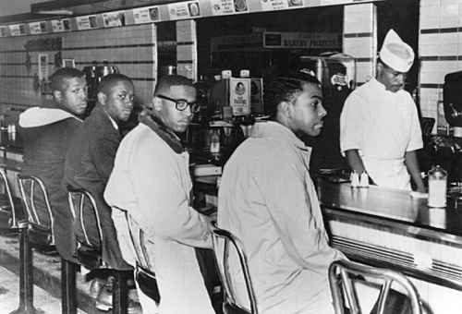
Restaurants
Many restaurants were segregated between blacks and whites
Some blacks weren't even allowed to stay and eat in the restaurant
Here a sit in is taking place
because the men wont put
up with the Jim Crow Laws

Slide 4
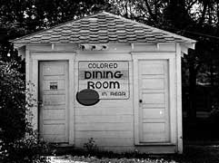
Restaurants Cont.
Here is a small little
restaurant for blacks
because they couldn’t
eat with whites

Slide 5
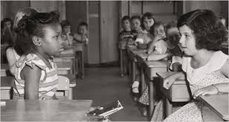
Schools
Schools were also segregated, black and white children weren't allowed to go to school together
Many parents refused to have they're children attend school with African American children
Here a racist little girl tries to
intimidate an African American
girl

Slide 6
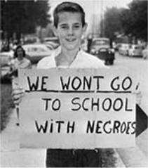
Schools Cont.
Here, a little boy is protesting
against going to school with
African Americans

Slide 7
Restrooms and Drinking Fountains
Even public restrooms were segregated, of course the white bathrooms being more nice and clean than the black bathrooms
Water fountains also were segregated, whites wouldn’t allow blacks to even take a quick sip from the white drinking fountains, same for the bathrooms

Slide 8
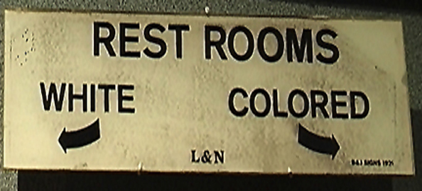
Restrooms and Water Fountains Cont.
Here, there is a sign pointing
in the direction for white and
colored bathrooms

Slide 9
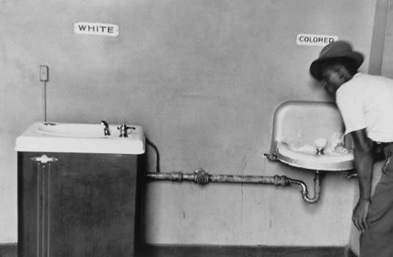
Restrooms and Water Fountains Cont.
The black water fountains were in worse condition, they were smaller, and had worse quality water.

Slide 10
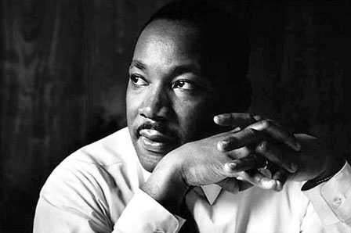
Conclusion
Jim Crow Laws affected many people, not just in public places. Black people didn’t have many of the rights that they do now, and this is thanks to Martin Luther King Jr. and many other Civil Rights activists.

Slide 11
Conclusion Cont.
Martin Luther King Jr. did many things to help get rid of the Jim Crow Laws, his peaceful protests all the way to Washington will be forever remembered.

