Slide 1
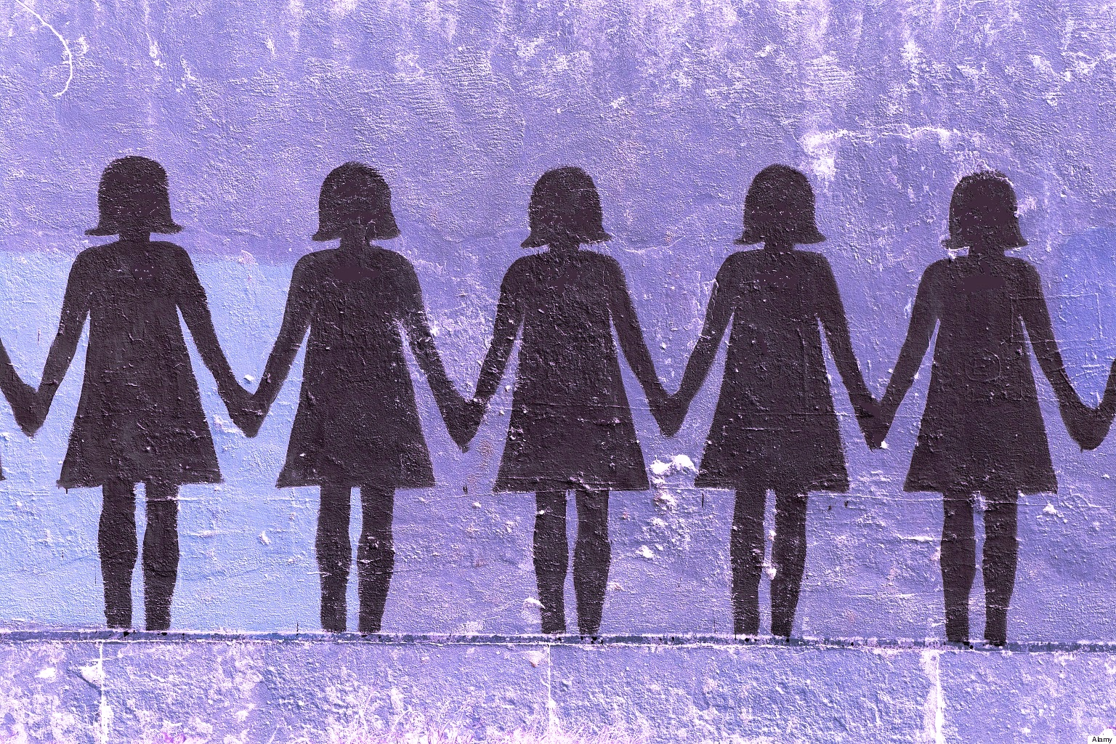
FEMINIST MOVEMENT
Nour Elzarkani
6th hour

Slide 2
How did it create change?
The movement brought major changes in the lives of many women
It opened to women professions and blue-collar jobs that previously had been reserved for men
There are many organizations working for women’s equality
-National Organization for Women

Slide 3
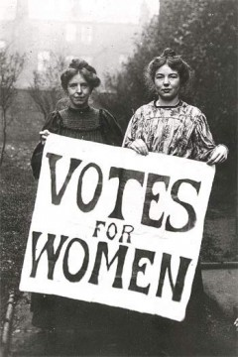
What was the goal of the Feminist Movement?
The goal of the Feminist Movement was to let women vote, have freedom, equal opportunity and control over their lives

Slide 4
Comparison to the actions of Rosa Parks
Rosa Parks fought for equality with whites
Women fought/ are fighting for equality with men
Rosa Parks put up with terrible treatment for not being white
Women put up with terrible treatment for not being men

Slide 7
