Slide 1
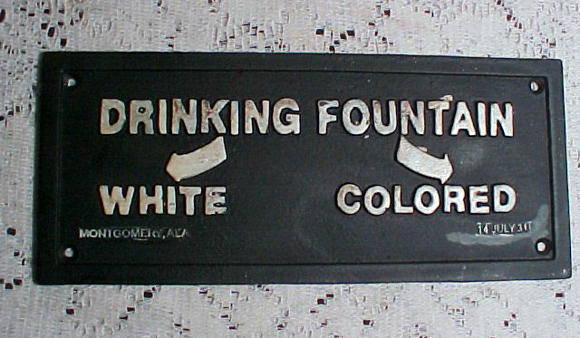
Civil rights Jim crow era & laws
© Copyright Brodie Millar 2014. (http://www.teacherspayteachers.com/Store/Brodie-Millar)

Slide 2
Jim Crow laws
The Jim Crow laws were racial segregation laws that existed between the 187o’s and 1960’s in the United States at the state and local level.

Slide 3
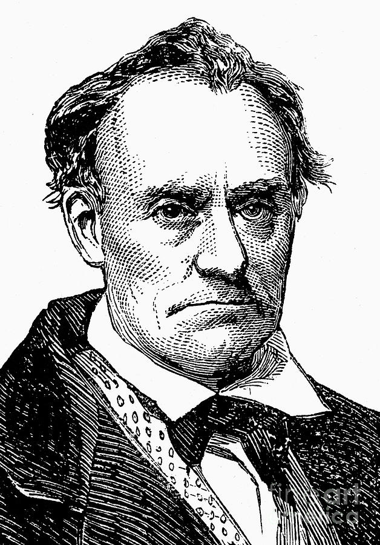
where did Jim crow come from?
Throughout the 1830s and '40s, the white entertainer Thomas Dartmouth Rice (1808-1860) performed a popular song-and-dance act supposedly modeled after a slave.
He named the character Jim Crow and during the show Rice darkened his face, acted in such a way that it belittled and made fun of African Americans.

Slide 4
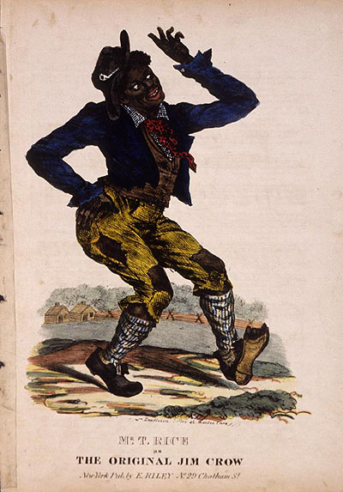
where did Jim crow come from?
Rice was not the first white comic to perform in blackface, but he was the most popular of his time, touring both the United States and England.
As a result of Rice's success, "Jim Crow" became a common stage persona for white comedians' blackface portrayals of African Americans.

Slide 5
where did Jim crow come from?
After the American Civil War (1861-1865), most southern states passed laws that denied African Americans basic human rights.
It is not clear how, but the character's name "Jim Crow" became a shorthand for the laws and traditions that segregated and demeaned African Americans primarily from the 1870s to the 1960s.

Slide 6
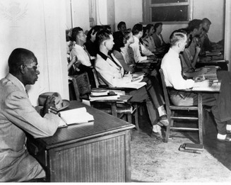
Jim Crow Laws
Under Jim Crow, African Americans were relegated to the status of second class citizens.
Some examples of Jim Crow laws are the segregation of public schools, public places, and public transportation, and the segregation of restrooms, restaurants, and drinking fountains for whites and blacks.
An African American man is attending a college but must attend class in a separate room from the rest of the white students.

Slide 7
Jim Crow Laws
Black people had the worst jobs and the poorest standard of education. Black people also found it difficult to register to vote because of the following:
Poll Tax – A tax had to be paid in order to be able to vote, and most black people were too poor to pay the tax.
Literacy Tests (reading) – In order to be able to vote, people had to prove that they could read difficult extracts. If black people passed these tests, they would then be threatened and attacked so that they would not vote.

Slide 8
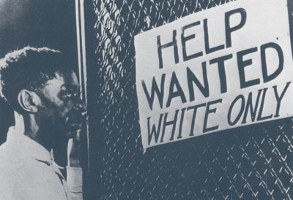

Slide 9
Jim Crow Laws
The Jim Crow system was made up of the following beliefs:
whites were superior to blacks in all important ways, including but not limited to intelligence, morality, and civilized behavior
sexual relations between blacks and whites would produce a mixed race which would destroy America
violence must be used to keep blacks at the bottom of the racial hierarchy

Slide 10
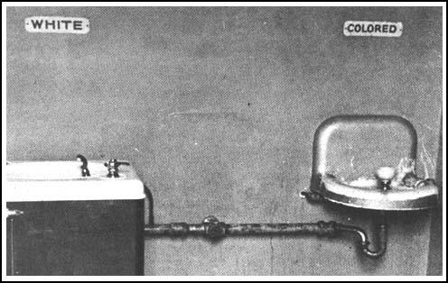
Jim Crow Laws
These beliefs led to a system of etiquette between blacks and whites. Jim Crow etiquette operated in conjunction with Jim Crow laws (black codes).

Slide 11
Jim Crow Etiquette
For Example:
A black male could not shake hands with a white male because it implied being socially equal.
A black male was limited in any interactions he could have with a white female.
Blacks and whites were not supposed to eat together. If they did eat together, whites were to be served first, and some sort of partition was to be placed between them.
Blacks were not allowed to show public affection toward one another in public, especially kissing, because it offended whites.

Slide 12
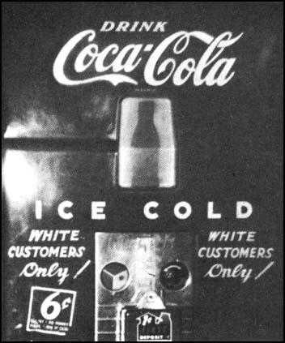
Jim Crow Laws
Jim Crow states passed statutes severely regulating social interactions between the races.

Slide 13
Jim Crow Laws
Jim Crow signs were placed above water fountains, door entrances and exits, and in front of public facilities.
There were separate hospitals for blacks and whites, separate prisons, separate public and private schools, separate churches, separate cemeteries, separate public restrooms, and separate public accommodations.
In most instances, the black facilities were grossly inferior -- generally, older, less-well-kept. In other cases, there were no black facilities -- no Colored public restroom, no public beach, no place to sit or eat.

Slide 14
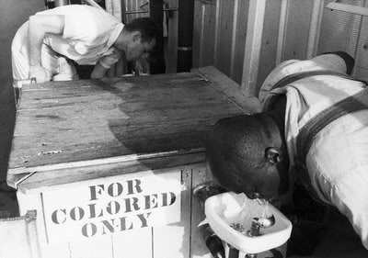

Slide 15
Jim Crow Laws
The effects of the Jim Crow System led to a number of economic, educational and social disadvantages for African Americans.

Slide 16
Jim Crow Laws
The Jim Crow laws and system of etiquette were upheld by violence.
Blacks who violated Jim Crow norms, for example, drinking from the white water fountain or trying to vote, risked their homes, their jobs, even their lives.
Whites could physically beat blacks and Blacks had little they could do against these assaults because the Jim Crow criminal justice system was all-white: police, prosecutors, judges, juries, and prison officials.

Slide 17
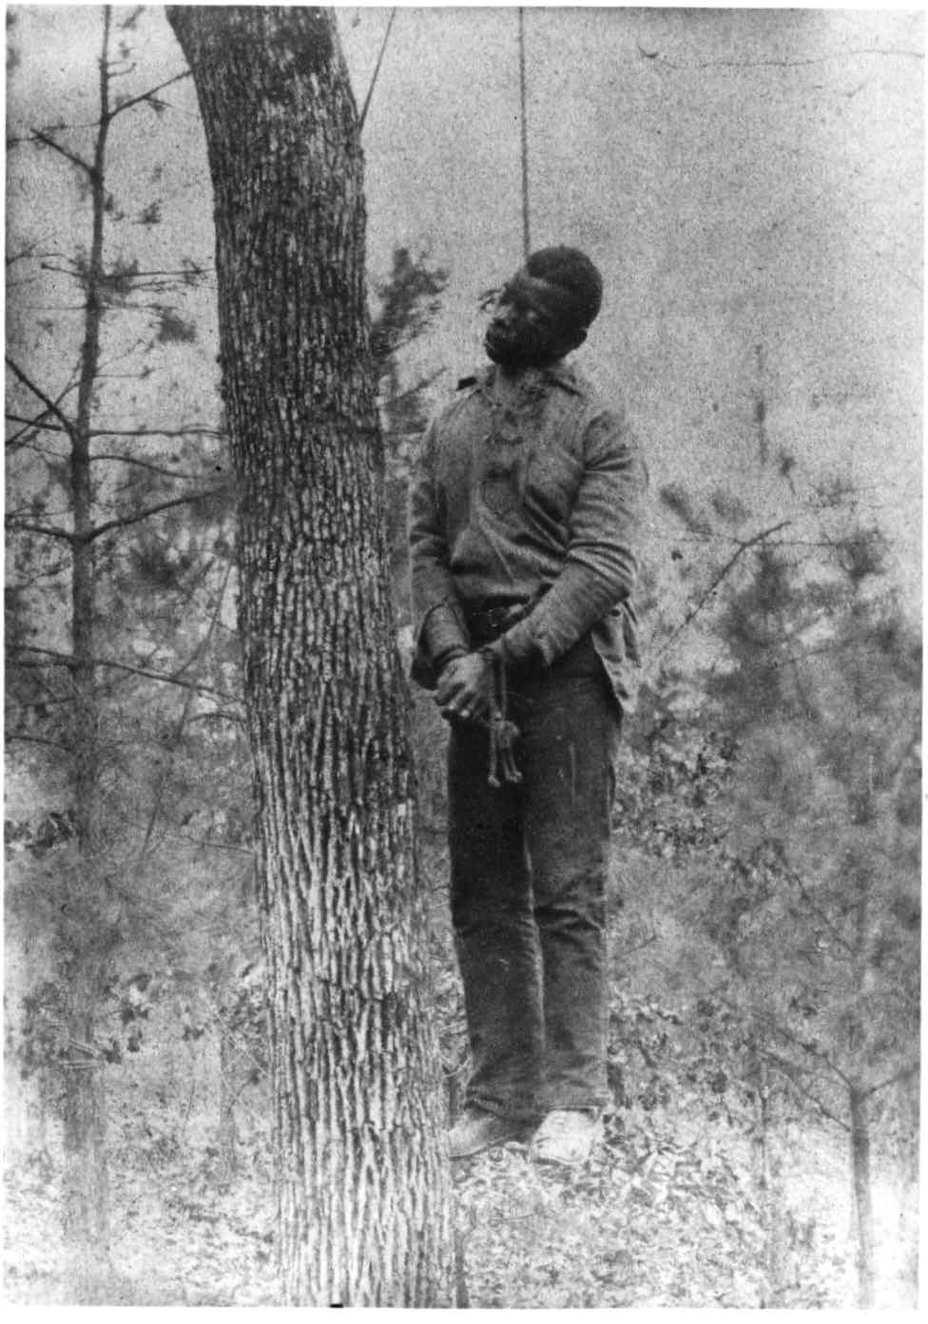
Jim Crow Laws
The most extreme forms of Jim Crow violence were lynchings.
Lynchings were public murders carried out by mobs.
Between 1882, when the first reliable data was collected, and 1968, when lynchings had become rare, there were 3,440 Lynchings of black men and women.

Slide 18
Jim Crow Laws
The great majority of lynchings occurred in southern and border states, where the resentment against blacks ran deepest.
According to the social economist Gunnar Myrdal (1994): "The southern states account for nine-tenths of the lynchings.”

Slide 19
Jim Crow Laws
Many whites claimed that although lynchings were distasteful, they were necessary supplements to the criminal justice system because blacks were prone to violent crimes.

Slide 20
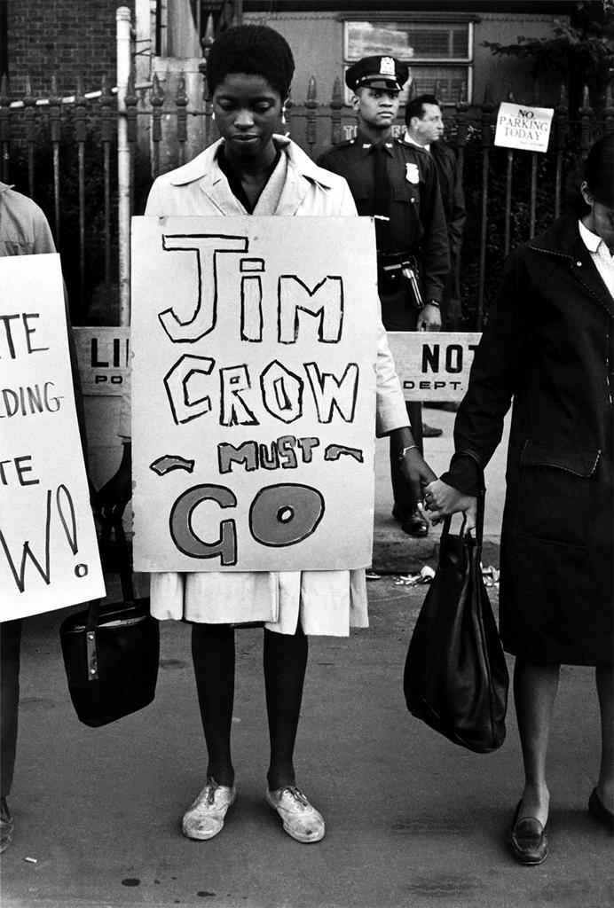
Jim Crow Laws
The Jim Crow Laws and Etiquette would eventually end with the advent of the Civil Rights Movement in the 1950’s and 1960’s.
State-sponsored school segregation was declared unconstitutional by the Supreme Court of the United States in 1954 in Brown v. Board of Education.
Generally, the remaining Jim Crow laws were overruled by the Civil Rights Act of 1964 and the Voting Rights Act of 1965.
© Copyright Brodie Millar 2014. (http://www.teacherspayteachers.com/Store/Brodie-Millar)

