Slide 1
Chapter 5 One Pagers

Slide 2
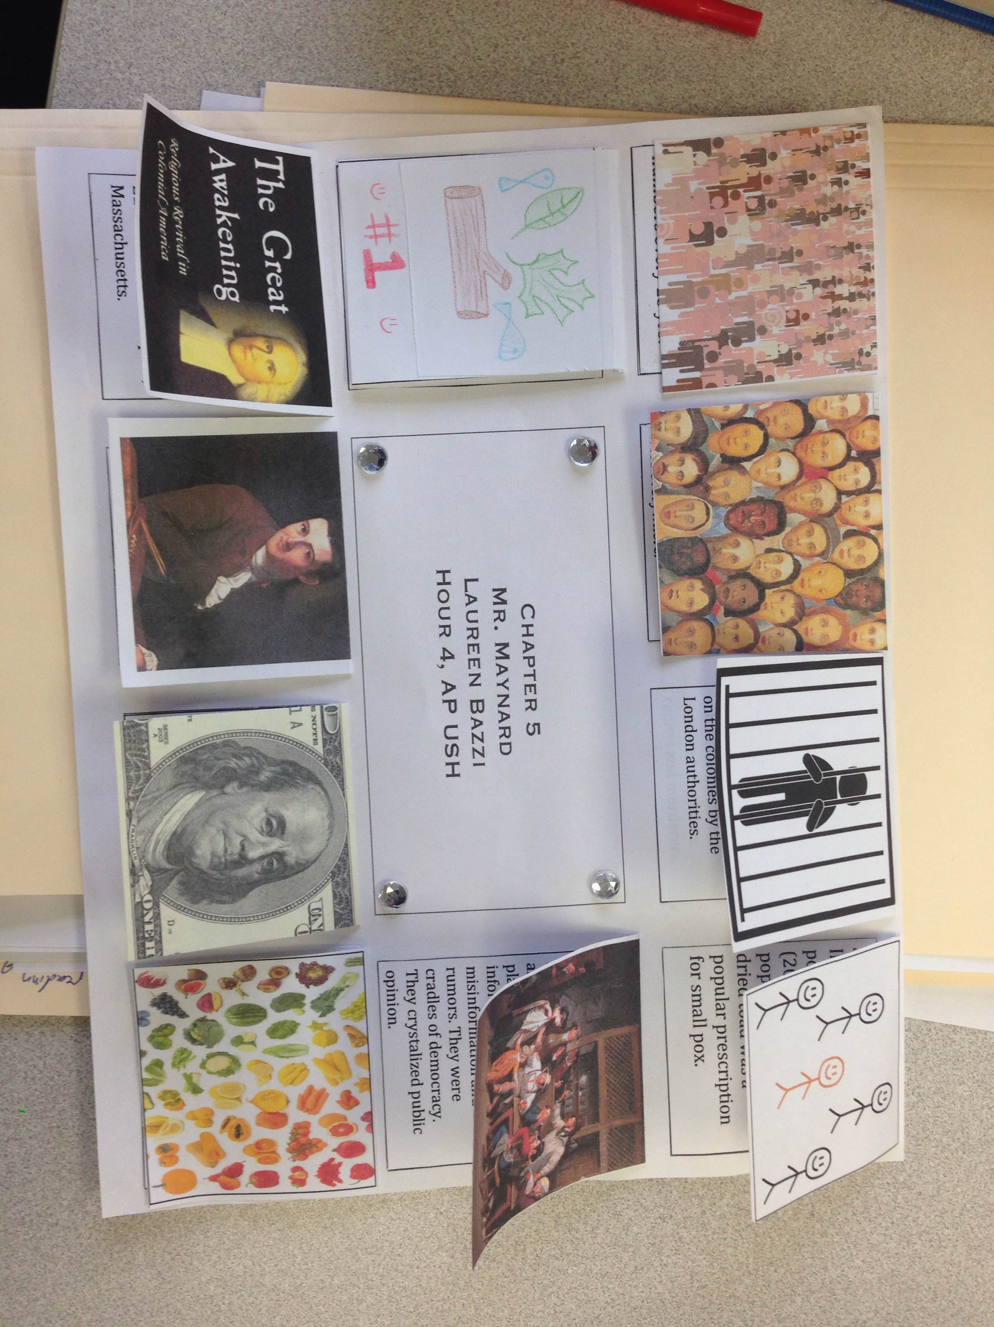

Slide 3
