Slide 1
Welcome Parents 2018 to
Howard Elementary School!
Ms. Martin
4th Grade Room 7

Slide 2
PBiS Classroom Rules
Be Respectful
Take care of personal and school property.
Use kind words.
Follow all adult/leader directions.
Speak when it your turn. Raise your hand.
Use indoor voices.
Be Responsible
Follow directions the first time they are given.
Give your best effort.
Be prepared for class. (homework, etc.)
Be honest.
Be Safe
Keep hands, feet, and objects to yourself.
Use peaceful solutions.
Sit correctly on chairs.
Use classroom materials properly.

Slide 3
PBIS- Howard’s Positive Behavior Support System
* Dragon Dollar drawings each Friday!
* Cheese Bucks - daily
* Star Students - posted monthly (no card flips for the month)
GREEN= Earn a punch | YELLOW= Loss of a privilege | BLUE= Complete a “think sheet” | RED= Complete a “think sheet)
Reminder!

Slide 4
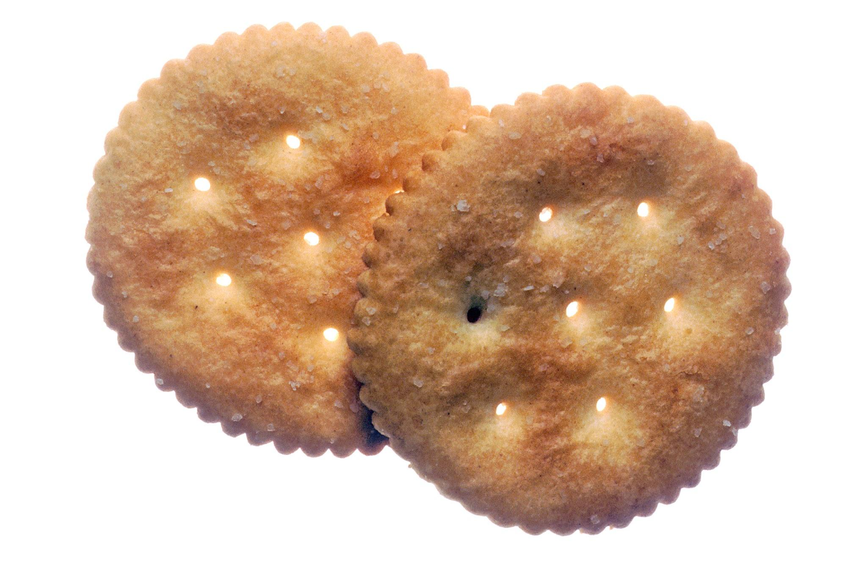
Snack/water time!
Students are welcome to bring an energy boosting, healthy snack (fruit, veggies, crackers, cheese, yogurt, etc.) and non-carbonated beverage (water, juice box, etc.). No Gatorade Please. Snack time will be provided in the morning.
If the temperature is predicted to be 85 degrees plus, students should bring an extra water bottle. Our classroom gets the afternoon Sun and can become quite warm.

Slide 5
READING
DRA testing - to get a current reading level Summer loss is common!
Reading groups will begin shortly once DRAs are complete. Students will be placed in groups with children of the same reading level. Higher students will work more independently and check in with the teacher a few times per week. Students who are reading below grade level will receive more group/individual instruction.
Students will take home a read-to-self/book report book home each night. They should be reading a minimum 20 minutes nightly. (expected) This will help build their fluency and comprehension skills.
I will meet with students daily to conference (read-to-self/book report book), as well as create and monitor reading goals. These goals will be highlighted in the back of each student’s reading log.
NOTE: Monthly Book Reports Begin October

Slide 6
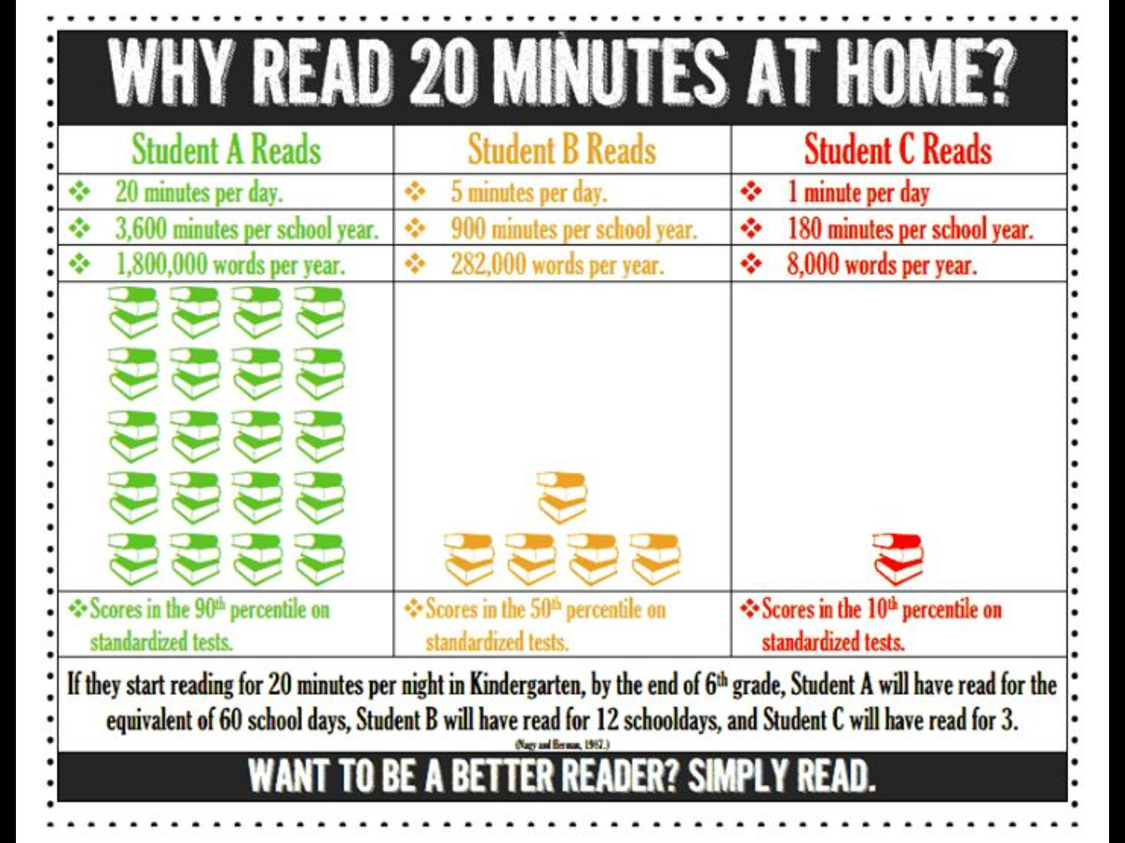
Reading

Slide 7
Math for 4th graders...
*New math program…. EUREKA MATH
Math is approximately 90 minutes per school day. The time may be broken up. This program is new to the district. We are to follow the manual very strictly the first year to get students used to the procedures, signals, and drills. It is very hands on. Students practice math fluency using wipe erase boards and do “sprints”. They will also have classwork, a time to debrief, homework, and an “exit ticket” for understanding.
When helping your children with homework, PLEASE follow the guidelines on the homework directions! Parent tip sheets are also available on my classroom blog.

Slide 8
Math Goals
Computation is important in 4th grade. Students need to know their multiplication facts 1-11.
In addition to our Eureka Math program, students will be working on individual math goals.
Goals are written in the back of their math notebooks, along with the date the goal was met.

Slide 9
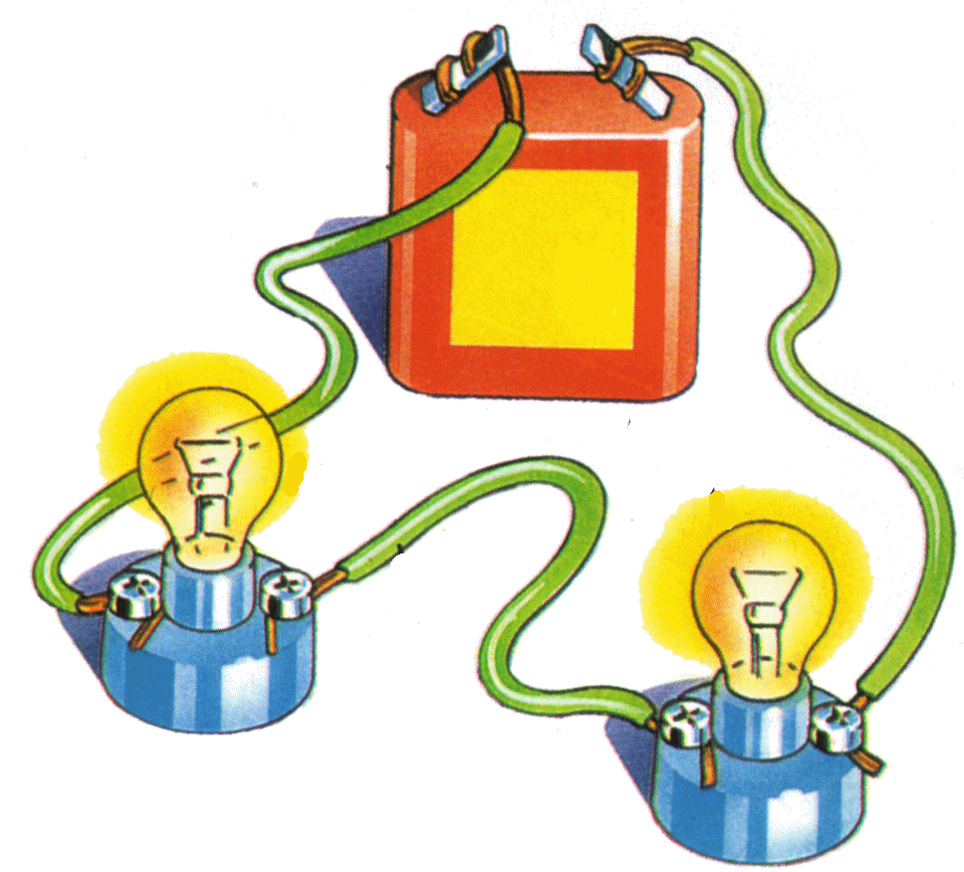
NGSS Science Standards for Grade 4 (Science)
Science
Processes that Shape Earth (Earth)
Energy & Waves (Physical)
Structure & Function- Human Systems (Life)

Slide 10
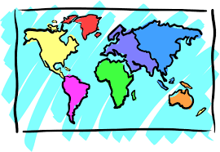
Social Studies- 4th grade
Geography: Regions of the United States, map skills
Human Geography: Migration & Immigration
United States Government
Economics

Slide 11
Homework
20 minutes of Daily Reading
Eureka Math worksheets (occasionally)
Unfinished classwork, reading response questions, etc.
Spelling/Word Work (bimonthly)
*All homework is written in the daily planner each day. Parents must sign or initial every night!
Check Parent Connect for Grades. Late assignments will be boxed in red.

Slide 12
4th Grade Resources for Practice at home
Clever site @dearbornschools.org
MobyMax (math and reading)
Khan Academy (math)
Master multiplication facts
Social Studies Unit Resources on Classroom Blog

Slide 13
How to contact me...
Blog: https://iblog.dearbornschools.org/martink1/
Email: martink1@dearbornschools.org

