Slide 1
Summer Learning
Math 2017

Slide 2
Khan Academy--60 minutes a week.
Below is the grade breakdown by minutes for Math.
480+ minutes A
384 - 479 B
336 - 383 C
288 - 335 D

Slide 3
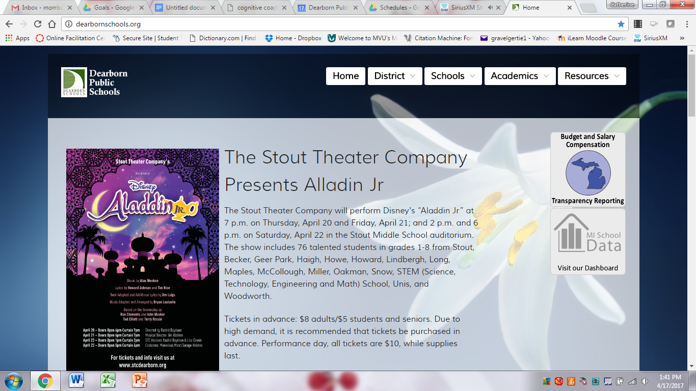
Go to Dearborn Home Page and Click on Resources

Slide 4
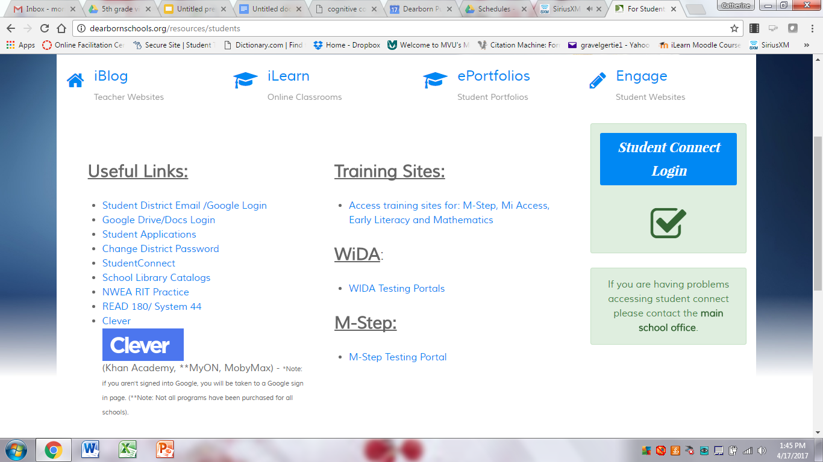
Scroll down to CLEVER (under “Useful Links”)

Slide 5
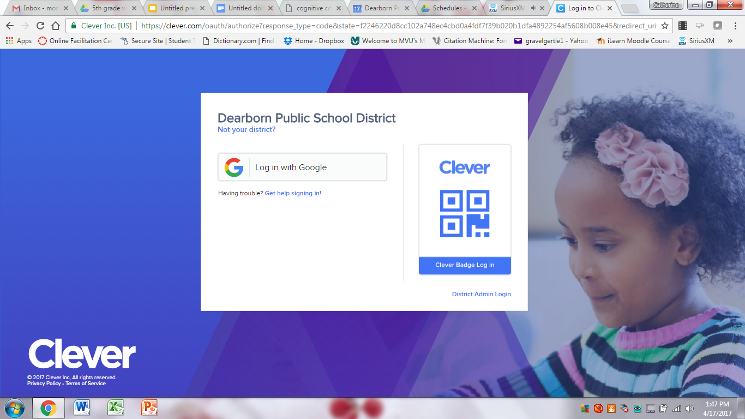
Click “Log in with Google”

Slide 6
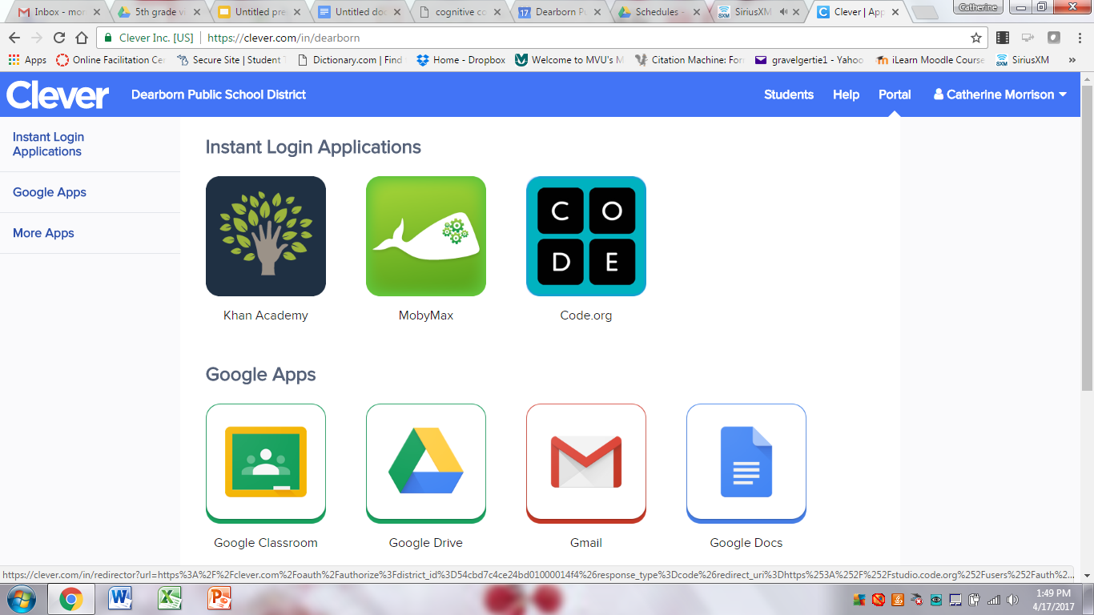
Click on the Khan Academy icon

Slide 7
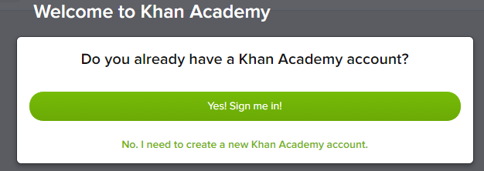
If prompted Click Yes! Sign me In!

Slide 8
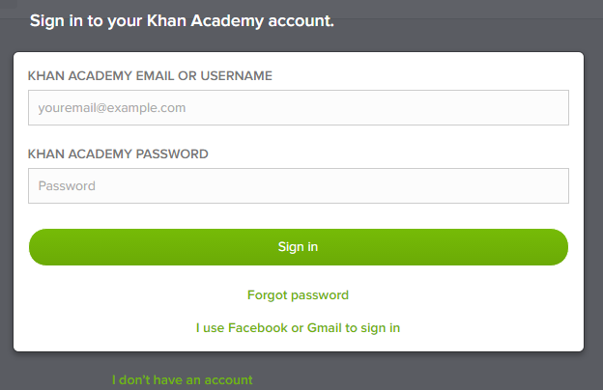
If prompted Click I use Facebook or Gmail to sign in

Slide 9
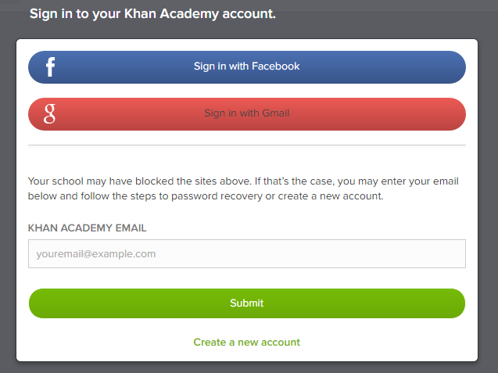
If prompted Click Sign in with Gmail

Slide 10
If prompted to select an account make sure the account is your Dearborn Public Schools Account and select Allow.
If prompted to give your age put it in and select Done! Keep learning

Slide 11
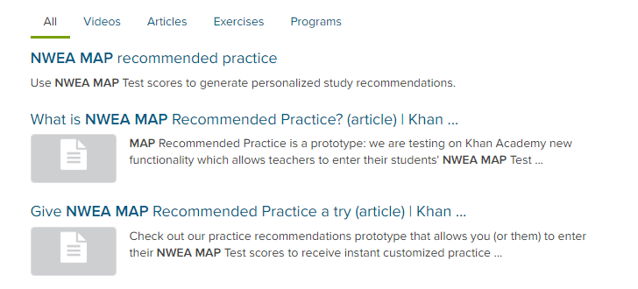
Type nwea into the search bar
Click NWEA MAP recommended practice

Slide 12
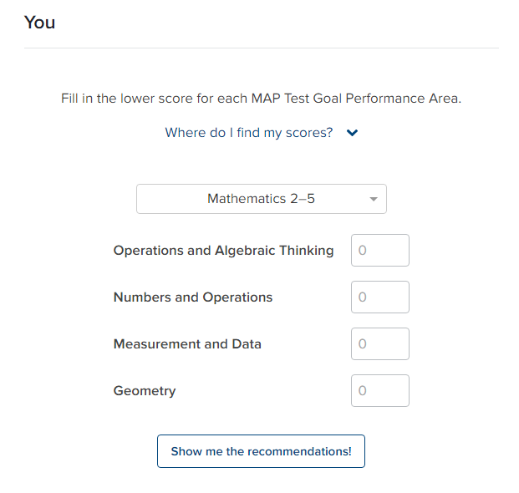
Put in your most recent NWEA scores
Click Show me the recommendations!

Slide 13
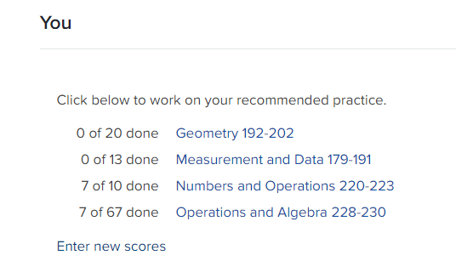
The next time you use Clever you will go directly to Khan.
Type nwea in the search bar and you will see your practice

Slide 14
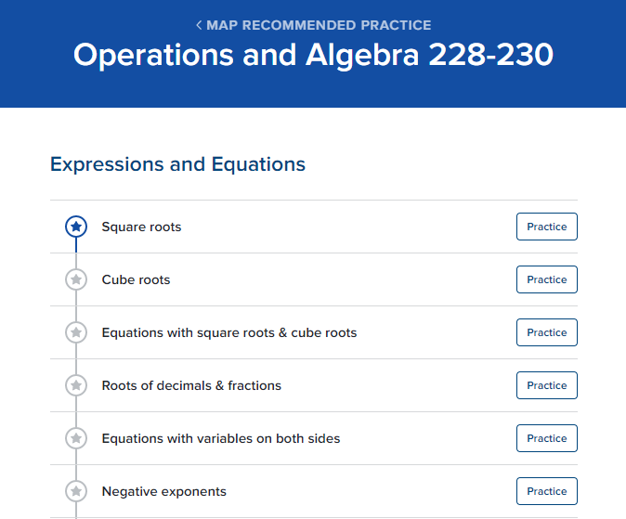
Choose a topic to practice and begin working

