Slide 1
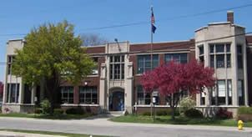
3rd Grade
Mrs. Ninkovich/Mrs. Mualem
Ms. G. Saab & Ms. L.Saab

Slide 2
About Mrs. Mualem
I live in Pleasant Ridge. I recently moved after living in Dearborn my entire life!
I am married and have a son (age 15), who is in the10th grade, a daughter (age 26), who is a nurse, and a son-in-law who is a police officer.
I have been teaching in Dearborn for 30 years. I earned my undergrad. degree from Hillsdale College, and graduate degrees from the University of Michigan-Dearborn.
I enjoy biking, tennis and golf.

Slide 3
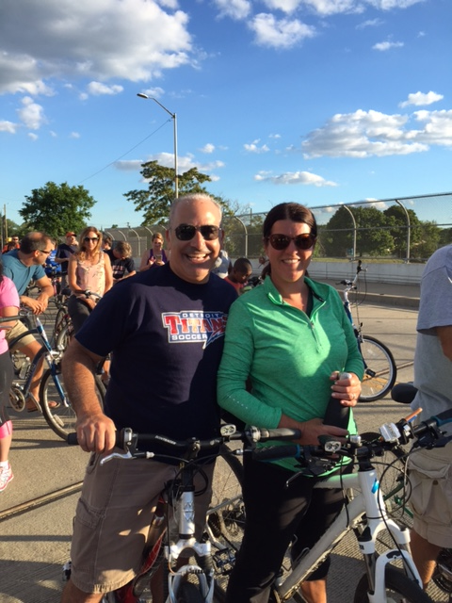

Slide 4
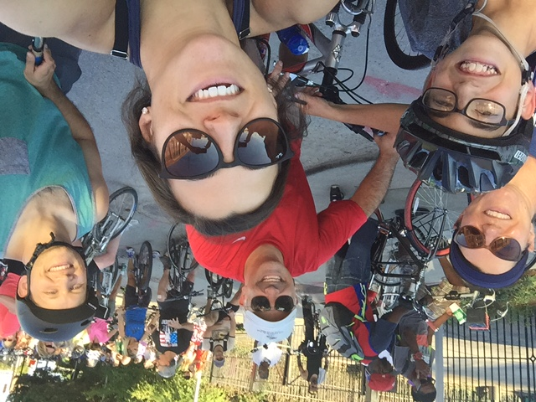

Slide 5
About Mrs. Ninkovich
I live in Novi but grew up in Dearborn.
I’ve taught third grade for 29 years in Dearborn.
I have been married for 28 years and have three children, Alyssa(24) Michael(22) and Cara(20).
I received my undergrad from Western Michigan University.
I received my Masters from Eastern Michigan University in Counseling.
I Love teaching, reading, playing with my new puppy and spending time up north with my family.

Slide 6
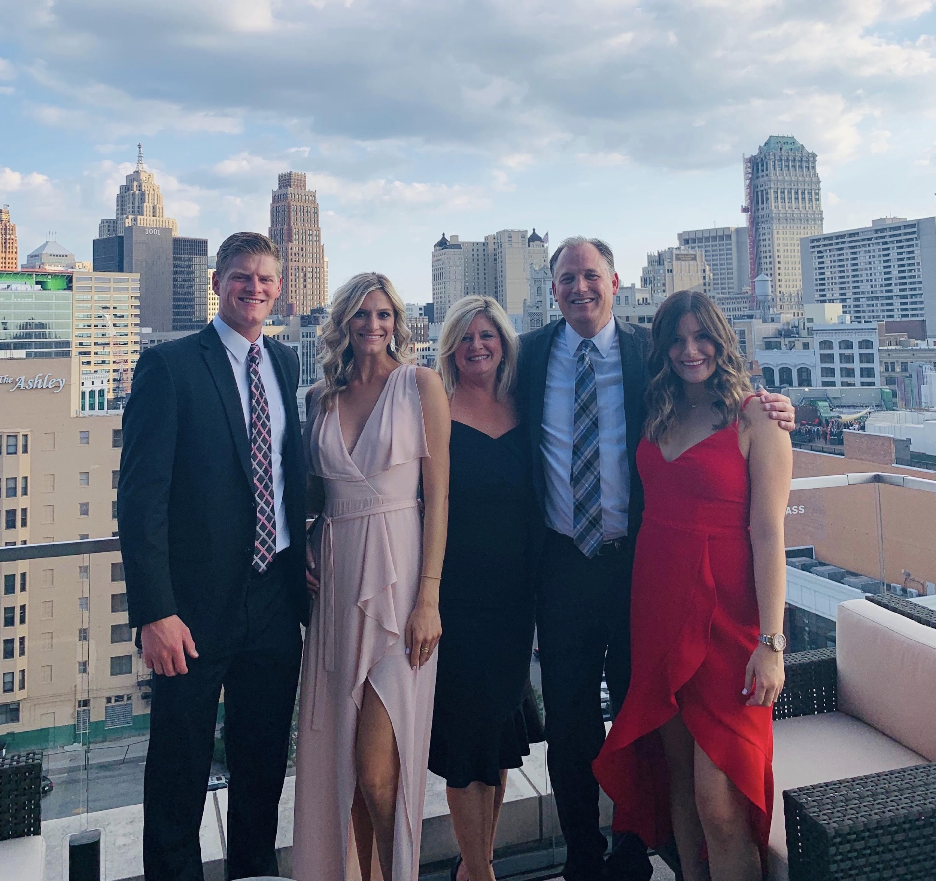
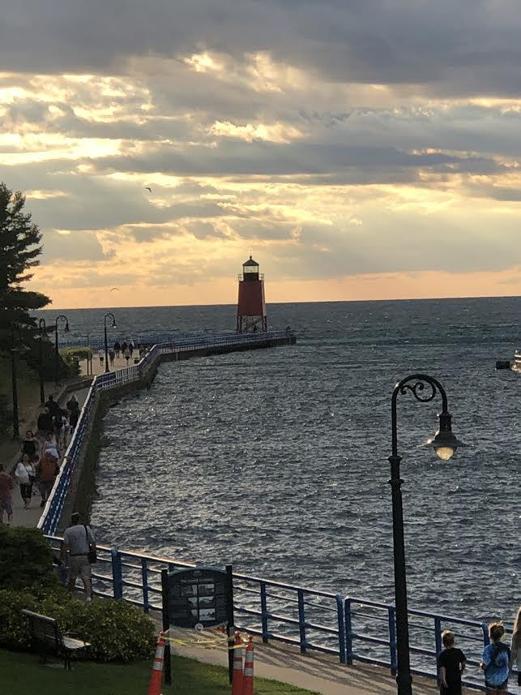
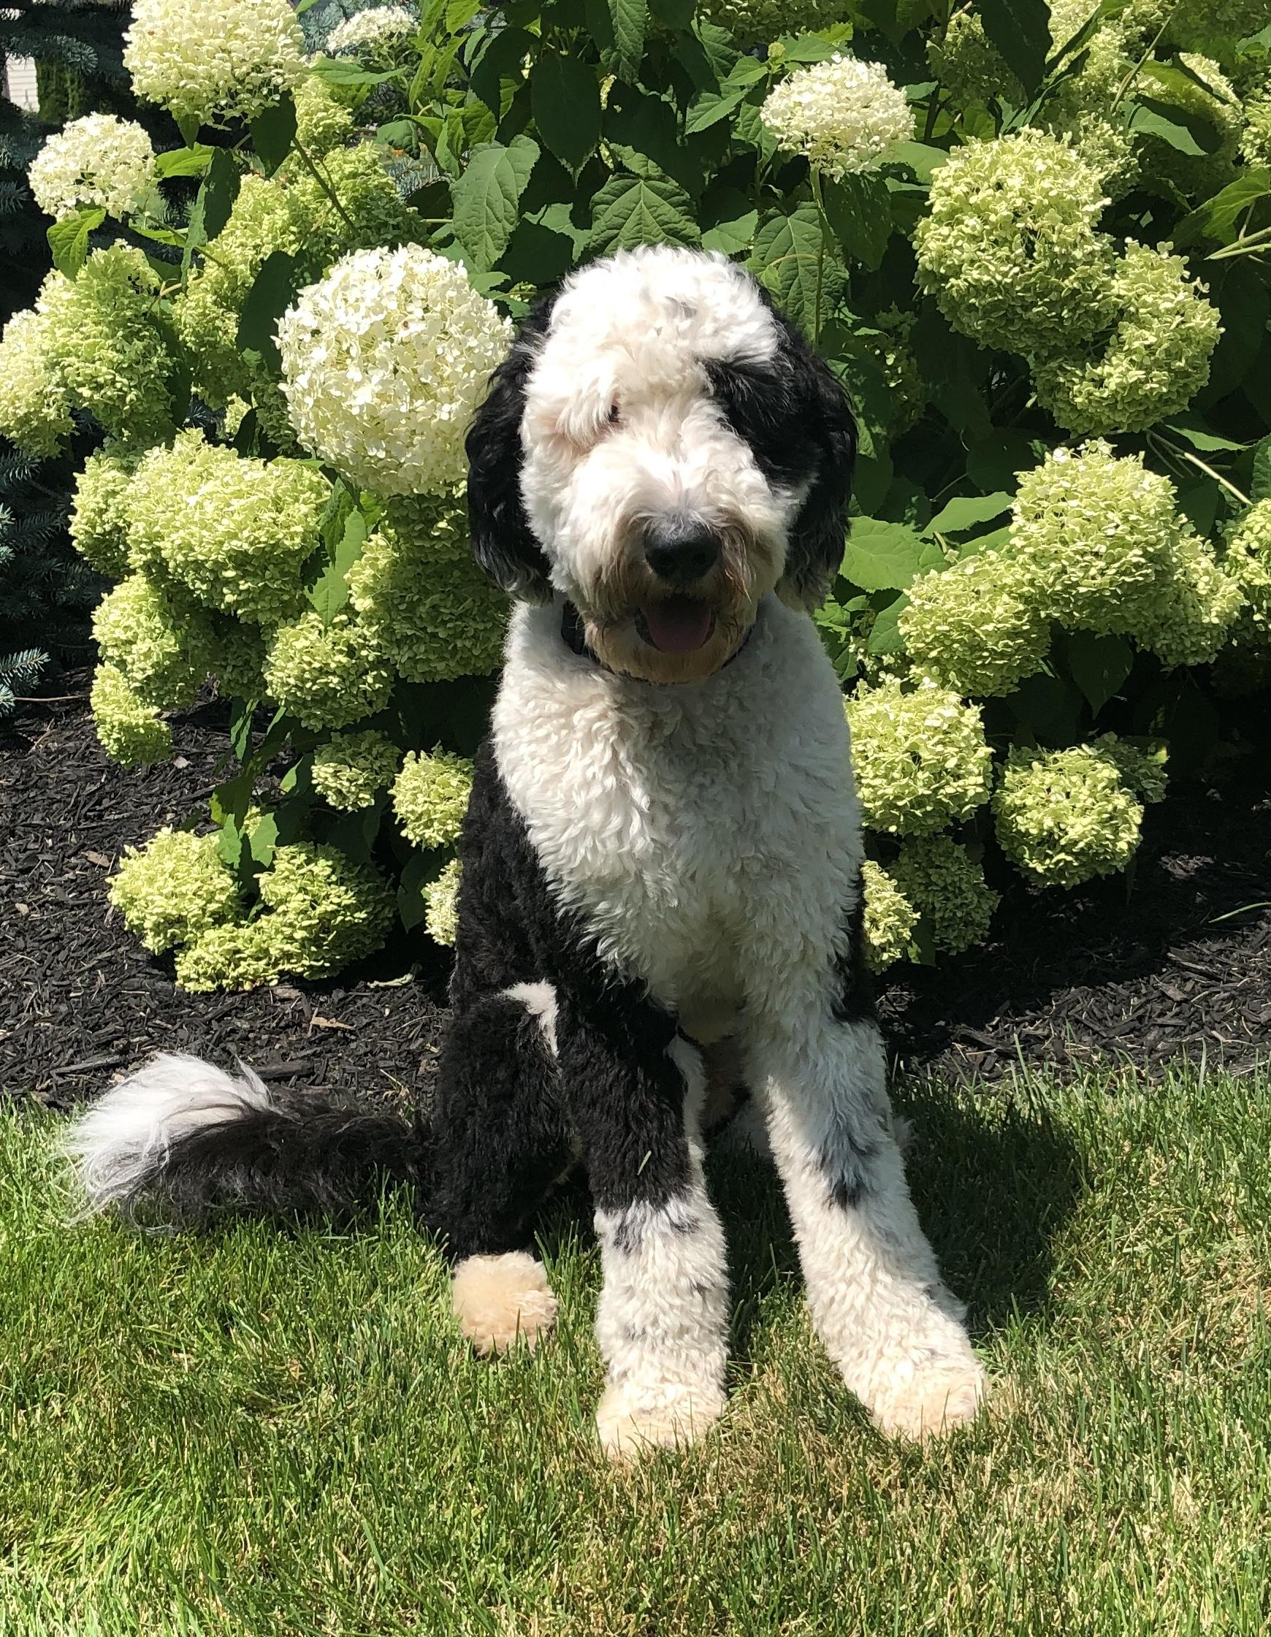

Slide 7
About Ms. Saab, L
I live in Dearborn, Michigan
I have three children, Mohamad, Najla, and Hussein.
I received both my undergrad and my grad degrees from the University Of Michigan- Dearborn.
I have been teaching at Henry Ford Elementary since 2007. Prior to 2007, I taught at different schools in the Dearborn School District.

Slide 8
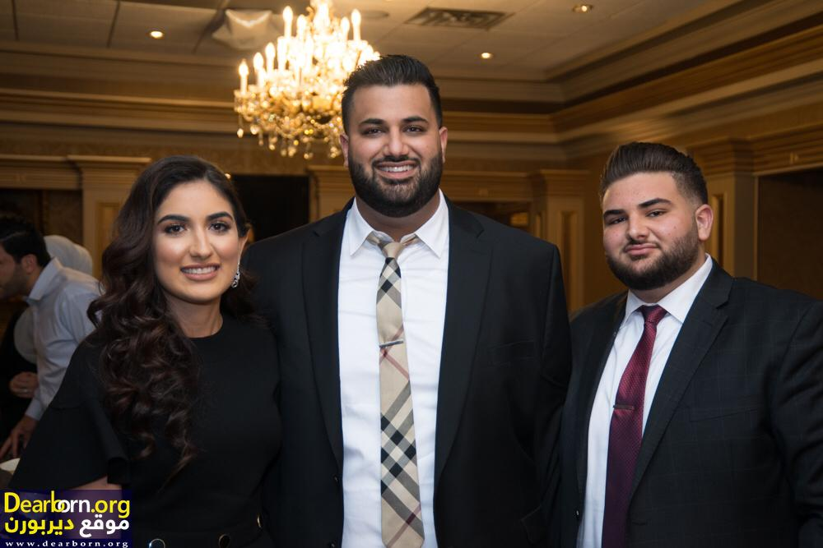

Slide 9
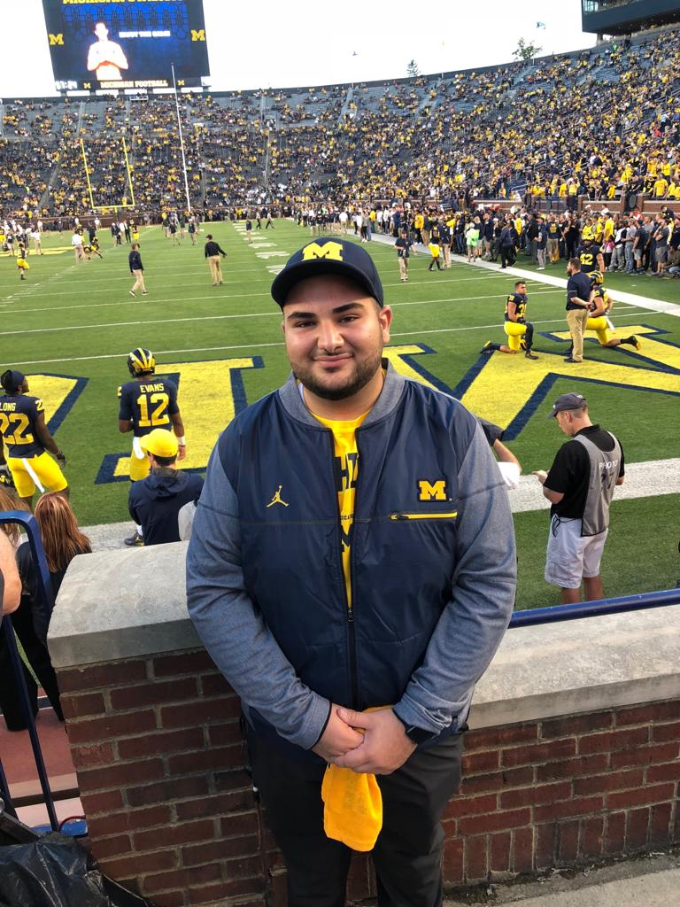
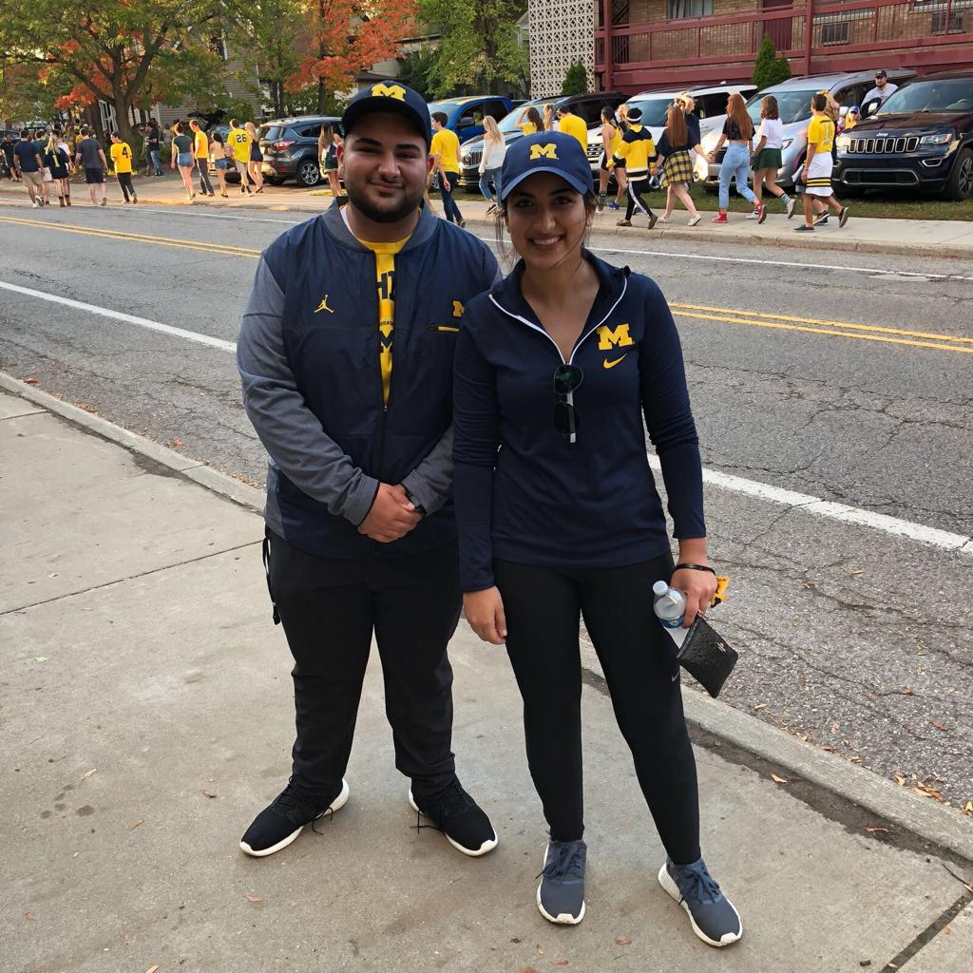

Slide 10
About Ms. Saab, G
I live in Dearborn Heights.
Attended Dearborn Public Schools from kindergarten through 12th grade.
Graduated from the University of Michigan- Dearborn.
This is my 6th year teaching. I have been teaching 3rd grade at Henry Ford my entire teaching career.
Just got engaged this past spring- wedding will be June 2020! ☺

Slide 11
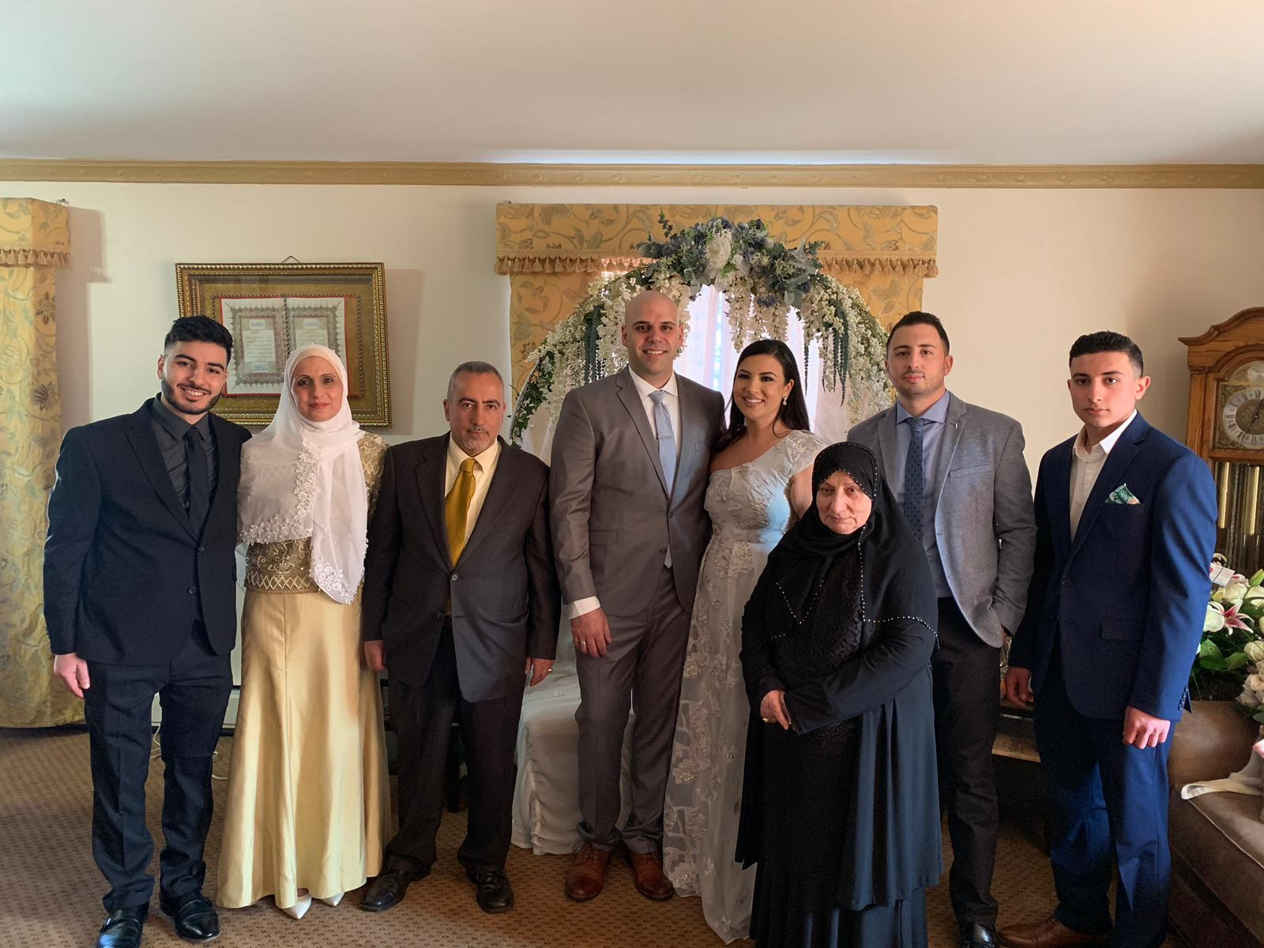
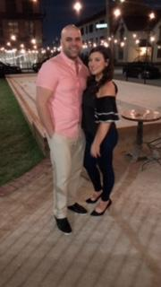
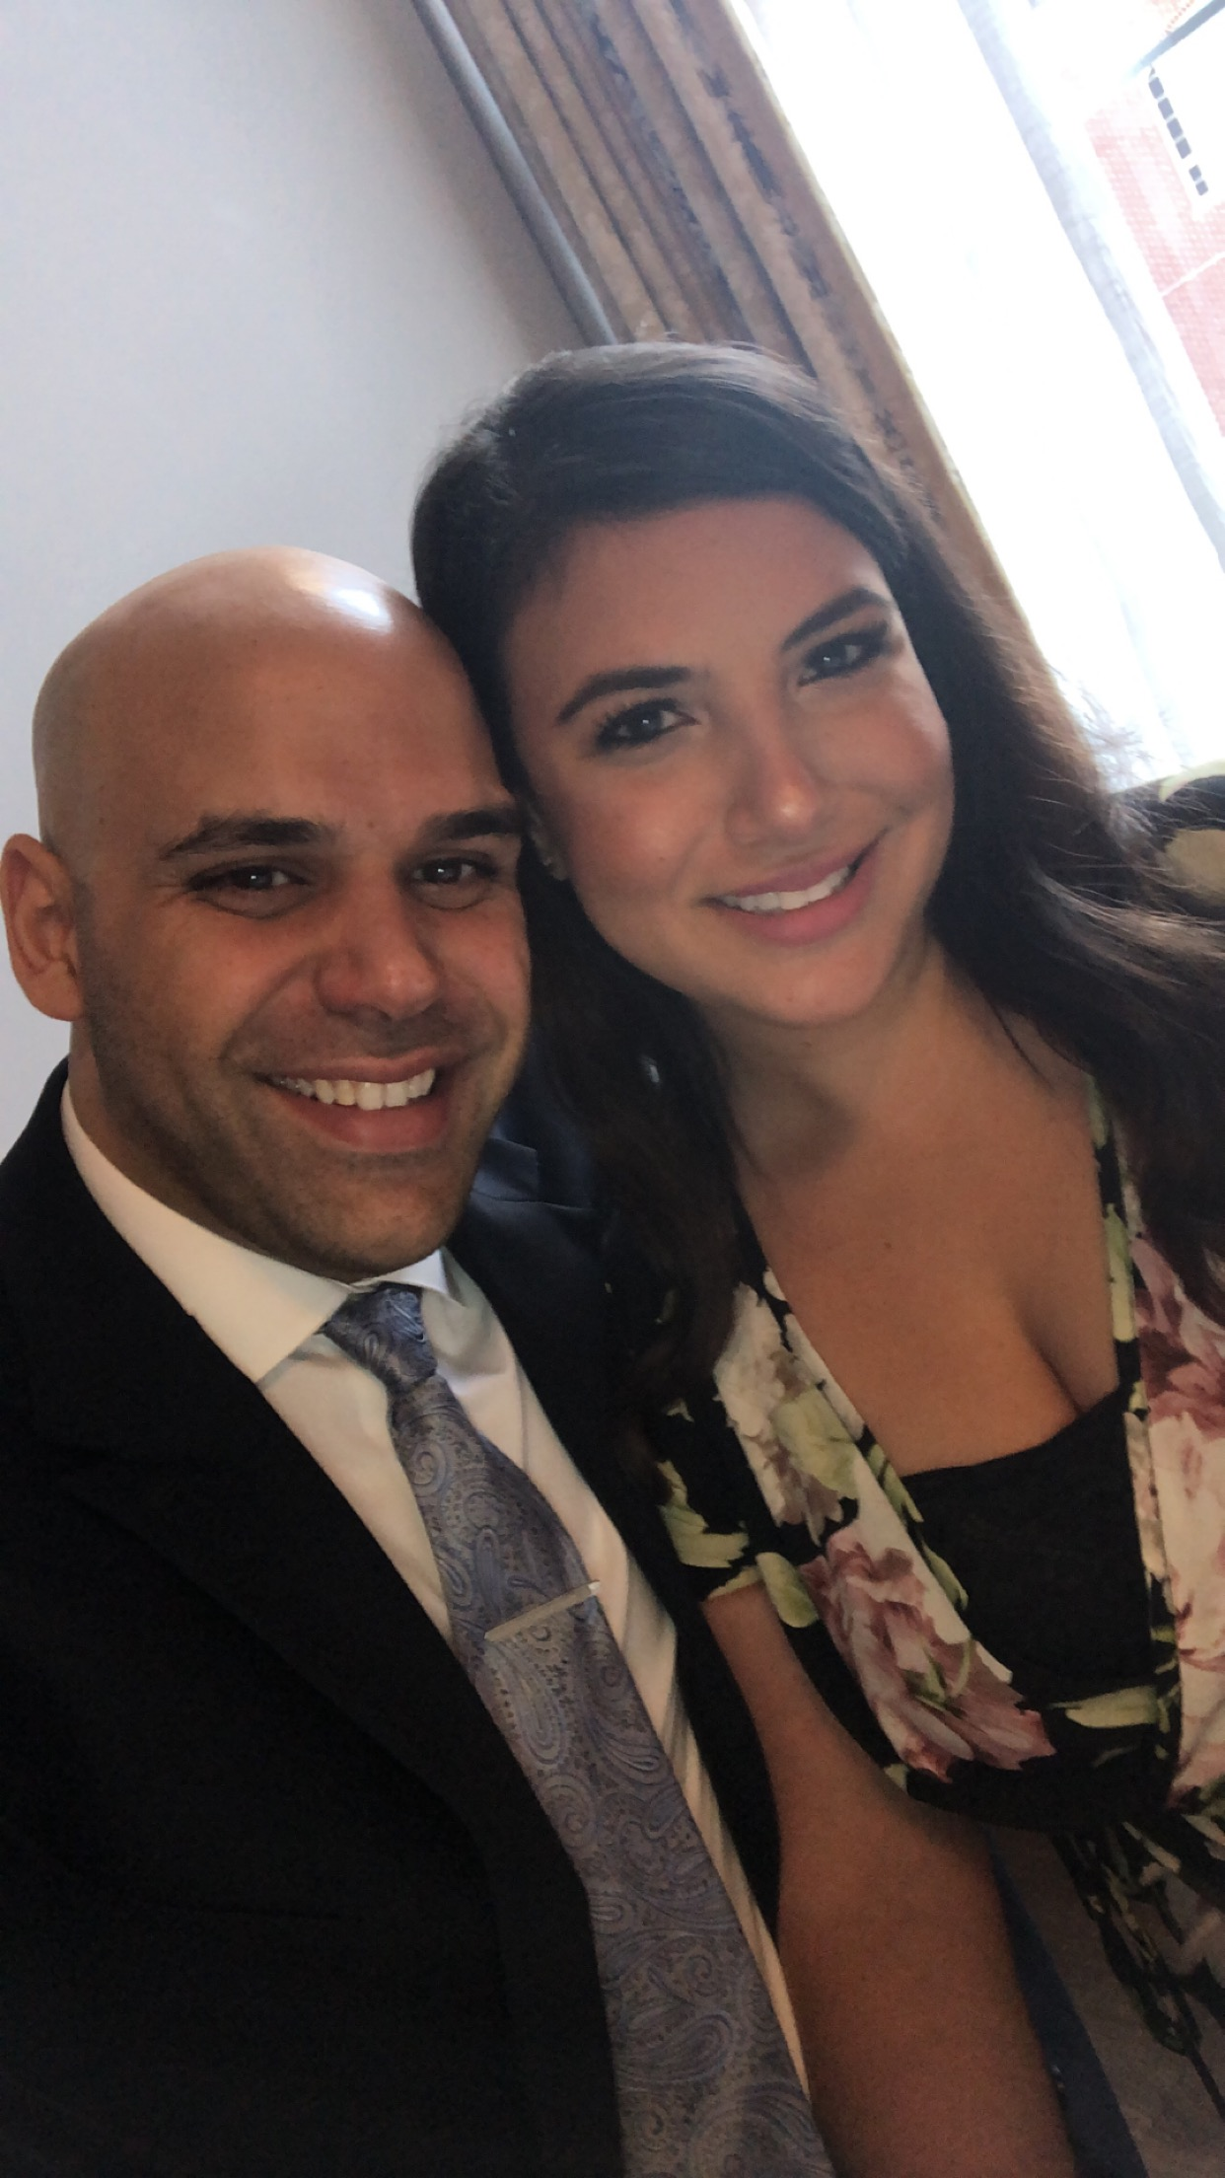

Slide 12

Homework
Designed to extend learning beyond the classroom and reinforce skills learned at school.
Students should expect some homework Monday through Friday.
Please let us know if your child is struggling with homework so that we may promptly address the issue and work together on a solution.
Please remember to sign your child’s planner each night.

Slide 13

Class Communication
Class Dojo
Blog
email - Please make sure we have a current email address
Please make sure that the teacher has a correct email address for you. We will be subscribing parents to Class Dojo and the classroom blog.
Remind (Saab, G.) rmd.at/mssaabs
Our Contact Information:
Mrs. Mualem: mualeml@dearbornschools.org
Mrs. Ninkovich: ninkol@dearbornschools.org
Ms. Linda Saab: saabl@dearbornschools.org
Ms. Ghinwa Saab: saabg@dearbornschools.org
Henry Ford Phone: (313)827-4700
Notes:
Maybe on sign in sheet they can update email address

Slide 14
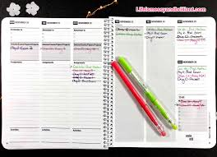
Classroom Planners
The planner is an excellent communication tool. Feel free to write us a note, ask a question, or share information with us in the planner.
Using the planner teaches responsibility, organization, and time management.
Each day students will enter all work completed in class into the planner.
The planner will be taken home every night and returned the next day.
Please sign your child’s planner everyday.
The teachers will also sign the planner everyday.

Slide 15

Parent Volunteers
Parent volunteers will be needed throughout the year for class projects, parties, and field trips. Please let us know if you are interested in volunteering . All volunteers must have a completed background check on file in the office.

Slide 16
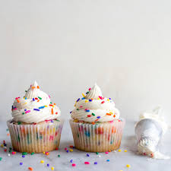
Birthdays
Students may bring in treats(cupcakes, fruit, cheese & crackers, pizza) Hand held items. (No cakes)
Please give us notice if you intend to send in birthday treats for your child.

Slide 17
Scent Free Zones
Henry Ford Elementary School has been designated a Scent Free Zone because of medical conditions of students and staff members. By eliminating the use of the items below, you are helping make sure that Henry Ford is a safe environment to learn and work for all staff and students! Individuals with health concerns have strong reactions to scented items including migraines, breathing problems, shortness of breath, nausea and difficulty concentrating. Scents can also trigger a severe asthma attack.

Slide 18
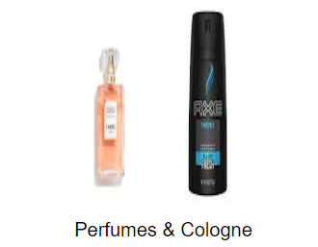
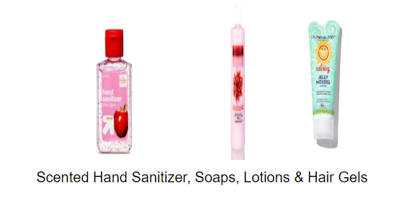
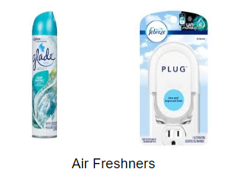
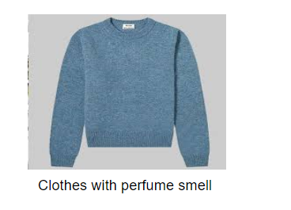

Products to Avoid

Slide 19
Classroom Expectations and PBIS
Students can move up and down
Colors will be inputted on MiStar by the end of each month
Blue: Above and Beyond
Green: Meeting PBIS Expectations (Ready to Learn)
Yellow: 1-1 conversation with student
Orange: Phone call home or Think Sheet
Red: Contact support staff or point person

Slide 20
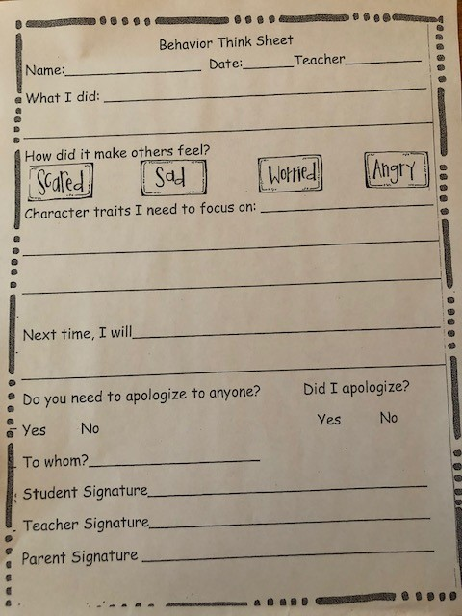
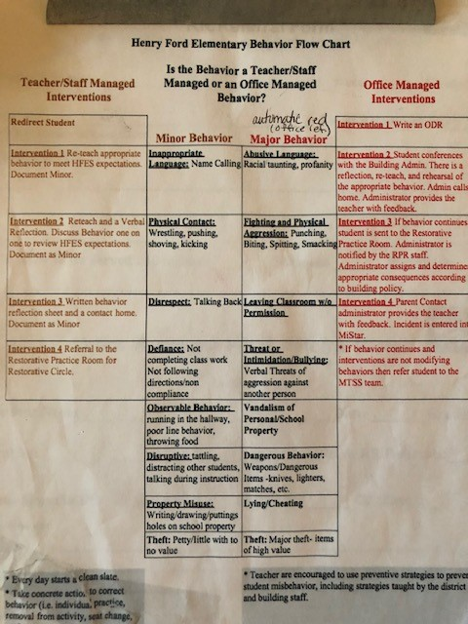
Notes:
Nice ! Make sure to add how they can volunteer - some have added this to sign in sheet.

