Slide 1
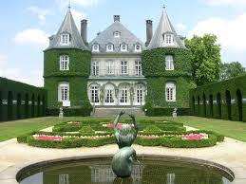
“The Most Dangerous Game”
Plot Flow Map
Your map must include the following:
  All events in the correct order
  Guiding Question and Frame of Reference
  Larger boxes must have an illustration with events as captions in the smaller boxes. See example below.
  Must be colored and neat!
  “His eyes made out the shadowy outlines of a palatial chateau; it was set on a high bluff…”

Slide 2
Cause and Effect
“The Most Dangerous Game”
Create a Multi-Flow map to show 4 important events throughout the story.
Start with the event first (this must be written in a complete sentence), and then fill in the causes and effects with at least one cause and one effect for each event.
You must use textual evidence for the Cause and the Effect. Don’t forget the PC.
Minimum of 4 events.
Remember to have a frame, Guiding Question, and Frame of Reference!

Slide 3


Guiding Question:
Cause
#1
Use Textual
Evidence
Effect
#1
Use Textual
Evidence
Event
#1
Frame of Reference:

Slide 4
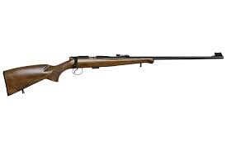
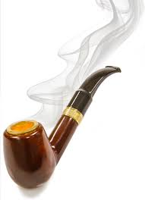
Compare and Contrast
Zaroff with Rainsford
Create a Double-Bubble Thinking Map comparing and contrasting Zaroff with Rainsford.
You must have a minimum of three ways they are similar and three ways they are different.
You must use textual evidence for every example! Don’t forget the PC’s(Connell 23).
You must have a Guiding Question and Frame of Reference!

Slide 5
Guiding Question:
Zaroff
Rainsford
Frame of Reference:

