Slide 1
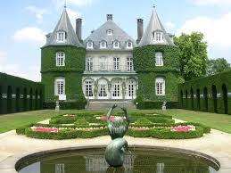
“The Most Dangerous Game”
Plot Flow Map
Your map must include the following:
  All events in the correct order
  Guiding Question and Frame of Reference
  Larger boxes must have an illustration with events as captions in the smaller boxes. See example below.
  Must be colored and neat!
  “His eyes made out the shadowy outlines of a palatial chateau; it was set on a high bluff…”

