Slide 1
UFLI
Parent Meeting
2025-2026
Notes:
45 minute parent meeting
Introduce the presenters and welcome the parents
2 minutes
Handouts:
Weekly Reading and Spelling Guide

Slide 2
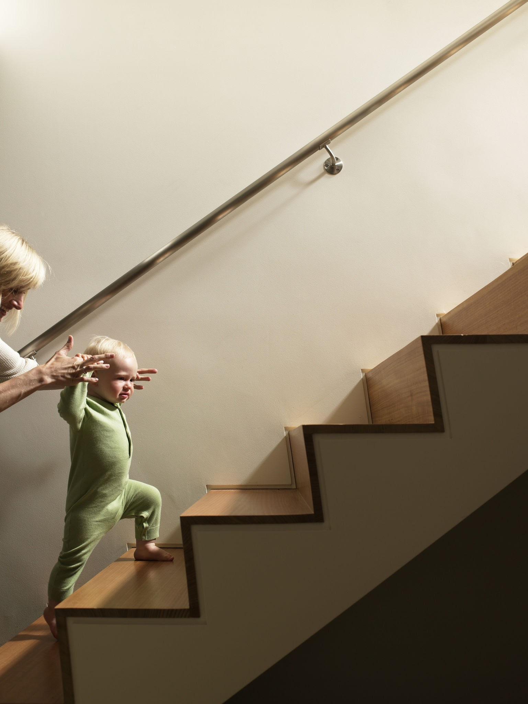
WHAT IS UFLI?
UFLI Foundations is an explicit and systematic program that teaches students the foundational skills necessary to become a reader.
Notes:
3 minutes
Daily
In order
Based on research
Skills build on each other
Spiraling skills
Building confidence in students

Slide 3
WHO WILL RECEIVE INSTRUCTION?
K-2
3-5
ALL students
whole group
30 minutes a day
as needed
small group
15 minutes
3-5 days a week
*3rd grade will begin the year with whole group
Notes:
2 minutes
(Can discuss building funding or specific staff who may be using it)

Slide 4
How: PARTS OF A UFLI LESSON
Phonemic Awareness
Blending and Segmenting
Visual and Auditory Drills
Blending Drill
New Concept (Skill)
Word Work
Irregular Words
Connected Text (Decodable)
Word Work Chains
Notes:
2-3 minutes
These are the components of a UFLI lesson (part 1 and 2). Some of these pieces are covered in more detail on the next few slides.

Slide 5
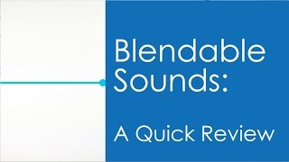
SAYING SOUNDS CORRECTLY
Watch this video and see if there are any sounds that surprise you.
Notes:
6 minutes
Watch 1st minute and can fast forward after b sound to (q is 2:39) (w and y 3:19 - 3:30) Make sure to stop and clarify these sounds as they are not what parents may suspect!

Slide 6

Segmenting
Blending
c-u-p
cup
Notes:
2-3 minutes
Blending is combining the sounds together. Segmenting is breaking the word into individual sounds.
Practice and give examples with a few other CVC words
Do it at home as a game

Slide 7
NEW CONCEPT
Listed-Home Practice sheet
Sample words
Don’t memorize!! Practice applying.
Say the sound for each letter or letter combination (d-i-sh)
Blend to read (dish).
To spell words:
break the word into sounds
write the letter or letter combination for each sound.
Notes:
2-3 minutes

Slide 8


IRREGULAR WORDS
Words to study
Words that have irregular spelling
“Heart” part of a word
to be memorized
High utility (common) words
Notes:
7 minutes
Heart has a link to a video describing “heart” words.
UFLI uses the heart word method to teach high-frequency (irregular) words so that they become automatic for even more of our students. Each word is at least partially decodable with only part of the word that students need to know “by heart.”

Slide 9
SAMPLE WORD CHAINS
Kindergarten at sat mat rat ran | First Grade pack back bash cash crash crush | Second Grade point joint join joy jaw saw caw cow how howl
Notes:
2 minutes
Kindergarten: one change, mostly initial sounds, with one ending sound change. Later vowels will also change.
First grade: One change at a time but it can be a beginning or end change and also a vowel change is possible
Second grade: changes occur one at a time in the beginning, middle and end. Students will have skills such as vowel teams and diphthongs

Slide 10
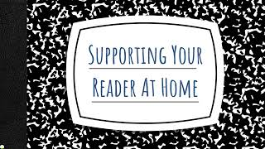
HOME PRACTICE
Notes:
6 minutes
Video is 5:30. It discusses the home practice.

Slide 11
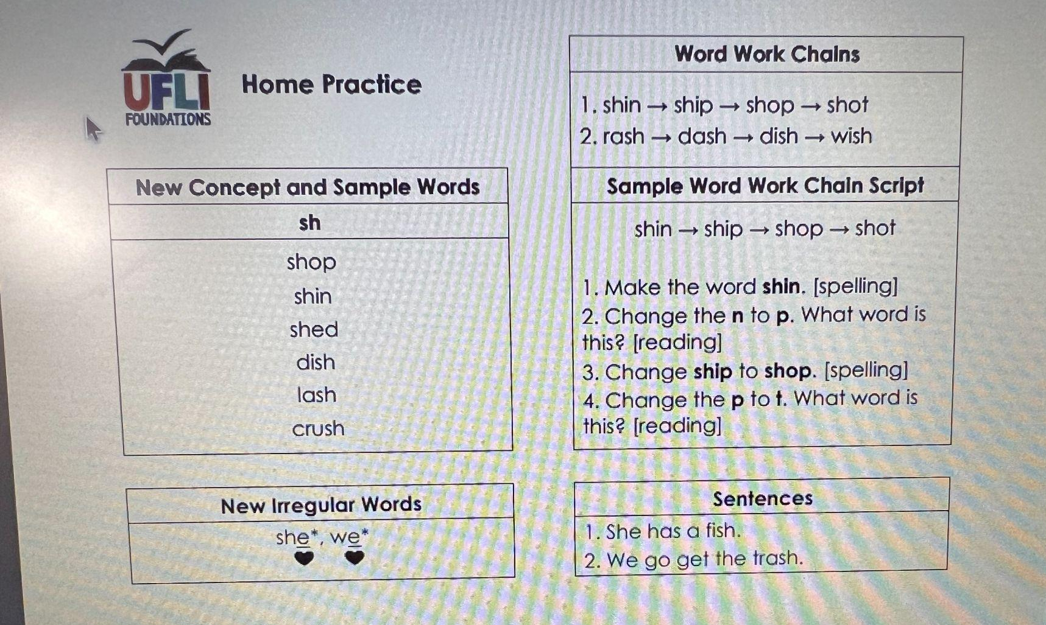
SPELLING
Activities to do at home
Study the pattern not the words
Sample dictation
Study these words
Notes:
2 minutes
Activities to do at home: Could be paper and pencil, ML or whiteboard and pen
Dictation: An example but not the actual sentence for Friday. Pulling all the skills together to write a complete sentence with a capital letter, spacing, punctuation and words spelled correctly

Slide 12
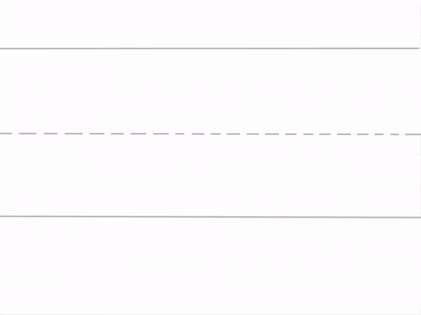
LETTER FORMATION
It is important that we are practicing this at home as well.
Once students are able to form letters correctly, they have more brain space to focus on what sounds they are writing instead of the mechanics of writing the symbols.
Notes:
3-4 minutes
Letter Formation Slides
Schools may wish to put this video on the school page, Class Dojo page etc so parents have access to it at home for handwriting practice
District 25-26 UFLI Letter Formation Slides

Slide 13

SPELLING
Notes:
2-3 minutes
Handouts- print in advance
Weekly Reading and Spelling Guide
Home Practice Lesson 5
Home Practice Lesson 6
The Weekly Reading and Spelling Guide explains the spelling home practice routine for the entire year. Each lesson has its own half page Home Practice sheet, starting with Lesson 5. For the most part, teachers will cover two lessons per week and will send home both half page Home Practice sheets for those lessons. The Review/Assessment piece that will be administered each Friday will be a combination of concepts from both lessons covered that week.

Slide 14
DICTATION
The purpose of sentence dictation:
Assist in transferring reading skills to writing (application of skill )
Provide students with opportunities to work with text that emphasizes phonetic elements
Help students become skilled in spelling words
Enhance listening and writing abilities
Notes:
2 minutes
Dictation is part of the progress monitoring: spelling assessment.

Slide 15
UFLI PARENT RESOURCE HUB
UFLI Website - The UFLI website has many resources and ideas for parents.
Notes:
2-3 minutes
Click on the link and show parents

Slide 16

Thank you Parents!
Questions?

