Slide 1
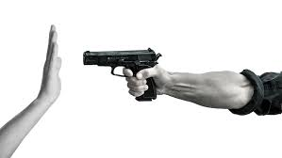
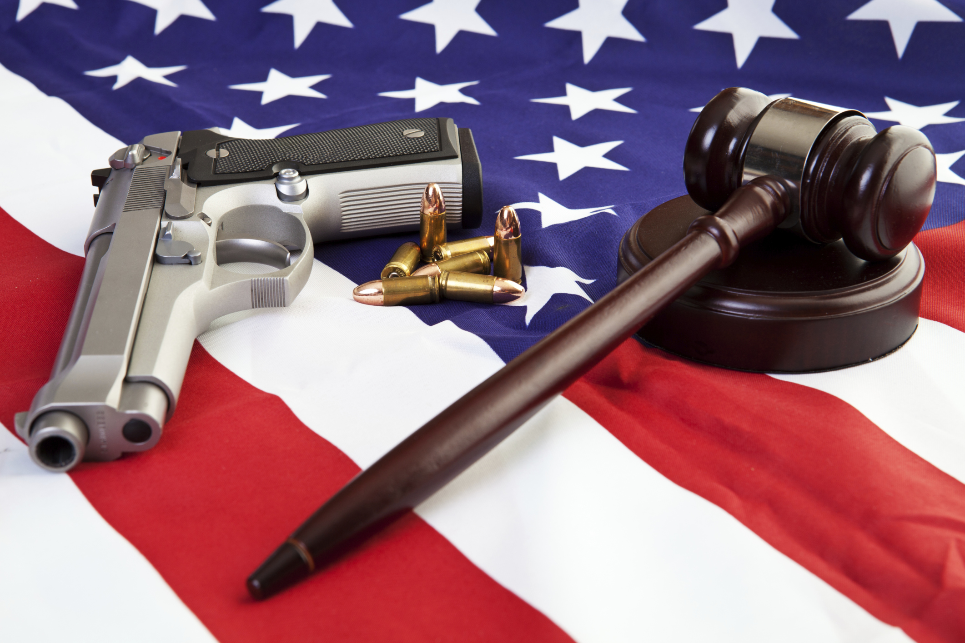
Gun Control
By: Hassan Hammoud

Slide 2
What Is Gun Control?
Gun control is the set of laws or policies that regulate the manufacture, sale, transfer, possession, modification, or use of firearms by civilians.

Slide 3
How is gun control a social issue?
Gun control is a social issue for several reasons. This has been a hot topic across the world these last couple years because of the mass shootings taking place at a higher rate. Shootings affect not only the victims but the families, friends, and communities and the people around the world.

Slide 4
What are the pros?
What is the problems?
Reduced crime rates: If everyone is allowed to own a gun, this will lead to an increase in crimes in areas because you don’t know genuine firearm owners and those with criminal thoughts. There is a correlation in the number of crime rates and gun possession.
Reduced homicide: Control of guns reduce homicide rates. In countries where there are gun bans, there are few reported homicides.
Reduced mass killings: Increase in gun ownership has led to increased mass public shootings. Restriction to own guns reduces the frequency of mass public shooting.
Decrease in suicide: In countries where guns are banned, there is a decrease in suicide rates. Although the victims may attempt other suicide methods, may not be as effective as using a gun.

Slide 5
What are the cons?
What are the solutions?
Less protection: Individuals with licensed firearms can use them for self-defense against any intruders or burglars. This is not possible without the guns.
Increased crime rate: Crimes and banning the use of guns to increase crime rates. Criminals fear to break into houses where they think the owners are in possession of guns and this reduces crime rates.
Increased supply in black markets: If guns were banned, people will obtain then in one way or another especially from the black market.
Reduces self-reliance: Strict gun control makes people more dependent on the government.

Slide 6
What experts say?
Experts like Adam Winkler and Margot Katz say, banning assault weapons was never meant to reduce overall gun deaths. It was meant to reduce gun deaths from mass shootings even if these represent a small portion of gun violence. Experts say focusing on reducing large capacity might be more effective. Gunmen are less deadly when they have to reload. Experts say, nothing is going to be done because of the money involved. The organizations and the NRA involved.

Slide 7
MY view on gun control
My view on this topic is there should be laws on gun control because regardless the cons are not that big of a deal compared to losing many innocent people lives because of the heartless people who think they are helping the world by pulling the trigger. With gun control, Everybody will be more safe in general. Also, people do not have to worry about going places like clubs,concerts, parties, school, etc. Everything will be more controlled and more calm.

Slide 8
References
https://www.prosancons.com/human/pros-and-cons-of-gun-control-2/
https://en.wikipedia.org/wiki/Gun_control#/media/File:Gun_Policy_by_Country.PNG
https://static.seattletimes.com/wp-content/uploads/2016/06/a1db598a-3cb1-11e6-ad3b-ad62395918a6-640x427.jpg
https://www.philosophytalk.org/blog/gun-control
https://news.iheart.com/featured/rush-limbaugh/content/2018-03-16-student-gun-control-protests-arent-organic/
https://www.washingtonpost.com/graphics/2018/opinions/gun-control-that-works/?noredirect=on&utm_term=.fdcf9e5c5c97

Slide 9
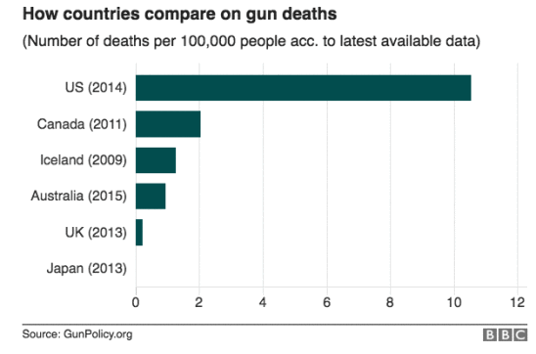
-For every 100,000 people in the US an average of 10 people die by a trigger. That is 5 times more than any other country.

Slide 10
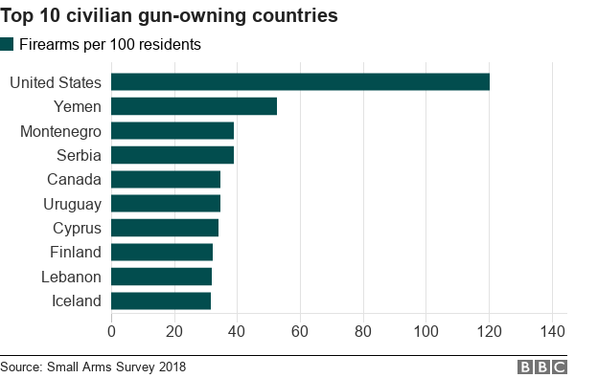
-United states is the top country in the world for firearm ownership.
-We have more than any other country in the world by at least double.
-For each family of 5 there is an average of 6 guns per household.

Slide 11
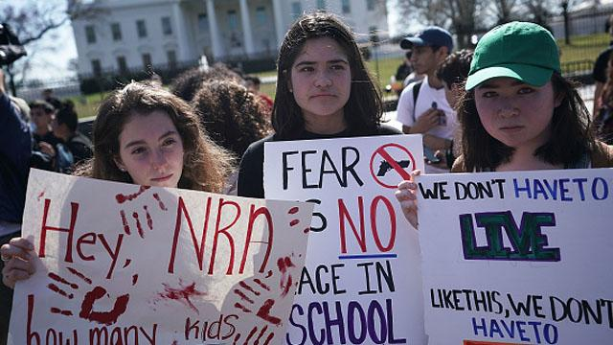
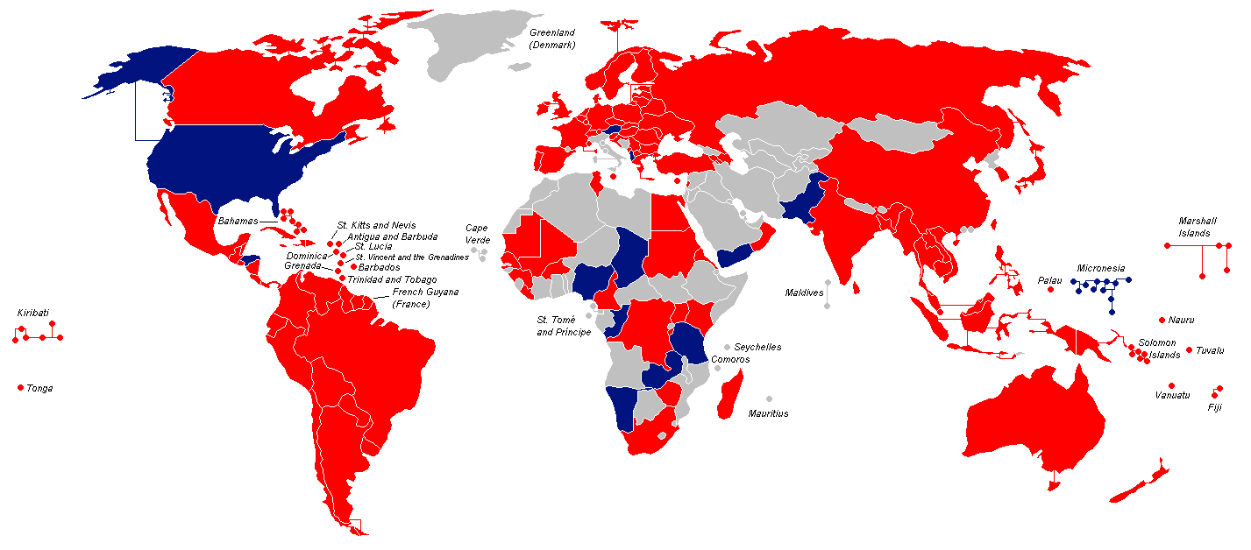
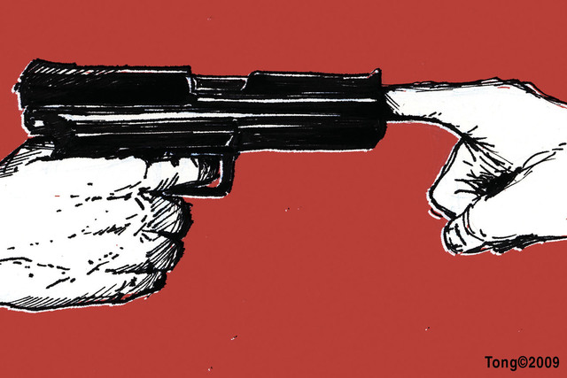
https://m.youtube.com/watch?v=bX4qUsgHa4Y

