Slide 1
Suicide
Zeinab Berro
6th hour

Slide 2
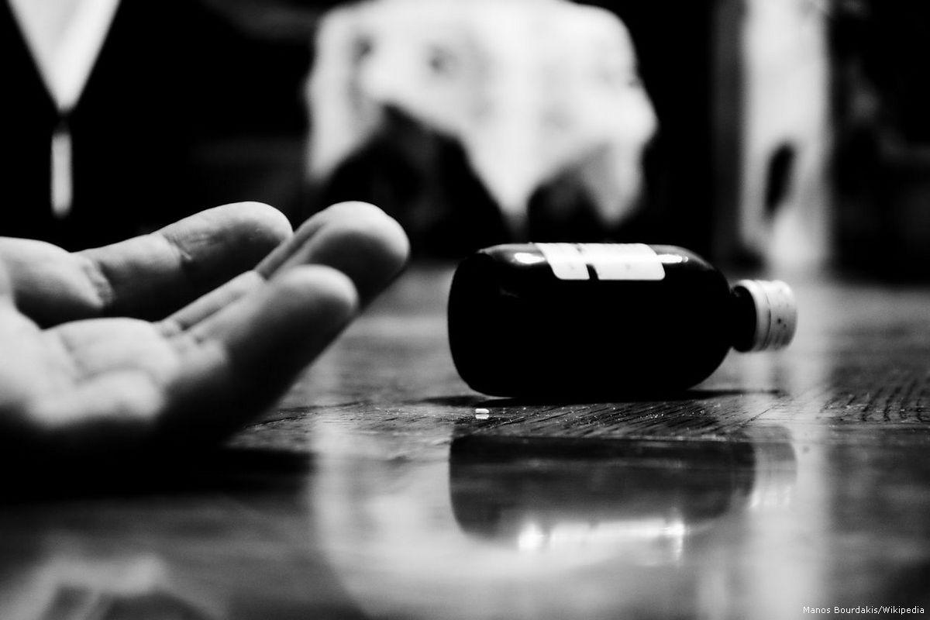
What is suicide?
Suicide is when someone ends their own life due to pain from something or someone. Many people commit suicide to escape the pain they are feeling.

Slide 3
Facts
~Suicide is the 10th leading cause of death in the united states for all ages.
~Men die from suicide 3.5 times more often than women.
~About 5,000 teens commit suicide each year.
~Patients with depression, impulsive disorders lead to suicide.
~Suicide is the 3rd leading cause of death for 15 -24 year olds and the 6th leading cause of death for 5-14 year olds.
~There is one death by suicide in the united states every 12 minutes.

Slide 4
Problem v solution
Problem: solution:
~drugs are one of the biggest causes of suicide. ~talking openly about suicidal thoughts can help save a life.
~30-70% of suicide victims suffer from depression, ~show that you care about the person.
bipolar disorder and schizophrenia. ~get a doctor or a psychologist involved.
~being socially isolated or a victim of bullying. ~give a suicidal person the opportunity to express their feelings so they know they are not alone.
~a history of being abused. ~pay attention to risk factors and look for changes in behavior.

Slide 5
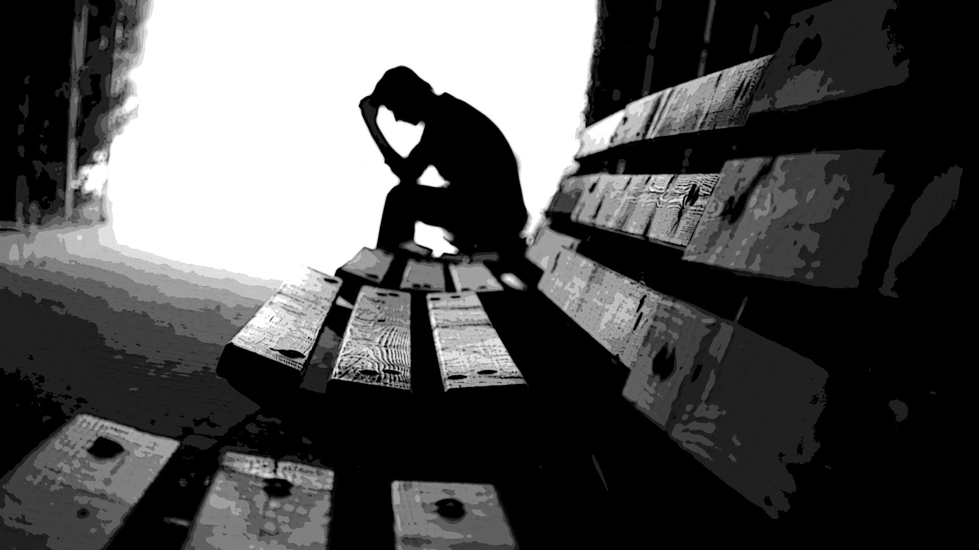
My position
Increasingly suicide is being viewed not only as a mental health problem but Also a Public Health problem as well. There is different possible solutions that could be taken to resolve or improve this issue, for example we must talk about it and know where to go. all of us need to know the local, regional and national resources that offer prevention education and support services for mental health. Also we need to pay close attention to how people Express themselves listen for ways that people communicate their emotional state.

Slide 6
How it affects people
Suicide, affects the health of others and the community.When people die by suicide, their family and friends often experience shock, anger, guilt, and depression.As a result, the people who interacted regularly with the individual who ended their life will feel the pain of the loss—likely wondering if they could have done more.
The economic toll of suicide on society is immense as well. Suicides and suicide attempts cost the nation approximately $70 billion per year in lifetime medical and work-loss costs alone.

Slide 7
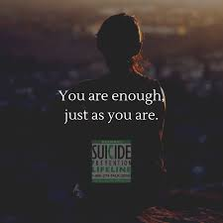
What experts say
For every person who dies by suicide, 280 people think seriously about it but don’t act,
(according to the National Suicide Prevention Lifeline).
“A conversation about depression or suicide is going to be difficult, but you can have it without putting a young person at risk and it can be very helpful,”
(John Ackerman,)

Slide 8
Current issues
~ In 2016 the highest suicide rate was among adults between 45-54 year olds.
~ in 2016 the highest united states suicide rate was among whites.
~ A recent study shows that over the last 30 years the suicide rate in young people has more than tripled.
~ The most dramatic increase in the suicide rate has occurred in the 15-24 age bracket up 312%.

Slide 9
Video
https://youtu.be/ghyamhuKpd8
Suicide is a very rare phenomenon at the far end of human anguish. And yet its existence tells us something crucial about how weak we all are: it's a further reminder of the need for Empathy and compassion.
Suicide

Slide 10
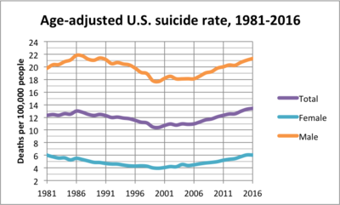
Info graph

Slide 11
References
https://afsp.org/abouhttps://afsp.org/about-suicide/suicide-statistics/t-suicide/suicide-statistics/https://afsp.org/about-suicide/suicide-statistics
https://www.cdc.gov/violenceprevention/suicide/fastfact.html?CDC_AA_refVal=https%3A%2F%2Fwww.cdc.gov%2Fviolenceprevention%2Fsuicide%2Fconsequences.html
https://www.nami.org/Blogs/NAMI-Blog/September-2018/The-Ripple-Effect-of-Suicide
CounselingCenter.utk.edu
Do something.org
Physican Assisted Suicide

