Slide 1
A I R
Yasmine Elhagehassan
6th Hour
4/8/2019

Slide 2
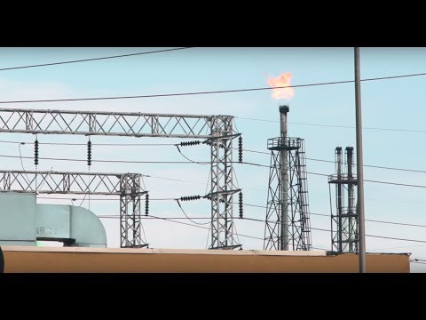
~ Current Issues ~
Notes:
End at 2:20.

Slide 3
~ Current Issues ~
On June 19, 2017, an air monitoring station was installed in a part of Southwest Detroit.
Boynton, Michigan, also known as zip code 48217, is considered to be one of the most toxic place in Michigan.
Many factories operate within the surrounding area of Southwest Detroit/and 48127, such as oil and coal burning plants.

Slide 4
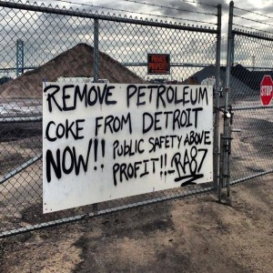
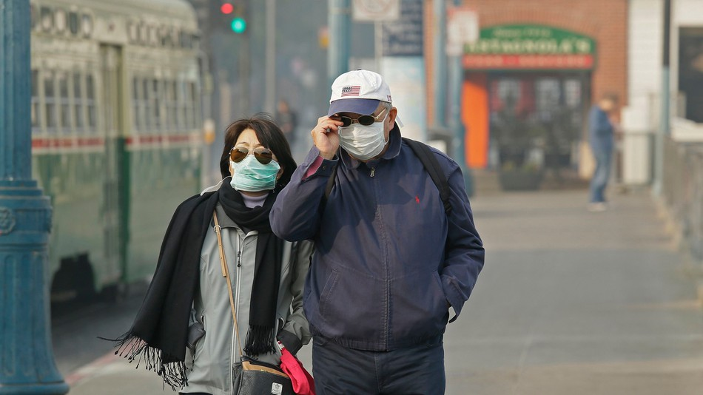
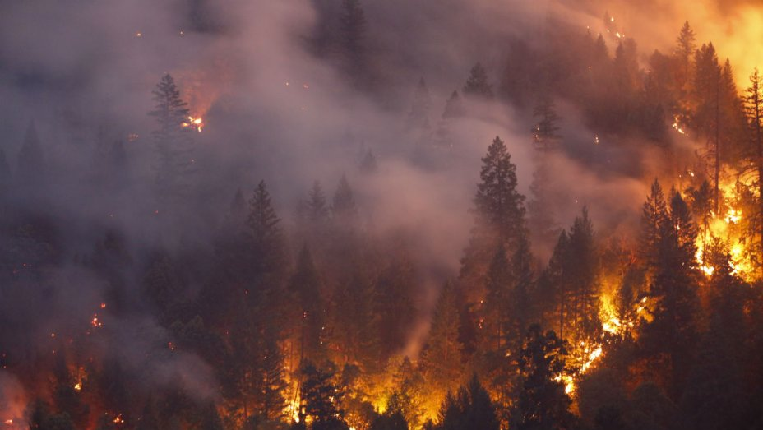
~ Current Issues ~
Why is the issue with 48217 important to us?
- What does this say about the growing air problems in Detroit/Dearborn?
Other Instances of Air Pollution:
- California Wildfires (worsened air quality in Northern California)

Slide 5
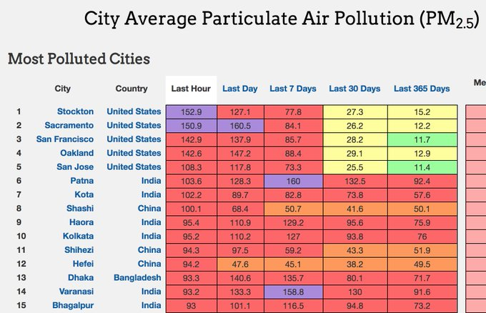
<----
Chart displaying air pollution based on PM2.5 in most polluted cities
(measured in ug/m3; purple indicates very hazardous air; only in cities with populations >250,000)
(Done around Nov 2018)

Slide 6
~ Critical Thinking ~
How do we define Air Pollution?
How can air pollution harm us and our environment?
What factors play into air pollution?
What are solutions to eliminating air pollution?
How is air pollution affecting us today?* *My personal opinion on the matter

Slide 7
~ Definition of Air Pollution ~
There are many ways people have defined Air Pollution:
The NRDC defines air pollution as “the release of pollutants into the air that are detrimental to human health and the planet as a whole.”
The WHO defines air pollution as “contamination of the indoor or outdoor environment by any chemical, physical or biological agent that modifies the natural characteristics of the atmosphere.”
National Geographic defined air pollution as “a mix of particles and gases that can reach harmful concentrations both outside and indoors.”

Slide 8
~ Definition of Air Pollution ~
Cont.
While complex, the WHO gives a better definition of what air pollution is. See, when it comes to the issue of air pollution, most often people assume that it’s pollutants that come from a factory. However, people ignore that air pollution isn’t just artificial, but can also be caused by natural occurrences (refer back to California wildfires).
The WHO’s definition also mentions a wide variety of pollutants that can pollute our air. Bacteria contaminants, such as mold, can contaminate the indoor air quality of our homes, buildings, etc. But, the WHO’s definition also forgets to mention how air pollution can affect the physical landscape of an area, our water sources, animals, etc.

Slide 9
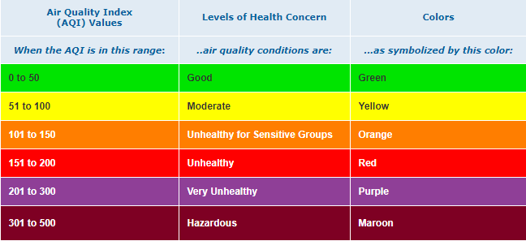
~ Definition of Air Pollution ~
Of course, I can’t explain every single detail to you about air pollution, so we’ll only be going over the two different kinds of air pollution:
Outdoor Air Pollution and Indoor Air Pollution
Before we get into those things, I want to mention a couple of key terms:
Air Quality Index (AQI): “an index for reporting daily air quality. It tells you how clean or polluted your air is, and what associated health effects might be a concern for you.”

Slide 10
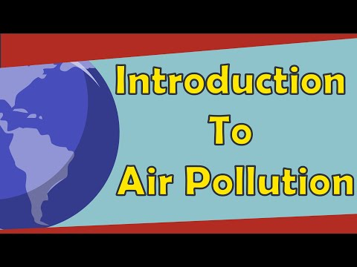
~ Definition of Air Pollution ~
Outdoor Air Pollution: It’s pollution, but occurs outside! When it comes to outdoor air pollution, it’s harder to define a source as there are multiple sources: human made and natural; biological, physical, or artificial.
Some Examples: CO2 emissions produced from factories; PM2.5 produced from ashes of wildfires; SO2 produced from burning fossil fuels (oil, coal) or mining.
Notes:
Starts from 2:46 to 4:26.

Slide 11
~ Definition of Air Pollution ~
Indoor Air Pollution: Yes, indoor air pollution can indeed happen inside. No, not from your father’s fart, or the smell of your bathroom. Indoor Air Quality (IAQ) refers to the quality of air inside a structure. Often times poor IAQ comes from inadequate maintenance of ventilation, causing bio-pollutants such as mold to form, or seeping in gases like CO.
Some Examples: Sick Building Syndrome.
Notes:
Starts from 6:02 to 8:11.

Slide 12
~ Cons/Problems with Air Pollution ~
Increase in Greenhouse Gases - It’s predicted that there’ll be a larger increase in gases such as CO2 in 2019 by about 2.75 parts per million (ppm); a larger increase than from 2018.
Health Problems/Illnesses/Diseases - According to the WHO, “bad outdoor air caused an estimated 4.2 million premature deaths in 2016, about 90 percent of them in low- and middle-income countries.”
Smog/Soot - Smog occurs when emissions from fossil fuels combine with sunlight; smog is a big problem in China, especially within its municipalities such as Shanghai. Soot are the particulate matter (PM) that come from ashes, dust, burning coal, etc.
Damage of Habitats for Wildlife - Air pollution can cause acid rain, which occurs when pollutants like SO2 and NO2 combine and come down as acid deposition, such as nitric acid. Acid rain can decrease the pH of soil/water, harming aquatic organisms in bodies of water and the vegetation that grows on the soil.

Slide 13
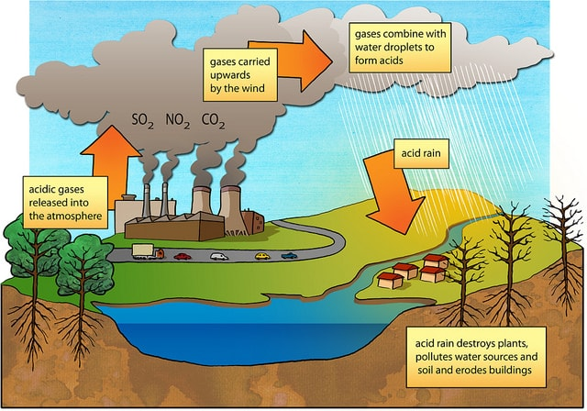
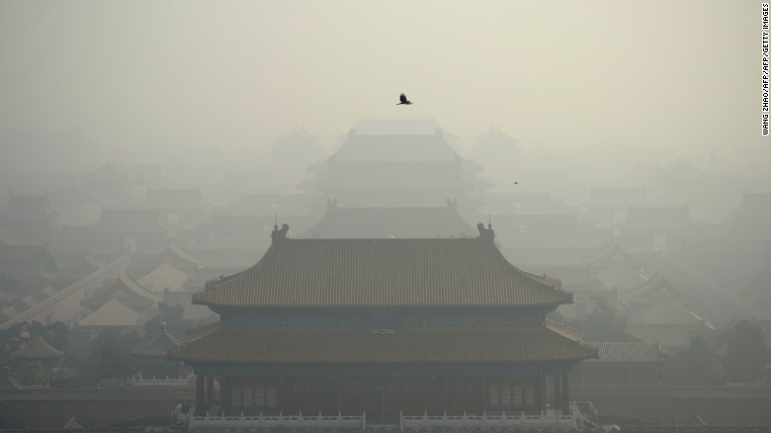
Pollution in Beijing, in the Hebei Province of China (Source: CNN)
Simple diagram that shows how acid rain forms/damages habitats. (Source: Earth Eclipse)

Slide 14
~ Factors That Cause Air Pollution ~
One thing people need to understand when it comes to air pollution is that there can be multiple sources of it. We call it nonpoint source. - For example: If a river next to a factory is polluted, the source can be easily Identified. However, if a city is polluted, and surrounded by multiple factories/ Natural and physical causes, it’d be harder to trace the source of pollution. - Different sources: mobile, stationary, area, and natural.
When we also discuss ways to mitigate/eliminate air pollution, we have to discuss other social factors that help cause it: - In areas of low-income/majority are minorities, factories are built more around The area.

Slide 15
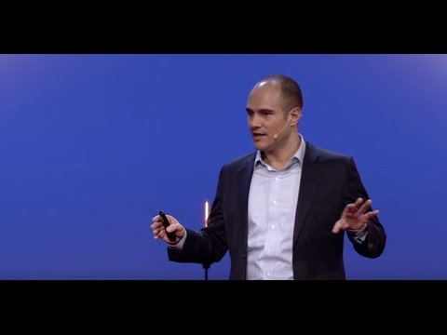
~ Expert Opinion ~
A former Silicon Valley entrepreneur, environmental researcher and World Bank consultant, Romain graduated in physics, applied mathematics and economics from Ecole Polytechnique and holds a MS in Technology Policy from MIT where he was a Fulbright Scholar. He is now launching an Internet of Things startup for greener cities.
Notes:
End at 3:40.

Slide 16
~ Pros/Solutions to Air Pollution ~
Reducing Automobile Gas Emissions - Fuel efficiency, also known as “fuel economy”, is used to measure how far a car can travel miles per gallon (mph). To reduce gas use, the EPA/government set up fuel economy standards for automobile companies to follow.
Switch to Renewable Energy Sources - Solar energy, a form of renewable energy where the sun is used in order to bring electricity (heat, light, etc.), is growing more in use around the U.S.
Better Ventilation at Home - Your home isn’t safe from any bio-pollutants such as pollen or mold coming from outside air, or from any other gases produced by your stove, fireplace, cigarettes, etc. To have a more healthier home, it’s suggested that you a) figure the source of any pollutants in your home, b) maintain ventilation, and c) use a form of air cleaners to remove any PM or bio-pollutants.
More Encouragement of Public Transport - Public transport can be key to reducing urban sprawl and use of automobiles! Allowing more funding for transport such as buses and trains can help people get around without the use of cars. You can even use renewable energy sources (in Ann Arbour, their bus shuttles run on biofuels!).

Slide 17
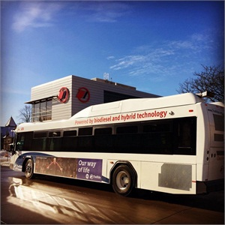
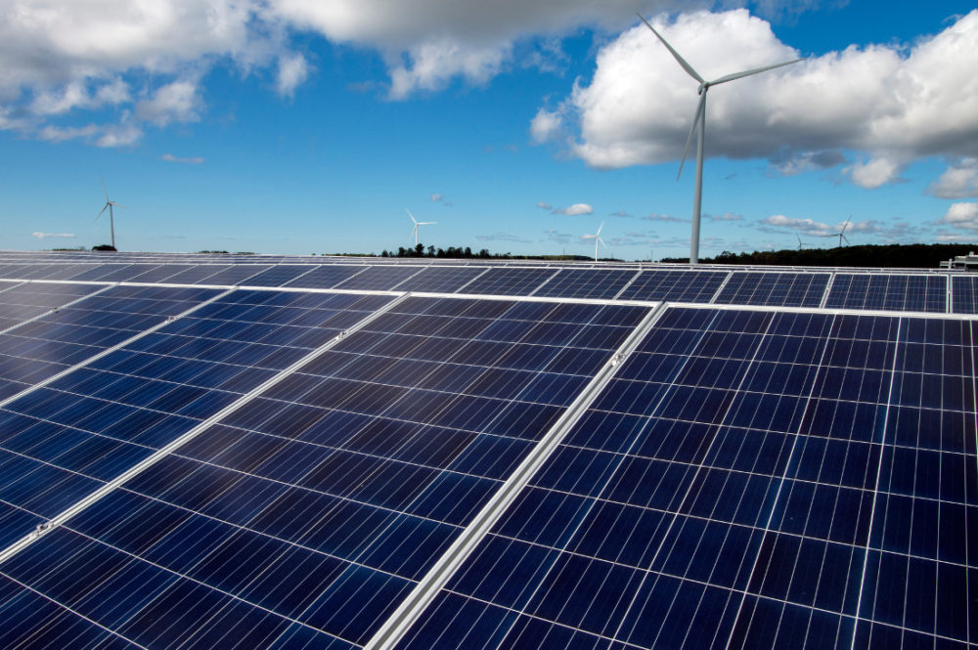
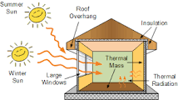
Displays of solar panels on a wind farm in Garden, Michigan.
A biodiesel/hybrid tech bus shuttle in Ann Arbour.
Over here is another form of solar energy, also known as Passive Solar Energy ----->

Slide 18
~ How Are We Affected by Air Pollution Now? ~
Many countries have taken an initiative to reduce the amount of air pollution produced within their own country. In China, Beijing has some of the lowest air pollution in history as they win the “war” against air pollution through implementing environmental/economic policies and air cleaners. However, the international fight against air pollution isn’t over yet! The U.S. is experiencing worse air pollution than past years, and based on the Trump Administration’s view of global warming, we may be seeing more and more pollution within our time. Many smaller communities that consist of a minority population suffer more of the effects of air pollution than any white suburban neighborhood. In order to ensure a better future for the newer generation in Dearborn/Detroit, we must keep our air clean!

Slide 19
~ Bibliography ~
https://www.michiganradio.org/post/toxic-town-michigans-most-polluted-zip-code https://mashable.com/article/california-worst-air-quality-smoke-fires/#L2omrUXHnOqC https://twitter.com/RARohde/status/1063444277987033088?ref_src=twsrc%5Etfw%7Ctwcamp%5Etweetembed%7Ctwterm%5E1063444277987033088&ref_url=https%3A%2F%2Fmashable.com%2Farticle%2Fcalifornia-worst-air-quality-smoke-fires%2F https://www.nrdc.org/stories/air-pollution-everything-you-need-know https://www.nationalgeographic.com/environment/global-warming/pollution/ https://www.who.int/airpollution/en/ 1https://airnow.gov/index.cfm?action=aqibasics.aqi https://www.theguardian.com/environment/2019/jan/25/worrying-rise-in-global-co2-forecast-for-2019 https://www.canada.ca/en/environment-climate-change/services/air-pollution/quality-environment-economy/ecosystem/wild-animals.html https://www.cnn.com/videos/world/2017/01/09/beijing-pollution-proof-life-orig.cnn https://www.eartheclipse.com/environment/primary-causes-of-acid-rain.html https://www.ucsusa.org/clean-vehicles/fuel-efficiency https://www.metro-magazine.com/sustainability/news/293950/41-of-u-s-public-transit-buses-use-alt-fuels-hybrid-technology https://energynews.us/2017/11/08/midwest/as-solar-booms-in-michigan-townships-tackle-land-use-questions/ http://www.alternative-energy-tutorials.com/energy-articles/passive-solar-energy.html http://blogs.edf.org/markets/2018/05/17/how-china-is-cleaning-up-its-air-pollution-faster-than-the-post-industrial-uk/

