Slide 1
Greek Drama

Slide 2
Origin of Tragedy Religious festivals in honor of Dionysus
Greek tragedy originated in religious festivals in honor of Dionysus, the god of wine and fertility.
Dionysus died each winter but was reborn each spring.

Slide 3
Thespis-”Father of Drama” (6th century B.C.)
Credited with the invention of drama and first person narrative.
Until this point, stories were expressed in third person narrative only.
First person to perform on stage.

Slide 4
Aeschylus
Added second actor which made dialogue independent of the chorus.
Chorus became less important.
Aeschylus wrote his plays in trilogies—three plays based on a single story or theme.
These three tragedies were performed during the festival as well as a satire play(comedy).

Slide 5
Sophocles
Wrote more than 120 plays, but only 7 have survived.
Wrote and presented Antigone in 441 B.C.
Antigone was said to belong to the Oedipus cycle.

Slide 6
Euripides
Considered the most tragic of the three great playwrights.
He made his plays more realistic, thus reducing the role of the chorus.
He opened his plays with a speech reviewing events.
Deus ex machina endings (“The god from the machine”)—an ending of his plays with intervention from heaven.

Slide 7
Structure of Theater
Thousands of Greeks attended the theater.
People would stand or sit on the hillside.
Eventually, wooden seats or bleachers were built. Later stone benches.

Slide 8
Theatron
Theatron—”watching place” held as many as 15,000-16,000 people.
Only men could sit in the theatron. Women and slaves had a separate viewing section.
State officials, priests and dignitaries had front row seats.

Slide 9
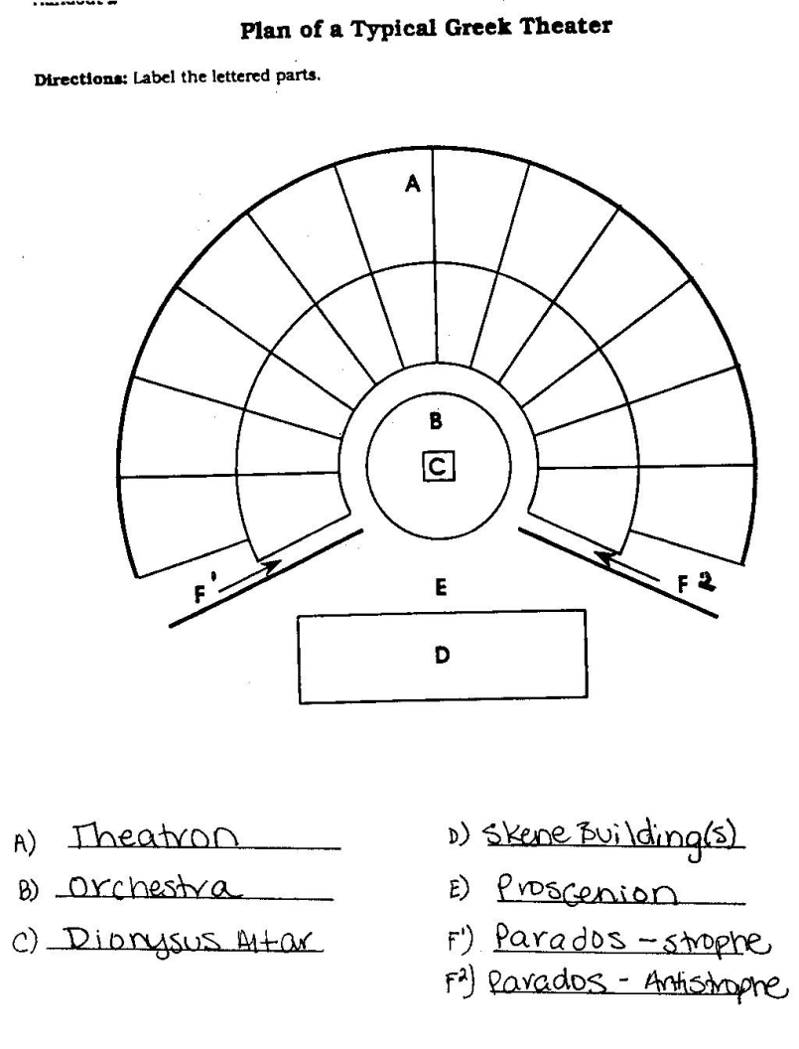
Plan of a Typical Greek Theater

Slide 10
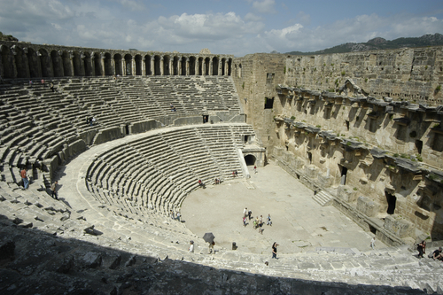
Greek Theater
This is what a Greek theater would have looked like.

Slide 11
Actors and Acting Hypocrites
Hypocrites—The word hypocrite was derived from the word for actor because the actor played a role or deceived an audience.
Protagonist—played leading role and minor roles
Deuteragonist—the second actor
Tritagonist—the third actor
A play could have many characters, but all the characters had to be divided among these three actors.
However, a play could have an unlimited amount of extras or mutes.

Slide 12
Actors and Acting Costumes and Masks
Actors were able to shift from character to character by using costumes and masks.
Actors changed their voice for each character.

Slide 13
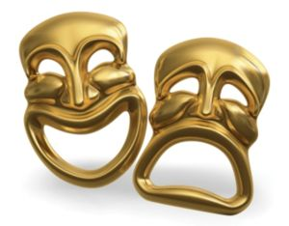
Masks
Actors wore many different types of masks. The large opening at the mouth was said to increase the volume of the actor’s voice.

Slide 14
Chorus Music and Dance
Greek tragedy used to involve only song and dance.
Greeks believed that musicians were an important part of celebrations and that each instrument had an emotional effect on the listener.
Dance, too, had special meaning for the Greeks.
The chorus moved in unison from left to right and back again or gestured in unison with broad sweeping hand motions.

Slide 15
Chorus Function
The chorus was made up of background characters, such as town elders, young maidens, or captives of war.
The chorus asked questions, commented on actions, offered approval or criticism and gave advice, usually through the chorus leader.
Choral odes were an important part of a tragedy.

Slide 16
Conventions Unities
Greek tragedy usually followed what Aristotle called the three unities.
Unity of Action had a single action with no subplots.
Unity of Time was limited to a 24 hour period.
Unity of Place meant one unchanging scene, marketplace, temple or courtyard.

Slide 17
Conventions Messenger
Playwrights employed the convention of messenger because of the religious nature of the theater and because of unity.
The messenger reported events that the audience couldn’t see as well as suggested acts of violence.
Violence could be suggested, but not depicted.

Slide 18
Conventions Limitations of Theater
The chorus was usually 50 men and remained on stage during the whole play.
The chorus remained silent in the background until the recitation of the choral odes.
Plays were performed during daylight hours in outdoor theaters.

