Slide 1
Thursday
October 8, 2020
Quick Write:
Write about a time when you witnessed something unfair.

Slide 2
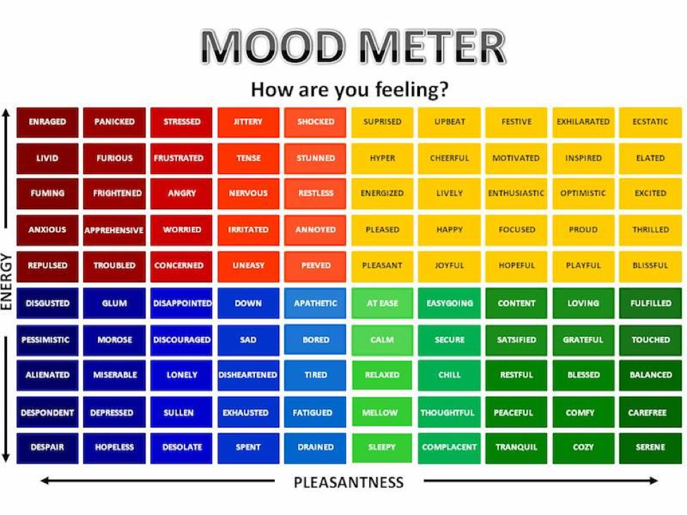

Slide 3
Social Emotional Learning Focus
SEL Video: GoNoolde Hand Jive (GoNoodle)

Slide 4
ELA
9:10-10:30
Thursday & Friday Lessons

Slide 5
Benchmark: Lesson 7- Cause and Effect
Read your Unit 1 Book Preview p.4-5. “The Structure of a Corn Plant”
Why does corn grow in so many places?
Break Out Room: Work with your team to annotate the text. Circle and connect other examples of cause and effect relationships (paragraphs 3-6)
Independent Work In Schoology:
Complete the Cause and Effect Assignment in Schoology
Notes:
Create Cause & Effect Chart (Copy from Teacher’s Manual add a column for paragraph reference)

Slide 6
Benchmark: Lesson 9- Informative Writing - Gather Information (facts, details, & quotes)
Watch “Harvesting Corn”
Model Filling out Key Idea & Facts/Details Organizer
Independent Work In Schoology:
View the video again and record at least three additional facts or details about harvesting corn.
Notes:
Create Graphic Organizer (Done)

Slide 7
Benchmark: Lesson 10- Visualization
Read your Unit 1 Book Preview p.6-7. “The Future of a Crop” - in ELA notebook
Paragraph 3: “Therefore corn is used to feed humans and livestock.”
Paragraph 8: “Keep Corn on the Cob - Not in My Car!”

Slide 8
Benchmark: Lesson 11- Informative Writing - Organizing Your Draft
Model: Organizing the Essay
Model Filling out Key Idea & Facts/Details Planning guide
Independent Work In Schoology:
Complete the Student Planning Guide
Notes:
Upload the Student Planning Guide

Slide 9
Math
10:40-11:45

Slide 10
Eureka: Lesson 16 Dividing Decimals
Review Lesson 16 Video
In your LEARN Book (p. 107-113)
Application Problem
Practice with Lesson 16
Independent Work In Schoology:
Lesson 16 Exit Ticket
M2L1 in Zearn

Slide 11
Social Studies
12:25-1:00

Slide 12
Social Studies + Asynchronous Work
Watch the taped lesson found in Schoology
Independent Work In Schoology:
Complete your exit ticket after you watch the lesson
Complete ReadWorks Article-A-Day activity
Read your choice book for 20 minutes
Complete all tasks in 10-8 folder in Schoology
Complete M2L1 in Zearn

