Slide 1
Tuesday
October 6, 2020
Quick Write:
Write about a time when you told a lie, but you shouldn't have. Why did you do it? How did it make you feel?

Slide 2
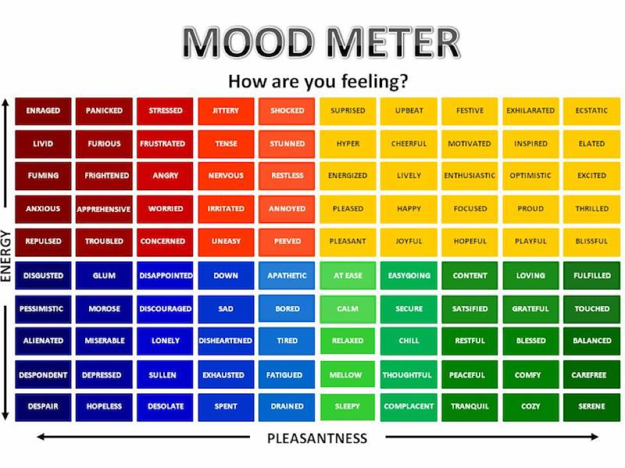

Slide 3
Social Emotional Learning Focus
SEL Video: How to Read Someone’s Mind. (GoNoodle)

Slide 4
ELA
9:10-10:25

Slide 5
Math
10:35-11:45

Slide 6
Eureka: Lesson 14
Dividing Decimals with Remainders
Review Lesson 14 Video
In your LEARN Book (p. 95-98)
Application Problem
Practice problems - Lesson 14
Independent Work In Schoology:
Lesson 14 Exit Ticket
Notes:
Lesson 13 Exit Ticket (Sylvia has it made)

Slide 7
Social Studies
Begin at 12:25
Log into Schoology and take your test. GOOD LUCK!

Slide 8
Afternoon Asynchronous Work
Independent Work:
ReadWorks: Choose one of the assigned “Article-A- Day” activities to complete. Be sure to do ALL assigned parts of your choice article.
20 minutes of Choice Reading.
Make observations of your mold terrarium

