Slide 1
Friday
October 2, 2020
Quick Write:
Imagine you woke up with the ability to fly. Where would you go and why?

Slide 2
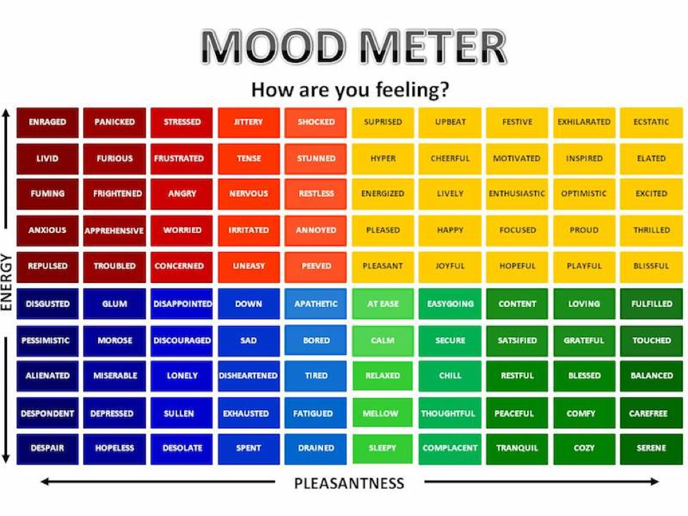

Slide 3
SEL Check-in
Watch the following BP Nellie Bly
Thoughts? Discuss in the chat.
Notes:
https://weather.com/weather/hourbyhour/l/7789d4498b384397eabdaf712275ad732858c45b6a050f390989122ca69fe47d

Slide 4
Today’s Agenda & Goal Setting
ELA Objectives:
C.O: I can write a How-To informative piece of writing.
L.O: I can in writing synthesize the knowledge that I have of proper mechanics to format a published copy of a How-To paragraph.
Today’s Agenda:
Morning Meeting/Log into Schoology and Benchmark
Make Up NWEA Testing
- - - - - - - - - - - - - - -
Asynchronous Work
YOU WILL BREAK FOR YOUR LUNCH by 11:45
Science/SS Whole Group (12:25 LOGIN)

Slide 5
ELA Block (9:20-11:45)
NWEA Make Up Assessments
Asynchronous work. Complete all items below: ALL STUDENTS WILL COMPLETE
1. You will listen to a story on ReadWorks about EMPATHY. You will complete the quiz at the end.
2. You will watch the Cause and Effect Lesson and complete the Cause and Effect Worksheet
3. Next, you will complete your HOW-TO paragraph on google docs. You will submit your pictures of your prewrites and your drafting using what you learned from all the mini lesson videos this week. Make sure you NAME your writing.
4. Complete the Mid Module Review assessment. Due Friday by 4pm.
5. Complete M1L16 in Zearn. You must be on MISSION 2 LESSON 1 by the end of the day.

Slide 6
Afternoon Work Time (12:25-1:00)
Afternoon Objectives:
Social Studies/Science
C.O: I can analyze the Bill of Rights and energy flow in a food chain.
L.O: I can orally and in writing discuss the review of the Bill of Rights and Food Chains
Kahoot Review Day!
Food Chains
Bill of Rights
Check on your Food Terrarium. Make a note on it’s progress.

Slide 7
Afternoon Asynchronous Work
Independent Work:
ReadWorks: Choose one of the assigned “Article-A- Day” activities to complete. Be sure to do ALL assigned parts of your choice article. Complete by 4pm.
20 minutes of Choice Reading. Complete by 4pm.
ALL OF Mission 1 in ZEARN MUST be completed today!
Complete the Schoology Scavenger Hunt (you MUST make your own copy) Review the navigating Schoology video if needed again.
You have your STEAM live lesson at 1:25pm

Slide 8
Have a wonderful day!

