Slide 1
Monday
October 5, 2020
Quick Write:
Name as many feelings words as you can.

Slide 2
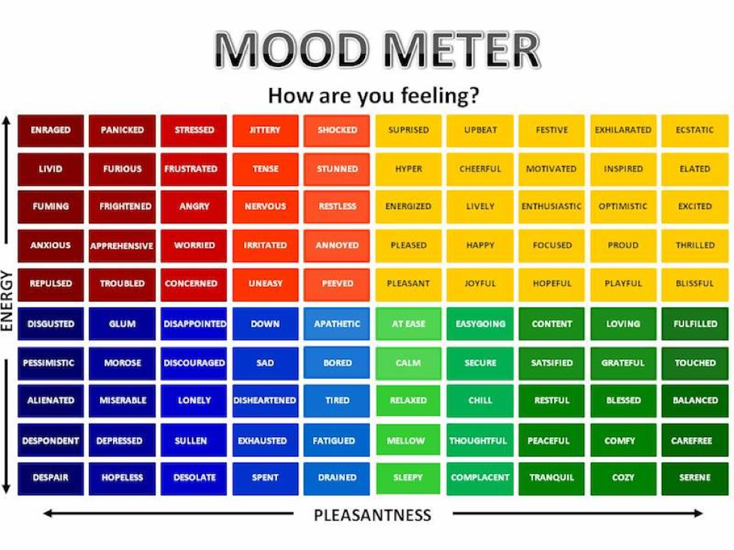

Slide 3
Social Emotional Learning Focus
Emotions Grow & Shrink (GoNoodle)

Slide 4
ELA
9:10-10:25

Slide 5
Benchmark: Lesson 1- Unit Preview & Questioning Strategies
Watch the “Cultivate Natural Resources” Video
Use your Unit 1 Book Preview P. 2-3
Break Out Room: Work with your team to come up with a list of questions you would like to explore during this Unit on Natural Resources. (Each person should contribute 2 questions to the team’s list. Write them down in your notebook.)
Report Out: Record in your Notebook (Circle Map)

Slide 6
Benchmark: Lesson 2- First Read - Vocabulary & Questions
Read your Unit 1 Book Preview p. 4-5. “The Structure of a Corn Plant”
Model Reading, Annotating & Questioning (paragraphs 1 & 2)
Guided Practice (paragraphs 3-6)
Independent Work In Schoology: Generate 2 after-reading questions that go with “The Structure of a Corn Plant”
Notes:
Create discussion post for 2 post-reading questions (Done)

Slide 7
Benchmark: Lesson 3- Informative Writing with a Mentor Text
Together create an anchor chart for Informative Writing
Independent Work In Schoology: Analyze the mentor text to identify the key components of an informative essay.
Notes:
Create an assessment dissecting a mentor text. (Drag & drop- Introduction; Supporting Details 1, 2, 3; Conclusion AND Main Ideas, Key details, Sources)
Dana will send the sample text to Sylvia

Slide 8
Math
10:30-11:45

Slide 9
Eureka: Lesson 13 Dividing Decimals
Review Lesson 13 Video
In your LEARN Book (p. 87-93)
Application Problem
Practice with Lesson 13
Independent Work In Schoology:
Lesson 13 Exit Ticket
Notes:
Lesson 13 Exit Ticket (Sylvia has it made)

Slide 10
Science
12:25-1:00

Slide 11
Science: Food Webs
Animal and Plant Life Cycles
Independent Work:
Students watch video.
Do assignment in Schoology.
Make observations of your mold terrarium

