Slide 1
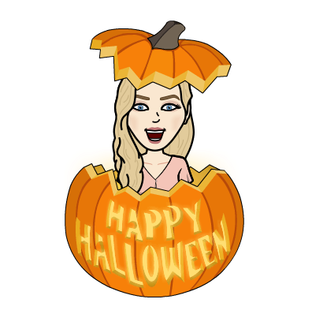
Thursday: 10-29-20
Quick Write:
What’s your favorite kind of sugar candy? Or do you prefer Chocolate candy?

Slide 2
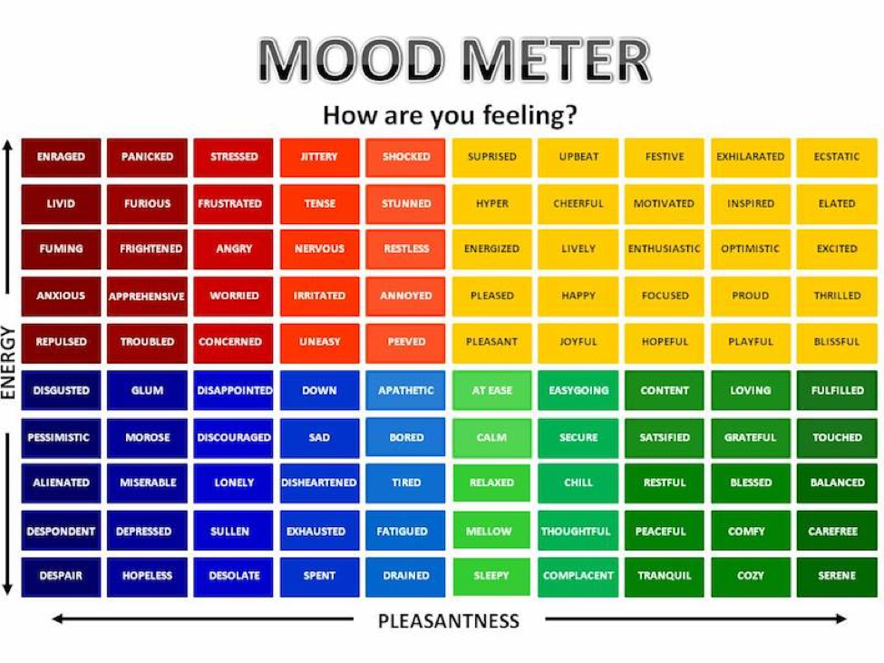
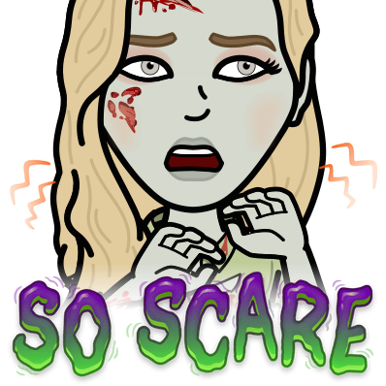
SEL Video: Trick of Treat

Slide 3
ELA
9:15-10:35
Benchmark lessons 10 & 11

Slide 4
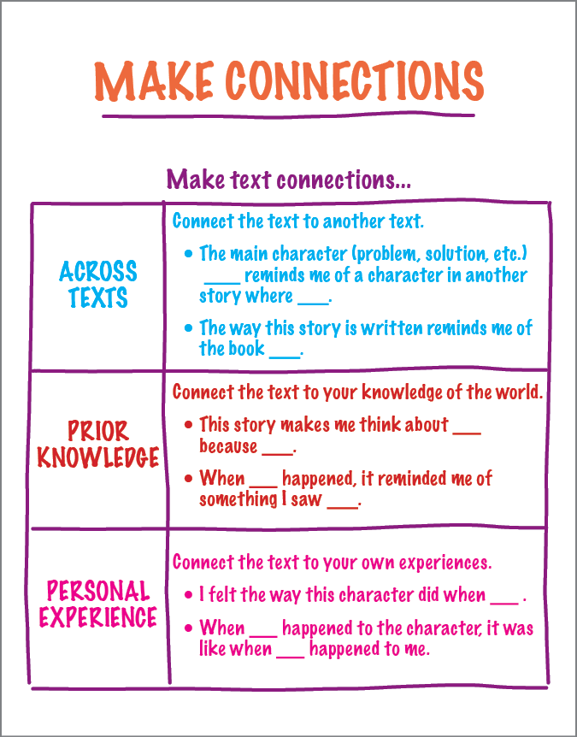
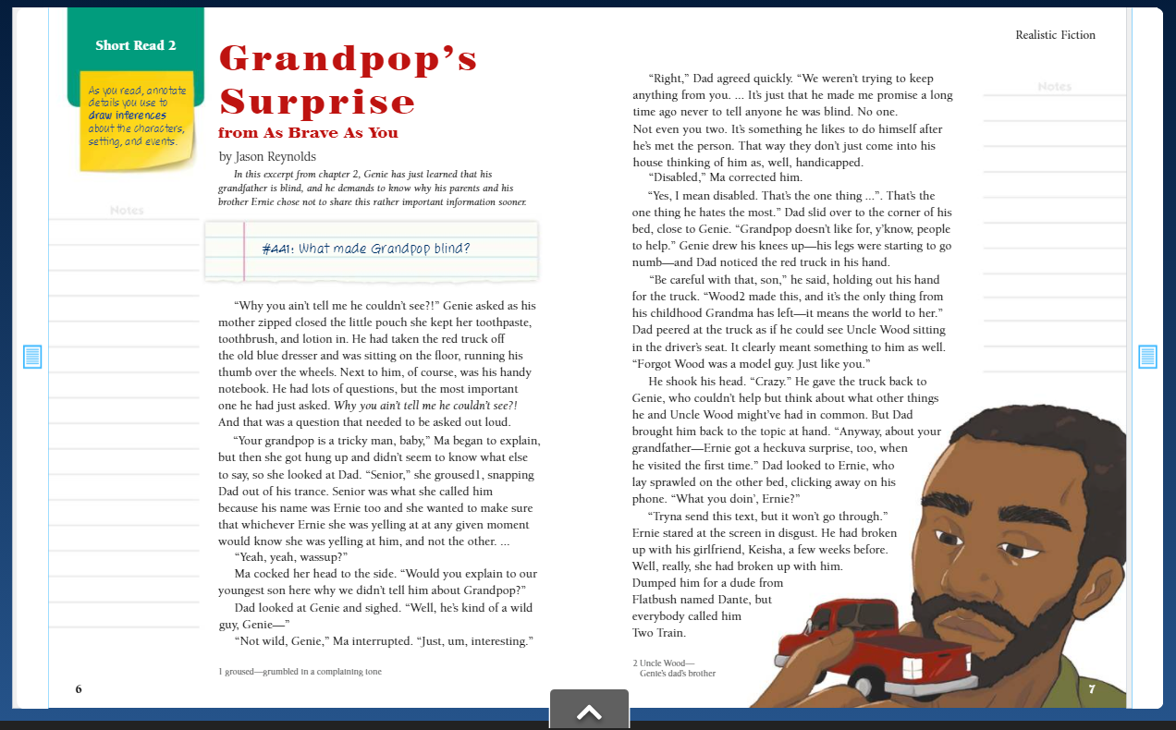
Benchmark:Unit 2:Lesson 10- first reading:make connections

Slide 5
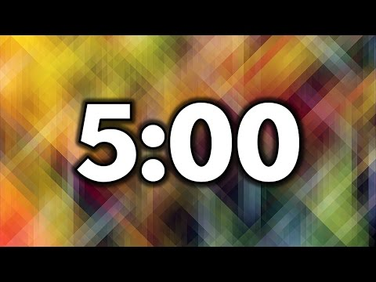
Guided practice: breakout room
Read paragraph 7. Discuss the text as a group and make connections to other texts, to prior knowledge, and to personal experiences.

Slide 6
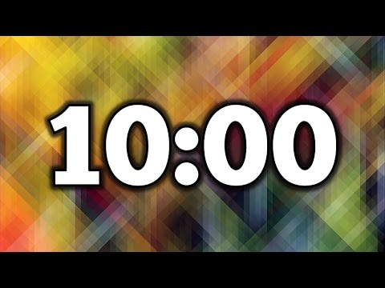
Independent Practice - Small Group
Independent Practice
Read paragraphs 11-16
Write a few sentences that explain how they connected the events or the characters to their personal experience, prior knowledge about the world, or to other texts.
Small Group
Bring your notebook, Close Reading Text (on Benchmark), and a pencil.
Group
Zak
Shaima
Mustafa
Jana
Abrar

Slide 7
Benchmark: lesson 11:write an opinion
essay: analyze a concluding statement

Slide 8
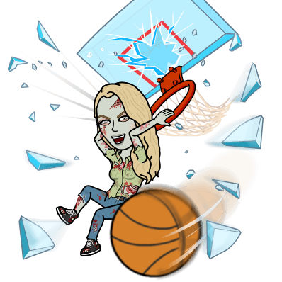
Guided practice: breakout room

Slide 9
Independent Practice - Small Group
Independent Practice
Create a different concluding statement for the mentor opinion essay on Schoology.
Small Group
Bring your notebook, Close Reading Text (on Benchmark), and a pencil.
Group
Sarah
Rana
Islam
Adam
Hana

Slide 10
Math
10:30-11:45
Watch the math video on your own and take notes
15 - minutes

Slide 11
Math Work
Whole Group
Math application problem Page 215
Page 216 #4
Page 217 ALL
Page 218 b, c, f
Whole Group
Page 218 d,e
Independent Practice
Lesson 14 Exit Ticket on Schoology
Zearn M2 L15 (BE ON 16)

Slide 12
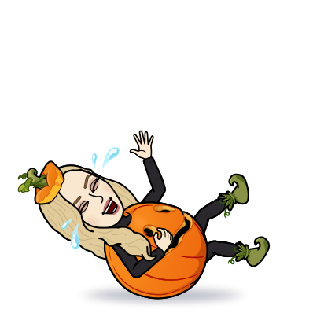
Afternoon Check In
12:25
Afternoon Preview

Slide 13
Asynchronous Work
Go into the social studies folder (inside the 10-29 folder) in schoology and review the links. Complete the readings and watch the video. Take notes in your SS Notebook!
Exit ticket in Schoology

Slide 14
Afternoon Asynchronous Work
Independent Work In Schoology:
Ensure that all tasks in 10-29 folder are completed.
Daily Additional Independent Work: NO READWORKS AGAIN THIS WEEK
Choice read for 20 minutes - Read books on your bookshelf in Benchmark.
You should be on Lesson 16 in Zearn by the end of the day
Tomorrow is a half day
No School next Tuesday
SIGN UP FOR CONFERENCES!
Reading Group at 12:35pm
Jordan, Ibrahim, Rena, Aiden, Ayat
Open your Benchmark Assignments to get your Book Club Book

