Slide 1
Friday: 10-30-20
Half-day
How do you feel about Halloween?

Slide 2
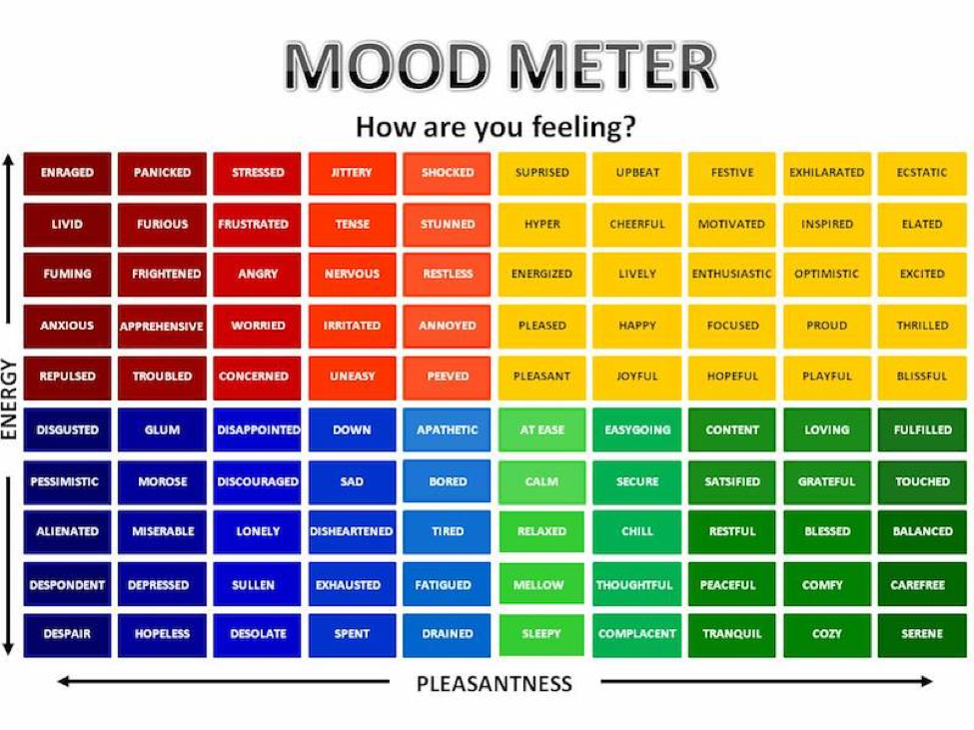
SEL Video: GoNoodle Bones! Bones! Bones

Slide 3
WOuld you rather?.

Slide 4
Would you rather...
Be chased by 5 zombies
or
Be chased by 1 werewolf

Slide 5
Would you rather
Meet a ghost
or
Meet a Vampire

Slide 6
Would you Rather….
Walk through a graveyard
Or
Walk through a haunted house

Slide 7
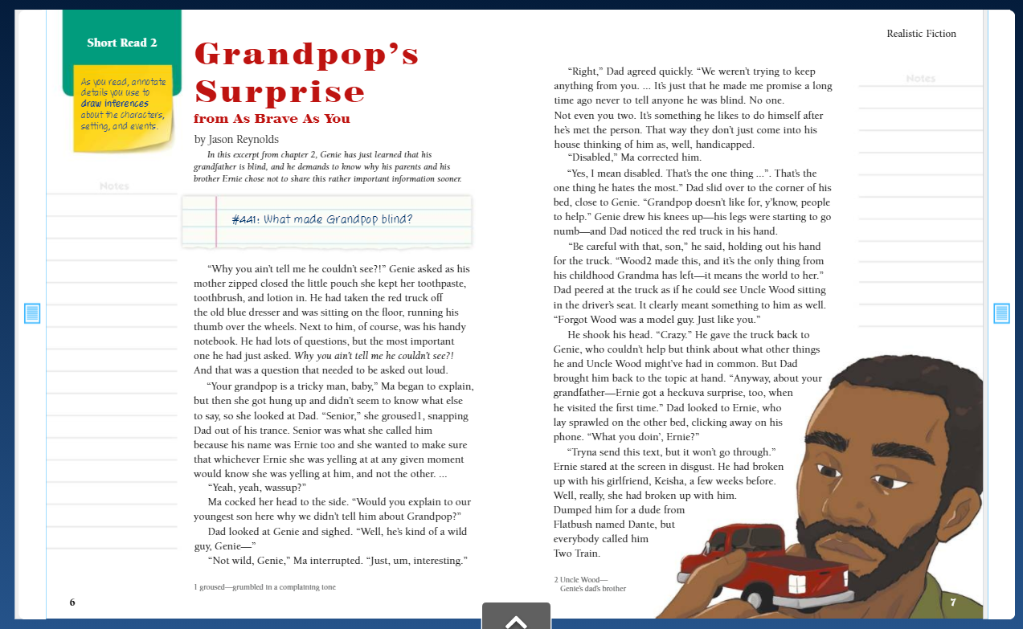
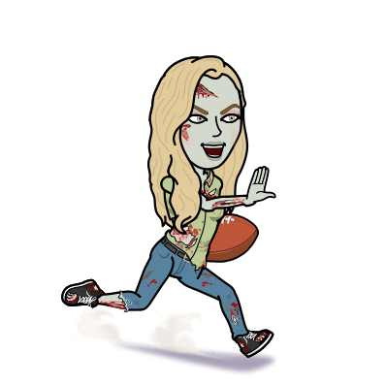
Benchmark:Unit 2:Lesson 13- analyze how visual elements contribute to meaning and tone

Slide 8
Independent Practice -
Look at the illustrations in “The Drive Down.”
Write 3-4 sentences that analyze how the illustrations add to the tone and meaning of the story in your notebook.
When finished, begin copying down the chart on the next slide in your ELA notebook.

Slide 9
Benchmark: lesson 14:grammar: from and use
the past perfect tense (copy this in your notebook)
Verb Tense | Tells About... | How the Verb Tense is Formed | Example
Past Tense | An action that occured in the past before another action was completed | Had + past participle | I had finished the job before I ate lunch.
Present Perfect | An action that was completed. | Have +past participle | I have finished the job.
Future Perfect | An action that will occur before another action. | Will have + past participle | I will have finished the job before I eat dinner.

Slide 10
Guided practice: breakout room
Come up with three sentences on your own in your notebook. Share in your group. Use the chart you just copied to help you!
Past-Perfect
Present-Perfect
Future-Perfect

Slide 11
Independent practice - Asynchronous Work
Independent Work In Schoology:
Complete Task #14 in 10-30 folder on Verb Tense.
Ensure that you complete your BENCHMARK ASSESSMENT (find it under assignments in Benchmark)
Daily Additional Independent Work: NO READWORKS AGAIN THIS WEEK
Choice read for 30 minutes - Read books on your bookshelf in Benchmark.
MAKE SURE YOU ARE ON Lesson 16 in Zearn
No School next Tuesday
SIGN UP FOR CONFERENCES. I will assign you a time if not chosen by 11/2.
Sign up on Prodigy (look at the blog). Log in as a Dearborn student. Battle it out with your classmates!
Math Activity:
Look inside the 10-30 folder on Schoology and select the Candy Corn challenge. Here is a copy of the Challenge to complete should you wish. Complete this today for EXTRA CREDIT in math!

