Slide 1
Friday
October 16, 2020
Quick Write:
Reflect on your work you’ve done in class. Do you think you are putting forth your BEST effort? What evidence do you have to support your claim?
SEL Video: Biography video on Malcolm X

Slide 2
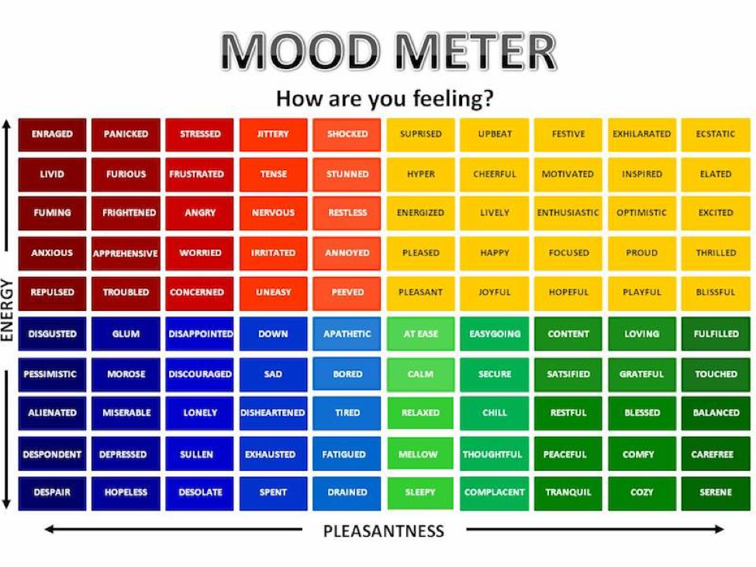

Slide 3
ELA
9:10-10:25

Slide 4
Benchmark: Unit 1- Week 2- Lesson 13- Language in Context: Combine Sentences for Meaning, Interest, and Style
What are conjunctions? F A N B O Y S and AAAWWUBBIS words video (take notes)
Combine the following two sentences using a conjunction:
Corn is used as a food for people. It is also used as food for livestock.
Corn on the cob is sweet. Corn for popcorn comes from dent corn.
Work in breakout rooms to combine the following sentences: People grew corn in other regions. They migrated to different places.
Decide what conjunction best combines these two thoughts. Come to an agreement
4 minutes
Review your rubric in Schoology - make the necessary updates when evaluating your writing later today

Slide 5
Benchmark: Lesson 11 REVIEW
Writing: Plan and Organize Your Ideas
Focus today is to look at our writing and replace sentences with conjunctions where appropriate and expand to include hybrid corn production.
Review the Prompt: Write an informative/explanatory essay in which you explain: How corn is produced in the United States. (essay)
In Breakout Groups: review your graphic organizer writing from yesterday. Reread paragraphs 2-3 of “The Future of a Crop” and paragraphs 10-13 of “A Short History of a Special Plant”. Integrate information from both texts and discuss hybrid corn production in the US. Be sure to add this information into your essay outline where appropriate. 15 minutes
In New Breakout Group: Discuss how you could make your writing better. 10 minutes

Slide 6
Math 10:30-11:45

Slide 7
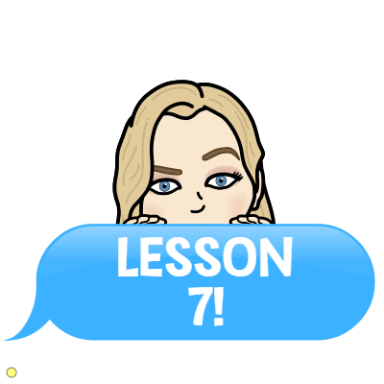
Eureka: Module 2- Lesson 5
Application Problem page 149 - 4 minutes
Review M2 Lesson 5 Video
Learn Pages (151-152)
Practice
Exit ticket in Schoology
Independent Work Asynchronously this afternoon
Zearn M2L6 (Be on lesson 7)
Notes:
Lesson 13 Exit Ticket (Sylvia has it made)

Slide 8
BENCHMARK
Preview & Check in
12:25

Slide 9
Independent Practice
Complete your Unit 1 Week 2 Assessment in Benchmark. Look for it in your assignments. This is a TEST. Good Luck!

Slide 10
After Check - In:
Afternoon/Asynchronous Work
Independent Work In Schoology:
Complete your Unit 1 Week 2 Assessment in Benchmark (assignments)
Ensure that all tasks in 10-16 folder are completed in Schoology
Daily Additional Independent Work:
Complete ReadWorks Article-A-Day assignment - Must have 5 done!
Choice read for 30 minutes
Complete Zearn M2L6
Behind? You’re staying online!
Small Group:
Group 1: Adam, Hana, and Rana- 12:45 Group 2: Daniel, Giselle, Kaydn, Khaled-1:00

