Slide 1
Thursday
October 15, 2020
Quick Write:
Write a short story about how you and your best friend met.
SEL Video: Kid President Kindness video

Slide 2
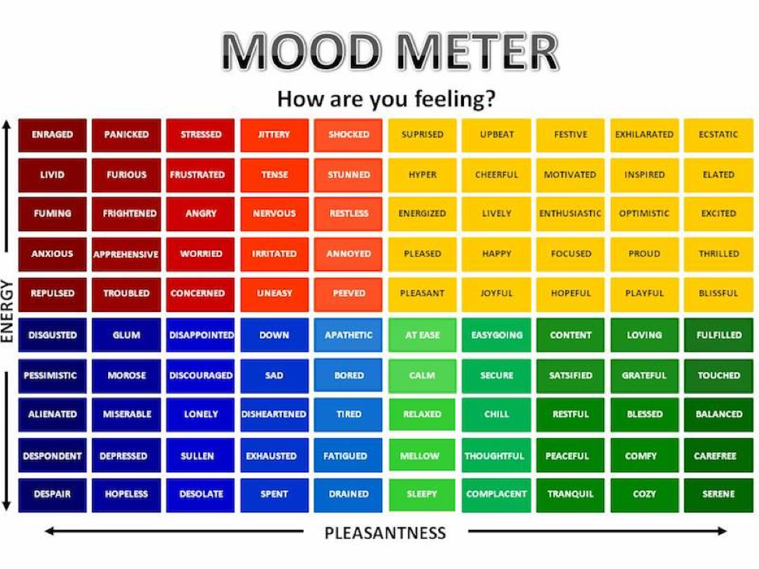

Slide 3
ELA
9:10-10:25

Slide 4
Benchmark: Unit 1- Week 2- Lesson 10- Draw on Information from Multiple Sources/Cause & Effect Questions
What is Cause & Effect?
Review Early Cultivation section and the diagram on page 13.
Question: What aspects of the Three Sisters planting method made it successful? Based on sources, explain how this approach was so successful. How does knowing this help you better understand the early days of corn production?
Cause:
Effect:

Slide 5
Small Group & Independent Practice Task #10
Small Group: Reread paragraphs 7-9 and look at the graphs entitled “The Corn Belt” and “Corn for Grain 2010 Production by County for Selected States.”
Answer: WHY did the Midwest become known as the nation’s “Corn Belt”? UNDERLINE information in the text and annotate the graph to support your response.
7 minutes
Discuss
Independently: Reread paragraphs 14-15 and refer to the graph “US Corn Production”.
ANSWER TASK #10 IN SCHOOLOGY: Based on this information, what factors may have contributed to the decline in corn production in 2012? Cite Specific evidence from the text to support your answer. DISCUSS the cause and effect relationships mentioned.
10 minutes

Slide 6
Benchmark: Unit 1- Week 2- Lesson 12- Close Reading: Integrate Information from Two Text on the Same Topic
Together: Review readings. Reread paragraphs 3-4 from “The Structure of a Corn Plant” and paragraphs 4-5 from “A Short History of a Special Plant”. Integrate information from both text to DESCRIBE HOW THE CORN’S STALK HELPS THE CORN PLANT GROW AND STAY HEALTHY.
Breakout Groups: Reread paragraph 1 in “The Structure of a Corn Plant” and paragraph 6 in “A Short History of a Special Plant.” Integrate information from both text to explain the role Native Americans played in the cultivation of corn. Cite specific evidence from the texts in your answer. Discuss
Independent Work: Task #12 In Schoology.
Reread paragraphs 2-3 of “The Future of a Crop” and paragraphs 10-13 of “A Short History of a Special Plant”. Integrate information from both texts and explain how hybrid corn has helped the United States. Cite specific evidence from the text to support your answer.
10 minutes

Slide 7
Math 10:30-11:45

Slide 8
Eureka: Module 2- Lesson 4
Application Problem page 141 - 4 minutes
Review M2 Lesson 4 Video
Learn Pages (143-145)
Practice
Exit ticket in Schoology
Independent Work Asynchronously this afternoon
Zearn M2L5 (Be on lesson 6)
Notes:
Lesson 13 Exit Ticket (Sylvia has it made)

Slide 9
Writing
12:25-1:00

Slide 10
Benchmark: Lesson 11- Writing: Plan and Organize Your Ideas
Focus today is a planning guide. How to utilize a planning guide to construct your writing effectively.
Review organizing essays video
Review the Prompt: Write an informative/explanatory essay in which you explain How corn is produced in the United States.
Complete graphic organizer TOGETHER - Model structure, Student copy, Work with peers
Small group: review your writing from yesterday and fill in your own table. Discuss how you could make your writing better. Orally discuss in your small groups WHERE the remaining key ideas will fit in the essay.
Introduction
Body Paragraph #1
Body Paragraph #2
Conclusion

Slide 11
Independent Practice
Continue to work on your Essay in Schoology
During your independent writing time, students should continue to work on your essays. Now we are ensuring proper organization of our essay that answers the question: How is corn produced in the United States. Using the notes from this week and last you will be organize your paragraphs in a more purposeful, informative way.
Paragraph #1: On traditional farms in the Midwest
Paragraph #2 Utilizing CSA to produce crops
Make sure you: Provide relevant information!

Slide 12
After 1pm:
Afternoon Science/Asynchronous Work
Independent Work In Schoology:
Watch Taped social studies lessons part 1 and part 2 and complete the writing response question exit ticket in Schoology
Ensure that all tasks in 10-15 folder are completed in Schoology
Daily Additional Independent Work:
Complete ReadWorks Article-A-Day assignment
Choice read for 20 minutes
Complete Zearn M2L5
Small Group:
Group 1: Shaima, Abrar, Sarah - 1:00 Group 2: Jana, Mustafa, Islam, Zak - 1:20

