Slide 1
Wednesday
October 14, 2020
Quick Write:
What is your definition of success in life?
SEL Video: Kid President Pep-Talk video

Slide 2
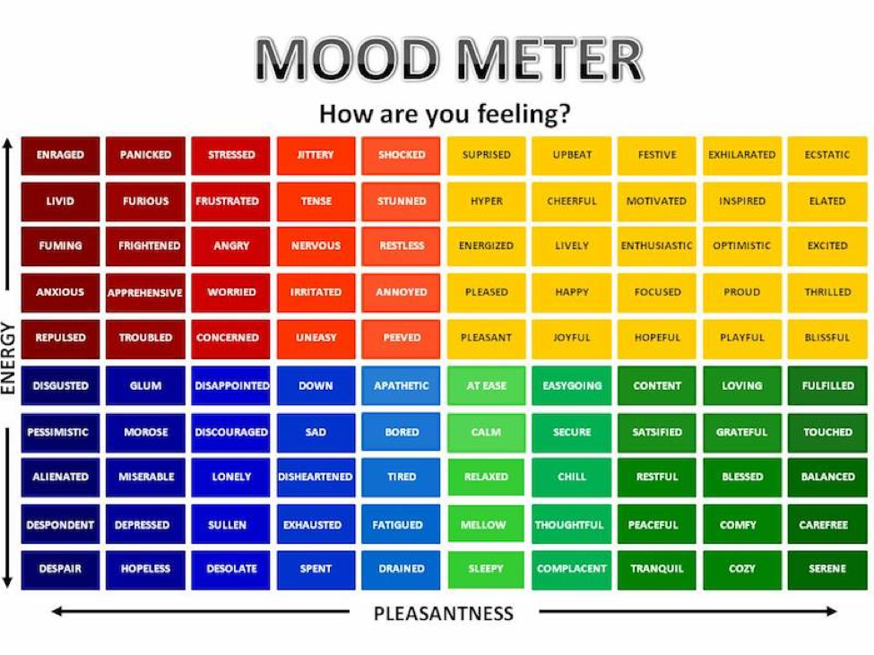

Slide 3
ELA
9:10-10:20

Slide 4
Benchmark: Unit 1- Week 2- Lesson 7- Coordinating Conjunctions and Independent Clauses
F A N B O Y S conjunction song
Display page 12 - Look at paragraph 2. Model
Maize spread through North and South America, and it became a major part of the Native American diet.
In the past, a farmer would grow corn year after year in the same field, and the soil would get worn out.
Notes:
Ask groups how using the graphic features and key details helped them determine how the “three sisters” planting method helped grow healthy crops.

Slide 5
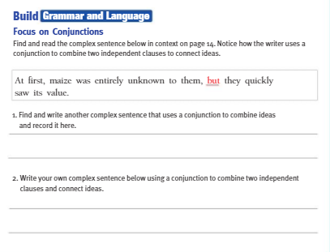
Independent Practice
Complete the Build Grammar and Language section on p.19 of Cultivating Natural Resources.
Take a picture of your book and submit it on Schoology.

Slide 6
Benchmark: Unit 1- Week 2- Lesson 8- Close Reading: Determine the Author’s Point of View and Purpose
Review pages 12-16 again. What is Close Reading?
Page 13 - “Early Cultivation”. What is the author’s point of view of the “Three Sisters” farming method?
Underline specific language to support your answer. Determine: based on this point of view, what can you infer about the author’s purpose for writing this section?
Breakout Rooms with groups: Point of View/Author’s Purpose
Reread “The Corn Belt” on pages 14-15. What is the author’s point of view on farming practices in the Midwest? Cite specific language to support your answer. Based on this information, make an inference about the author’s purpose for writing this section.
Notes:
Share and reflect on importance of confriming the meaning of domain-specific words

Slide 7
Independent Practice
See Schoology for your task #8 Reread the section “The Rise of Industrial Farming.” Be prepared to answer this question: What do the details reveal in this section about the author’s point of view on the impact of new farming techniques? What is the author’s purpose in this section? Cite evidence to support your answer.

Slide 8
Math
10:30-11:45

Slide 9
Eureka: Module 2- Lesson 3
Review M2 Lesson 3 Video
Learn Pages (133-139)
Application Problem
Practice
Exit ticket in Schoology
Independent Work Asynchronously this afternoon
Zearn M2L4 (Be on lesson 5)
Topic A quiz in Schoology
Notes:
Lesson 13 Exit Ticket (Sylvia has it made)

Slide 10
Writing
12:25-1:00

Slide 11
Benchmark: Lesson 9- Gather Notes From a Video Source
Use the “A Short History of a Special Plant” (pages 12-16) print source taking notes on facts and details about important ideas.
Review the Prompt: Write an informative/explanatory essay in which you explain how corn is produced in the United States.
Review video on CSA - complete chart
Small group: review video again, look and listen for information about how corn is grown and harvested on a CSA
Key Idea | Key Words | Facts and Details
 | CSA, shareholders

Slide 12
Independent Practice
See Schoology for your task #9
During your independent writing time, students should continue to work on your essays. By now you are able to write clearly to your prompt: How is corn produced in the United States. Using the notes from this week and last you will be constructing an introduction paragraph and two body paragraphs.
Make sure you: Provide relevant information!

Slide 13
After 1pm:
Afternoon Science/Asynchronous Work
Independent Work In Schoology:
Watch recorded Science lesson and complete exit ticket in Schoology
Ensure that all tasks in 10-14 folder are completed
Independent Work:
Complete ReadWorks Article-A-Day assignment
Choice read for 20 minutes
Complete Zearn M2L4

