Slide 1
Tuesday
October 13, 2020
Quick Write:
Imagine you are having a big party at your house. What things would you want at your party?
SEL Video: Developing a Growth Mindset video

Slide 2
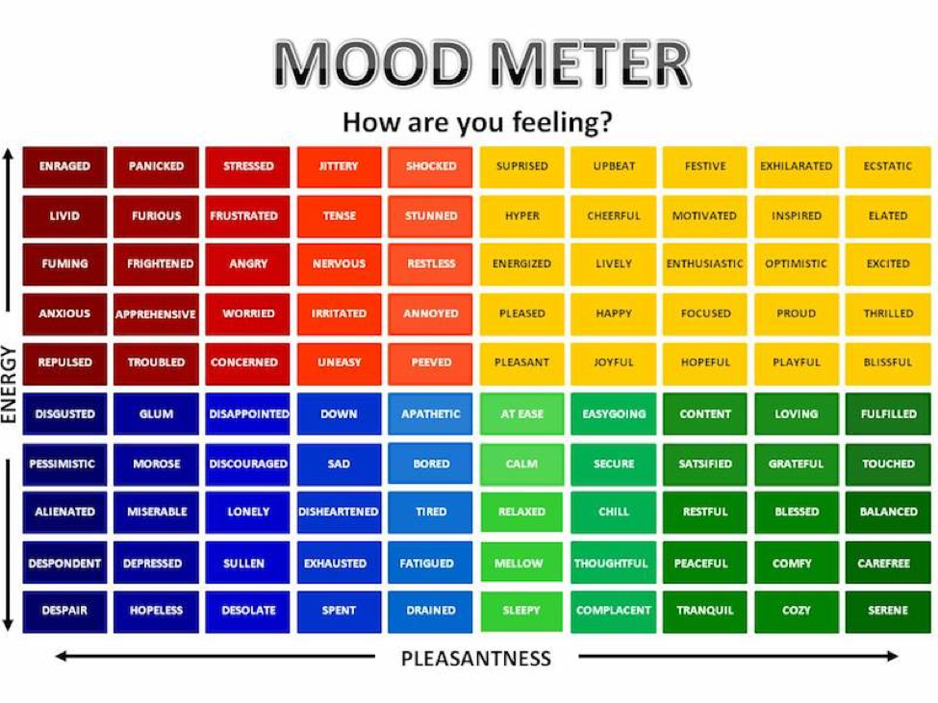

Slide 3
ELA
9:10-10:20

Slide 4
Benchmark: Unit 1- Week 2- Lesson 4- Identifying Key Details and Determine Central Ideas
Read “A Short History of a Special Plant” Unit 1 Book P. 12-16- Questioning & First Read
Determine Central Idea - Anchor Chart review. See Blog
Guided Practice paragraphs 4-6
Independent Practice- paragraphs 7-9/Complete Chart with breakout groups.
Key Details | Central Idea
Notes:
Ask groups how using the graphic features and key details helped them determine how the “three sisters” planting method helped grow healthy crops.

Slide 5
Benchmark: Unit 1- Week 2- Lesson 5- Build Vocabulary: Determine the meaning of Domain- Specific Vocab
Review unknown words in informational text - use context clues to uncover meaning.
Together - page 13/paragraph 5. Compare context clues to definition
Breakout Rooms with groups:
Word | Context Clues | Definition
Rotation
Hybrid
Notes:
Share and reflect on importance of confriming the meaning of domain-specific words

Slide 6
Math
10:30-11:45

Slide 7
Eureka: Module 2- Lesson 2
Start off with Breakout Room/ Page 119/120 #2 a-e (T/F)
Review M2 Lesson 2 Video
Learn Pages (127-131)
Application Problem
Practice
Independent Work In Schoology
Lesson 2 Exit Ticket
Independent Work Asynchronously this afternoon
Zearn M2L3
Notes:
Lesson 13 Exit Ticket (Sylvia has it made)

Slide 8
Writing
12:25-1:00

Slide 9
Benchmark: Lesson 6- Gather Facts/Details from Printed Sources
Review the Prompt: Write an informative/explanatory essay in which you explain how corn is produced in the United States.
Today we are finding relevant facts and details from the print source, “A Short History of a Special Plant” (pages 12-16) - Re read paragraphs 7-9 (model)
Key Idea | Key Words | Facts and Details

Slide 10
Benchmark: Lesson 6- Gather Facts/Details from Printed Sources
Breakout Rooms to continue to work on paragraphs 10-15. Utilize diagram on page 16 as well
Key Idea | Key Words | Facts and Details

Slide 11
Benchmark: Lesson 6- Gather Facts/Details from Printed Sources
Independent Writing Time - You will re read the section titled “Early Civilization” on page 13. Underline facts and details and record them in a table in your ELA notebook.
Circle the most important facts that should be included in an essay about how corn is produced in the United States.
Self monitor - Why do you think ________ is an important fact? How will you include in in your essay?
Validating and Confirming - _______ and _______ are facts and details that will be helpful when you write your essay.

Slide 12
After 1pm:
Afternoon Social Studies/Asynchronous Work
Independent Work In Schoology:
Watch recorded Social Studies lesson and complete exit ticket
Complete Zearn M2L3
Independent Work:
Complete ReadWorks Article-A-Day assignment
Choice read for 20 minutes
Small Group Schedule:
Jana, Mustafa, Zak, Islam 1:20 Shaima, Abrar, Sarah 1:40

