Slide 1
Monday
October 12, 2020
Quick Write:
Write about a time you broke something
SEL Video: What is SEL? Why it matters video

Slide 2
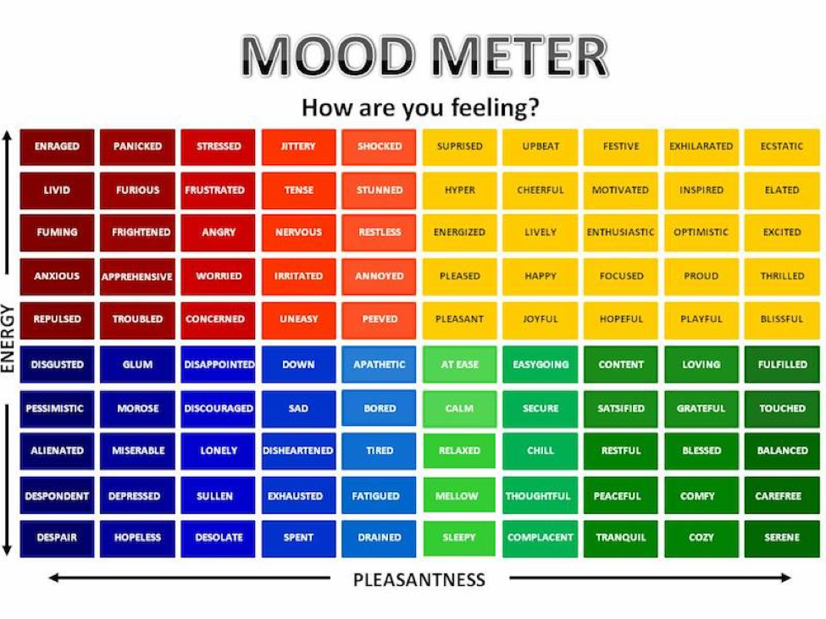

Slide 3
ELA
9:10-10:30

Slide 4
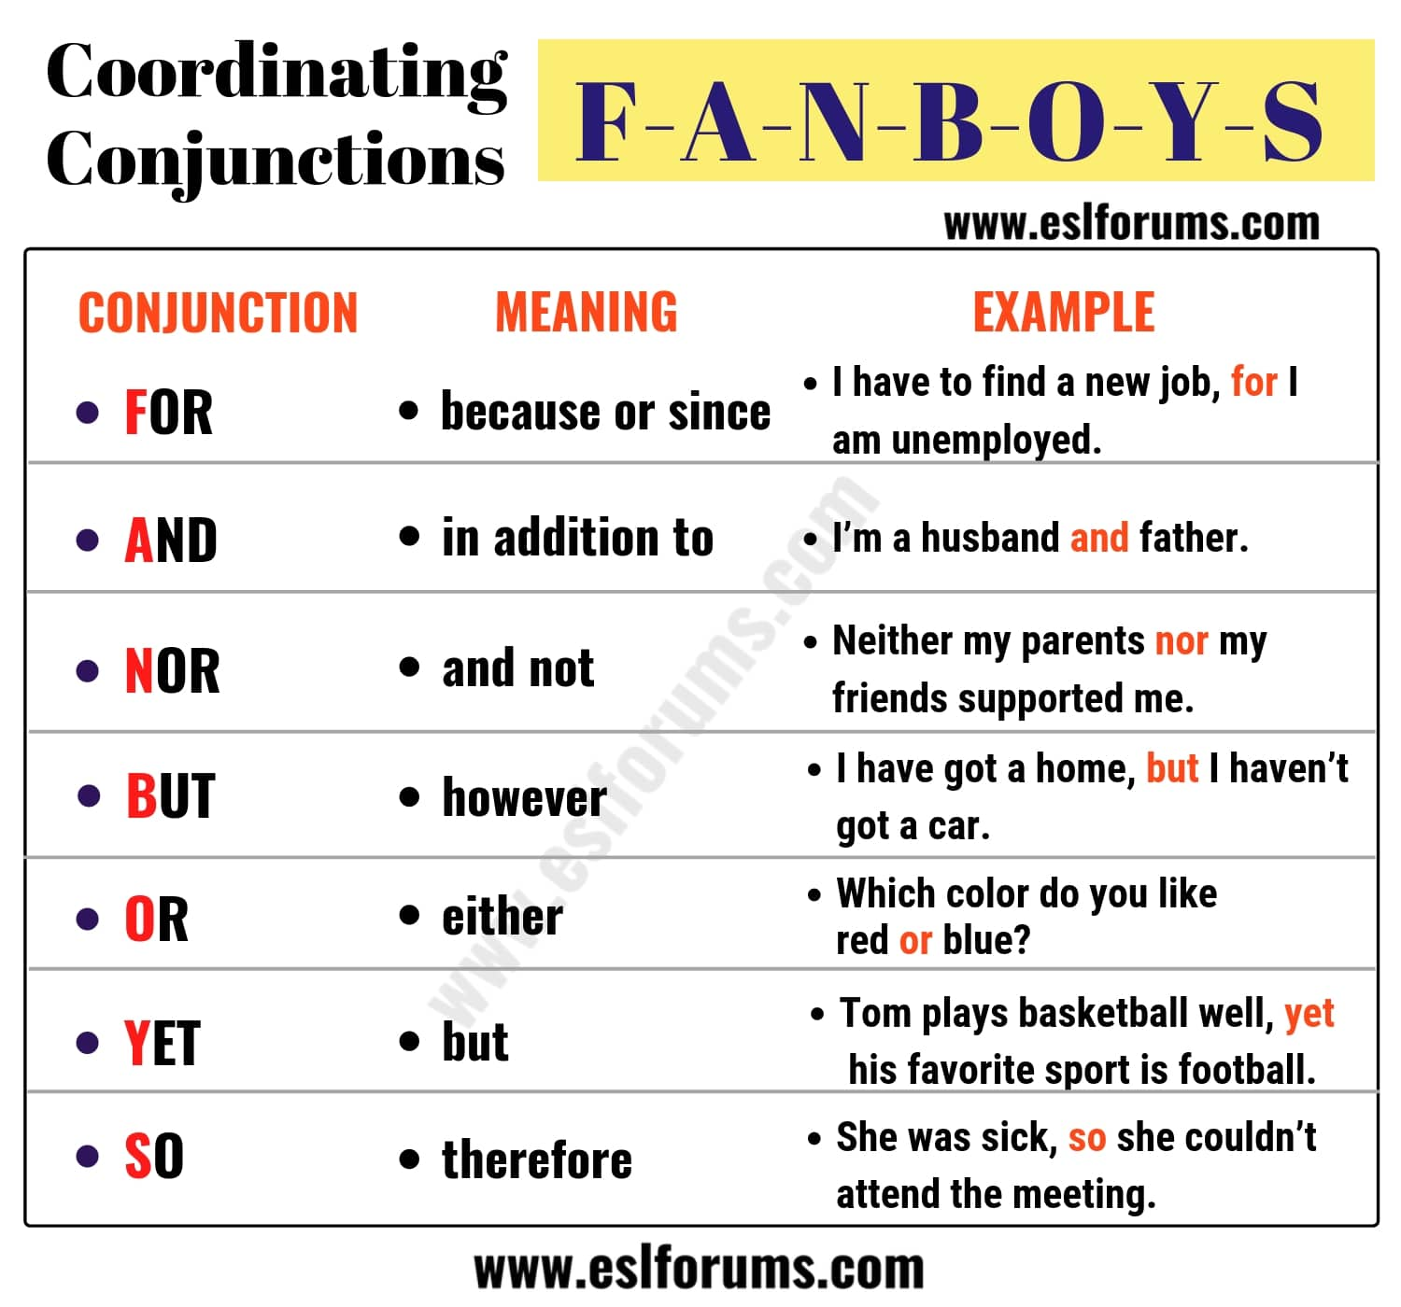
Benchmark: Lesson 14 - Conjunctions
Watch the following video and take notes in ELA notebook.

Slide 5
Benchmark: Unit 1- Week 2- Lesson 1- Unit Preview & Questioning Strategies
Read “A Short History of a Special Plant” Unit 1 Book P. 12-16- Questioning & First Read
Model pp. 1-3
Guided Practice pp.4-5
Independent Practice- pp. 6-15
Independent Work In Schoology: Generate 1 after-reading questions that go with today’s reading.

Slide 6
Benchmark: Unit 1- Week 2- Lesson 2- Long Vowel Syllable Patterns
Review long vowel syllable patterns
Independent Work In Schoology:
Syllable Practice
Context Clues Practice
Build Vocabulary (p. 19 in Cultivating Natural Resources book)
Notes:
Create discussion post for 2 post-reading questions (Done)

Slide 7
humor
elevate
provide
breeding
propose

Slide 8
Math
10:35-11:45

Slide 9
Eureka: Module 2- Lesson 1: Mental Strategies for Multi-Digit Whole Number Multiplication
Review M2 Lesson 1 Video
Learn Pages (117-125)
Application Problem
Quick Practice
Small group work in Schoology:
Lesson 1 Exit Ticket
Independent Work In Schoology
Unit 1 ASSESSMENT
Notes:
Lesson 13 Exit Ticket (Sylvia has it made)

Slide 10
Writing
12:25-1:00

Slide 11
Benchmark: Lesson 3- Analyzing the Writing Prompt
Show short video on structuring informative writing.
Think, what questions should we answer in our writing?
Review the Prompt:
Based on facts and details from the text and illustrations of “A Short History of a Special Plant” and information from the video “Corn from the CSA,” write an informative/explanatory essay in which you explain how corn is produced in the United States.
Independent Work In Schoology: Generate questions about corn production that will help them focus on main ideas and key details as they read and view sources.

Slide 12
After 1pm:
Afternoon Science/Asynchronous Work
Independent Work In Schoology:
Watch Generation Genius Video-Habitats and complete the exit ticket.
Complete Math Module 1 Assessment
Complete outstanding assignments not finished in class (10-12 folder)
Independent Work:
Complete ReadWorks Article-A-Day assignment
Choice read for 20 minutes
Small Group Schedule:
Jana, Mustafa, Zak, Islam 1:20 Adam, Hana, Rana 1:40

