Slide 1
Quick write:
if you could drive, Where would you go? What would you do?

Slide 2
tuesday
October 20, 2020
SEL Video: Taking responsibility for your actions

Slide 3
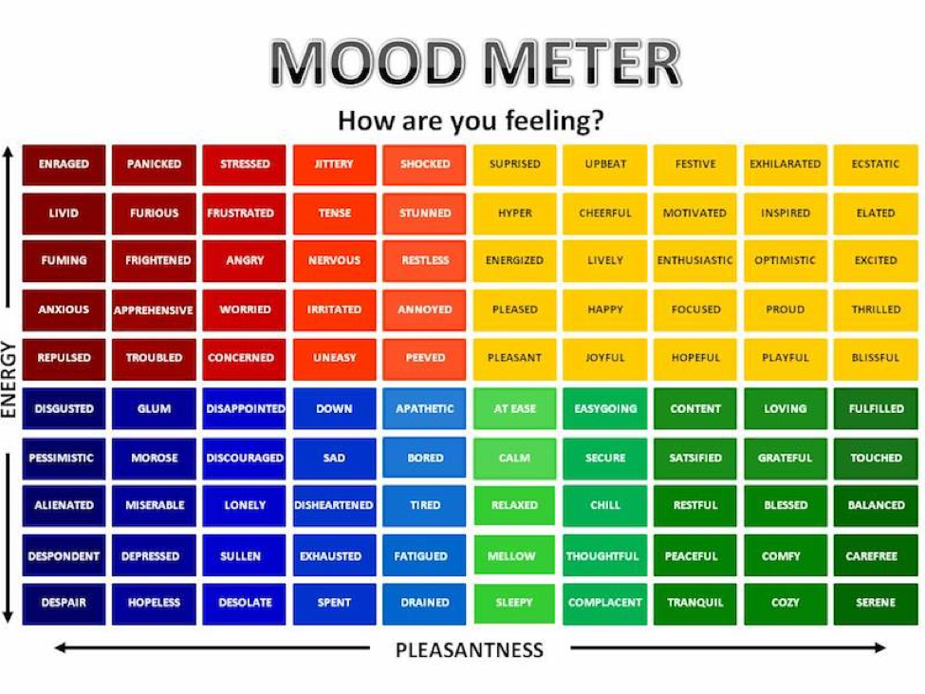

Slide 4
ELA
9:10-10:30

Slide 5
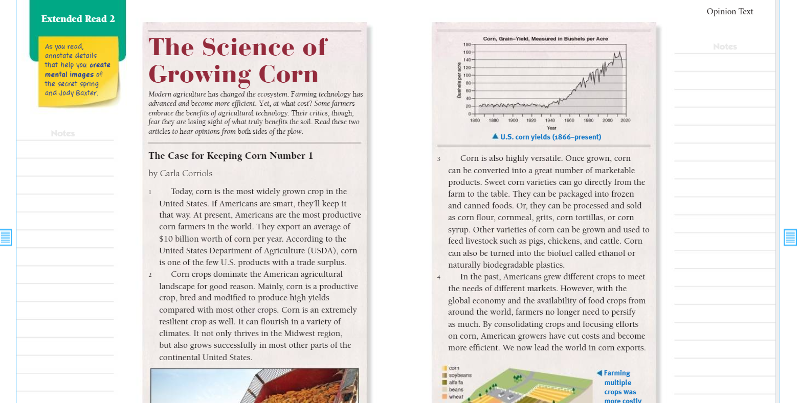
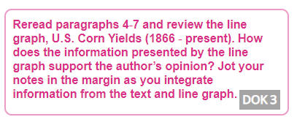
Benchmark:Week three:Lesson 4- Draw on Information from Multiple Sources
Constructive Conversation: Partner

Slide 6
Reinforce or Reaffirm the Strategy
If... | Then...
Students need support to integrate information from the text and line graph...
Students independently integrate information from the text and line graph...

Slide 7
Independent Practice - Small Group
Independent Practice in SCHOOLOGY
Answer Question 1 in Write: Use text evidence on Page 26 of Cultivating Natural Resources.
Upload a picture on Schoology.
Continue to build your bookshelf when you are done. Free read if you have time.
Small Group
I will be joining your small groups!

Slide 8
Benchmark: lesson 5: Language in context: correctly use frequently confused words - Video/take Notes
Homophones are words that sound alike, but are usually spelled differently and have a different meaning.
Common homophones include: their/there/they’re;
buy/by/bye; cell/sell; whole/hole; where/wear; write;right.

Slide 9
Language in context:
correctly use frequently confused words there/their/they’re video
Their critics, though, fear they are losing sight of what truly benefits the soil.
In the Midwest, there are critics who fear that farmers are losing sight of what truly benefits the soil.

Slide 10
Guided practice: work with groups
Directions: Circle the words in each sentence that are homophones. Discuss the meanings of the words.
The number of crops has dwindled to exactly two: corn and soybeans.
Over there is their house. They’re so lucky to live there.

Slide 11
Independent Practice - Small Group
Independent Practice in SCHOOLOGY
Complete the Build Grammar and Language section on p.27 of Cultivating Natural Resources. Then upload a picture of it on Schoology.
Do an audio recording of a sentence you create using the homophone pair to and two.
Small Group
I am meeting with your small groups!

Slide 12
Math 10:35-11:45

Slide 13
Eureka: Module 2- Lesson 7
Application Problem page 163 - 4 minutes
Review M2 Lesson 7 Video
Learn Pages (165-167)
Practice
Exit ticket in Schoology
Those of you who are behind in Zearn are working through your lunch today! (You must be on lesson 8 today - 9 by tomorrow!)
Independent Work Asynchronously this afternoon
Zearn M2L8
Notes:
Lesson 13 Exit Ticket (Sylvia has it made)

Slide 14
Writing
12:25-1:00

Slide 15
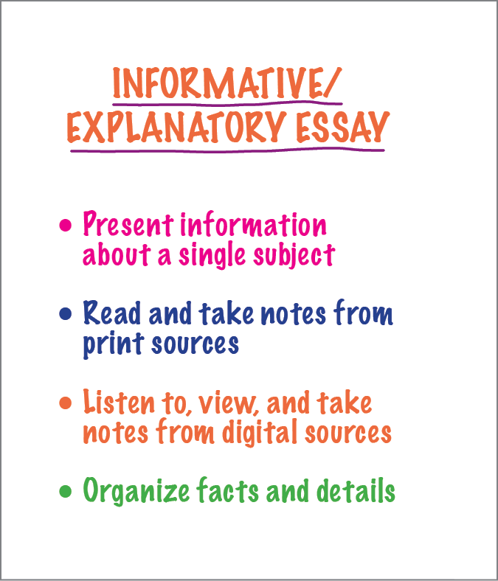
Benchmark: Lesson 6: write an informative/explanatory essay: develop the topic with facts, details, and quotations from sources - check!

Slide 16
Facts and details to support my main ideas
Facts and Details
As Laura McDonald explains in “A Short History of a Special Plant,” the “Three Sisters” method of growing crops was used by Native Americans. By planting squash, beans, and corn together, the plants help one another as they grow. McDonald states that “the mixture of the mixture of plants helped preserve nutrients in the soil.” Bean vines grow up around the taller, straight corn plants and add nutrients to the earth. The squash leaves cover the ground, keeping in water for all of the plants. Today CSA farms utilize the idea of crop rotation in an effort to restore the soil’s necessary nutrients for a successful yield.

Slide 17
Conclusion - expanding on these facts to get 5 sentences
Concluding Statement:
Using smart growing practices like the “Three Sisters” method and crop rotation, farmers are far more likely to increase crop production and ensure that soil remains fertile.

Slide 18
Creating an conclusion for your informative essay
The US is the number 1 producer of corn in the world today. For thousands of years, corn has been an important source of food for humans and animals alike. However, most people do not understand the structure of this amazing plant and how it grows. The strong corn plant that once migrated across the US is planted often in rotation with other crops in an effort to yield bountiful harvests and not deplete the soil. The corn produced in the US is more than 2 times that of any other crop.

Slide 19
Practice in breakout room
Corn is also produced in the United States on farms called CSAs. - What did you include in your writing?
Key Idea | Key Words | Facts and Details
CSAs are another way crops like corn are produced. | CSA, Shareholders Corn Soy Crop rotation Annual Administer | CSA stands for Community Supported Agriculture. Smaller farms that people join in their local communities Shareholders pay each year for fresh food grown on the local farm; they choose what they want each week. Corn is an annual crop, thats last one growing cycle. A human consumes 56 pounds of corn a year. CSA is harvested by hand
In your group, add additional facts and details from your notes in the planning guide to incorporate facts and details that will help readers learn more about this topic.

Slide 20
Independent Practice - Small Group
Independent Practice in SCHOOLOGY
Continue to work on your essay.
Drafters make sure you are using facts, details, and quotations from your notes to support the main ideas. Make sure you are keeping your draft work!
Small Group
I am meeting with your small groups!

Slide 21
Social Studies Day!
Afternoon/Asynchronous Work
Independent Work In Schoology:
Watch your lesson on Native Americans/Peoples of the Southwest Region
Complete your Social Studies exit ticket
Ensure that all tasks in 10-20 folder are completed
Daily Additional Independent Work: NO READWORKS THIS WEEK
Choice read for 20 minutes - using books on your bookshelf in Benchmark
Complete Zearn M2L8 (be on lesson 9)

