Slide 1
Quick write:
If you had a podcast, what would you talk about on your show?

Slide 2
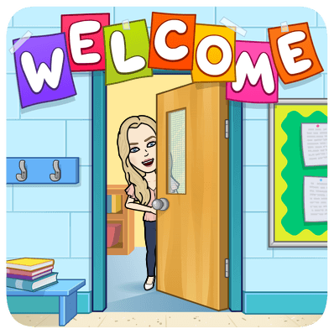
Thursday
October 22, 2020
SEL Video: Mindfulness

Slide 3
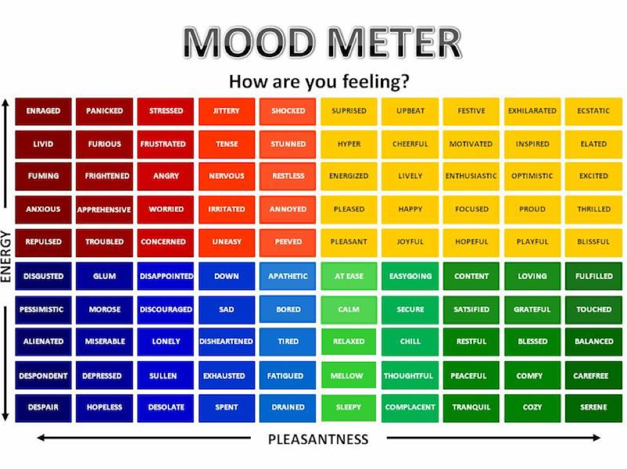

Slide 4
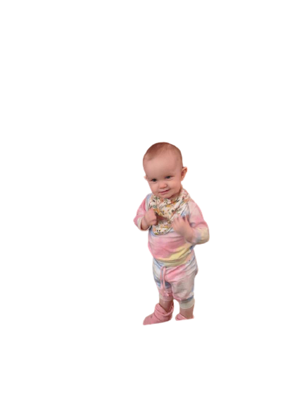
ELA
9:10-10:30

Slide 5
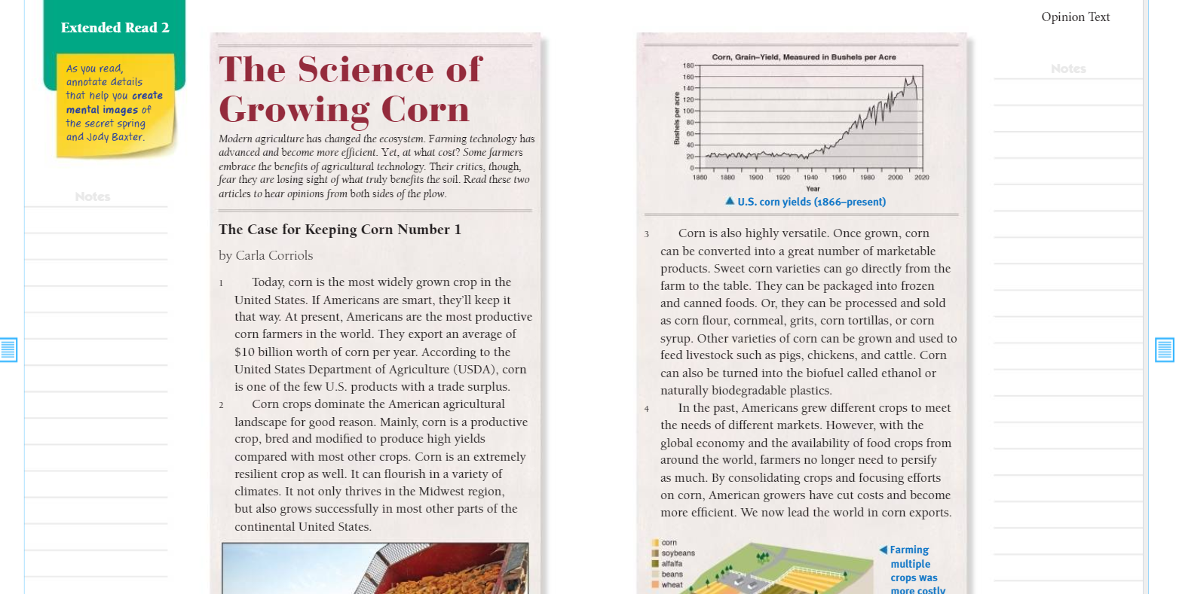
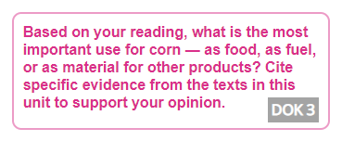
Benchmark:Week three:Lesson 9- Integrate Information from Several Texts on the Same Topic
Constructive Conversation: Partner

Slide 6
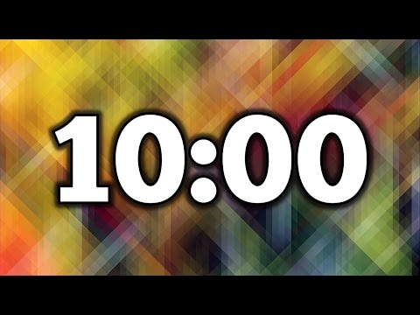
Independent Practice
Independent Practice
Answer Question 3 in Write: Use Text Evidence on page 26 of Cultivating Natural Resources.
Upload a picture on Schoology.
10 minutes

Slide 7
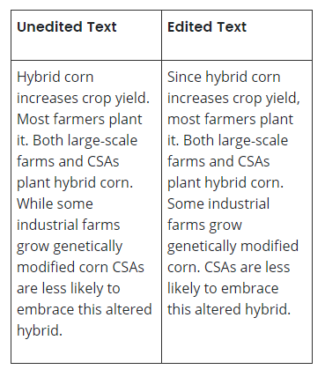
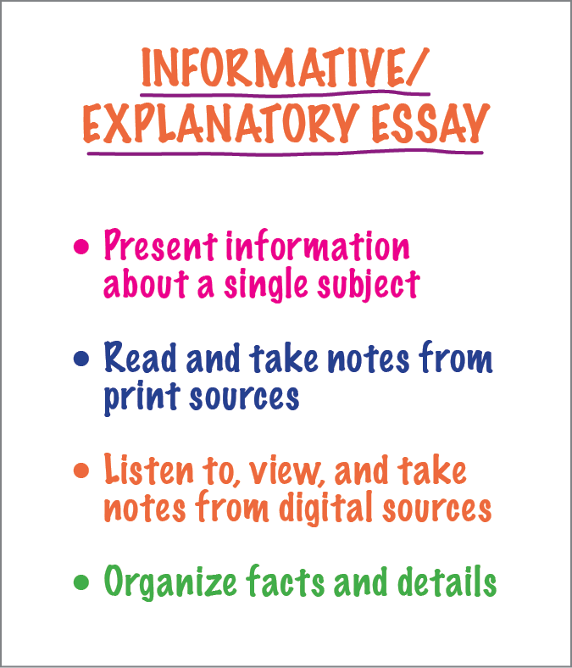
Benchmark: lesson 10: Informative Essay: Edit to Combine and Reduce Sentences

Slide 8
Independent Practice
Independent Practice
Complete the practice on combining sentences.
Continue working on your essay. You should be DONE with your draft. Look it over to revise, and edit. Can you combine sentences to link ideas for clarity? Is your writing a demonstration of your knowledge?
10 minutes

Slide 9
Math 10:40-11:45

Slide 10
Eureka: Module 2- Lesson 9
Application Problem page 177 - 4 minutes
Review M2 Lesson 9 Video
Learn Pages
Practice 179-181
Exit ticket in Schoology
Independent Work Asynchronously this afternoon
Zearn M2L10 - BE ON LESSON 11
Notes:
Lesson 13 Exit Ticket (Sylvia has it made)

Slide 11
Writers workshop
12:25-1:00

Slide 12
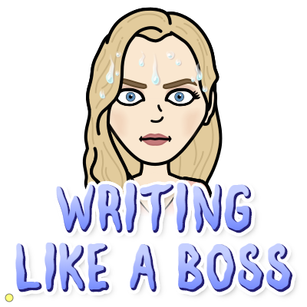
Sharing your writing - continuing to publish
You will be sharing your paper with small groups today. If you do not know your draft done, you will not be participating with your peers. As a peer tutor you will be looking for: facts, page numbers, paragraph numbers, and authors mentioned in their written information. You will continue to work independently to finalize the edits done on your essay.
Today you complete your last revision and edit session

Slide 13
SOCIAL STUDIES Day!
Afternoon/Asynchronous Work
Independent Work In Schoology:
Watch your SOCIAL STUDIES video to compare the peoples of the Pacific Northwest to the Southwest
Complete your SOCIAL STUDIES exit ticket
Ensure that all tasks in 10-22 folder are completed
Daily Additional Independent Work: NO READWORKS THIS WEEK
Choice read for 20 minutes - using books on your bookshelf in Benchmark
Complete Zearn M2L10 (be on lesson 11)
*REMINDER - MUSIC IS TODAY
TOMORROW YOU HAVE BENCHMARK ASSESSMENT UNIT 1 WEEK 3, & A MATH QUIZ

