Slide 1
Quick write:
what scares you? Why?

Slide 2
Monday
October 19, 2020
SEL Video: Having Courage and Being Fearless

Slide 3
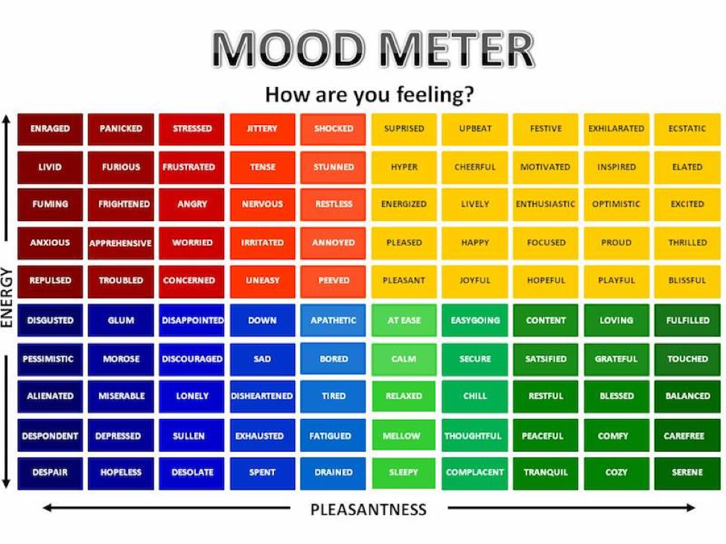

Slide 4
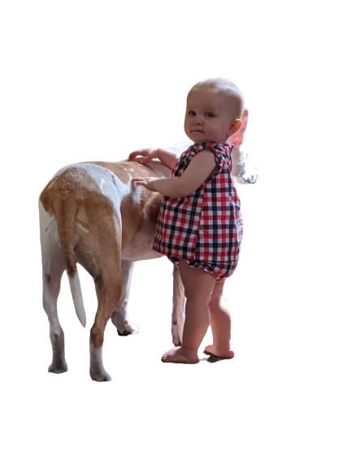
Monday:10-19-20
ELA
9:10-10:30

Slide 5
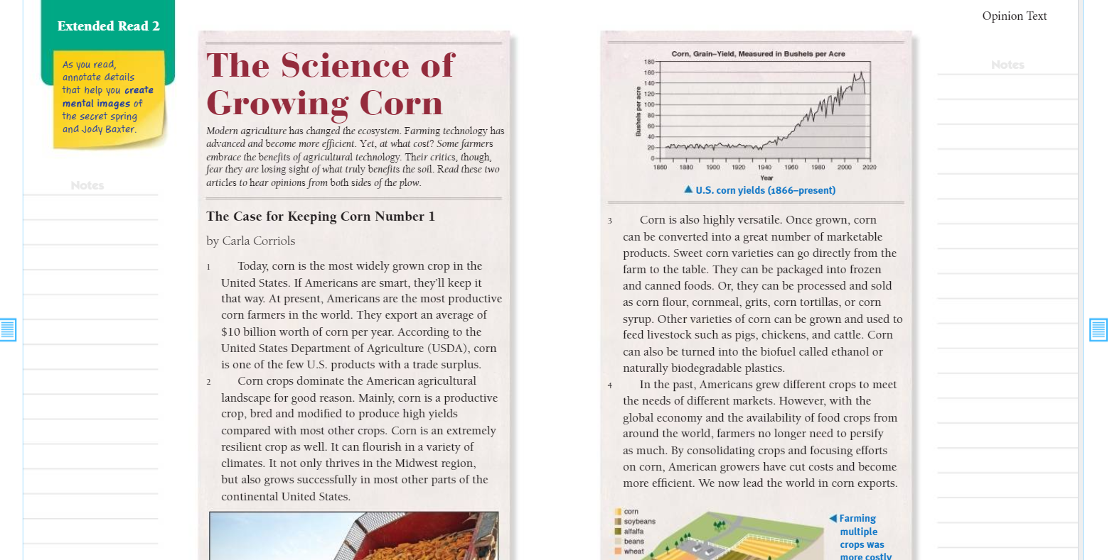
Benchmark:Week three:Lesson 1- first reading: create mental images

Slide 6
Based on the title, subheadings, and graphics:
What do you think this text is going to be about.
Share: Write it in the chat.

Slide 7
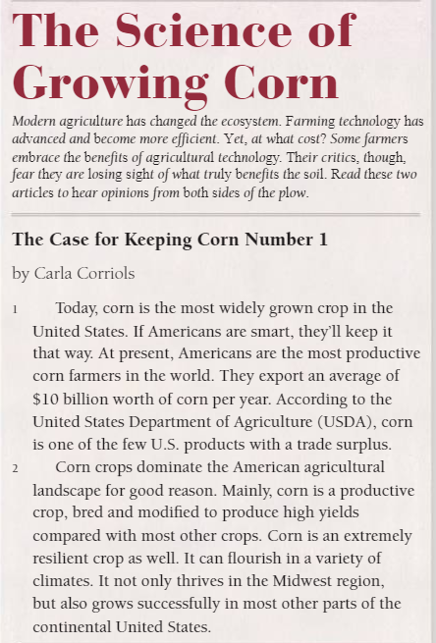
Let’s read!

Slide 8
Practice - Break Out room: 5 minutes
Read paragraph 3. Underline words and phrases that help you create a mental image of the many uses of corn. Then describe what you learned about corn to a partner in your own words.

Slide 9
Independent Practice - Small Group
Independent Practice - Schoology Task
Read the remainder of the first text as well as the second article, “Did Farmers of the Past Know More Than We Do?”
Underline the details that help you create mental images and upload the picture on Schoology.
Small Group
I will be joining your small groups!

Slide 10
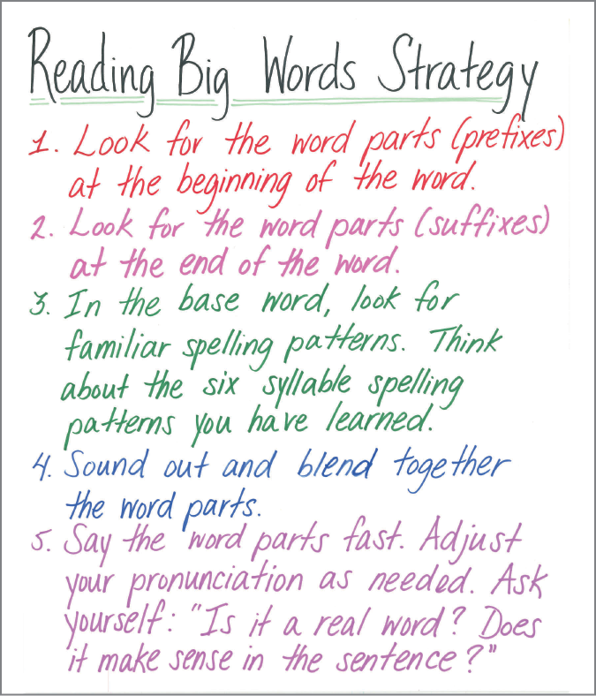
Benchmark: lesson 2: r-controlled vowels /ur/er,ir,ur
Survey
Lawyer
Earned
Firsthand
Nature
Reverse

Slide 11
Let’s try it together!!!
Converted
Determination
Surplus
Curtain
Burst

Slide 12
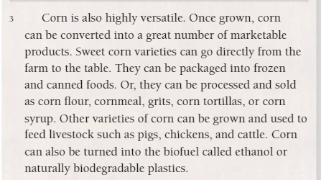
Look at the word, versatile in paragraph 3.
Ask yourself: How can I pronounce the word?

Slide 13
Spelling words:
Covered | future | scorching*
desert | kernels | surprising
earned | member | temperature*
first | person | thirteen

Slide 14
Independent Practice - Small Group
Independent Practice in Schoology
Write a sentence for each spelling word listed.
Small Group
I am meeting with your small groups!
Review Video - Create Bookshelf Unit 1
Your choice read (independently for 20 minutes) afternoon assignment will come from your Benchmark Bookshelf books

Slide 15
Math 10:30-11:45

Slide 16
Eureka: Module 2- Lesson 6
Application Problem page 155 - 4 minutes
Review M2 Lesson 6 Video
Learn Pages (157-159)
Practice
Exit ticket in Schoology
Independent Work Asynchronously this afternoon
Zearn M2L7 (Don’t fall behind, or you will work through your lunch this week!)
Notes:
Lesson 13 Exit Ticket (Sylvia has it made)

Slide 17
Writing
12:25

Slide 18
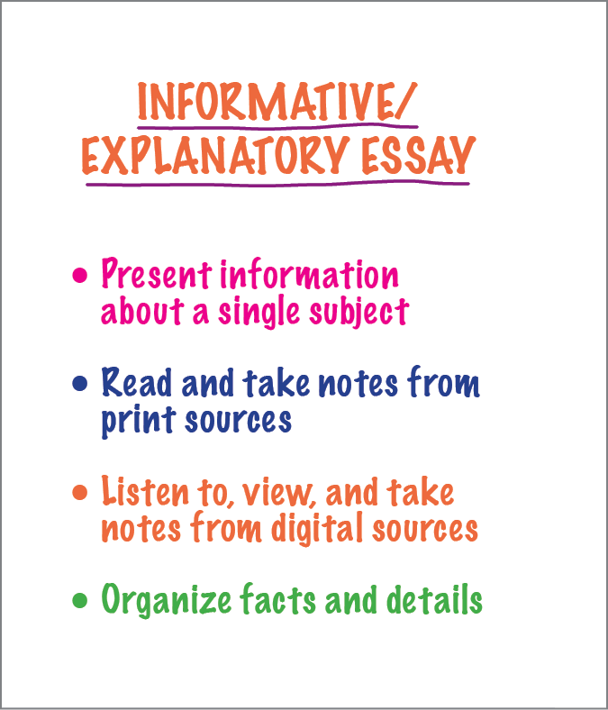
Benchmark: Lesson 3: write an informative/explanatory essay: draft a clear introduction. continue on your Draft

Slide 19
Creating an introduction for your informative essay
For thousands of years, corn has been an important source of food for humans and animals. However, most people do not understand the structure of this amazing plant and how it grows.

Slide 20
Practice: 4 minutes in a breakout room
With a partner, talk about how you will begin your introductions. Partners should rehearse their topic statement and discuss ways to make their essay sound interesting to a reader.

Slide 21
Independent Practice - Small Group
Independent Practice in Schoology
Read the writing prompt.
Use the planning guide to help you plan and structure your introduction, body, and conclusion paragraphs.
Use the checklist as a guide.
Small Group
I am meeting with your small groups!

Slide 22
Science Day!
Afternoon/Asynchronous Work
Independent Work In Schoology:
Complete your Science Generation Genius Lesson: Ecosystems
What you will learn from this video/MUST HAVE notes in your Science Notebook:
An ecosystem is a community of interacting organisms & their environment.
Organisms only survive in an ecosystem when their specific needs are met.
Newly introduced organisms can throw off the balance of an ecosystem.
A healthy ecosystem has many different kinds of organisms.
Watch the video and complete the exit ticket in Schoology
Ensure that all tasks in 10-19 folder are completed
Daily Additional Independent Work: NO READWORKS THIS WEEK
Choice read for 20 minutes - create a bookshelf in Benchmark
Complete Zearn M2L7

