Slide 1
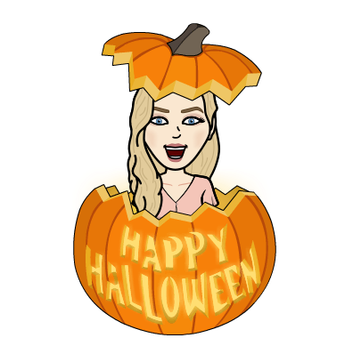
Monday: 10-26-20
Quick Write:
What is the best book you’ve ever read? What made it so special?

Slide 2
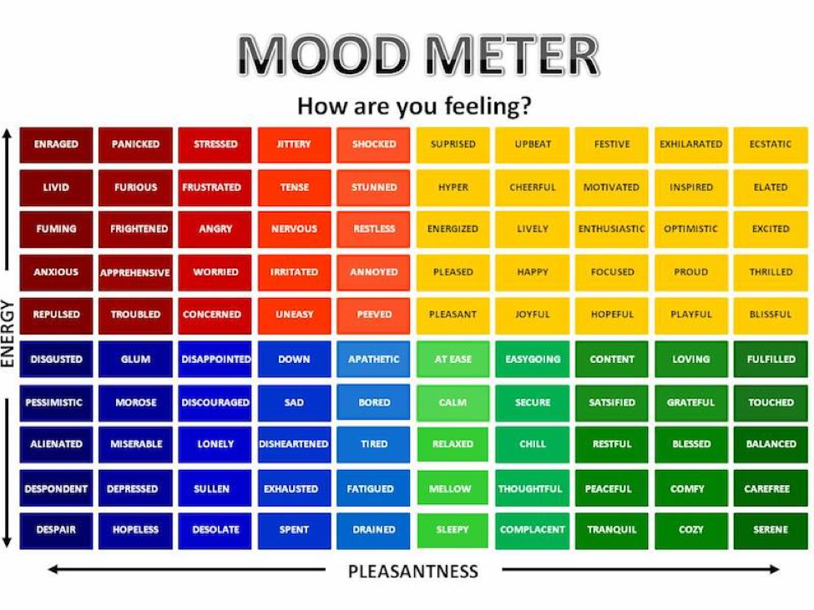
SEL Video: Creepy Crawlies Halloween Special

Slide 3
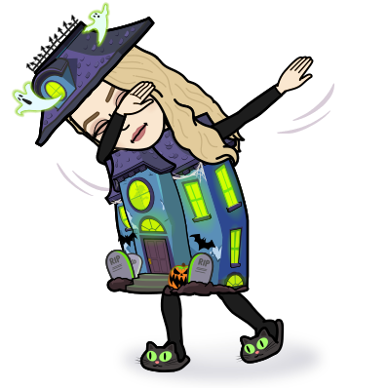
ELA
9:15-10:30

Slide 4
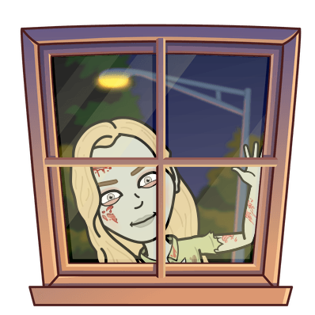
Benchmark:Unit 2:Lesson 1- Developing CHaracters’ Relationships
Essential Question:
Why do we value certain qualities in people?
Vocabulary:
Admire
Compassion
Perseverance

Slide 5
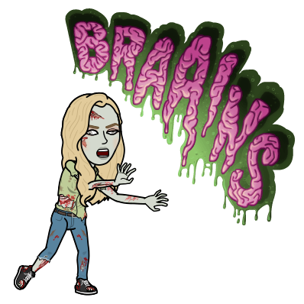
Constructive Conversation:
Breakout Groups
Directions: Generate questions that will guide your inquiry about character traits and relationships in this unit.
Guiding Questions | Initial Ideas

Slide 6
Real-World Perspectives - Guiding unit Questions

Slide 7
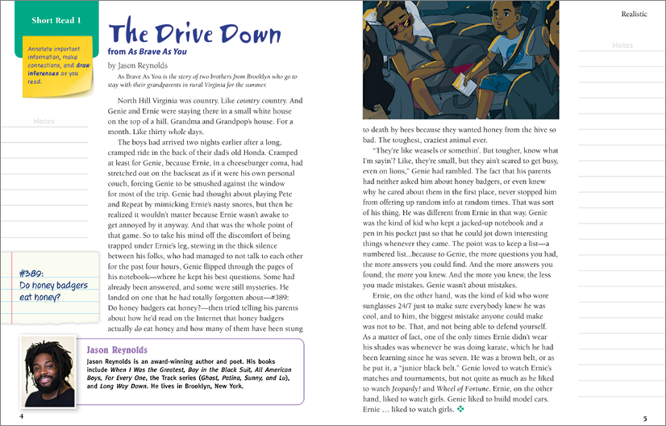
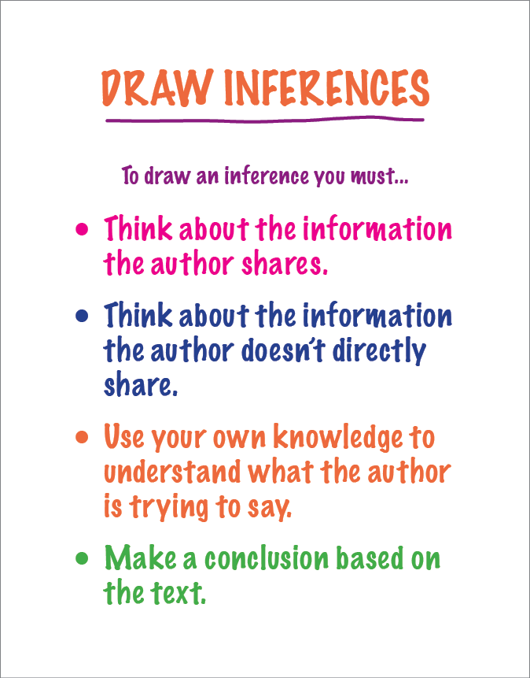
Benchmark: Unit 2 lesson 2: Draw Inferences

Slide 8
Independent Practice
Independent Practice in SCHOOLOGY
Reread paragraph 2 and draw an inference about Genie. Jot down your inferences in the margin.
Take a screenshot or picture and upload your notes on Schoology.
Small Group
Zak, Shaima, Mustafa, Jana, Abrar
Open your Benchmark Assignments to get your Book Club Book

Slide 9
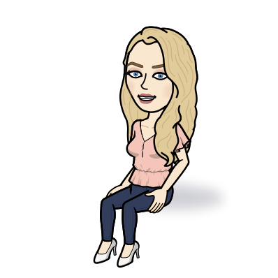
Math
10:40-11:45
Do the application problem on page 191

Slide 10
Math Work
Whole Group
Lesson 11 Video
Page 194 #1b
Page 195 #5
Small Group
Page 194 #2b,2d,3b
Page 195 #4
Independent Practice
Lesson 11 Exit Ticket on Schoology
Zearn M2 L12

Slide 11
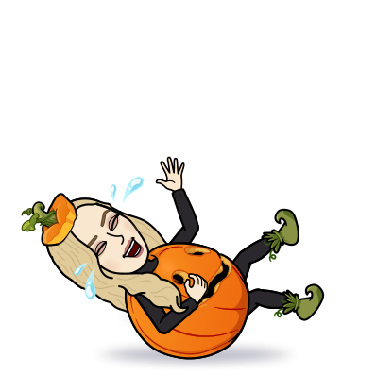
Afternoon Check In
12:25-1:00
Writer’s workshop

Slide 12
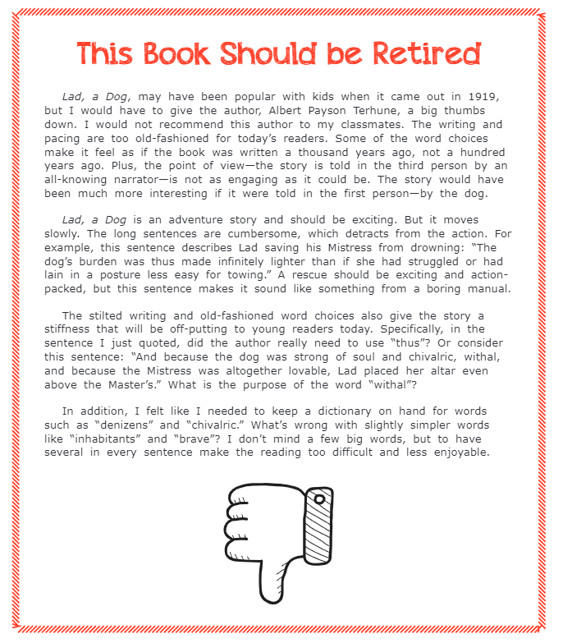
Benchmark: Lesson 3: write an Opinion Essay: Analyze a Mentor Opinion Text

Slide 13
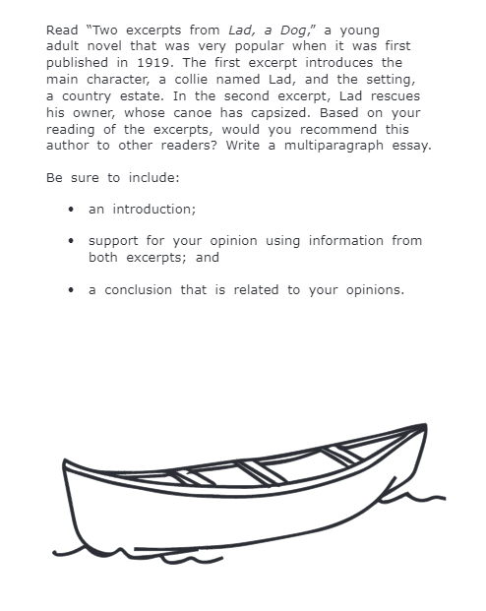
Writing Prompt: Opinion Essay

Slide 14
Independent Practice
Independent Practice in SCHOOLOGY
Answer this question in the discussion on Schoology: What are features of an opinion essay?
Reply to TWO classmates whether you do agree or do NOT agree with the features they came up with.
Small Group
Lara, Ali, Maya, Ethan, Zahia, Sam, Mariam, Waleed
Open your Benchmark Assignments to get your Book Club Book

Slide 15
Asynchronous Work
Adaptations and the Environment Video on Generation Genius. Take notes in your Science Notebook!
Exit ticket in Schoology

Slide 16
Afternoon Asynchronous Work
Independent Work In Schoology:
Ensure that all tasks in 10-26 folder are completed.
Daily Additional Independent Work: NO READWORKS AGAIN THIS WEEK
Choice read for 20 minutes - Read books on your bookshelf in Benchmark. Be sure to update your bookshelf regularly.
Small Group at 1:25pm
Khaled, Daniel, Giselle, Kadyn
Open your Benchmark Assignments to get your Book Club Book

