Slide 1
Wednesday: 10-27-20
Quick Write:
What do you want to be when you “grow up”? What do you like about that career?

Slide 2
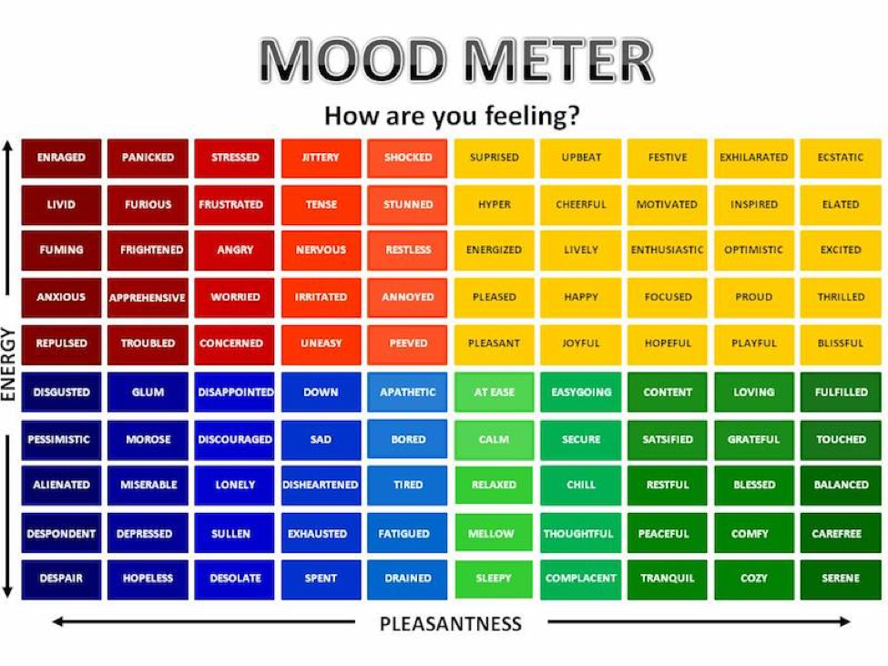
SEL Video: How-To

Slide 3
ELA
9:15-10:35

Slide 4
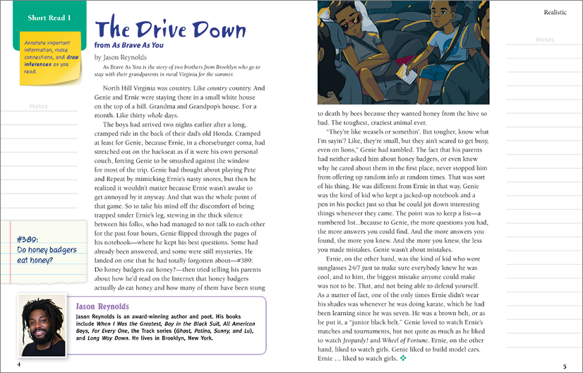
Benchmark:Unit 2:Lesson 7- Compare and Contrast Two Characters in a Story

Slide 5
Independent Practice - Small Group
Independent Practice
Identify two characters in the story.
Identify traits for each character and then write a short paragraph to compare and contrast.
Small Group
Bring your notebook, Close Reading Text (on Benchmark), and a pencil.
Group
Zak
Shaima
Mustafa
Jana
Abrar

Slide 6
Benchmark: lesson 8: Form and Use the Past Perfect Verb Tense
Verb Tense: actions performed in the past, present, or future.

Slide 7
Independent Practice - Small Group
Independent Practice
Complete the Build Grammar and Language section on p. 11 of Developing Characters’ Relationships.
Complete the Verb Tense worksheet.
Small Group
Bring your notebook, Close Reading Text (on Benchmark), and a pencil.
Group
Lara
Ali
Maya
Ethan
Zahia
Mariam
Sam
Waleed

Slide 8
Math
10:30-11:45
Watch the math video on your own and take notes
15 - minutes

Slide 9
Math Work
Whole Group
Pages 211-212
Small Group
Lesson 13 Exit Ticket in Schoology
Independent Practice
Zearn M2 L14 (Be on 15)
Topic C Quiz in Schoology

Slide 10
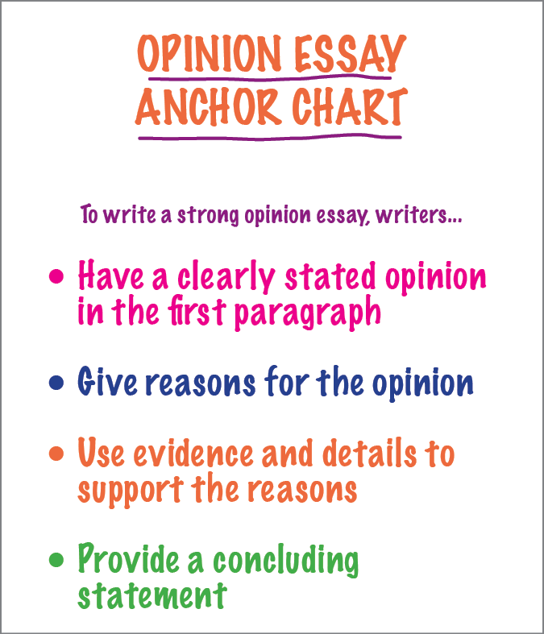
Benchmark: Lesson 9: write an Opinion Essay: Read a Source Text to Find Facts and Details

Slide 11
Opinion: I would not recommend author Albert Payson Terhune to my classmates.
Reason for Opinion | Details and Example
Old-fashioned writing and pacing (lack of excitement - boring) | Slow pacing Cumbersome sentences detract from the action “The dog’s burden was thus made infinitely lighter than if she had struggled or had lain in a posture less easy for towing.” (Excerpt 2)
Outdated word choices | Old-fashioned, complex words unknown and unattractive to modern young readers “And because the dog was strong of soul and chivalric, withal, and because the Mistress was altogether loveable, Lad placed her alter even above the Master’s.” (Excerpt 1)
Ineffective point-of-view | less interesting third‑person point of view instead of first‑person point of view “He felt he owned it. It was assuredly his to enjoy, to guard, to patrol from high road to lake.” (Excerpt 1)

Slide 12
write an Opinion: Share your Reasons for Opinion
Reason for Opinion | Details and Examples

Slide 13
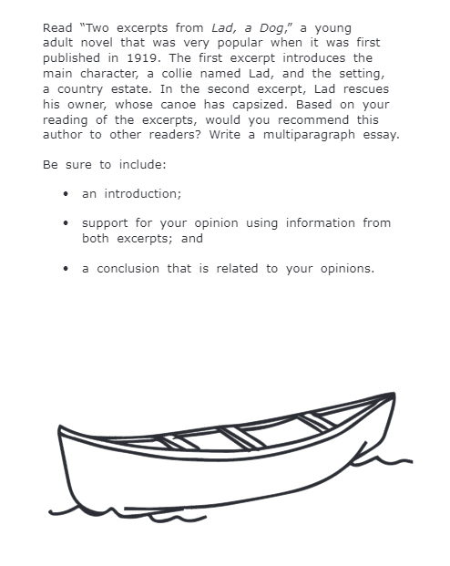
Writing Prompt: Opinion Essay

Slide 14
Independent Practice - Small Group
Independent Practice
Form an opinion about a text that you read during independent time (Use your small group reading text).
Identify reasons and details or facts to support your opinion.
Small Group
Bring your notebook, Close Reading Text (on Benchmark), and a pencil.
Group
Khaled
Daniel
Giselle
Kadyn

Slide 15
Asynchronous Work
Today is your Unit 1 Test
Go to Schoology to see the Test Questions you will need to answer.
You MAY use your notes.
Go to Flipgrid to post your responses.
Good Luck!

Slide 16
Afternoon Asynchronous Work
Independent Work In Schoology:
Ensure that all tasks in 10-28 folder are completed.
Flipgrid assignment is A TEST - take it seriously!
Daily Additional Independent Work: NO READWORKS AGAIN THIS WEEK
Choice read for 20 minutes - Read books on your bookshelf in Benchmark.
You should be on Lesson 15 in Zearn by the end of the day
You have until tomorrow to get all missing work caught up!
Friday is a halfday

