Slide 1
Quick write:
What do you like most about your neighborhood?

Slide 2
wednesday
October 21, 2020
SEL Video: Conflict Resolution

Slide 3
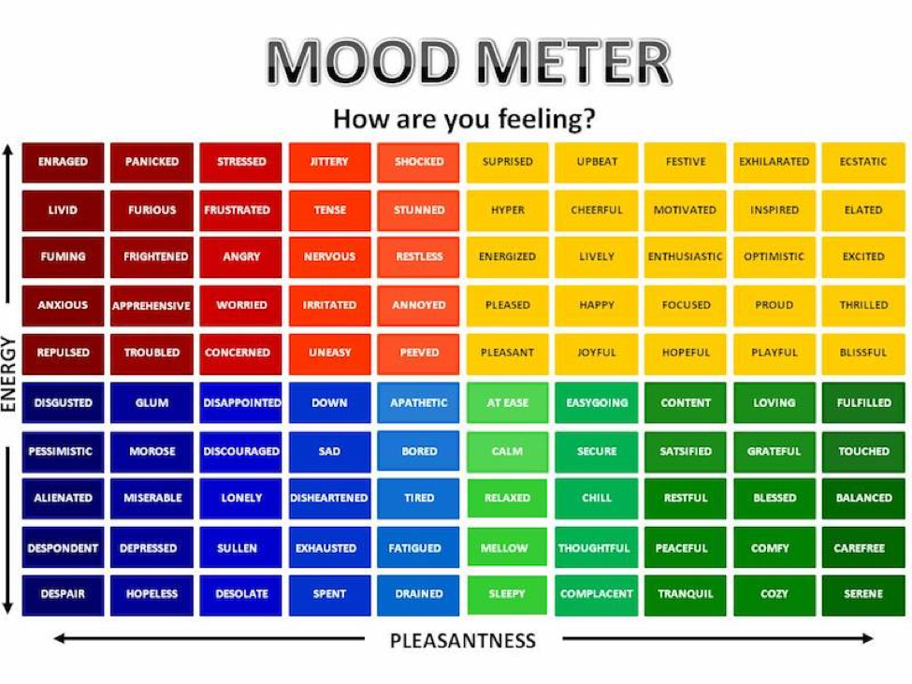

Slide 4
ELA
9:10-10:30

Slide 5
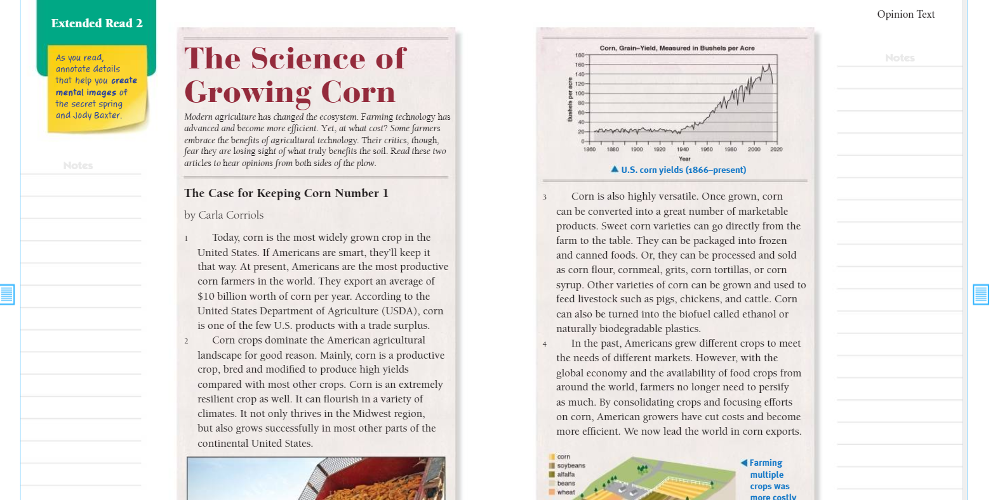
Benchmark:Week three:Lesson 7- Analyze Point of View and Purpose in Two Texts on the Same Topic
Constructive Conversation: Partner
Reread and annotate both texts.
Share your evidence and answers to the questions with the class.

Slide 6
Share and Reflect
Point of View 1 | Point of View 2

Slide 7
Independent Practice - Small Group
Independent Practice in SCHOOLOGY
Answer Question 2 in Write: Use Text Evidence on page 26 of Cultivating Natural Resources.
Upload a picture of it on Schoology.
Reread paragraphs 6-7 and 12-13 and analyze the author’s language in these paragraphs.
Small Group
I will be joining your small groups!

Slide 8
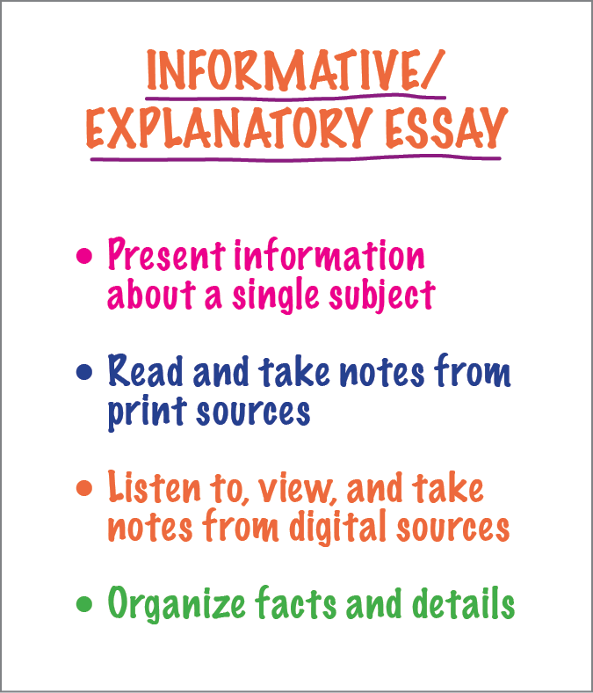
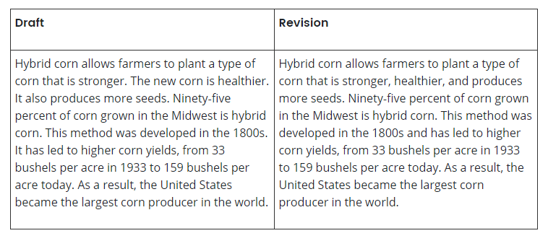
Benchmark: lesson 8: Informative Essay: Link Ideas Within and Across Categories of Information

Slide 9
Guided Practice
Draft | Revision (2 groups share)
Many CSAs use a method of crop rotation. This helps preserve the nutrients in the soil. One year, squash might be grown in one field. The next year, beans might be planted to take their place.
Many CSAs use a method of crop rotation. This helps preserve the nutrients in the soil. One year, squash might be grown in one field. The next year, beans might be planted to take their place.

Slide 10
Independent Practice - Small Group
Independent Practice in SCHOOLOGY
Continue working on your essays.
Drafters look for places in your writing where you can combine sentences to link ideas using conjunctions in order to make your texts smoother and easier to follow.
Writer’s Workshop begins at 12:25
Small Group
I am meeting with your small groups!

Slide 11
Math 10:40-11:45

Slide 12
Eureka: Module 2- Lesson 8
Application Problem page 171 - 4 minutes
Review M2 Lesson 8 Video
Learn Pages (173-175)
Practice
Exit ticket in Schoology
Independent Work Asynchronously this afternoon
Zearn M2L9 - BE ON LESSON 10
Notes:
Lesson 13 Exit Ticket (Sylvia has it made)

Slide 13
Writers workshop
12:25-1:00

Slide 14
Sharing your writing - continuing to publish
You will be sharing your introduction and conclusion paragraphs with me today. You will share your facts, page numbers, paragraph numbers, and authors for your information on your TWO body paragraphs. You will continue to work independently to finalize your essays.
Today you will finalize your Body Paragraph #1 (paragraph #2 in your essay)

Slide 15
Science Day!
Afternoon/Asynchronous Work
Independent Work In Schoology:
Watch your mystery science video (ONLY) Why did Dinosaurs go Extinct?
Complete your Science exit ticket
Ensure that all tasks in 10-21 folder are completed
Daily Additional Independent Work: NO READWORKS THIS WEEK
Choice read for 20 minutes - using books on your bookshelf in Benchmark
Complete Zearn M2L9 (be on lesson 10)
REMINDER - YOU HAVE GYM TODAY AT 2:25pm

