Slide 1
Tuesday: 10-27-20
Quick Write:
How would you feel if you saw someone being bullied? What do you think you should do?

Slide 2
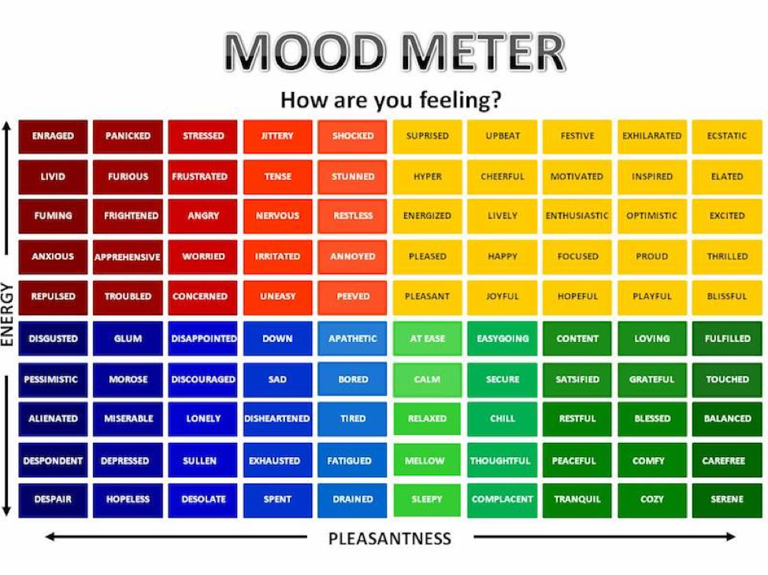
SEL Video: Joy

Slide 3
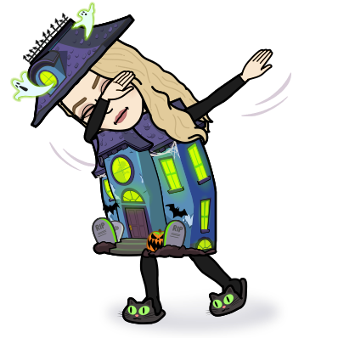
ELA
9:15-10:35

Slide 4
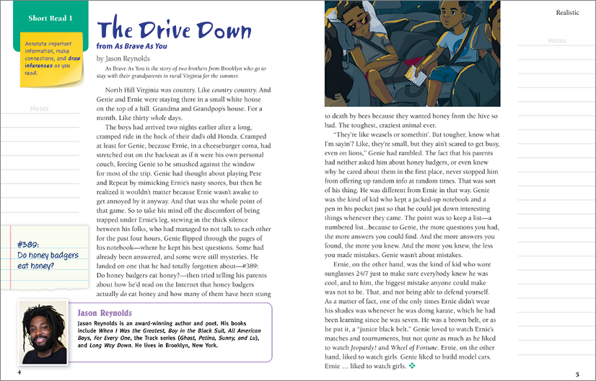
Benchmark:Unit 2:Lesson 4- summarize the text
“The Drive Down” is an excerpt from a story about two brothers who have been on a car trip to Virginia to visit their grandparents. Ernie’s behavior annoys Genie, and Genie copes by looking at questions in his notebook.

Slide 5
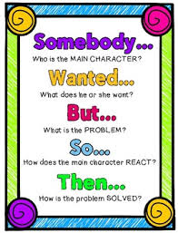
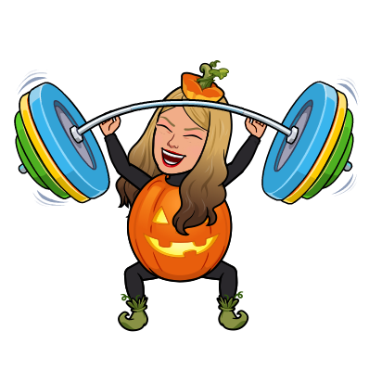
Guided practice: annotate, pair, share

Slide 6
Independent Practice - Small Group
Independent Practice
Continued- Write a summary of paragraph 4 in The Drive Down. What do Genie and Ernie like to do and why? Summarize to explain how the boys are different.
Small Group
Bring your notebook, Close Reading Text (on Benchmark), and a pencil.
Group
Zak
Shaima
Mustafa
Jana
Abrar

Slide 7
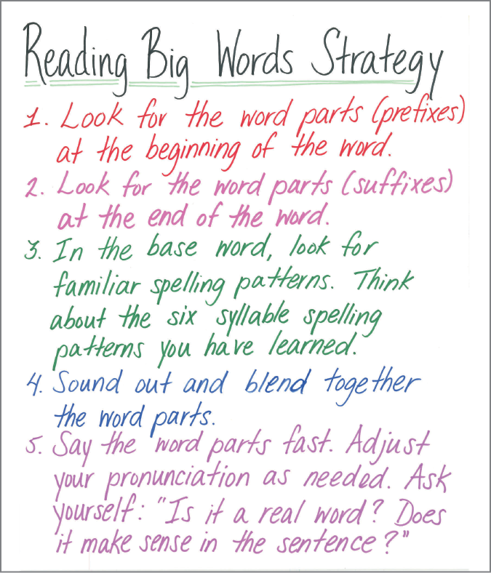
Benchmark: lesson 5: r-controlled vowels /ar/,/or/(air, are; ar;or;our;ore
Marble
Clamor
Repair
Prepare
Nourish
encore
Vocabulary:
Admire
Compassion
Perseverance

Slide 8
Let’s try it together!!!
Unimportant
Parents
Orbit
Karate
Reformat

Slide 9
Spelling words:
absorb* | depart | source
adore* | important | square
corporation* | margin | support
court | partial | upstairs

Slide 10
Independent Practice - Small Group
Independent Practice
R-controlled vowel worksheets with spelling words.
Small Group
Bring your notebook, Close Reading Text (on Benchmark), and a pencil.
Group
Sarah
Rana
Islam
Adam
Hana

Slide 11
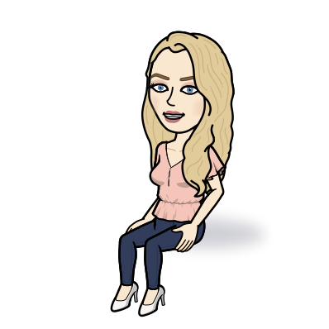
Math
10:40-11:45
Do the application problem on page 199

Slide 12
Math Work
Whole Group
Lesson 12 Video
Page 201 #1a
Page 202 #2a, d, e, h
Page 203 #3
Small Group
Page 203 #4
Lesson 12 Exit Ticket in Schoology
Independent Practice
Zearn M2 L13
Topic C Quiz in Schoology

Slide 13
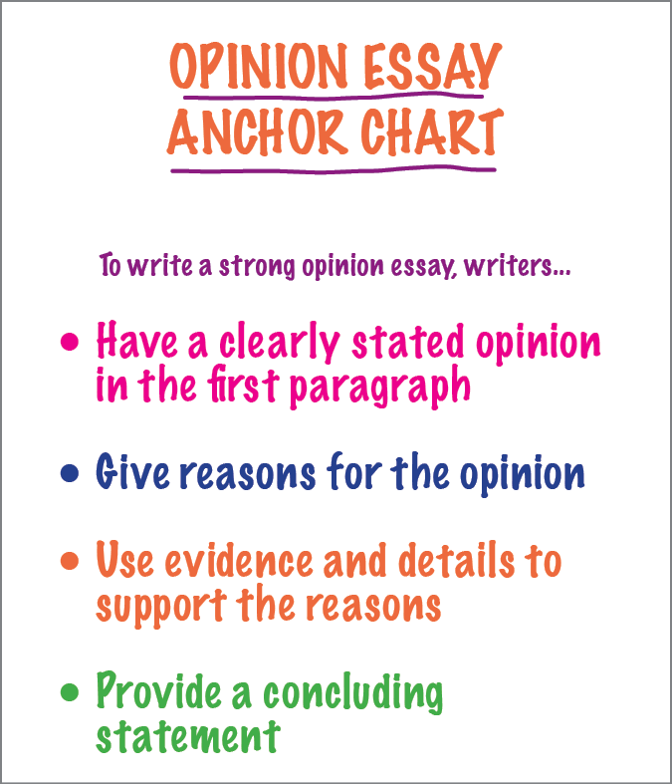
Benchmark: Lesson 6: write an opinion essay: analyze an author’s reasons, facts, and details

Slide 14
Opinion: I would not recommend author Albert Payson Terhune to my classmates.
Reason for Opinion | Details and Example
Old-fashioned writing and pacing
Outdated word choices
Ineffective point-of-view

Slide 15
Opinion: I would not recommend author Albert Payson Terhune to my classmates.
Reason for Opinion | Details and Example
Old-fashioned writing and pacing | Slow pacing Cumbersome sentences detract from the action “The dog’s burden was thus made infinitely lighter than if she had struggled or had lain in a posture less easy for towing.” (Excerpt 2)
Outdated word choices | Old-fashioned, complex words unknown and unattractive to modern young readers “And because the dog was strong of soul and chivalric, withal, and because the Mistress was altogether loveable, Lad placed her alter even above the Master’s.” (Excerpt 1)
Ineffective point-of-view | less interesting third‑person point of view instead of first‑person point of view “He felt he owned it. It was assuredly his to enjoy, to guard, to patrol from high road to lake.” (Excerpt 1)

Slide 16
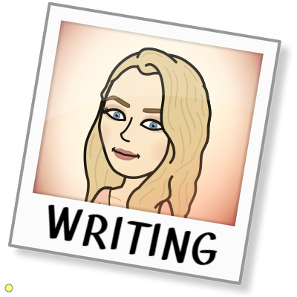
Practice: 4 minutes in a breakout room
With a small group take additional notes about the second reason in the essay and use supporting details.

Slide 17
Independent Practice - Small Group
Independent Practice
Reread the opinion essay and identify the author’s third reason for her opinion and the supporting details she provides. Record them in the chart. Submit the chart on Schoology when finished.
Small Group
Bring your notebook, Close Reading Text (on Benchmark), and a pencil.
Group
Jordan
Ibrahim
Rena
Aiden
Ayat

Slide 18
Asynchronous Work
Go into the social studies folder (inside the 10-27 folder) in schoology and review the links. Complete the readings and watch the video. Take notes in your SS Notebook!
Exit ticket in Schoology

Slide 19
Afternoon Asynchronous Work
Independent Work In Schoology:
Ensure that all tasks in 10-27 folder are completed.
Daily Additional Independent Work: NO READWORKS AGAIN THIS WEEK
Choice read for 20 minutes - Read books on your bookshelf in Benchmark. Create Unit 2 Bookshelf and move your books you are interested in free reading to it.
You should be on Lesson 14 in Zearn
You have until Thursday to get all missing work caught up!

