Slide 1
Quick write:
What’s the funniest thing that ever happened to you? Or...what is something that made you laugh till you cried?

Slide 2
Friday
October 23, 2020
SEL Video: Why do we laugh?

Slide 3
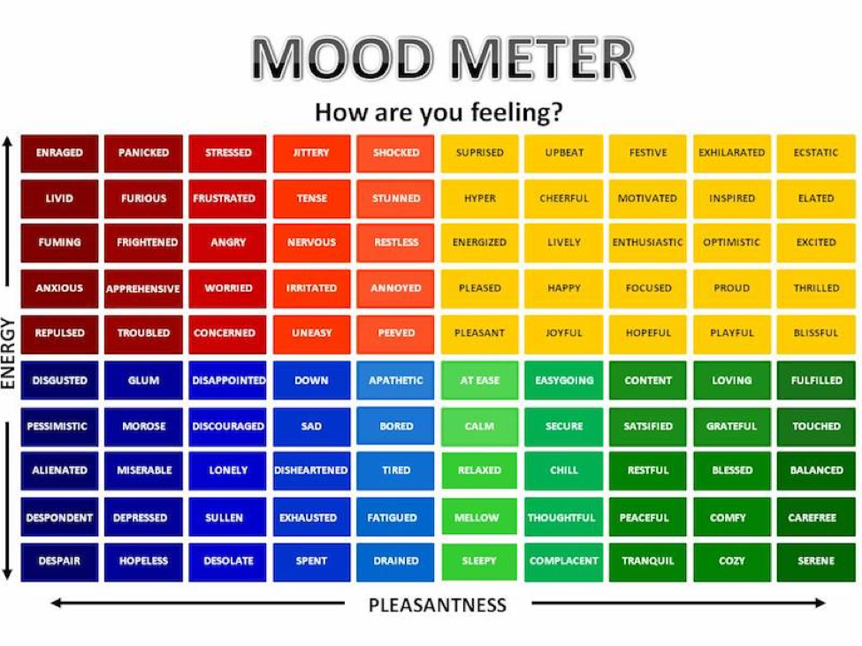

Slide 4
ELA
9:10-10:30

Slide 5
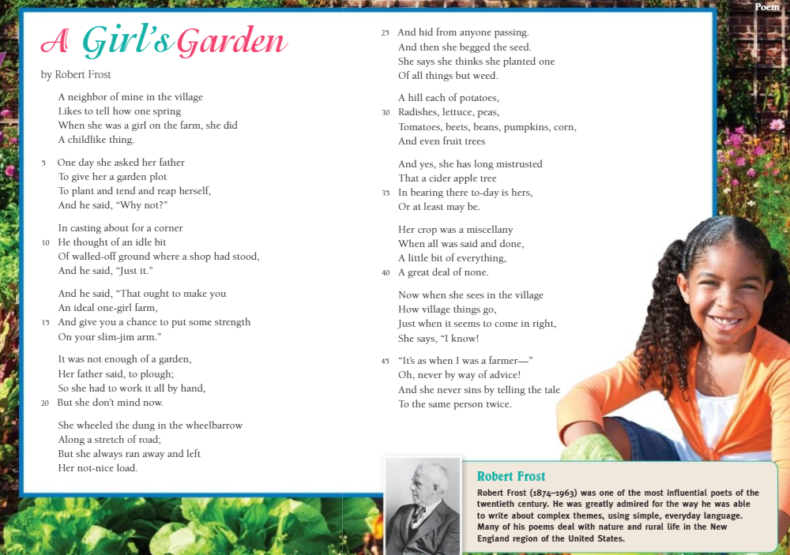
Benchmark:Week three:Lesson 11: review the features and structures of poetry

Slide 6
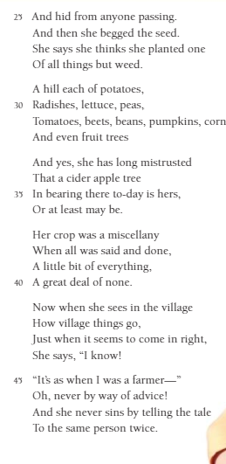
Guided practice: work with a partner
Read aloud lines 25-44. Identify and discuss the features and structures you discover. In small groups, summarize the lines.

Slide 7
Independent Practice
Independent Practice in SCHOOLOGY
Under assignments in Benchmark, review the POETRY READING book and listen to different poems read aloud to you for 10 minutes. Which one is your favorite? Why? Summarize one poem that you listened to.
Read independently from your bookshelf.

Slide 8
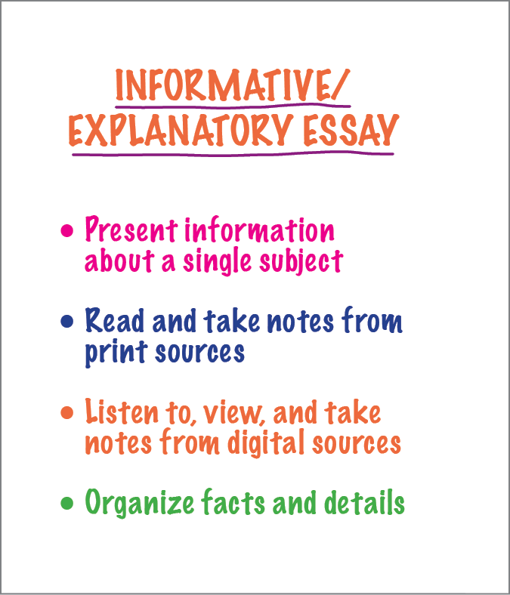
Benchmark: lesson 12: write an informative/explanatory essay: evaluate and reflect on writing
Today you will be typing your FINAL copy of your informative paper that answers the question HOW IS CORN PRODUCED IN THE UNITED STATES?

Slide 9
Rubric review - in schoology. Final review
Rubric Criteria | Sample Modeling | Sample Score
Present information on a subject, organized in a logical way | As I look through the paragraphs, I see that I have presented a single subject – a corn plant structure and appearance. I see that I have organized it logically. First, I tell how the plant looks, and then I develop information about the plant's structure. | 4
Include relevant facts and details from source texts. | Let's see if I included relevant facts and details from the sources. Relevant Facts: I included facts such as: the ears are the female part of the plant, and the male part is the tassel. Details: I included details about an ear of corn. For example, I described how it grows, and all the structures that grow within it, such as the ovules and silks. I included details about the tassel, such as that it grows from the top of the plant, and its branches are covered with tin flowers that contain pollen. I think all of the facts and details help readers understand how the structure and parts of a corn plant help it grow and develop. | 4

Slide 10
Independent Practice
Independent Practice
Look through the rubric and make sure you have everything included in your paper. Begin to type it out making sure you indent, capitalize your appropriate letters, watch your grammar, and demonstrate your BEST WORK. You will submit it by tomorrow on SCHOOLOGY

Slide 11
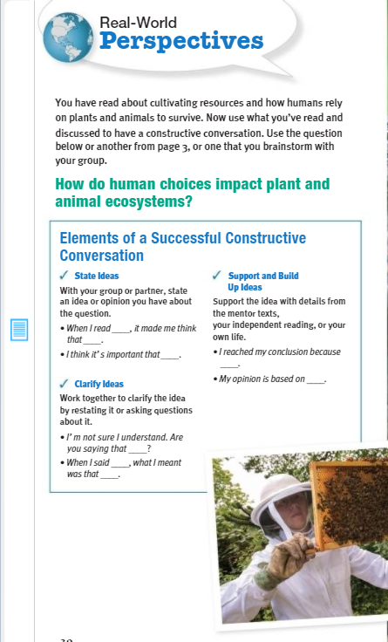
Benchmark: Lesson 13:unit wrap-up share real world perspectives
How do humans choices impact plant and animal ecosystems?

Slide 12
Guided practice: work with a group
Use the different print sources within Unit One, Cultivating Natural Resources. Answer the question: How do human choices impact plant and animal ecosystems?

Slide 13
Math 10:40-11:45

Slide 14
Eureka: Module 2- Lesson 10
Application Problem page 185 - 4 minutes
Review M2 Lesson 10 Video
Learn Pages
Practice 187-188
Exit ticket in Schoology
Independent Work Asynchronously this afternoon
Zearn M2L11 - BE ON LESSON 12
Take the math Quiz in the 10-23 folder
Notes:
Lesson 13 Exit Ticket (Sylvia has it made)

Slide 15
Afternoon check in
12:25

Slide 16
Independent Practice
GOOD LUCK!
Independent Practice
Complete end of the unit assessment Unit 1, Week 3 on Benchmark in SCHOOLOGY.

Slide 17
Happy friday!
Afternoon/Asynchronous Work
Independent Work In Schoology:
Ensure that all tasks in 10-22 folder are completed. Your Benchmark assessment and Math Quiz MUST be completed TODAY. Your FINAL paper is due by SATURDAY at 10pm
Daily Additional Independent Work: NO READWORKS THIS WEEK
Choice read for 30 minutes - using books on your bookshelf in Benchmark (some was DONE this morning)
Complete Zearn M2L11 (be on lesson 12)
*REMINDER - STEAM IS TODAY

