Slide 1
Friday
October 9, 2020
Half day - END AT 11am
Quick Write:
Do you ever feel your moods change with the season? Why or Why not?

Slide 2
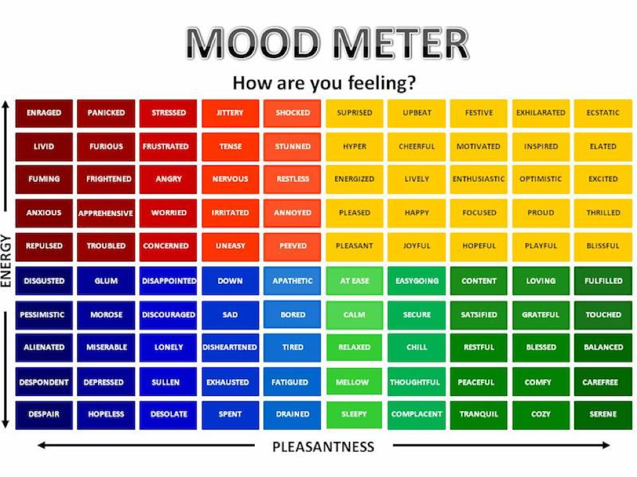

Slide 3
Social Emotional Learning Focus
SEL Video: Biography Friday
Cleopatra (BP)

Slide 4
ELA
9:10-10:10
Thursday & Friday Lessons

Slide 5
Benchmark: Lesson 10- Visualization
Read your Unit 1 Book Preview p.6-7. “The Future of a Crop” - in ELA notebook
Paragraph 3: “Therefore corn is used to feed humans and livestock.”
Paragraph 8: “Keep Corn on the Cob - Not in My Car!”

Slide 6
Benchmark: Lesson 11- Informative Writing - Organizing Your Draft
Model: Organizing the Essay
Model Filling out Key Idea & Facts/Details Planning guide
Independent Work In Schoology:
Complete the Student Planning Guide
Notes:
Upload the Student Planning Guide

Slide 7
Math
10:15-11:00

Slide 8
Eureka: M1 Test Monday - STUDY!
Review Module 1 concepts (notebook check with peers)
Review whole group - notes
Breakout groups to work.
Independent Work In Schoology:
Complete End of Module Review
M2L2 in Zearn

Slide 9
Asynchronous Work
Complete ReadWorks Article-A-Day activity
Read your choice book for 30 minutes
CHECK: Have you completed all tasks in 10-9 folder in Schoology?
CHECK: Have you completed M2L2 in Zearn?

