Slide 1
Monday
September 14, 2020

Slide 2
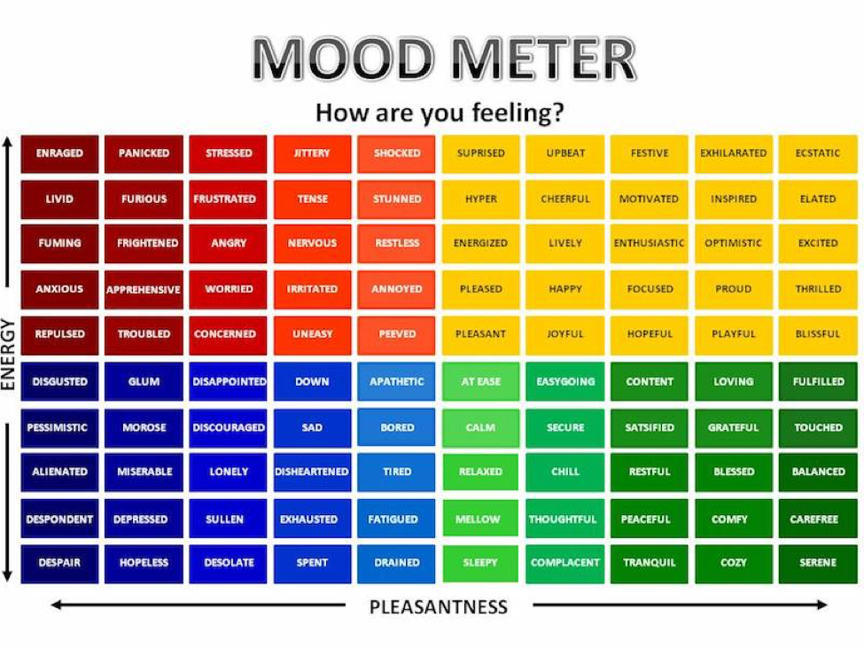

Slide 3
Today’s Weather
High of 70F
Sunny. Get outside later and take a walk!
https://weather.com/weather/hourbyhour/l/7789d4498b384397eabdaf712275ad732858c45b6a050f390989122ca69fe47d

Slide 4
SEL Learning Activity
Watch the following BrainPop video on Sleep (Videos are Collaborative for Academic, Social, and Emotional Learning (CASEL) framework.
Breakout rooms - discuss 1 new thing that you learned with your group. Practice accountable speech.
Breakout Room - 2 minutes

Slide 5
Writing Prompt & Quick Discuss
Daily writing prompt in your ELA/Writer’s Notebook. Be sure to date the top of your paper, copy the entire prompt, and write your answer in complete sentences. Complete your writing in 6 minutes.
What is the most valuable thing you own? Why is it special?
Discuss in your breakout group using accountable talk - 4 minutes

Slide 6
Today’s Agenda & Goal Setting
Morning’s Objectives:
ELA
C.O: I can write a persuasive letter and review the routines for ELA Working Time.
L.O.: I can orally and in writing use persuasion to write what I feel and describe the routines for ELA Working Time
Math
C.O: I can complete mathematical problems demonstrating patterns with powers of ten.
L.O: I can orally and in writing describe the meaning of place value and power of ten patterns.
Today’s Agenda:
Morning Meeting (8:55 LOGIN)
ELA Whole Group
ELA Work Time
Math Whole Group (10:30 LOGIN)
Math Work Time
Writing Whole Group (12:25 LOGIN)

Slide 7
ELA Block (9:00-10:25)
Benchmark Rules and Routines Day 5
OYO - Listen to a story and complete questions on ReadWorks *Assigned story: Peer Pressure Power - take the quiz
OYO - Choice Reading for 20 minutes minimum - I-PICK books (your choice) on EPIC JUST RIGHT BOOKS! NOTHING TOO EASY (Class code: puk0847)
OYO - Complete your writing task from today’s Benchmark lesson

Slide 8
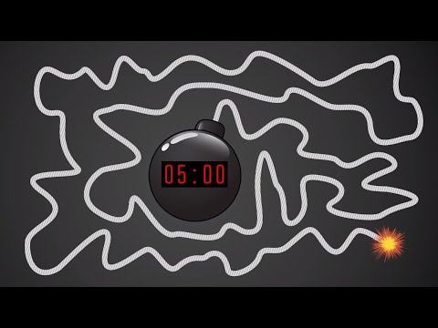
Break Time!

Slide 9
Math Block (10:30- 11:45)
Students will be working on:
Random call on - Homework Check
Watch a hook video and take notes. Have students copy down King Henry in their Learn Book (Application problem page 27)
Video for M1L4 (take notes)
Whole group - practice (pgs 29 & 30 together) use white boards
Small group - breakout rooms (exit ticket page 31)
Whole group review exit ticket.
OYO - Succeed book Homework problems page 19 & 20 (pg 17 & 18 are HELPER pages!!)
OYO - Log into Zearn and complete Mission 5.
Mrs. Kronk’s Schedule:
Here to help!
Additional math help found on Youtube

Slide 10
Afternoon Work Time (12:25-1:00)
Students will be working on:
Watch the Mystery Science exploration video on Food Chains, stop to discuss/chat box, or breakout room feedback.
Listen to the story on Newsela titled, Wild animals are losing their fear as largest predators disappear. Take notes in your science notebook.
OYO - complete the form to reflect what you’ve learned regarding Food Chains today.
Afternoon Objectives:
Science
C.O: I can describe a food chain
L.O: I can orally and in writing discuss what all food chains start and end with.

Slide 11
Have a wonderful day!

