Slide 1
Tuesday
September 22, 2020

Slide 2
Quick Write in ELA/Writer’s Notebook
Be sure to copy the prompt and the date into your notebook before you write.
9/22/2020
What has surprised you most about virtual learning? Why?
Share in your breakout room - 2 minutes

Slide 3
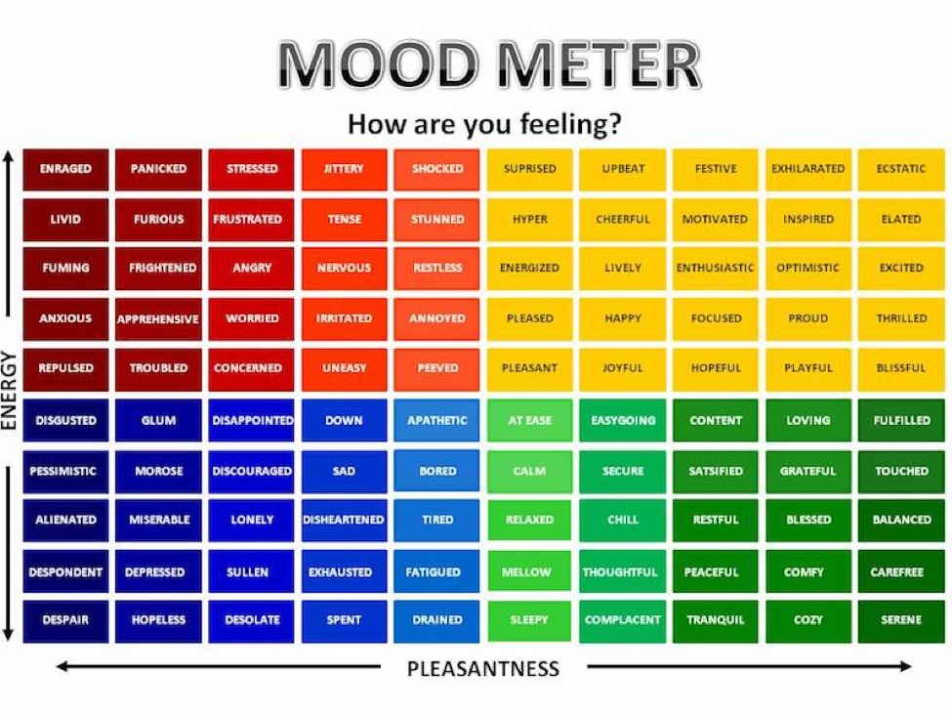

Slide 4
Today’s Weather
High of 73F & Mostly SUNNY! Welcome to FALL! It is the first official day of fall!
Get outside today!
https://weather.com/weather/hourbyhour/l/7789d4498b384397eabdaf712275ad732858c45b6a050f390989122ca69fe47d

Slide 5
SEL Learning Activity
SEL Behavior video on BP
What is one thing that this video taught you? Type it into the chat.

Slide 6
Today’s Agenda & Goal Setting
Morning’s Objectives:
ELA
C.O: I can question with thick and thin question types when reading.
L.O: I can orally and in writing create a list of thick and thin questions to help guide my understanding
Math
C.O: I can decompose numbers into place value specific sums
L.O: I can orally and in writing show the value of numbers according to place value
Today’s Agenda:
Morning Meeting (8:55 LOGIN)
ELA Whole Group
ELA Work Time
Math Whole Group (10:30 LOGIN)
Math Work Time
Social Studies/Science Whole Group (12:25 LOGIN)

Slide 7
ELA Block (9:00-10:25)
Benchmark Rules and Routines Day 11
Complete Informational Writing video #3
Complete questioning activity during read aloud
Complete questioning with independent reading and expand on your questions with writing.
Complete writing mini lesson with new writing prompt

Slide 8
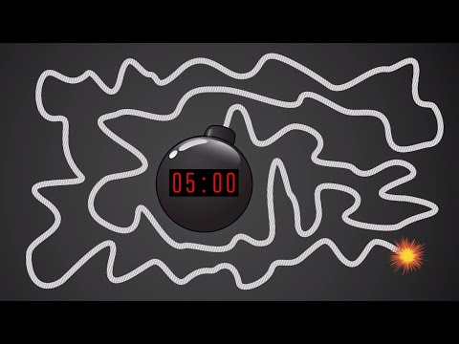
Break Time!

Slide 9
Math Block (10:30- 11:45)
Students will be working on:
Complete Application Problem on page 69 and some practice problems on page 71/72 together
Work on page 72 #5 and EXIT TICKET page 73 in GROUPS in breakout rooms.
OYO - Watch the video for M1L10 (take notes in your notebook)
Mrs. Kronk’s Schedule:
Here to help!
Gym teacher meet and greet 10:35

Slide 10
Afternoon Work Time (12:25-1:00)
Students will be working on:
Together: NWEA Readiness Check
Afternoon Objectives:
NWEA
Social Studies lesson - Asynchronously presented.
C.O: I can define federalism and describe the jobs of the judicial branch
L.O: I can orally explain uncovered information on the judicial branch, supreme court, and federalism as a concept.

Slide 11
Afternoon Asynchronous Work (after 1pm)
ReadWorks - Article-A-Day. Go to assignments and complete ONE article and assignment
Log into Zearn and complete M1L11.
You will complete Social Studies all asynchronously today. Click on the LINK to watch the lesson. Complete your Flipgrid reflection on your lesson today.
TECHNOLOGY SPECIAL TODAY! 2:55-3:50. Watch the helpful video on Schoology

Slide 12
Have a wonderful day!

