Slide 1
Monday
September 21, 2020

Slide 2
Quick Write in ELA/Writer’s Notebook
Be sure to copy the prompt and the date into your notebook before you write.
9/21/2020
What is the greatest gift you have ever received? Why?
Share in your breakout room - 2 minutes

Slide 3
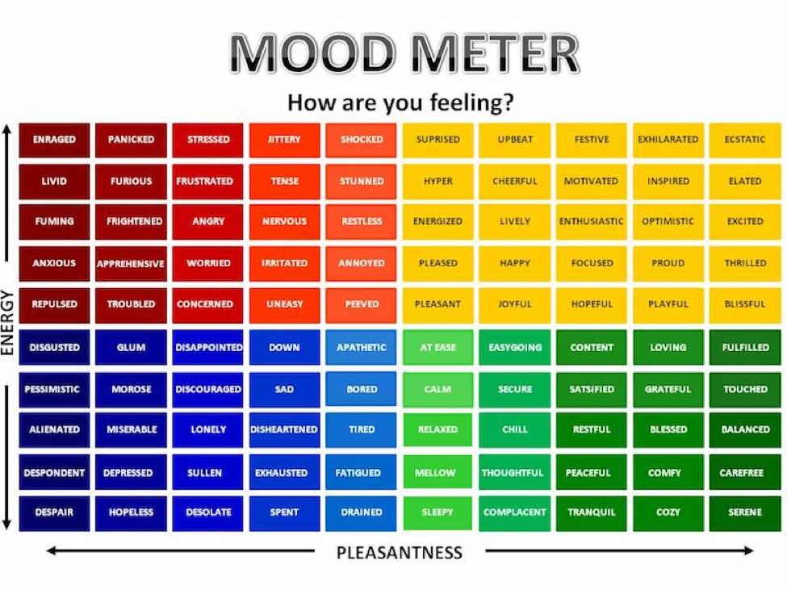

Slide 4
Today’s Weather
High of 67F & SUNNY!
Get outside today!
https://weather.com/weather/hourbyhour/l/7789d4498b384397eabdaf712275ad732858c45b6a050f390989122ca69fe47d

Slide 5
SEL Learning Activity
SEL Getting Help video on BP
What is one thing that this video taught you? Type it into the chat.

Slide 6
Today’s Agenda & Goal Setting
Morning’s Objectives:
ELA
C.O: I can question with thick and thin question types when reading.
L.O.: I can orally and in writing create a list of thick and thin questions to help guide my understanding
Math
C.O: I can decompose numbers into place value specific sums
L.O: I can orally and in writing show the value of numbers according to place value
Today’s Agenda:
Morning Meeting (8:55 LOGIN)
ELA Whole Group
ELA Work Time
Math Whole Group (10:30 LOGIN)
Math Work Time
Social Studies/Science Whole Group (12:25 LOGIN)

Slide 7
ELA Block (9:00-10:25)
Benchmark Rules and Routines Day 10
Discuss thick and thin questions. Create a T-Chart in your notebook while we discuss. Write to expand ONE idea (10 minutes)
ReadWorks - Article-A-Day. Go to assignments and complete ONE article and assignment (15 minutes)

Slide 8
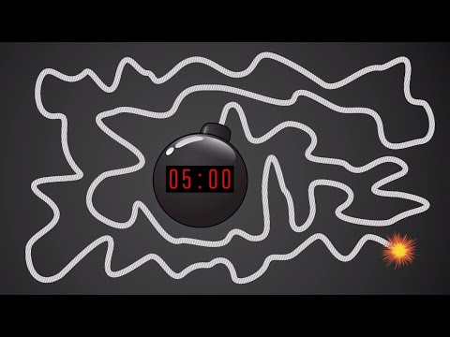
Break Time!

Slide 9
Math Block (10:30- 11:45)
Students will be working on:
The first 15 minutes will be On Your Own.
OYO - Watch the video for M1L9 (take notes)
Complete Application Problem on page 63 in breakout rooms.
Whole group - Check answer. Practice page 65/66
Complete the exit ticket
Mrs. Kronk’s Schedule:
Here to help!

Slide 10
Afternoon Work Time (12:25-1:00)
Students will be working on:
Review the mystery science lesson and discuss with peers questions pertaining to mystery. Take notes as needed.
Discuss the importance of air to plants. Make a hypothesis.
Watch mystery video at the end to see if your hypothesis was correct.
Break out rooms to discuss end of mystery questions. These questions are for you to DISCUSS ONLY.
Afternoon Objectives:
Science
C.O: I can review the flow of energy in a food chain.
L.O: I can orally and in writing explain on energy flows from one organism to the next in a food chain.

Slide 11
Afternoon Asynchronous Work (after 1pm)
Choice Reading - Books from home, Readworks open library, EPIC, BookBub, MagicBlox, or a different choice option! (20+ minutes)
Writing lesson - Watch the Writing mini lesson on paragraph structure & capital letters. Use your September Writing guide and select a NEW topic to write about. You will type this on google docs.
Complete the math QUIZ.
Log into Zearn and complete M1L10.
Complete the exit ticket from today’s science lesson.

Slide 12
Have a wonderful day!

