Slide 1
Tuesday
September 15, 2020

Slide 2
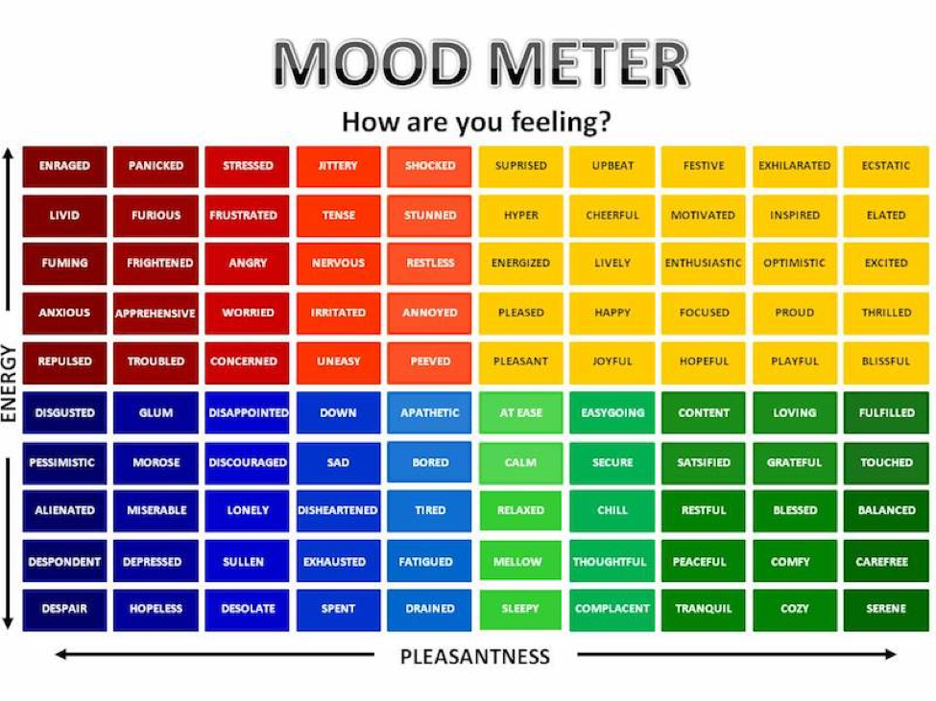

Slide 3
Today’s Weather
High of 72F
https://weather.com/weather/hourbyhour/l/7789d4498b384397eabdaf712275ad732858c45b6a050f390989122ca69fe47d

Slide 4
SEL Learning Activity
Watch the following BrainPop video on Dreams (Videos are Collaborative for Academic, Social, and Emotional Learning (CASEL) framework.
Breakout rooms - discuss 1 new thing that you learned about Dreams with your group. Practice accountable speech.
Breakout Room - 2 minutes

Slide 5
Writing Prompt & Quick Discuss
Copy the prompt into your writer’s notebook and include the date. Write your answer.
9/15/20
Do you like to try new things? Why or why not?
Discuss in your breakout group - 3 minutes

Slide 6
Today’s Agenda & Goal Setting
Morning’s Objectives:
ELA
C.O: I can review Authors Purpose.
L.O.: I can orally and in writing explain different writing styles.
Math
C.O: I can express numbers as decimal numerals.
L.O: I can orally and in writing numbers as values in words.
Today’s Agenda:
Morning Meeting (8:55 LOGIN)
ELA Whole Group
ELA Work Time
Math Whole Group (10:30 LOGIN)
Math Work Time
Social Studies/Science Whole Group (12:25 LOGIN)

Slide 7
ELA Block (9:00-10:25)
Benchmark Rules and Routines Day 6
OYO - Listen to a story and complete questions on ReadWorks *Assigned story: The Circus Comes to Town - take the quiz
OYO - Choice Reading for 20 minutes minimum - I-PICK books (your choice) on EPIC JUST RIGHT BOOKS! NOTHING TOO EASY (Class code: puk0847)
OYO - Complete your writing task from today’s Benchmark lesson

Slide 8
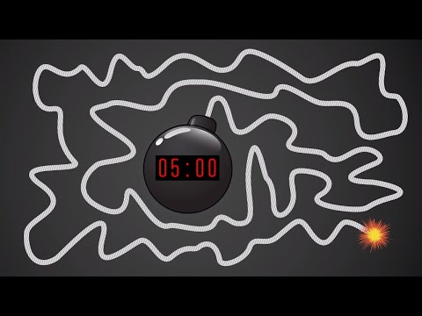
Break Time!

Slide 9
Math Block (10:30- 11:45)
Students will be working on:
Random call on - Homework Check
Watch a hook video and take notes.
Video for M1L5 (take notes)
Whole group - Application Problem & Practice (pgs 33 & 35 together) use white boards
Small group - breakout rooms (practice & exit ticket page 36 & 37)
Whole group review exit ticket.
OYO - Succeed book Homework problems page 23 & 24 (pg 21 & 22 are HELPER pages!!)
OYO - Log into Zearn and complete Mission 6.
Mrs. Kronk’s Schedule:
Here to help!

Slide 10
Afternoon Work Time (12:25-1:00)
Students will be working on:
Watch hook video
Review the Big Idea and vocabulary - copy in notebook
Brain Pop video - take notes.
Breakout rooms - Discuss why the constitution is important.
OYO - Complete the exit ticket form
Afternoon Objectives:
Social Studies
C.O: I can review that the constitution was written with a purpose and discuss that purpose with peers
L.O: I can orally and in writing discuss the reasons why the constitution is important.

Slide 11
Have a wonderful day!

