Slide 1
Thursday
October 1, 2020
Quick Write:
In your opinion, what three qualities make a good leader?

Slide 2
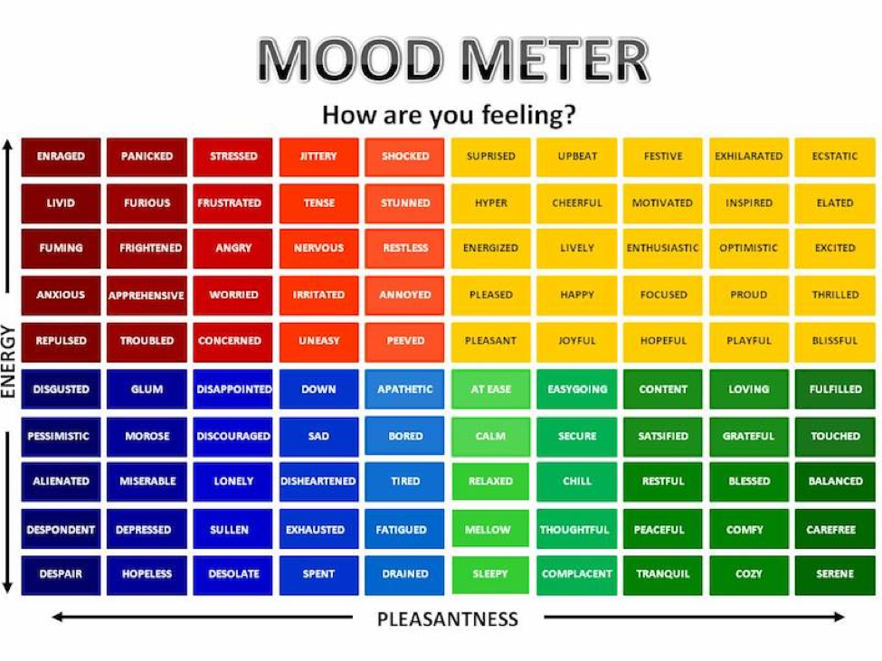

Slide 3
SEL Check-in
Watch the following video on civil rights.
Thoughts? Discuss in the chat.
Notes:
https://weather.com/weather/hourbyhour/l/7789d4498b384397eabdaf712275ad732858c45b6a050f390989122ca69fe47d

Slide 4
Today’s Agenda & Goal Setting
ELA Objectives:
C.O: I can create a hook to begin my informational writing.
L.O: I can write a hook by creating interest while using proper functionality and mechanics.
Today’s Agenda:
Morning Meeting
Group B NWEA Testing
Kronk_Math Fall
Group A Asynchronous Work
YOU WILL BREAK FOR YOUR LUNCH by 11:45
Science/SS Whole Group (12:25 LOGIN)

Slide 5
Groupings
Group A - ASYNCHRONOUS WORK (THURSDAY)
Long
McCollough
Nowlin
William Ford
Group B - NWEA MATH ASSESSMENT (THURSDAY)
Duvall
Henry Ford
Lindbergh

Slide 6
ELA Block (9:20-11:45)
Group B - NWEA MATH Assessment
Group A - Asynchronous work. Complete all items below:
1. You will listen to a story on ReadWorks about Abe Lincoln and the 13th amendment. You will complete the quiz at the end.
2. You will watch the grammar lesson and take notes in your ELA notebook. Complete the exit ticket on the synonym and antonym lesson.
3. Next, watch three writing mini lessons on Informational Writing and TAKE NOTES IN YOUR NOTEBOOK. Review each video as many times as you need to fully understand. Friday you will be writing your FINAL copy of your informational HOW TO and you will submit pictures of your brainstorming, pre-writes, and drafting.
Hook
Punctuation
Paragraph Writing
4. Work on the Mid Module Review assessment. Due Friday by 4pm. Test Next Week.
5. Complete M1L15 in Zearn. You must be on Lesson 16 by the end of the day.

Slide 7
Afternoon Work Time (12:25-1:00)
Afternoon Objectives:
Social Studies
C.O: I can analyze the roles of the branches of government, identify the Bill of rights, and define federalism.
L.O: I can orally and in writing discuss the review of the Unit 1 test on Government.
You have your music live lesson at 1:40
View the Recorded Lesson: Link
Take notes in your Social Studies notebook and STUDY. Your test on government is next Tuesday.
Check on your Food Terrarium. Make a note on it’s progress.

Slide 8
Afternoon Asynchronous Work
(ALL students)
Independent Work:
ReadWorks: Choose one of the assigned “Article-A- Day” activities to complete. Be sure to do ALL assigned parts of your choice article. Complete by 4pm.
20 minutes of Choice Reading. Complete by 4pm.

Slide 9
Have a wonderful day!

