Slide 1
Thursday
September 10, 2020

Slide 2
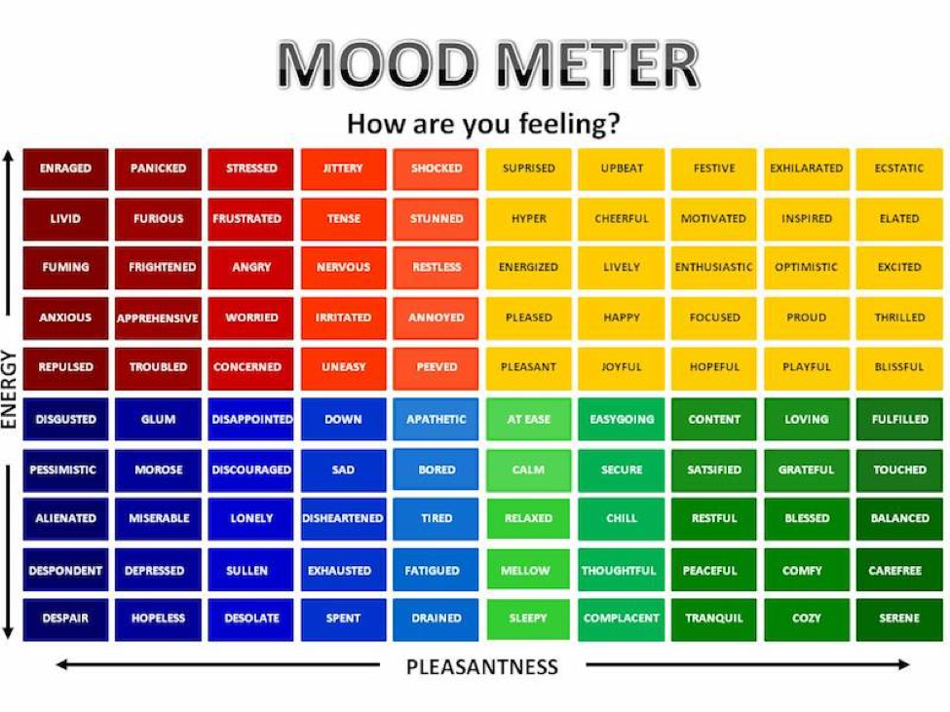

Slide 3
Today’s Weather
High of 70F
Cloudy. Welcome to Fall :/
https://weather.com/weather/hourbyhour/l/7789d4498b384397eabdaf712275ad732858c45b6a050f390989122ca69fe47d

Slide 4
Writing Prompt & Quick Discuss
Copy the prompt into your writer’s notebook and include the date. Respond with your answer.
9/10/20
Suppose you were stranded on a deserted island in the middle of the ocean for 10 years. You will be allowed to bring one each of the following: book, movie, CD, game, food item, drink item, piece of clothing, and one other miscellaneous item. List the items you would bring and why? Explain your thinking.
Discuss in your breakout group - 5 minutes

Slide 5
Today’s Agenda & Goal Setting
Morning’s Objectives:
ELA
C.O: I can review the routines for ELA Working Time.
L.O.: I can orally describe the routines for ELA Working Time
Math
C.O: I can log into Zearn and begin practicing the meaning of place value.
L.O: I can orally describe the meaning of place value.
Today’s Agenda:
Morning Meeting (8:55 LOGIN)
ELA Whole Group
ELA Work Time
Math Whole Group (10:30 LOGIN)
Math Work Time
Social Studies/Science Whole Group (12:25 LOGIN)

Slide 6
ELA Block (9:00-10:25)
Benchmark Rules and Routines Day 3
OYO - Listen to a story and complete questions on ReadWorks *Assigned story: The Shortest Path - take the quiz AND complete the writing activity for Lift a Line from the Benchmark lesson this morning.
OYO - Choice Reading for 20 minutes minimum - I-PICK books (your choice) on EPIC (Class code: puk0847)
OYO - Sign into Freckle. Class Code: HEDKEX - asynchronous work assigned. Complete Thursday 9_10 assignment

Slide 7
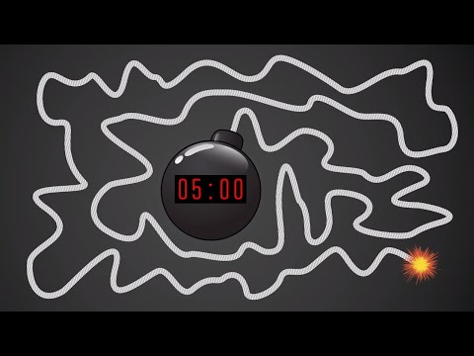
Break Time!

Slide 8
Math Block (10:30- 11:45)
Students will be working on:
Review exit ticket from yesterday. Visit page 11 in LEARN for help!
Video for M1L2
Whole group - application problem (pgs 13 & 15 together).
Small group - breakout rooms (Learn Book practice problems page 16 & Exit Ticket page 17)
Whole group review exit ticket.
OYO - Succeed book Homework problems page 11 & 12
OYO - Log into Zearn and complete Mission 3.
Mrs. Kronk’s Schedule:
Here to help!
Additional math help found on Youtube

Slide 9
Afternoon Work Time (12:25-1:00)
Afternoon Objectives:
Social Studies
C.O: I can review current events by watching CNN10.
L.O: I can listen to the news and respond in writing by completing a response form.
Students will be working on:
Watch today's CNN10 episode
Submit your response to the CNN10 video.

Slide 10
Have a wonderful day!

